Slide 1
Nano-patterned cathode surfaces for high efficiency photoinjectors
SBIR Phase II with RadiaBeam

Slide 2
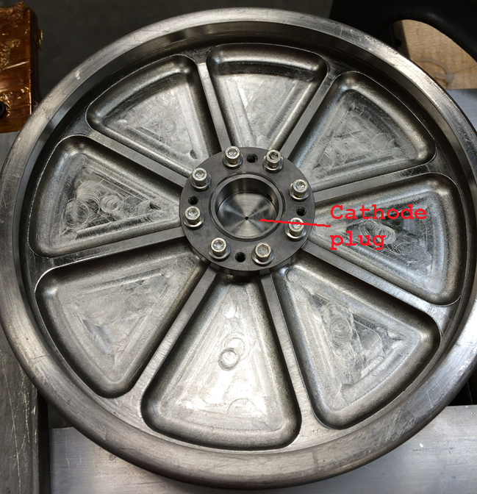
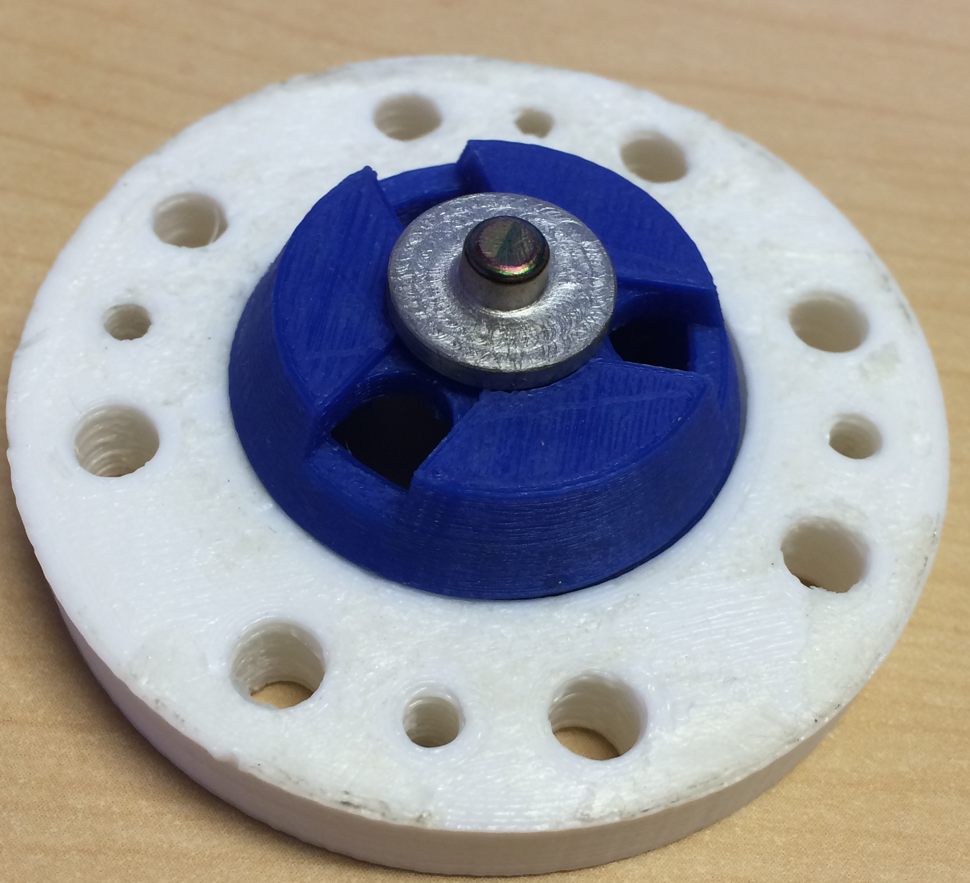
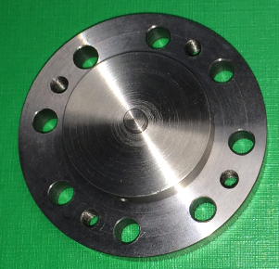
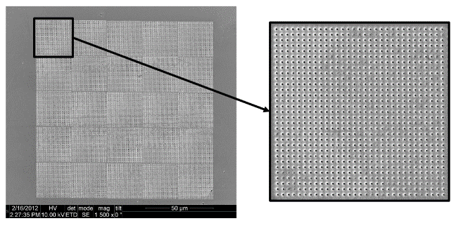
Superconducting photocathode testing
1.5 cell SRF gun and test stand (+ laser for e- beam production ~40MV/m on cathode)
For superconducting cathodes:
Niobium (multi-photon)
Diamond nano-tip field emitters
Nano-structures for plasmon QE enhancement on Nb
Niobium + thin films (lead, magnesium)

Slide 3
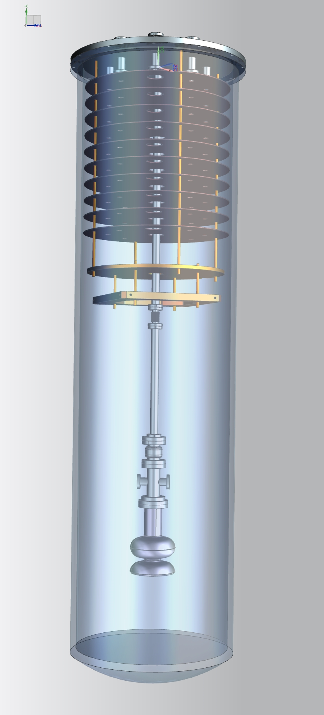
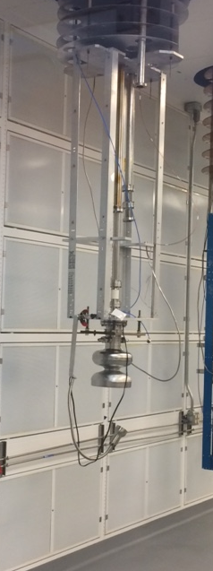
Test stand

Slide 4
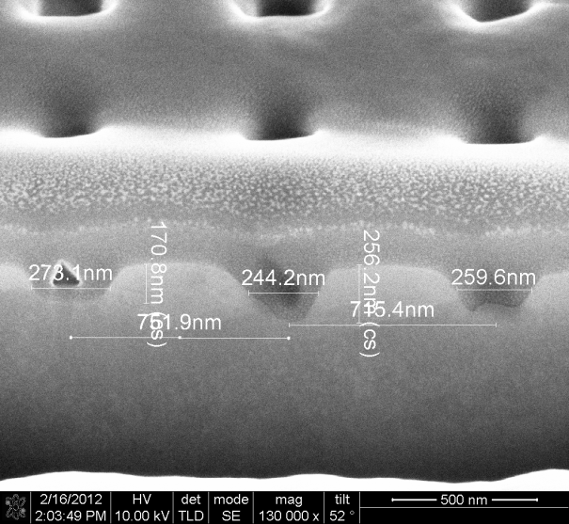
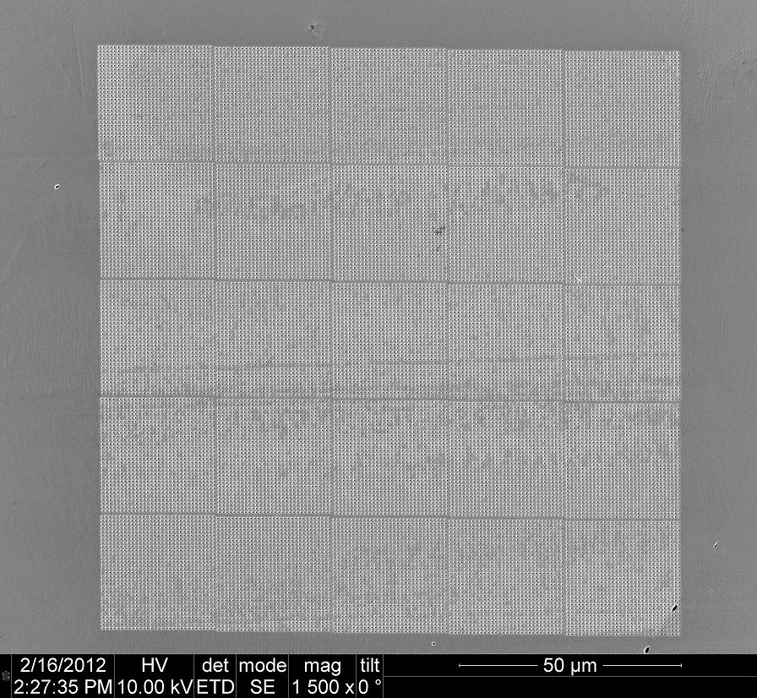
800 nm
Demonstration with Copper
125 um
25 um square
Material | Spacing (nm) | FWHM (nm) | Depth (nm) | Reflectivity @800 nm
Cu | 767 | 200 | 240 | 0.4%
Nb | 750 | 280 | 364 | 8 %
Mg | 780 | 217 | 261 | 0.81 %
Ag | 770 | 174 | 209 | 0.63 %
Would like to use niobium

Slide 5
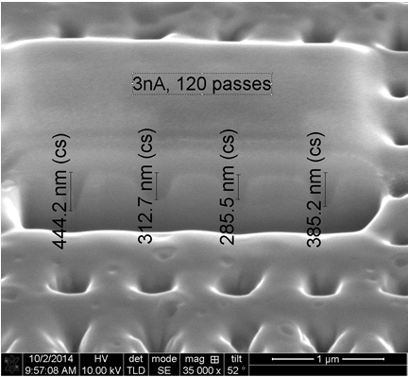
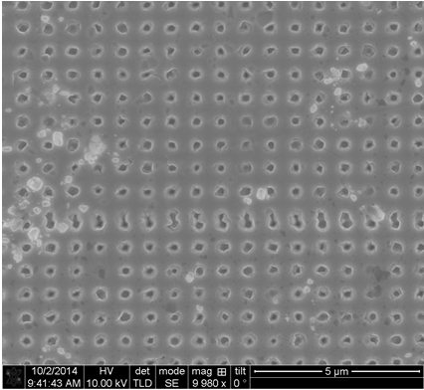
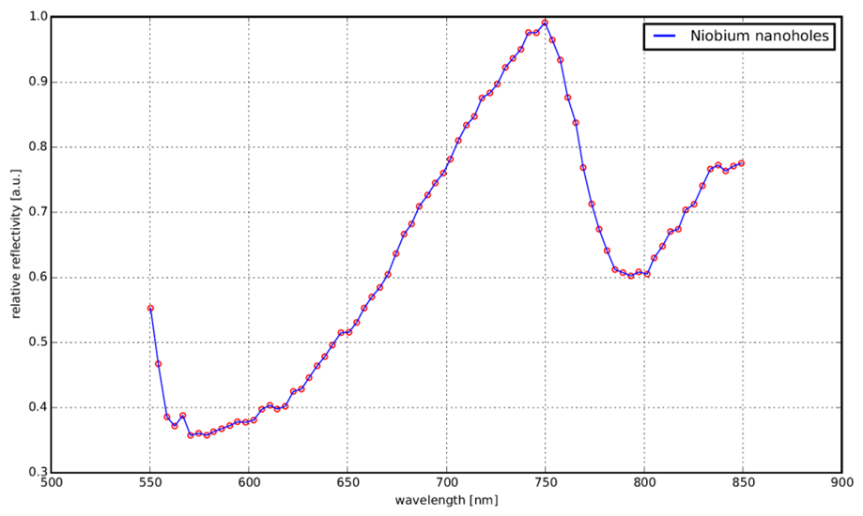
First test at UCLA
FIB generate holes with not reproducible dimensions
-Tune up FIB current/spot size
-Multigrain sample?
Reflectivity measurements - Wide peak (and small dip) consistent
with large fluctuations in nanohole dimensions

Slide 6
Fay looking sad
7th leak check!

Slide 7
Metallic photocathode testing

Slide 8
Easily obtained superconducting materials
Material | Workfunction | Critical temp | Lattice Structure | Type | Wavelength
Ta | 4.22 | 4.48 | BCC | I | 294.4016588
V | 4.44 | 5.03 | BCC | II | 279.8141892
Pb | 4.18 | 7.19 | FCC | I | 297.2188995
Nb | 4.2 | 9.26 | BCC | II | 295.8035714
Sn | 4.35 | 3.72 | TET | I | 285.6034483
NbTi |  | 10
NbN |  | 16

Slide 9
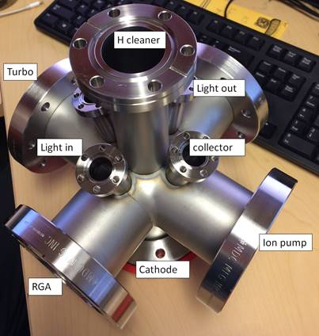
Schematic
H cleaner
light
collector
sample

Slide 10
The chamber

