Slide 1
Plan on e⁺ Collection – A. Ushakov and Y. Enomoto (KEK)
Simulations of positron collection at SuperKEKB injector in CST Yoshinori Enomoto (KEK) shares all information on e⁺ beamline
Calculations of fields
○ Capture magnet: pulsed Flux Concentrator (FC)
○ Capture accelerator
Beam tracking in SuperKEKB e⁺ capture section

Slide 2
Y. Enomoto, LCWS2023

Slide 3
Y. Enomoto, LCWS2023: Particle Tracking in Capture Accelerator

Slide 4
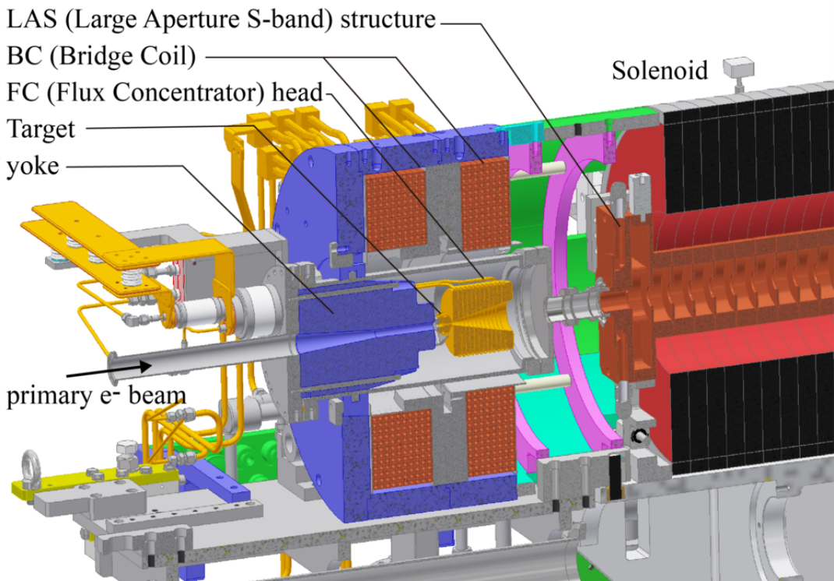
Parameters of SuperKEKB e⁻/e⁺ Beam and Model of Target Area

