Slide 1
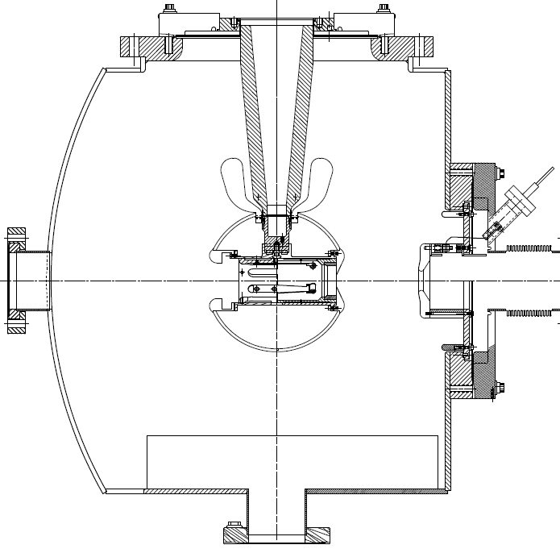
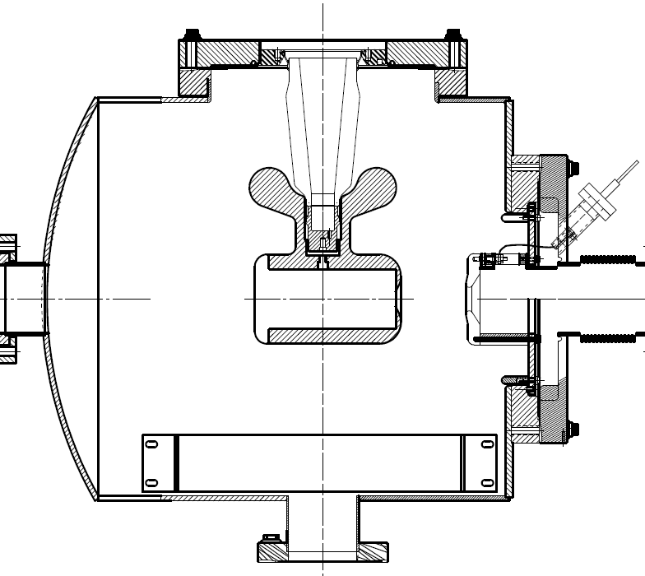
Jefferson Lab: Inverted Insulator Photogun
with optimized triple point shields and mildly conductive insulators
CEBAF 200 kV Gun
350 kV gun for GTS and UITF
Both designs, maximum field strength < 10 MV/m

Slide 2
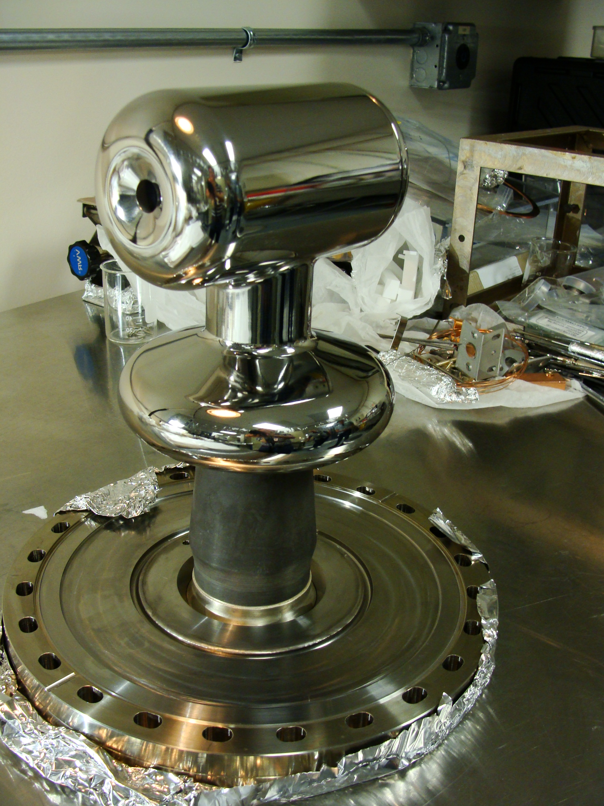
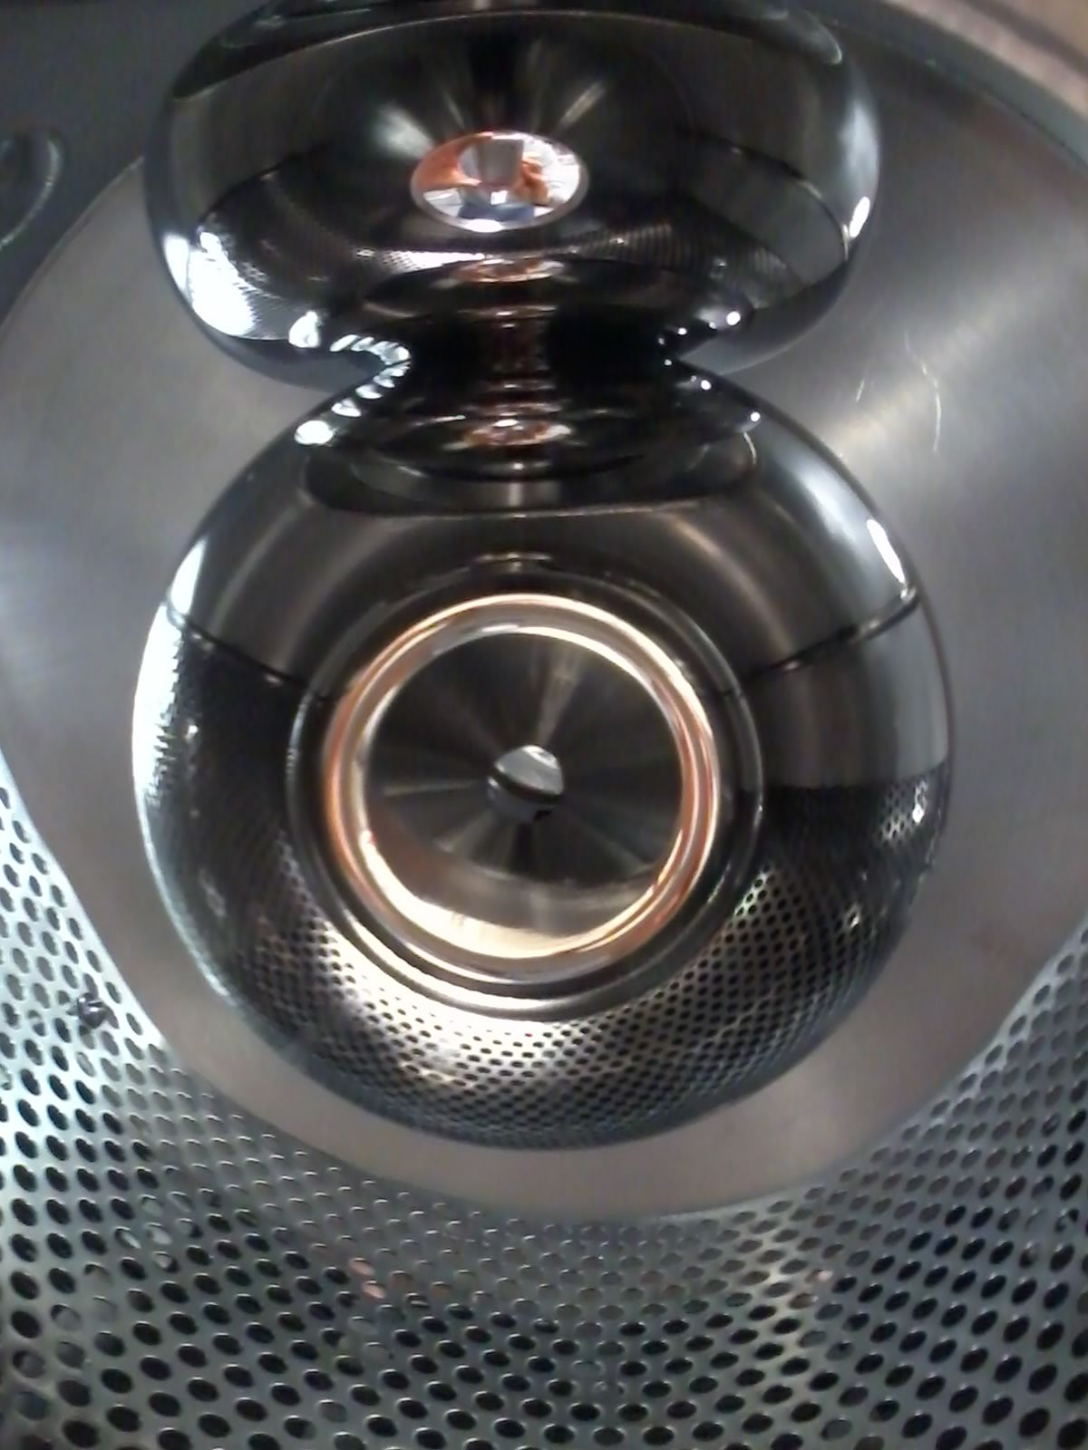
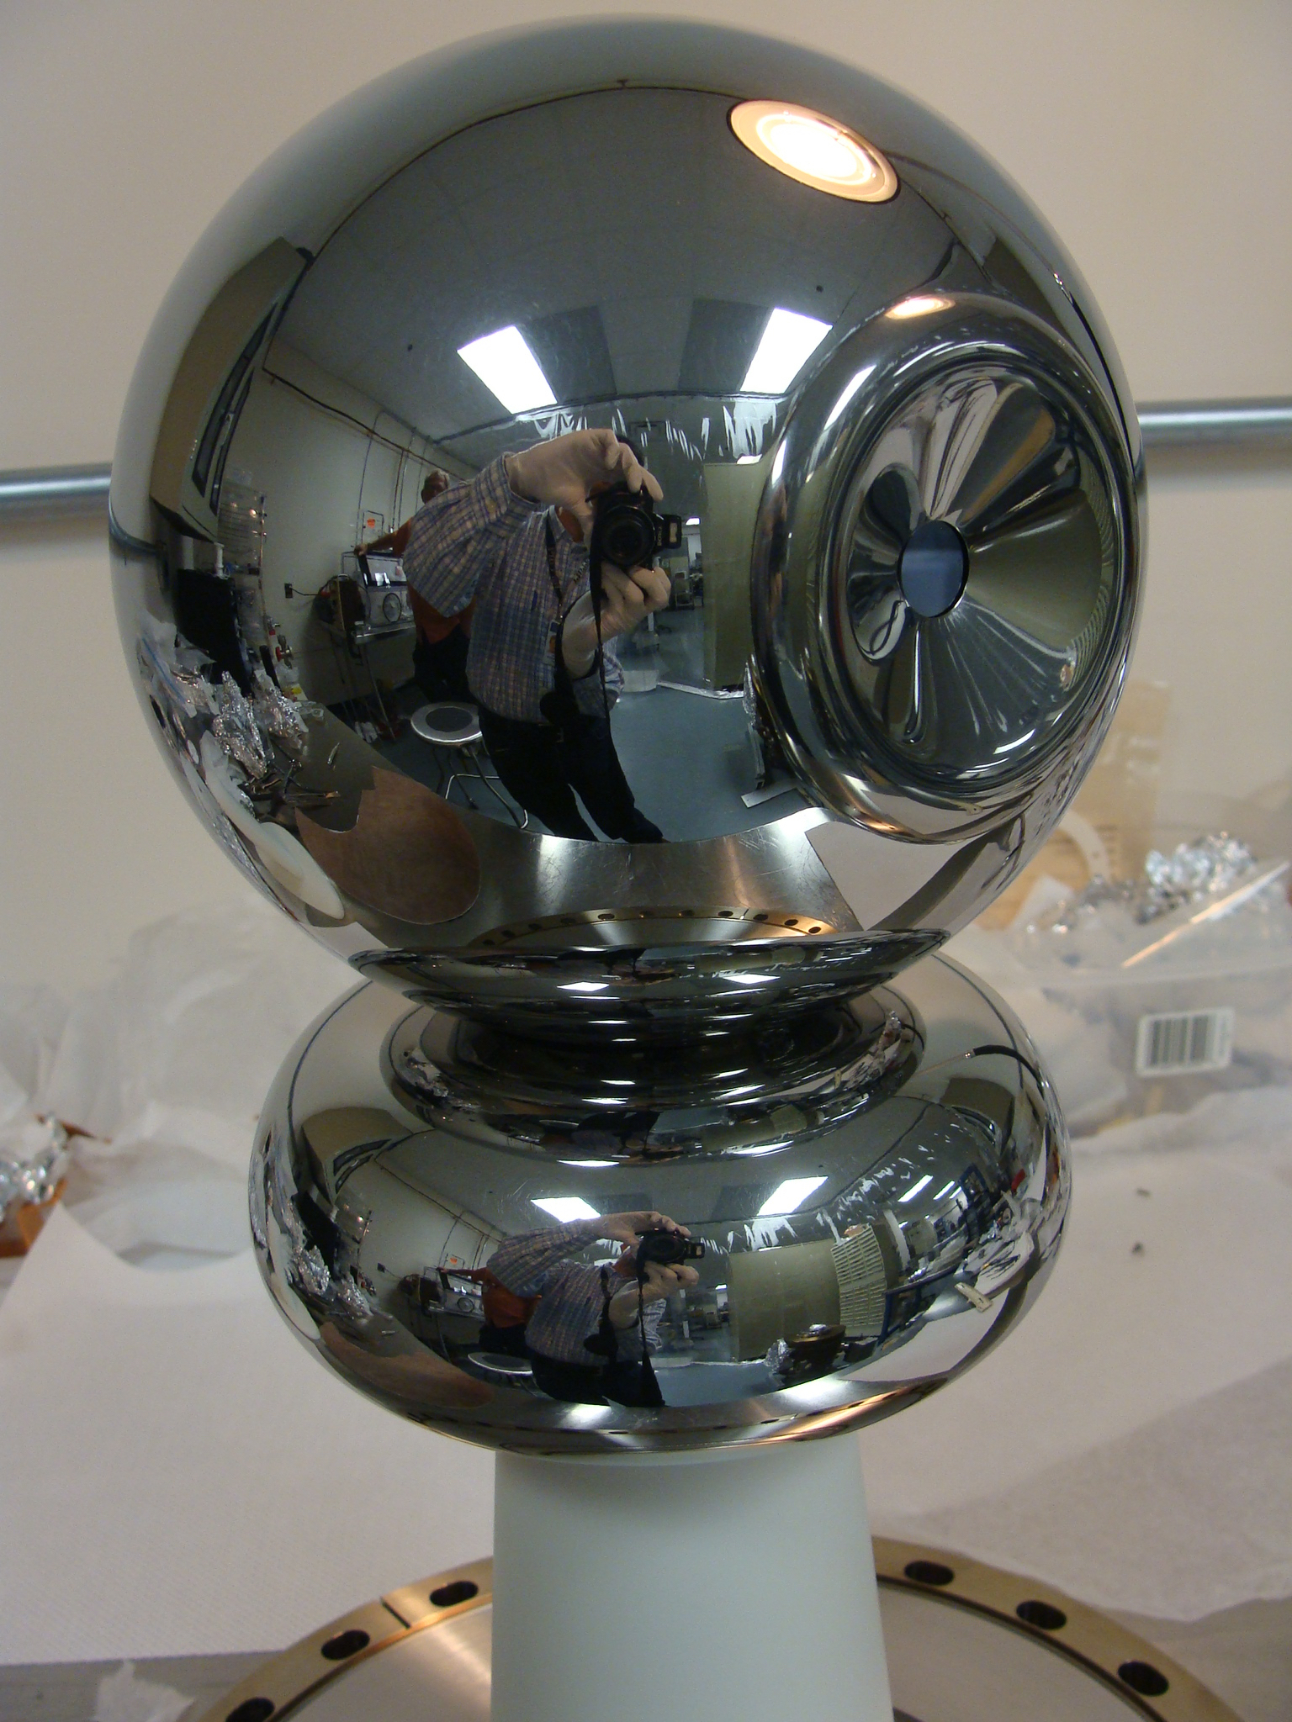
Jefferson Lab: High Voltage (200-350 kV) Inverted Insulator Photo-guns
CEBAF 200 kV
Installed June 2018
(operates at 130kV until an upgrade in 2020)
GTS 350 kV
In operation since Nov 2016 with CsK₂Sb photocathode
UITF 350 kV
Polarized Gun
Under assembly

Slide 3
Metric of Success: High Voltage without Field Emission
Reached
360 kV in 70 hours
10 MV/m at 350 kV
Vacuum and radiation levels indistinguishable from background at 350kV

Slide 4
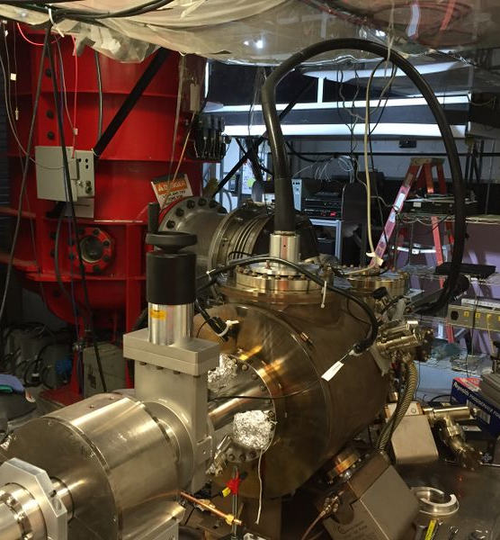
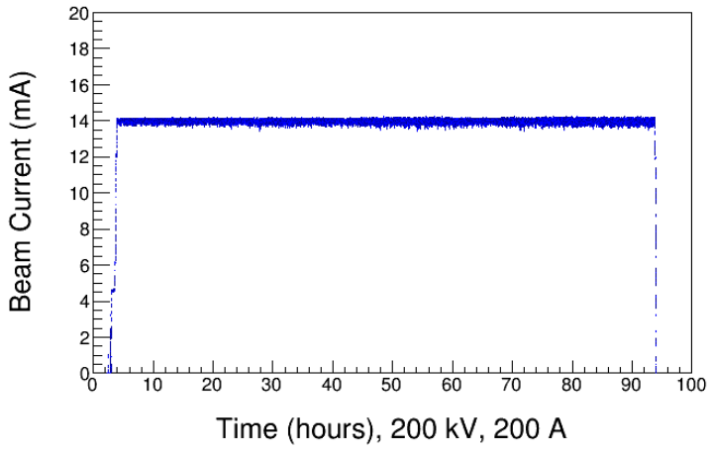
Magnetized Beam Photogun at the Gun Test Stand (GTS)
Magnetized Beam LDRD, PI's: R. Suleiman and M. Poelker
Load-lock inverted insulator photo-gun (multiple photocathodes), like CEBAF geometry.
Cable connection from HVPS to gun.
Over 1000 hours operating >300kV; HV conditioning about 1 week.
Operating with CsKSb photocathodes at >10 mA average current, and 0.7nC bunch charge.

Slide 5
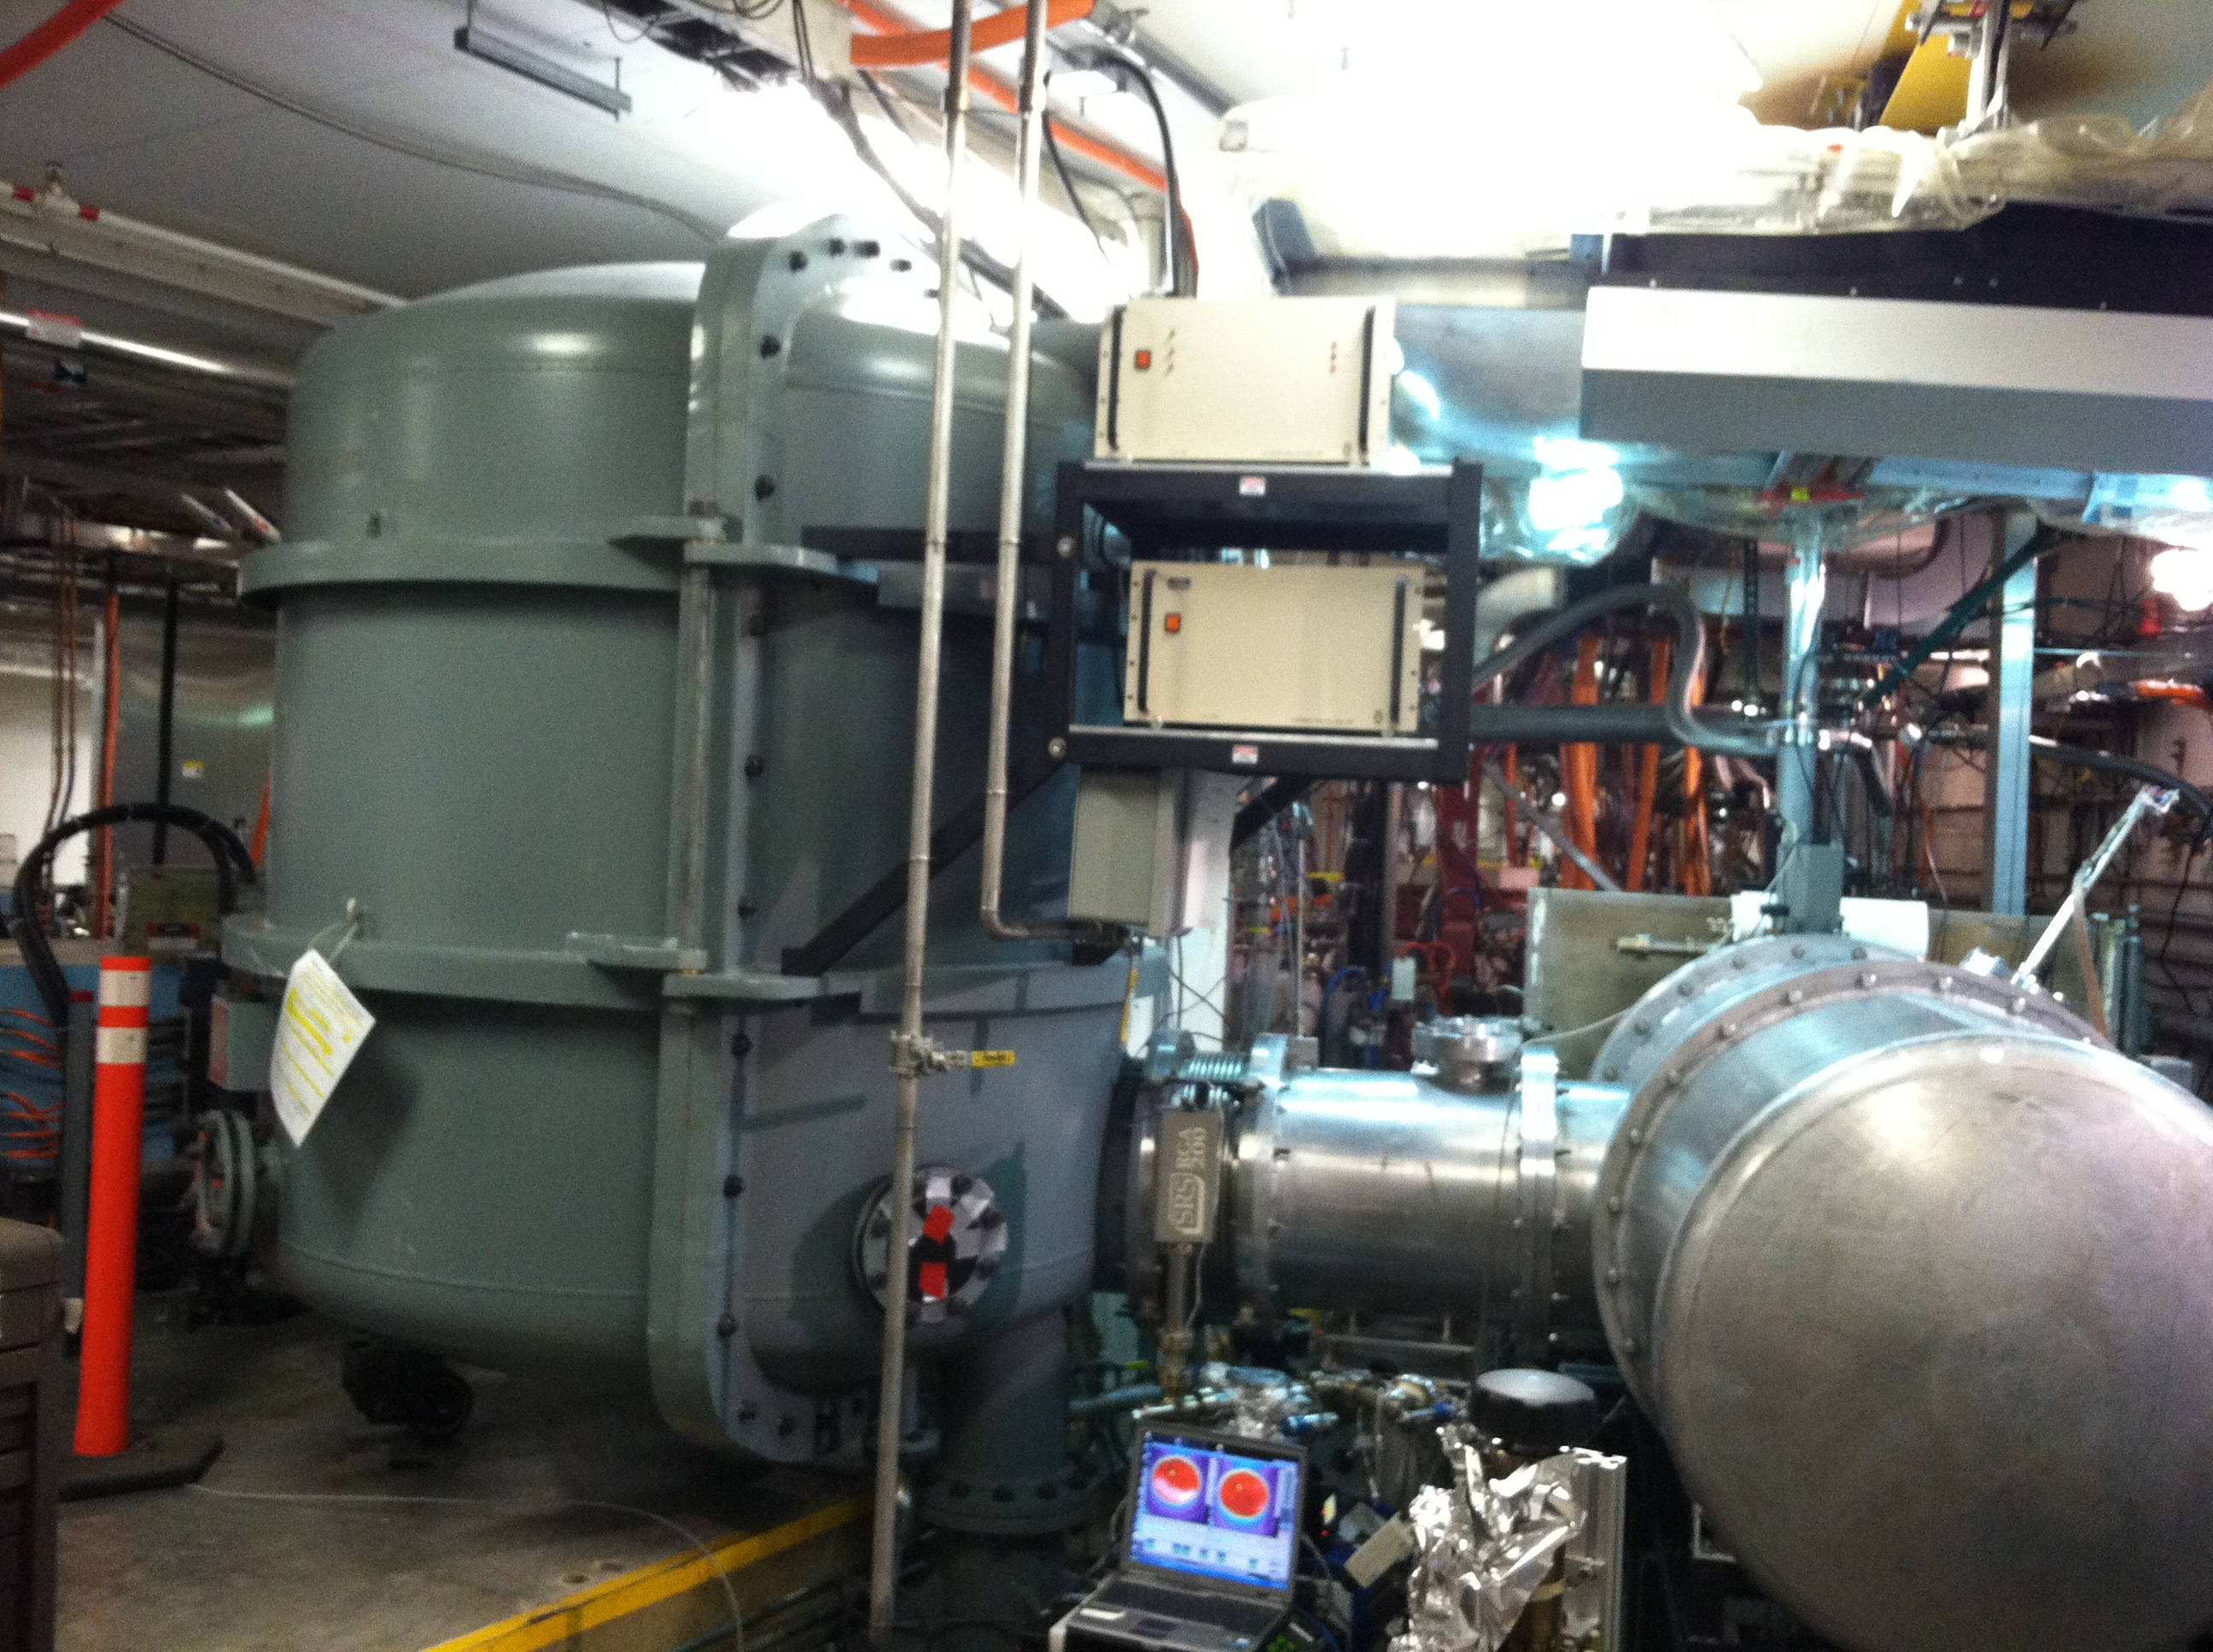
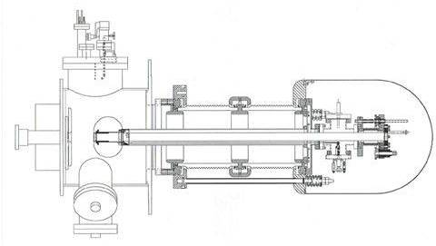
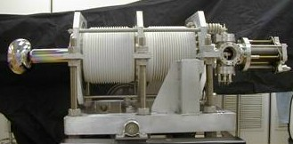
Higher voltages present a challenge
The 350 kV FEL vent-bake gun is based on large cylindrical insulators
Demonstrated 10 mA with with ~500 Coulombs 1/e lifetime
Takes about 4 weeks to replace a photocahode (no load-lock)
Requires large SF6 filled tank to connect with high voltage power supply
RGA, extractor gauge
and leak valve
Electrodes
Corona shield
Vacuum chamber
Ceramic stand-offs
End flange
Photocathode retractor mechanism
Anode
Photocathode
End flange
(3) 1000 l/s NEG pumps
High voltage feed
80 cm

Slide 6
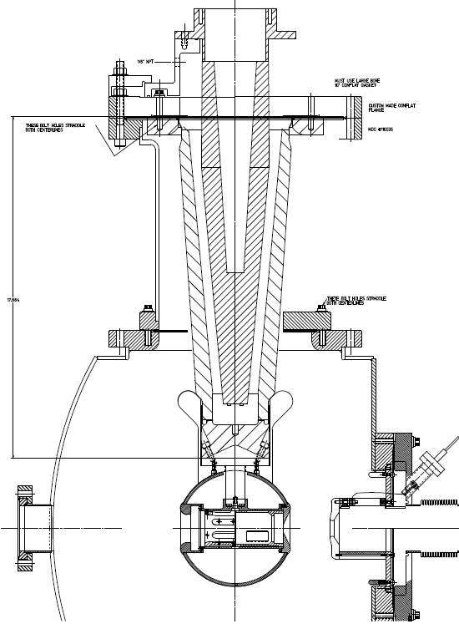
Our quest for higher voltage inverted insulator guns using cables
350 kV GTS Gun
The next step:
400 kV
R&D !
CEBAF 200 kV Gun
CONCEPT !
12"
R28 200kV
R30 300kV
R350, 400kV ?

Slide 7
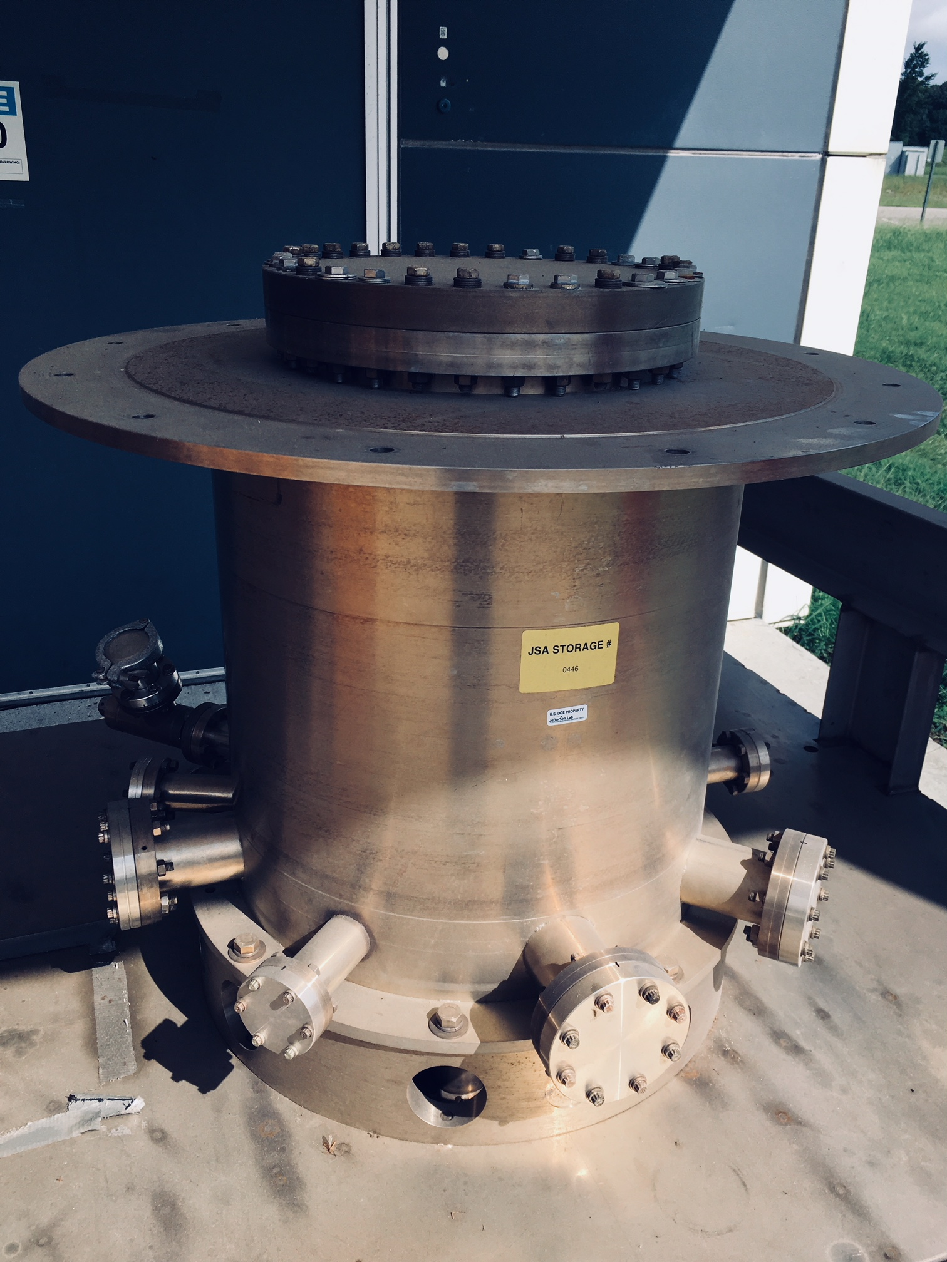
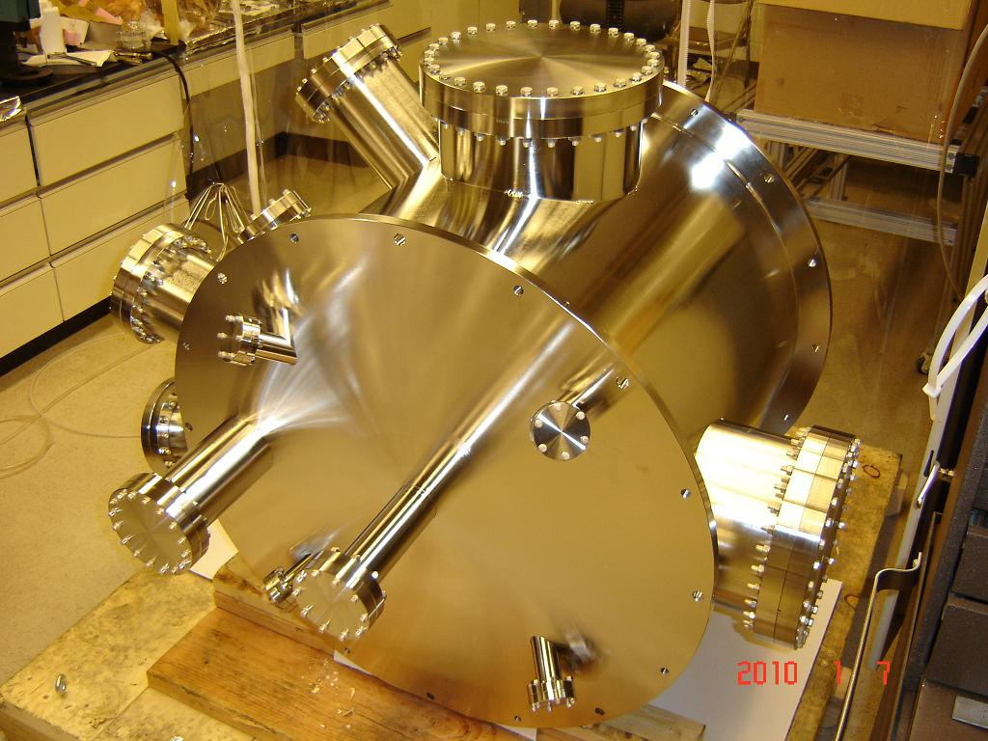
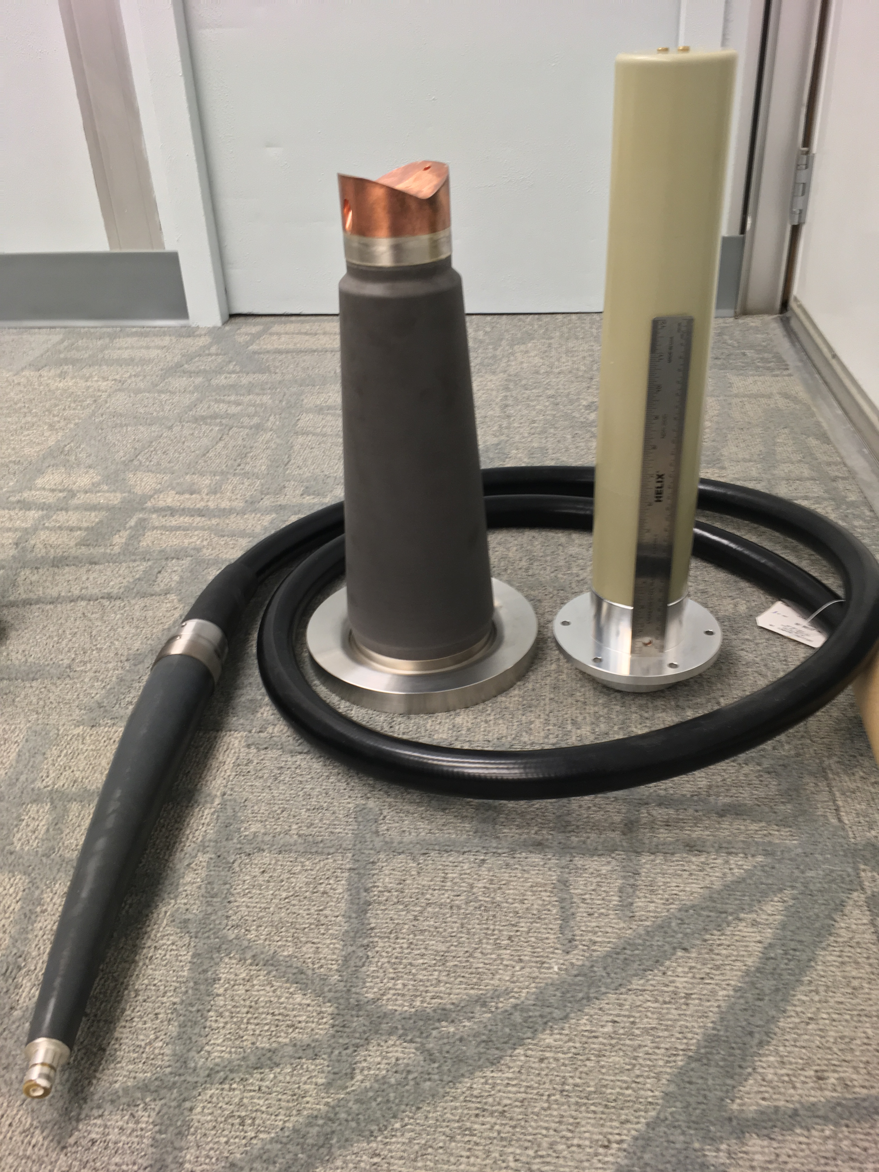
The next step: our 400kV R&D plan
Can the commercial plugs and receptacles be operated at 400kV sustained for days?
What is the highest voltage limit before breakdown?
Design coupling between large insulator and R350 cable plug
(spinoff: partner with industry to design new conical insulator to mate with commercial R350 cable plug as done now for 200kV and 300kV)
Test all of this in SF6-filled chamber
Success? Then:
Design electrode and triple junction shields
Build and test in vacuum, likely will need larger chamber to keep gradient < 10 MV/m at 450kV
Our HV chamber

