Slide 1
Gun with NEG Pumps
Yan
1/19/16

Slide 2
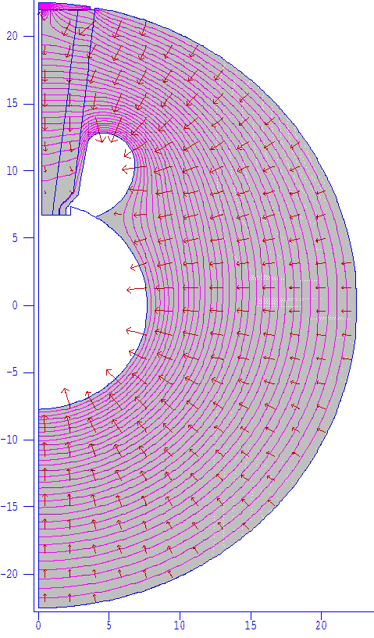
GTS GUN at 350kV
Turn 90 deg

Slide 3
Gun with NEG Pumps

Slide 4
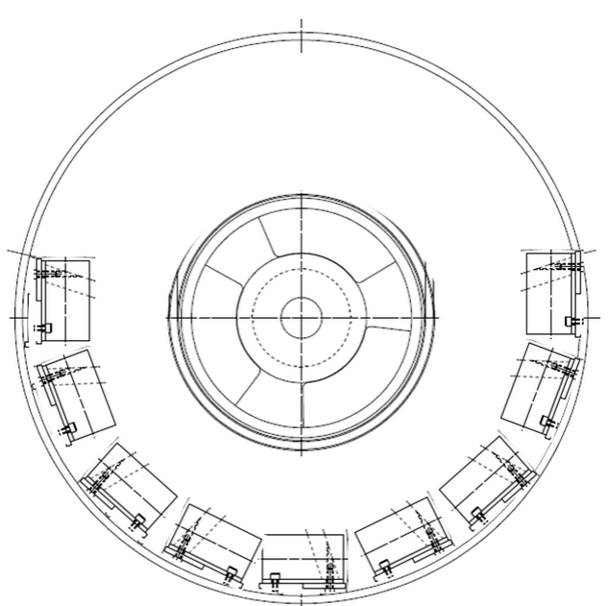
Configuration of NEG Pumps
NEG Dimensions: 50mm x 30mm x 312 mm

Slide 5
Configuration of NEG Pumps
45mm
65mm
50mm
30 mm

Slide 6
E Field Changes with NEG Pumps

Slide 7
E Field Changes with NEG pumps
R = 22.50 cm
R1 = 17.86 cm
R2 = 15.95 cm
E1 = 5.25 MV/m
E2 = 6.04 MV/m
E = 4.16 MV/m
E1/ E = R / R1 = 1.26, E2 / E = R/ R2 = 1.45

