Slide 1
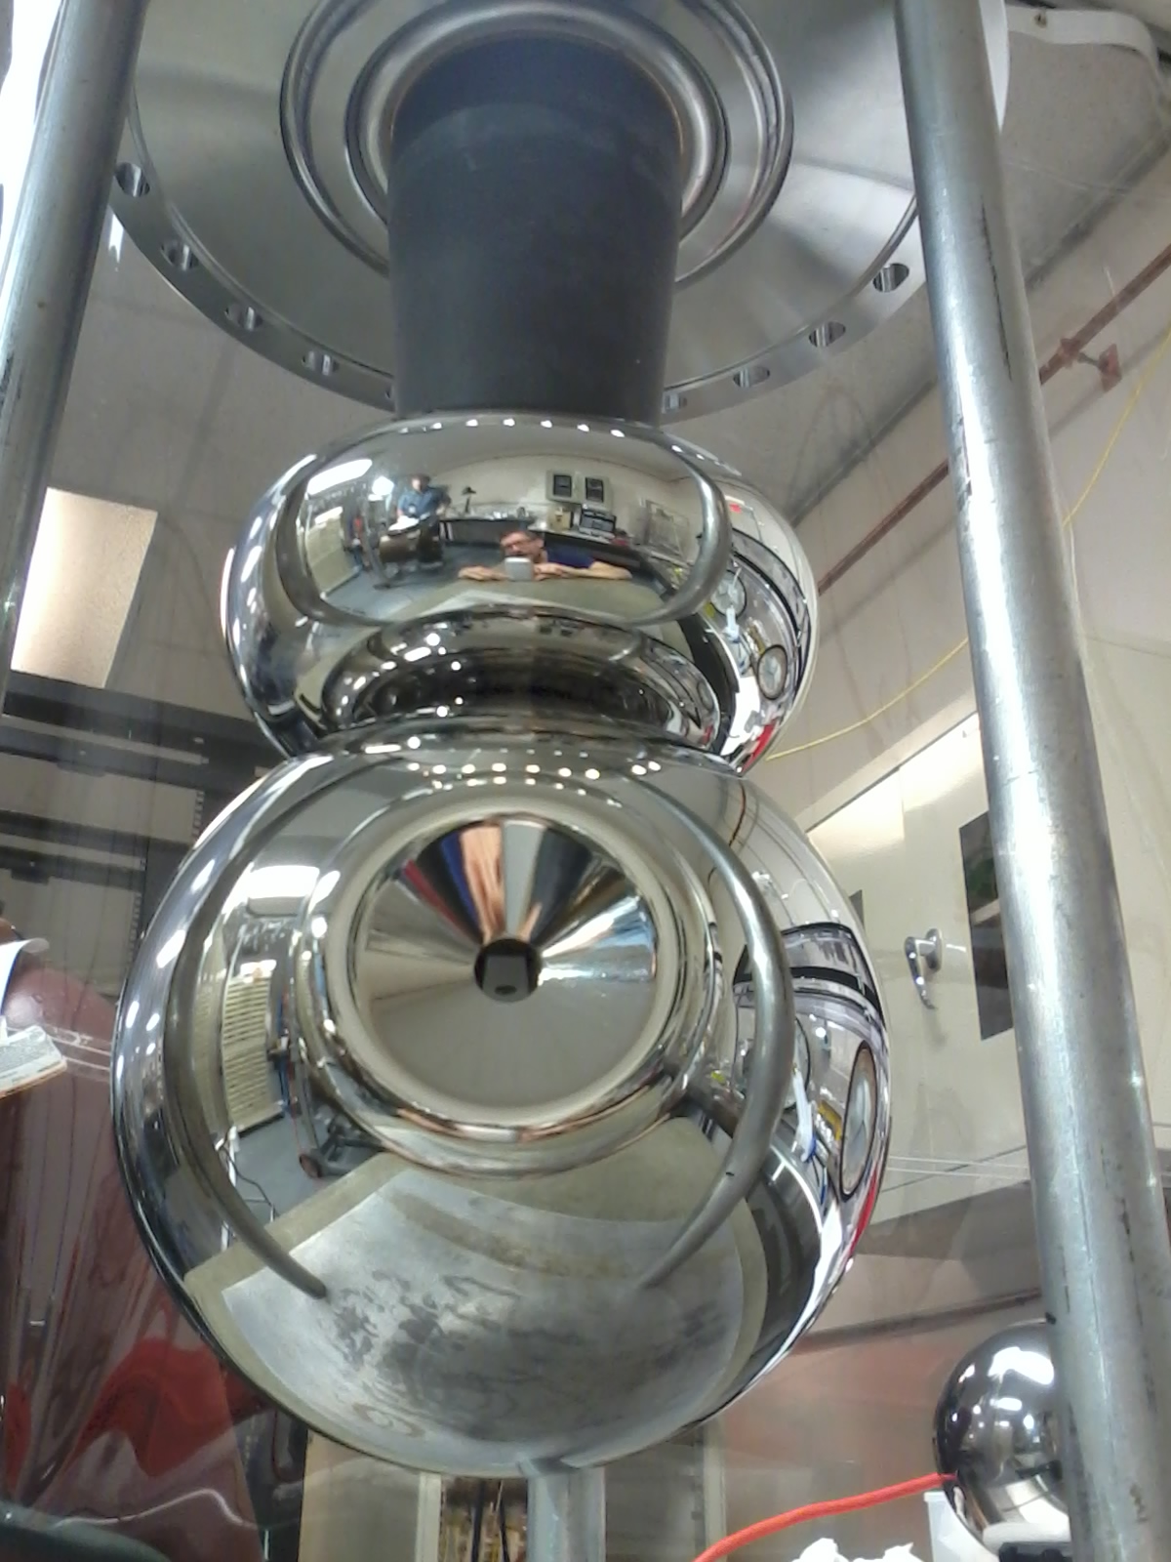
Update on magnetized electron gun development at the Gun Test Stand GTS
P. Adderley, D. Bullard, F., Hannon, C. Hernandez-Garcia, A. Mamun, M. Poelker, R.Suleiman, Y. Wang
JLEIC R&D weekly meeting, Thursday Jan 26, JLab.

Slide 2
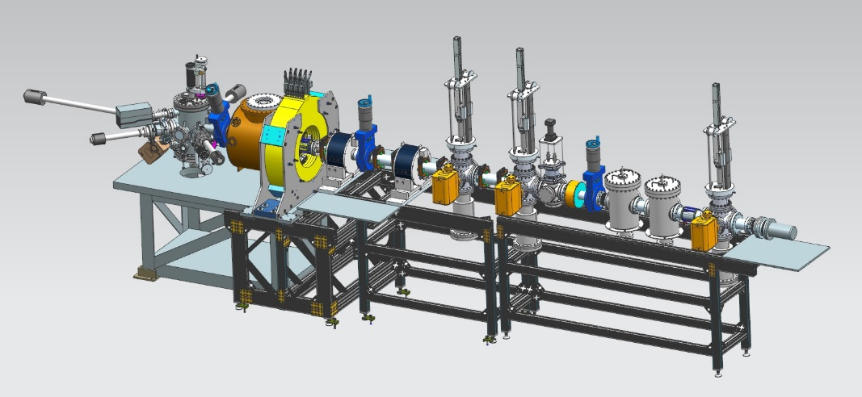
Experimental Overview: Gun Test Stand
Cathode
Solenoid
(B_{z}=2kG)
Beamline
Focusing
Solenoid
Diagnostic Cross 1
(Slit + YAG Screen)
Diagnostic Cross 3
(YAG Screen)
Anode
Green
Laser
K₂CsSb
Photocathode
150 cm
Diagnostic Cross 2
(Slit + YAG Screen)
Generate magnetized beam:
Laser size: 1– 5 mm, B_{z} = 0 – 2 kG
Bunch charge: 1 – 500 pC
Frequency: 15 Hz – 476.3 MHz
Bunch length: 10 – 100 ps
Average beam currents up to 32 mA
Gun high voltage: 200 – 350 kV

Slide 3
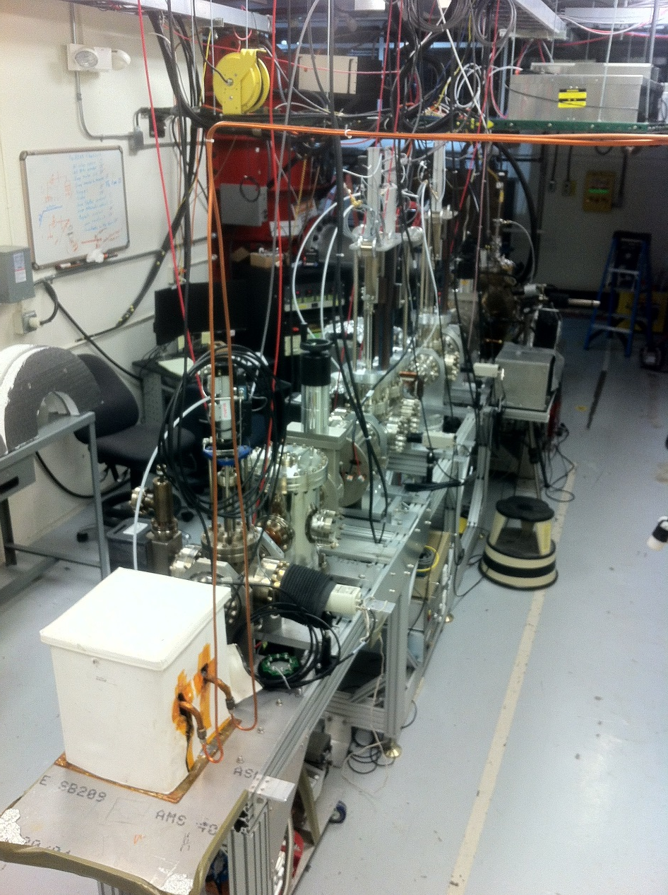
FY16 Accomplishments (summer 2016)
K₂CsSb Photocathode Preparation Chamber, Gun and Beamline: delivered 1 mA, 300 keV to dump (non-magnetized)
Simulation (Fay Hannon):
Used ASTRA and GPT simulation to design beamline and to locate magnets and diagnostics at optimum positions
Simulated magnetized electron beam properties along beamline for various starting conditions
Simulated a round to flat transformer

Slide 4
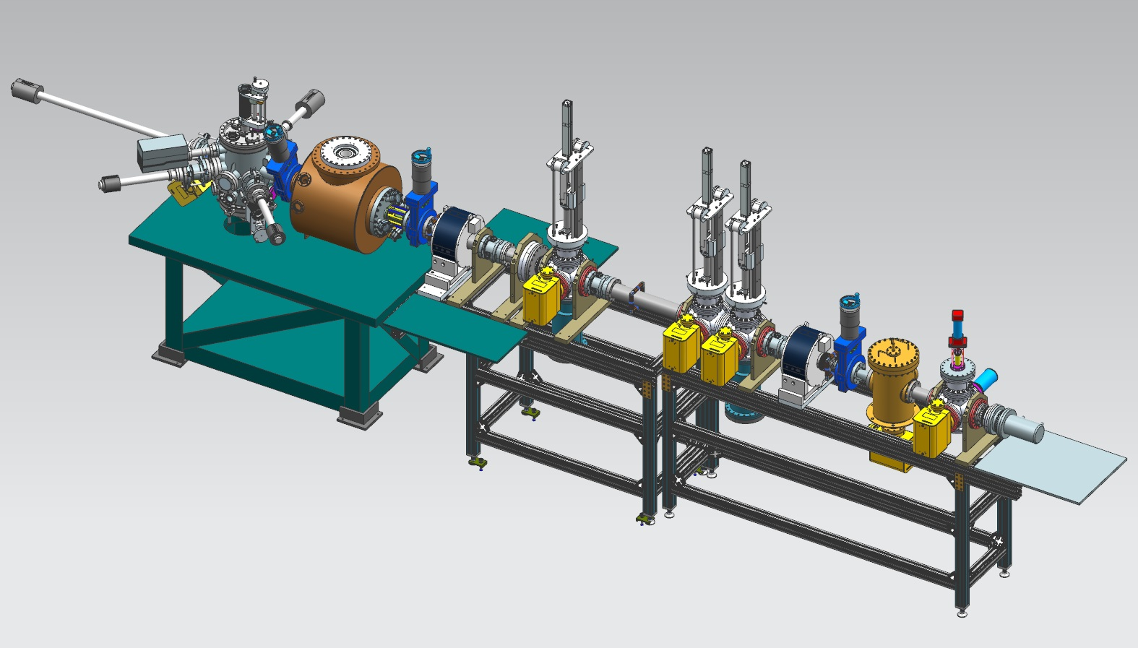
GTS Beam Line as it was in Summer 2016 for beam ops
EB Viewers
Focusing solenoids
Photocathode preparation chamber
HV Gun
1 m
Steering magnets
Faraday Cup (dump)
The EB is generated at the HV Gun and transported to the Faraday Cup (beam dump) where the beam current is measured (QE evaluation over time).

Slide 5
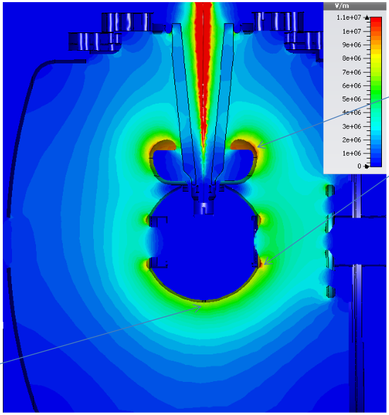
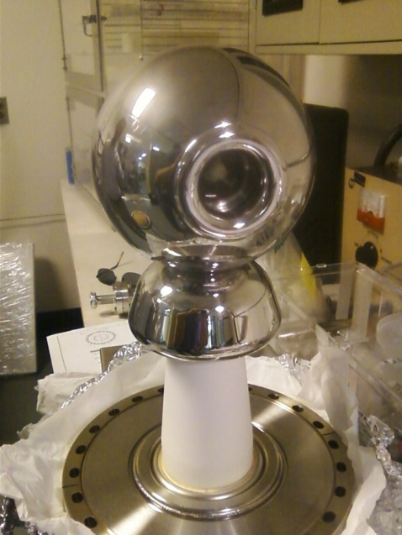
300kV Inverted insulator gun with CsK₂Sb Photocathode
11 MV/m
@ 350kV
6” ball diameter
8 MV/m
Pure alumina insulator with diamond paste hand polished electrodes conditioned to 325kV, but operated at 300kV due to field emission (from dusty NEG strips on bottom of vacuum chamber)

Slide 6
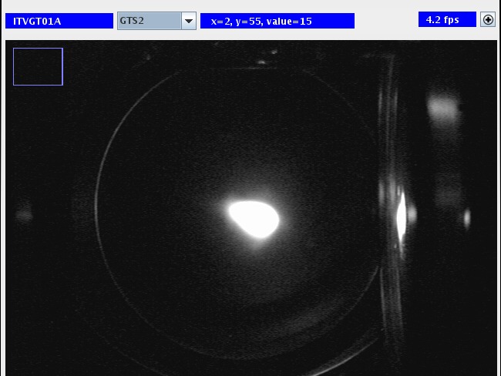
First beam on May 20 2016

Slide 7
We observed no QE decay up to 1 mA:
1mA DC
0.5 mA DC
Same cathode, two different runs
We were not been able to increase to 5 mA because ion back bombarding induces arcing in the photocathode, decreasing the QE…
Canales, Mexican Autonomous University,
intern student summer 2016.

Slide 8
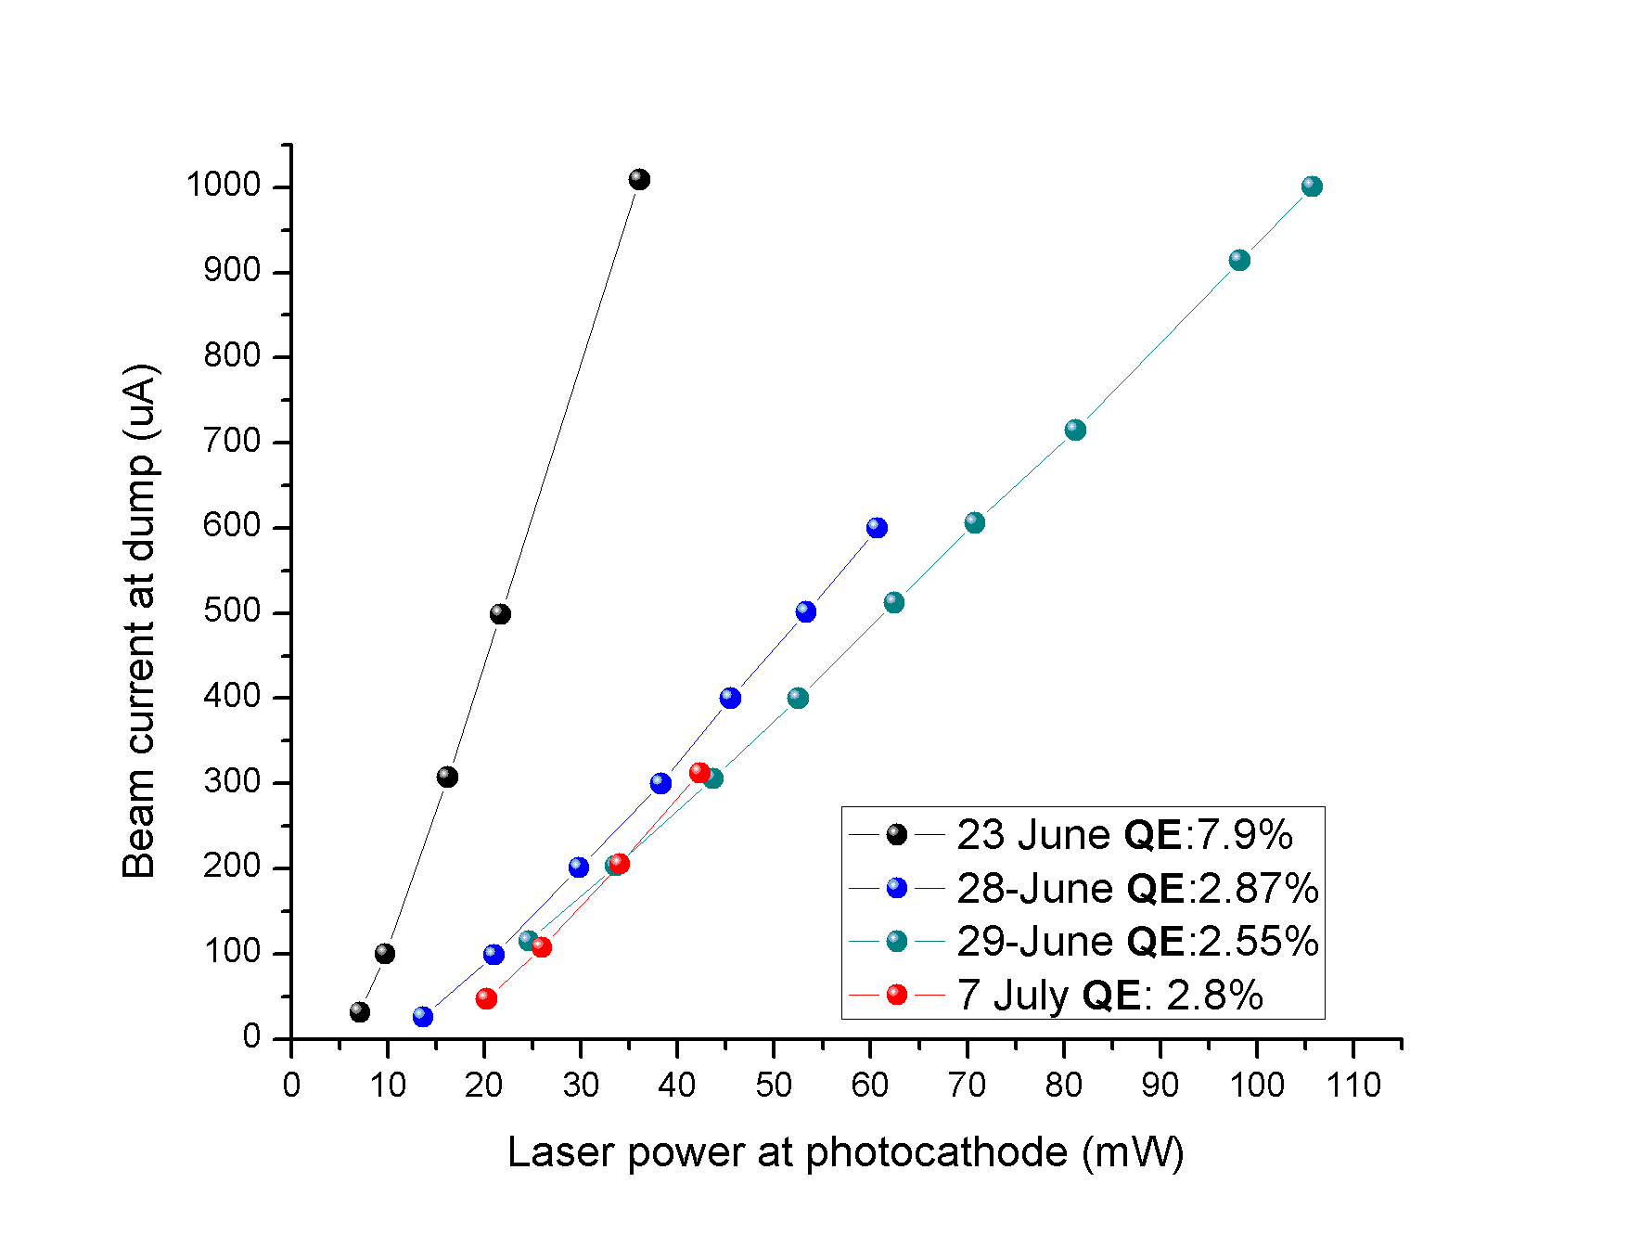
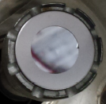
..even so, CsK₂Sb cathode is very robust
Sometimes QE at laser-illuminated spot drops significantly after each arcing event
Some other times the QE at laser-illuminated spot barely changes after each arcing event
18 Jul
HVPS current bursts correlated to arcing events
1 cm
Grown on GaAs substrate
Initial QE
Freshly made cathode
Are arcing events vacuum induced ?
Large initial QE drop
1 cm
Same cathode, different runs
Non-masked cathode = significant beam halo
Laser ON
Laser OFF
8
Canales, Mexican Autonomous University intern student summer 2016.

Slide 9
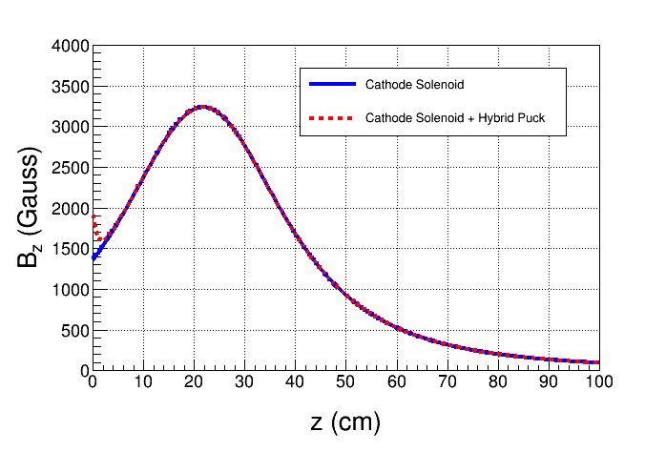
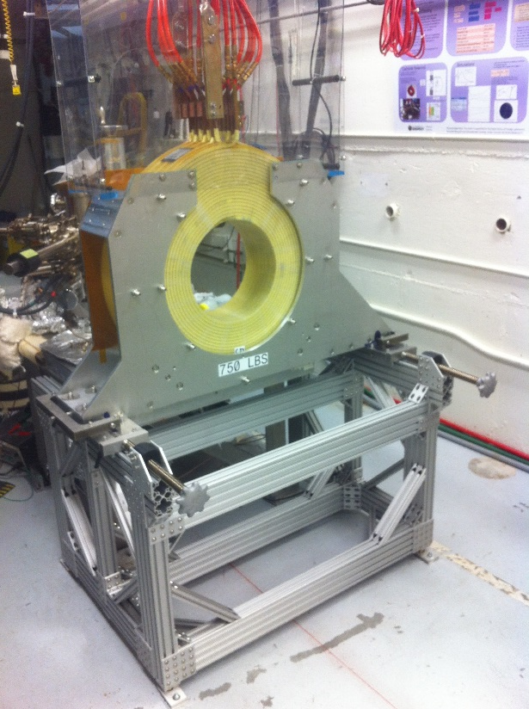
After concluding beam studies in summer 2016, we proceeded with Magnet Coil installation & beamline upgrade
Design and
modeling by Jay Benesch
New Pucks
Designed to enhance magnetic field at cathode to 2.0 kG
Molybdenum
Steel

Slide 10
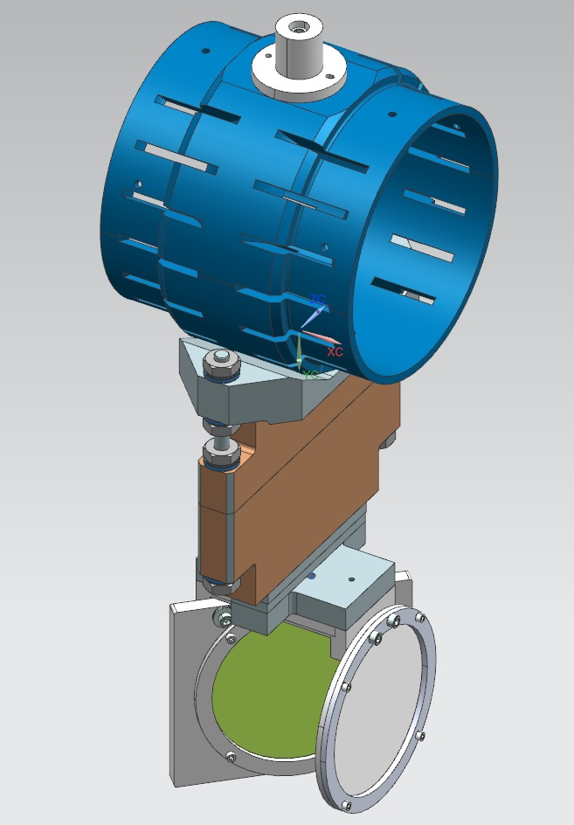
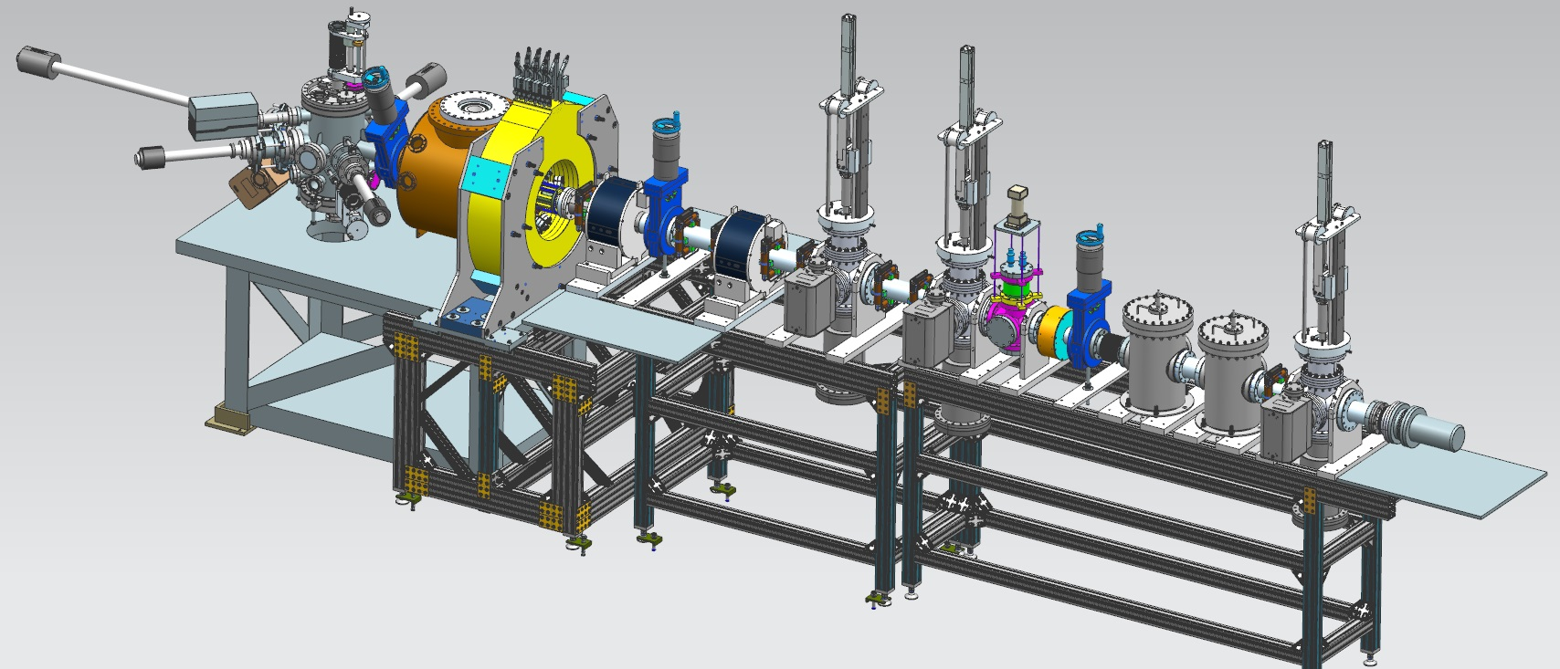
The upgrade beamline currently under installation has slits for magnetized beam characterization and emittance measurements.
Slit
YAG Screen

Slide 11
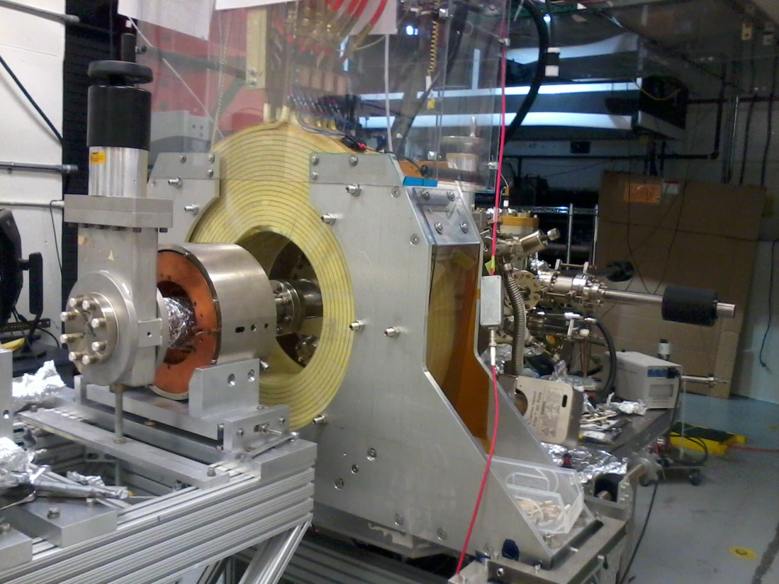
The magnet coil has been installed and commissioned

Slide 12
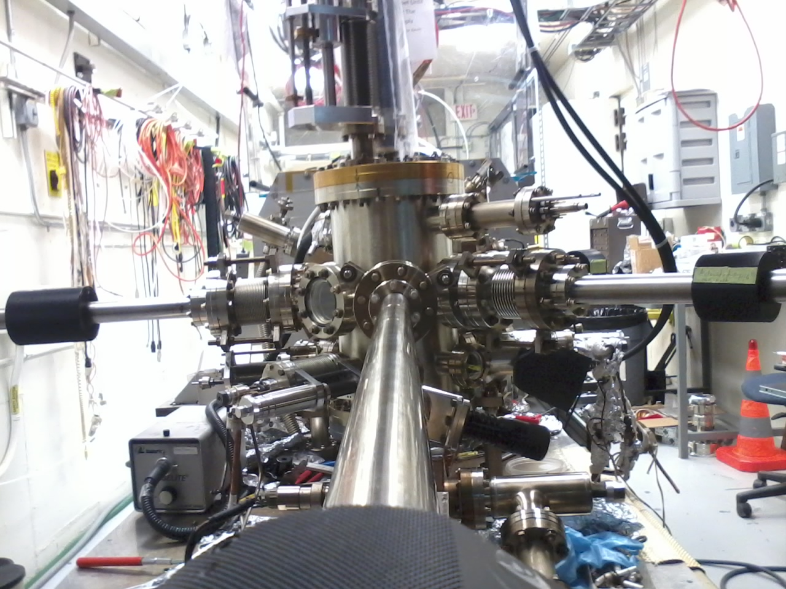
The cathode prep chamber has been improved
Making photocathode in the original chamber was tremendously difficult because the photocurrent could not me monitored, ie the puck was at ground through its heater and holder.
Biasing a nearby anode ring proved useless because it was collecting photoemission from the chamber walls!

Slide 13
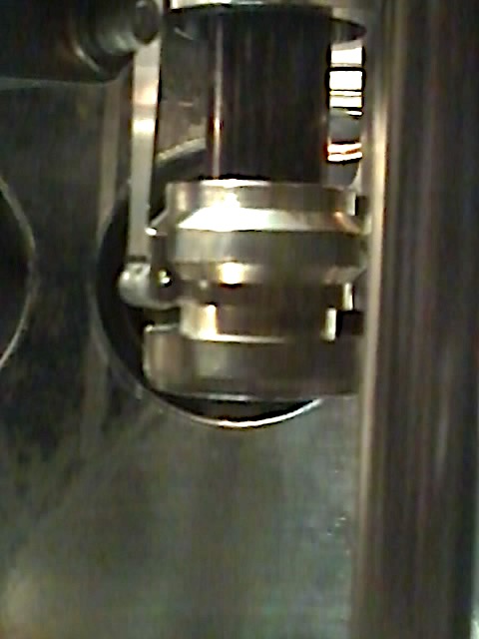
Mamun developed a novel concept for grabbing the puck based on the retainer mechanism used inside the ball electrode, allowing to:
Bias the puck to monitor photocurrent during activation and measuring QE in-situ
Heat the puck during activation
Finely control the gap between puck and Cs-K effusion source for precise film growth
Use a mask for reducing active area to minimize electron beam halo

Slide 14
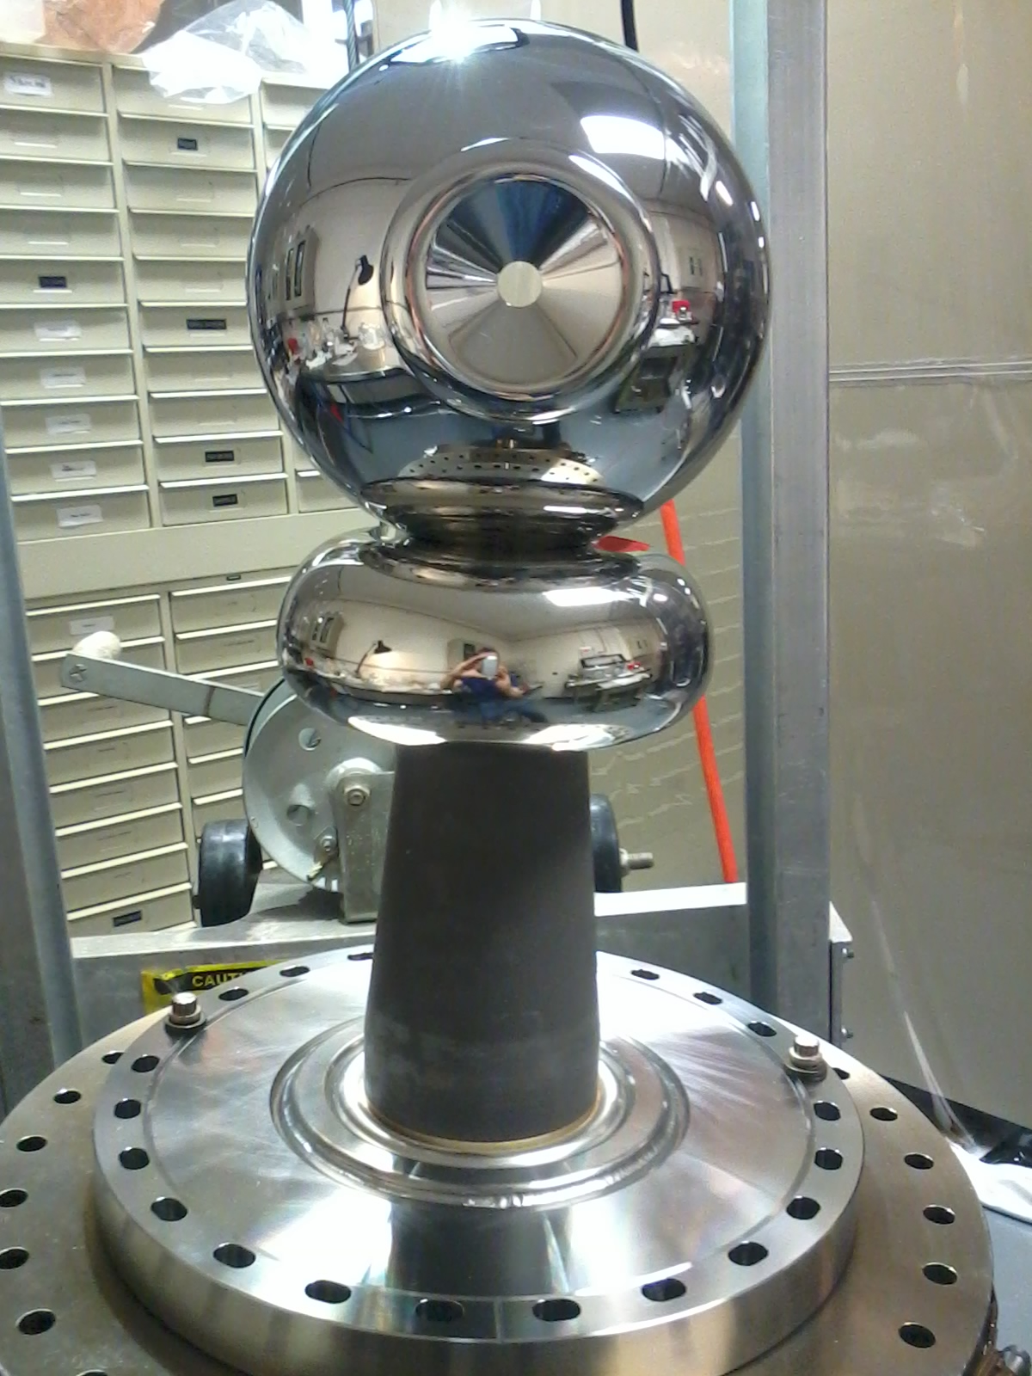
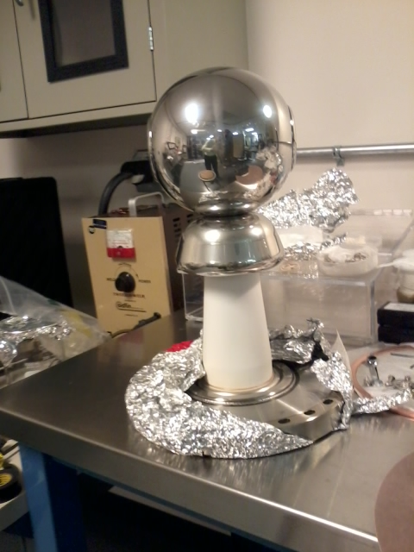
The gun has been refurbished
Pure alumina insulator replaced with doped alumina for higher voltage stand-off and robust operations
Electrode ‘shed’ (triple junction shield) re-designed by Yan Wang to lower gradient from 12 MV/m to 10 MV/m at 350kV
Pure alumina insulator
Doped alumina insulator

Slide 15
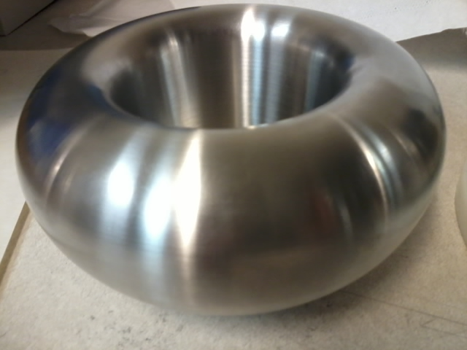
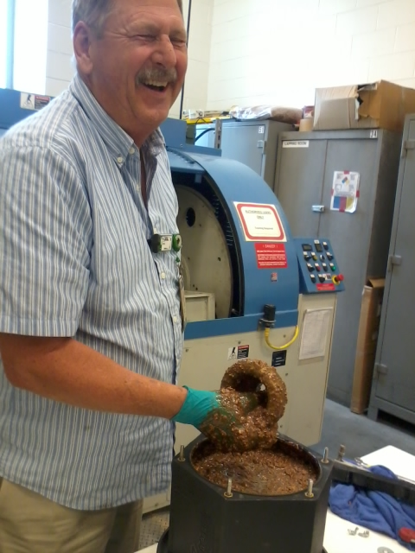
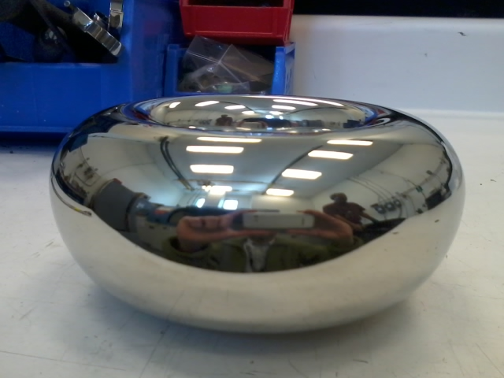
Gun refurbishing continued
Electrodes have been polished with barrel tumbling technique developed by Don Bullard, cutting down the polishing time from 1 week to 1 day !!!
After barrel polishing for 30 min in plastic cones + 30 min corncob
As received from machine shop

Slide 16
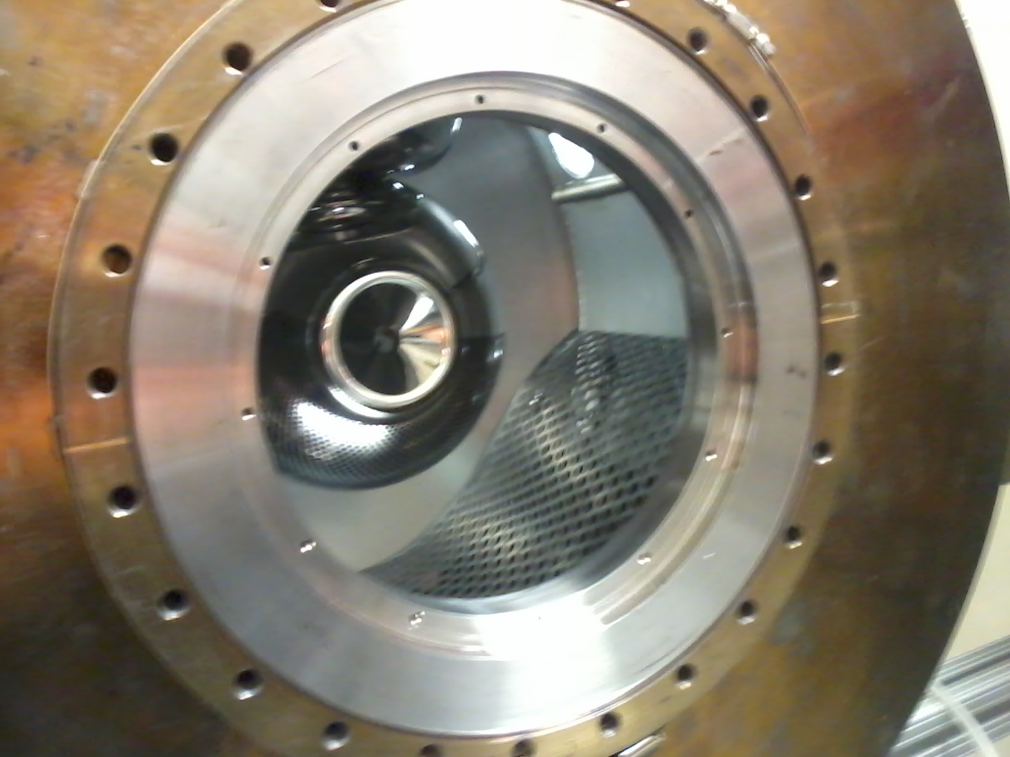
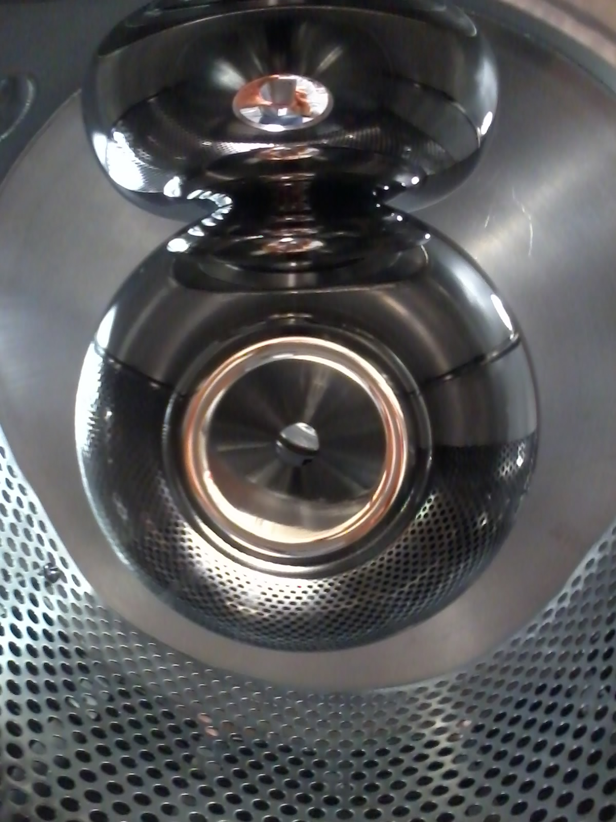
Gun refurbishing continued
Replaced dusty NEG sheets and wire mesh shield with full NEG modules and perforated plate to minimize dust and keep electric field from pulling it towards electrode

Slide 17
As a result of gun improvements the gun high voltage conditioning takes 1/3 of the time!
Indicated voltage reached with Kr processing
Diamond Paste Polished
Barrel Polished

Slide 18
The inverted insulator gun electrostatic ‘package’ shows robust operation at 365kV with Kr
kV

Slide 19
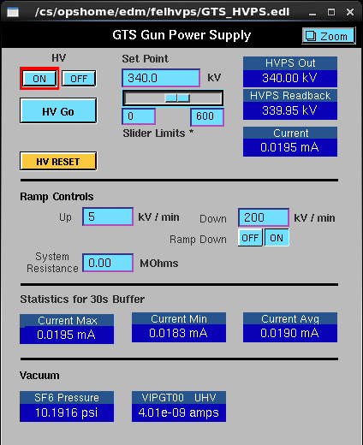
The gun has been conditioned up to 340kV in vacuum

Slide 20
But first trials with gun at 340kV AND magnet coil at 200 A resulted in field emission and vacuum activity

Slide 21
Is this the first time a 300kV DC gun has been operated with a solenoid coil !!??!!

Slide 22
For the sake of progress, we decided to operate at 300kV and re-condition for 100, 200, 300 and 400 A magnet coil current set points
300kV
Magnet coil ON 200 A
Vacuum 5 nA
Ion pump current
Vacuum 2 nA
Ion pump current
Field emission 20 Counts per Second

Slide 23
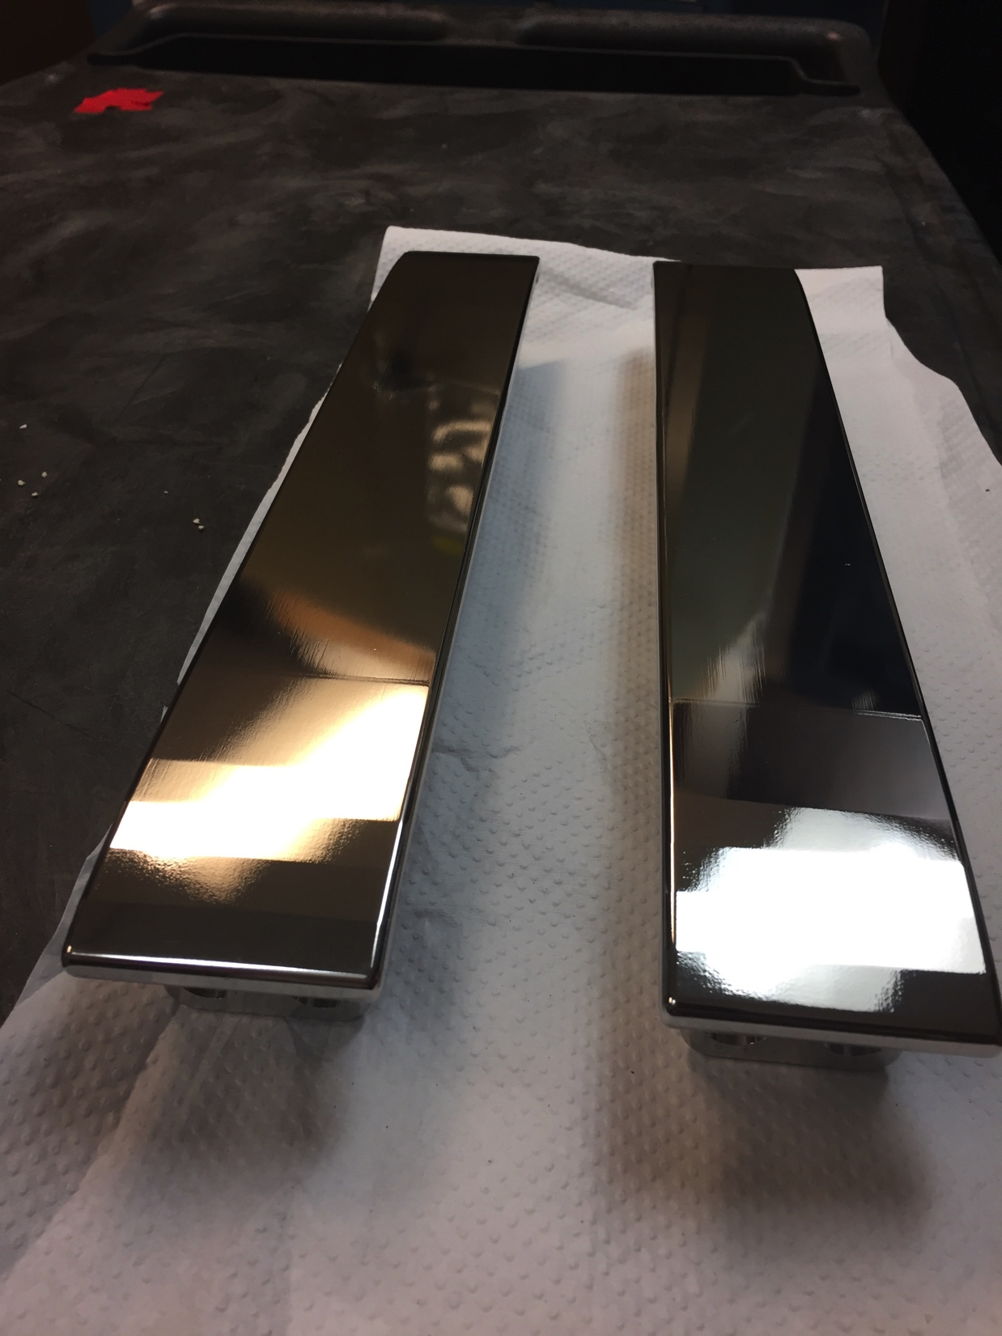
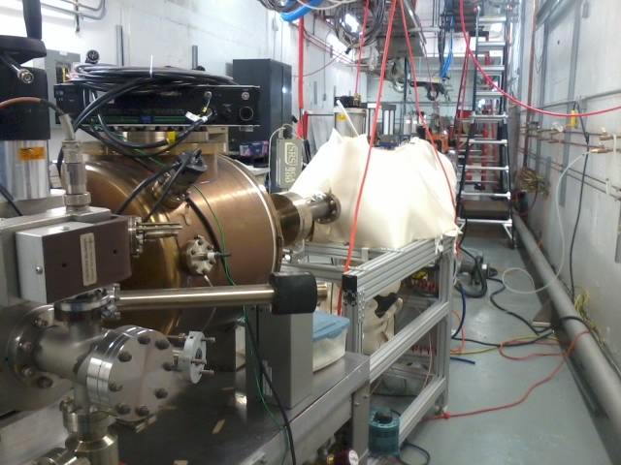
The GTS work also benefits activities at CEBAF for the gun upgrade and at the UITF
Barrel polishing applied to the Wien electrodes which tested successfully for the gradient needed to support 200keV Ops at CEBAF
The UITF DC Photogun is a copy of the improved GTS gun
We anticipate implementing the GTS gun improvements to the upgrade 200keV photogun at CEBAF

Slide 24
In the next few weeks we plan to:
Make CsK₂Sb photocathode in improved cathode preparation chamber
Complete beam line assembly
Vacuum bake beam line
Implement Instrumentation and Control for new diagnostics, added solenoids and steering coils
Complete gun high voltage conditioning at 300kV with magnet coil at 100, 200, 300 and 400 A current set points
Make beam!

