Slide 1
ASY-R30-3: Hinged anode tilts
Gabriel Palacios Serrano
02/22/2021
gabrielp@jlab.org

Slide 2
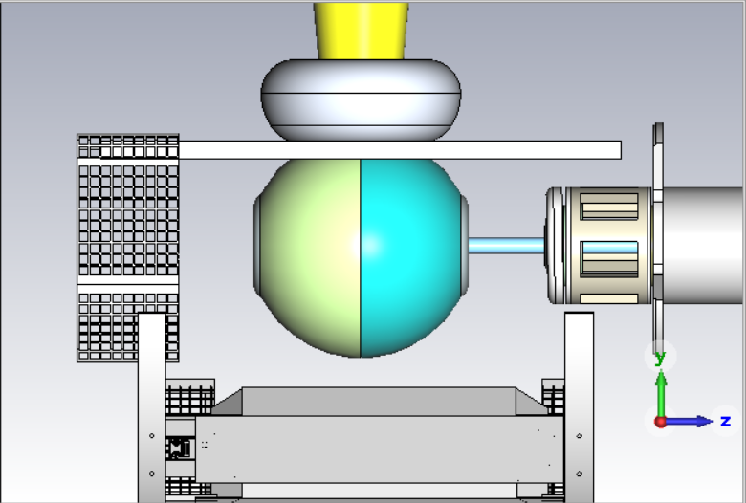
Model
Hinge location

Slide 3
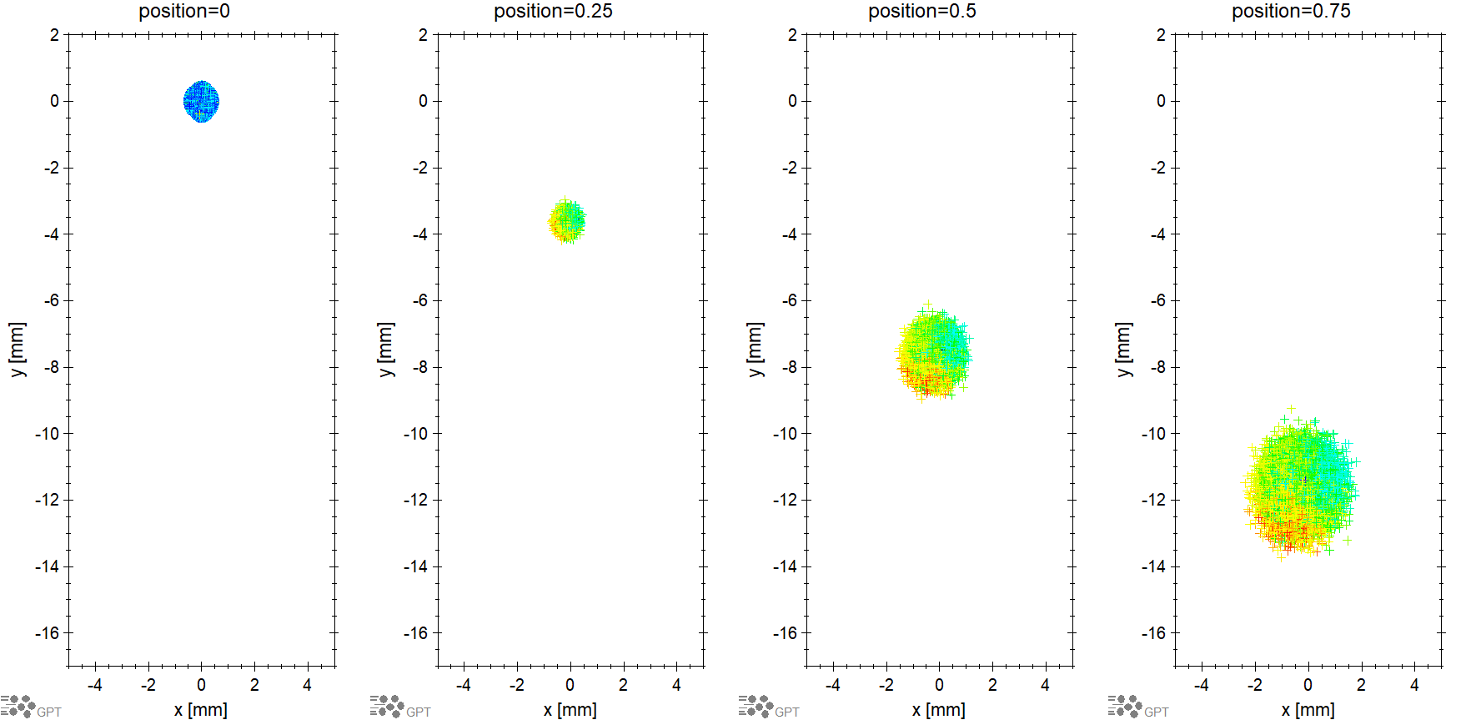
0deg: x-y at z-positions

Slide 4
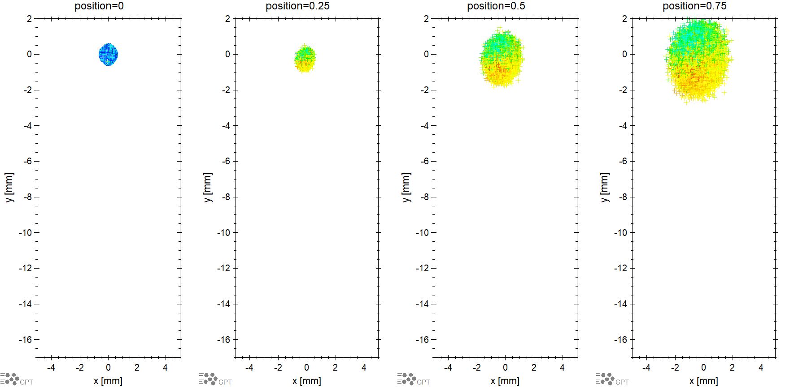
-2.5deg: x-y at z-positions

Slide 5
Average beam position: -2.5 deg hinge tilt

Slide 6
Normalized emittance: -2.5 deg hinge tilt

Slide 7
Angle: -2.5 deg hinge tilt

Slide 8
extras

Slide 9
Tilt effect on horizontal trajectory

Slide 10
Tilt effect on vertical trajectory

Slide 11
Normalized emittance: horizontal

Slide 12
Normalized emittance: vertical

Slide 14
Consistent red 2.5

Slide 15
Spot size: horizontal

Slide 16
Spot size: vertical

