Slide 1
Organizational for the Installation of a
Wien filter and Mott polarimeter
in the keV section of the UITF
Work Coordinator:
Joe Grames
grames@jlab.org
757-344-0188
https://devweb.acc.jlab.org/CSUEApps/uitflist/task/1852

Slide 2
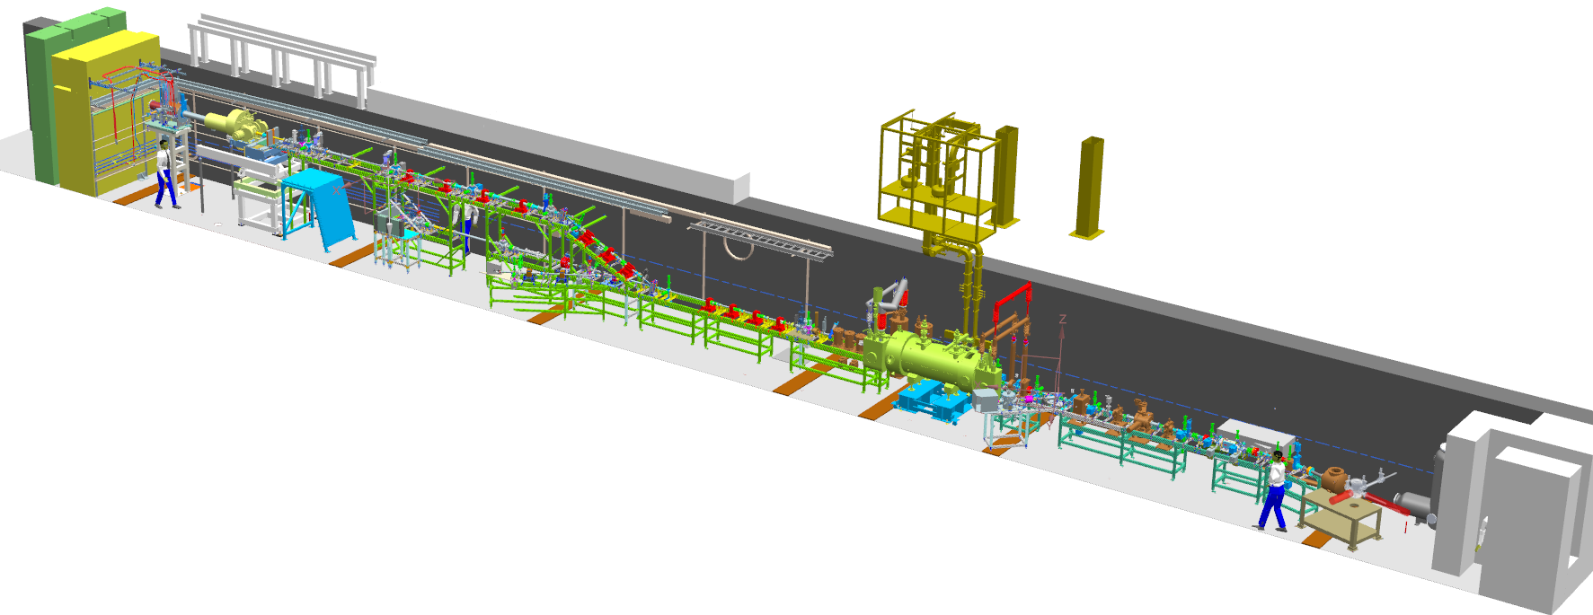
Here are the two areas at UITF where the work happens…
U-Wien Install
High level summary
Initially – disconnects (magnets, diagnostics) for CIS vacuum work
Then – for the new installation…
Permanently removing a harp and bpm (less stuff to manage)
Adding a Wien filter (uses installed magnet + HV controls)
Four (4) new magnet trim channels ….. Eek?!?
Swapping out a viewer for just a video/light channel
Adding a STAC5 target ladder
Aligning the Wien, Mott and beam pipe (lots of bellows!!!)
Rebuilding the keV Mott lead dump (RadCon!)
Mott Install

Slide 3
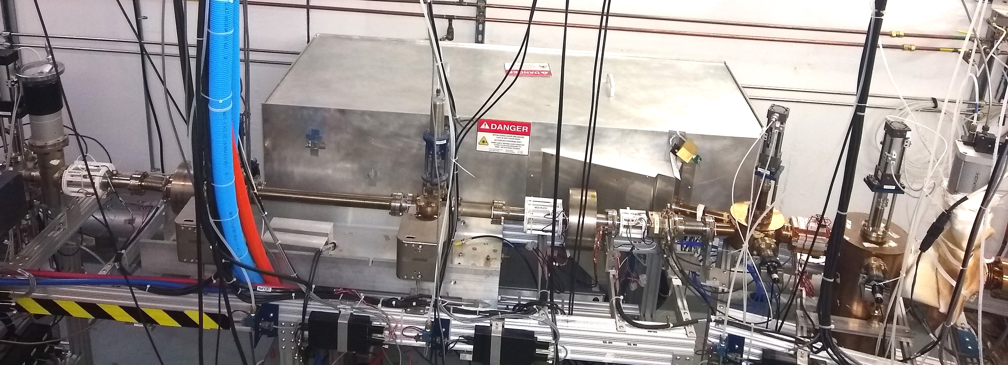
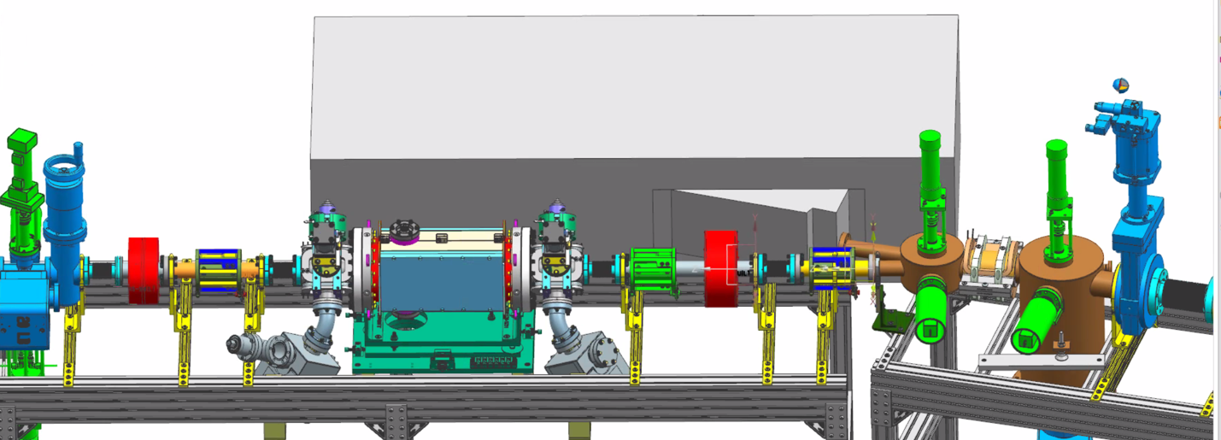
U-Wien Install
Element-by-Element Jobs
TODAY
CED | Uninstall | Install | Comment
VBVK201 | No | n/a | Closed
VIPK201 | No | n/c | Disconnect for bake
MDSK201 | No | n/c | Disconnect for bake
ITVK201A | No | n/c | Disconnect for bake Add shed/tophat
IPMK201 | Yes | n/a | Remove permanently
MBHK201H/V | No | n/c | Disconnect for bake
MFBK202 | No | n/c | Disconnect for bake
MBHK202H/V | No | n/c | Disconnect for bake
ITVK202 | No | n/c | Disconnect for bake Add tophat
VIPK202 | No | n/c | Add to Wien Cross
MQxK202 | n/a | Yes | New Wien quad
MWFK202 | n/a | Yes | New Wien Filter 20 Amp SCE + Wien HV Control
ITVK203 | No | n/c | Disconnect for bake Add tophat
VIPK203 | No | n/c | Add to Wien Cross
MQxK203 | n/a | Yes | New Wien quad
MBHK203H/V | No | n/c | Disconnect for bake
MFQK203 | No | n/a | Disconnect for bake
MBHK203AH/V | n/a | Yes | New H/V pair
VMVK203 | No | n/a | Closed
UPGRADE

Slide 4
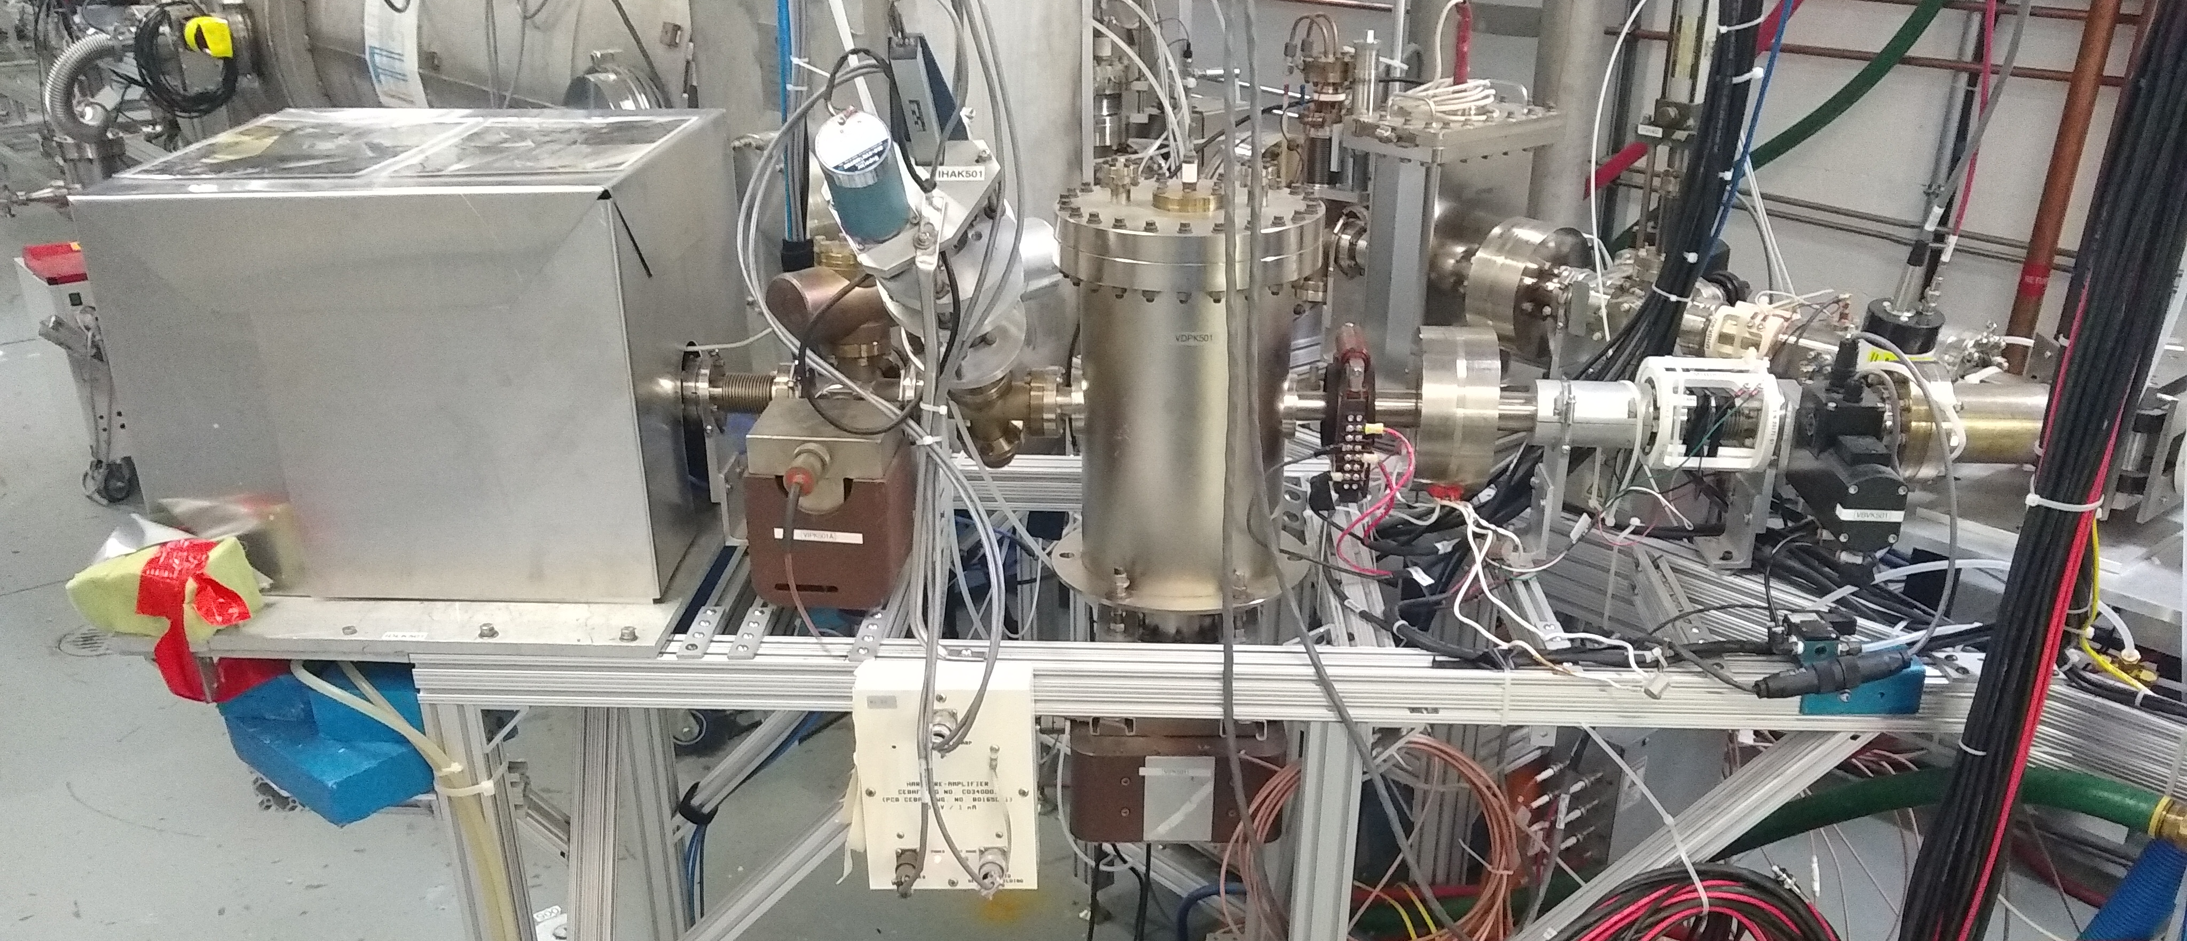
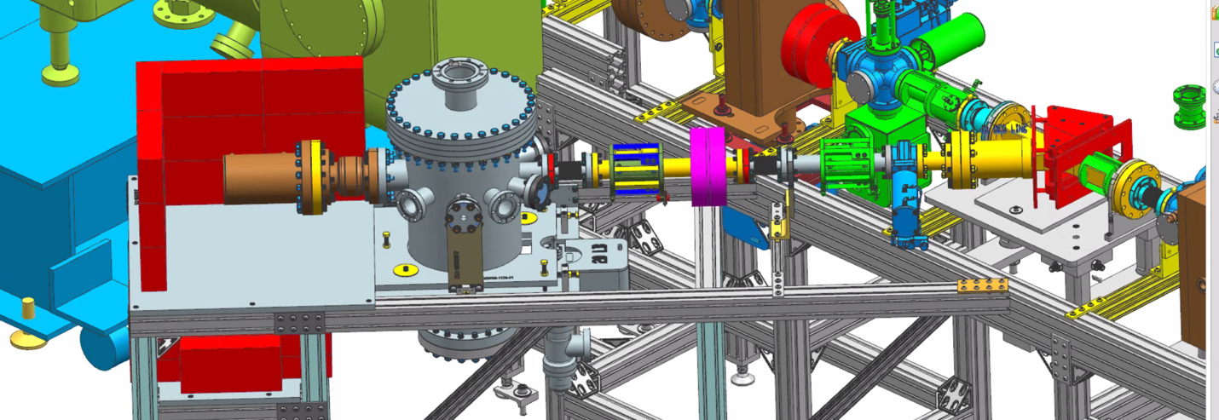
Mott Install
TODAY
Element-by-Element Jobs
CED | Uninstall | Install | Comment
VBVK501 | No | n/a | Closed
MBHK501H/V | No | n/c | Disconnect for bake
MFQK501 | No | n/c | Disconnect for bake
MCR501AH/V | Yes | Yes | Disconnect for bake Replace with MBH501AH/V
VIPK501 | No | n/c | HV off for bake (below Mott)
VDPK501 | No | n/c | Below Mott
ITG5R01 | n/a | Yes | Mott target ladder STAC5 cable
ITVK501 | Yes | n/a | Disconnect for bake
ITVK501 | n/a | Yes | Replace with video/light on/off
IHAK501 | Yes | No | Remove permanently
VMVK501A | Yes | No | Remove permanently
VIPK501A | Yes | No | Remove permanently
IDLK501 | No | n/c | Disconnect ammeter for bake Unstack lead for bake
UPGRADE

Slide 5
Schedule
Week of May 16 – Last week of present run period
UITF beam studies ends
PSS certification completed
Week of May 23 – Focus on Wien region
Isolate valves, Safe DC power (per OSP), Remove I&C cables
Vent both region and perform mechanical disconnects
CIS modify Y/Laser viewers + align
Install U-Wien girder, pumps, viewers, beam pipe, 1A align
Pump down, leak-check, burp NEG, setup for bake
Week of May 30 – Focus on Mott region
Monday – Holiday
Bake U-Wien region, activate NEG
Install Mott chamber, beam pipe, ladder if ready, dump and align
Mild bake, activate NEG
Week of June 6 (and 13 if needed) – Complete installation
Wrap up bake outand leak check
DC and I&C reconnects and HCO
Software/ME/Ops/CASA – Finish updating documentation

Slide 6
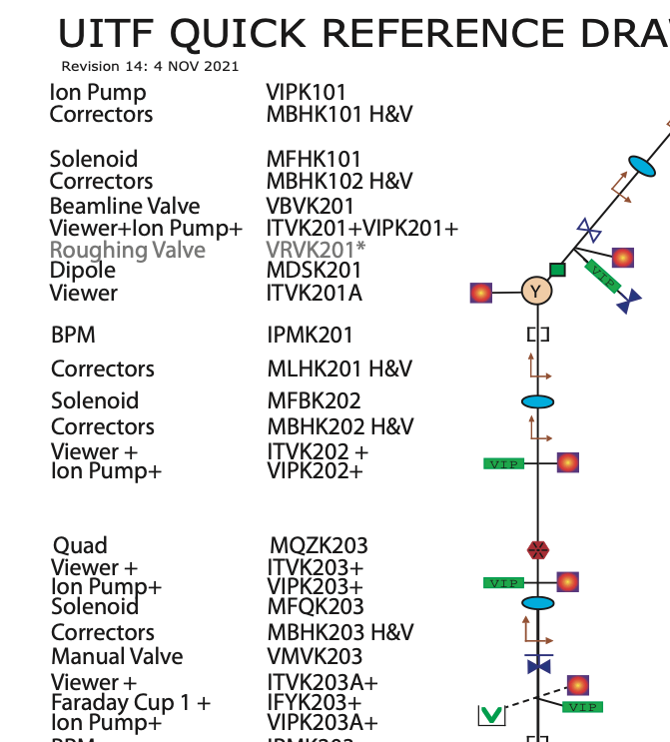
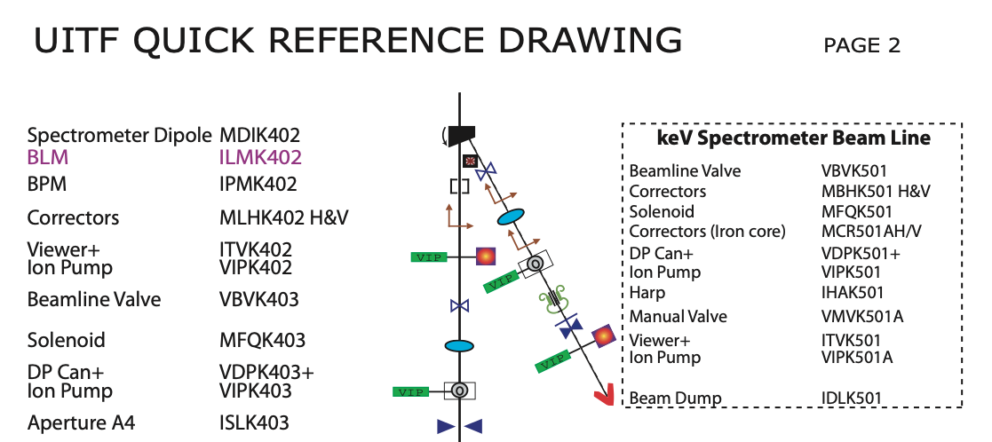
U-Wien Install Area (Today)
Mott Install Area (Today)

