Slide 1
Test measurements with C₃F₈ Dec 2017 – Jan 2018
Sensitivity to superheat
(tested 3 temperatures with similar superheats, 2 pressures)
2. Distribution of bubbles in the vessel
3. Background and 1/r² distribution
(2-3 distances)

Slide 2
Critical curves for liquids used in the ANL bubble chamber

Slide 4
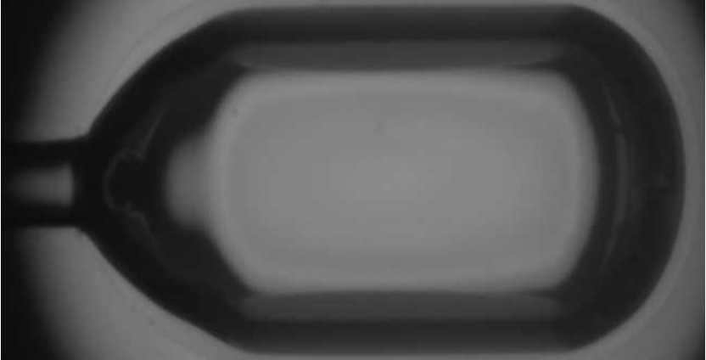

Slide 5


Slide 6
Pu-¹³C neutron source, 8º of superheat

Slide 7
“1/r² “ distribution

