Slide 1
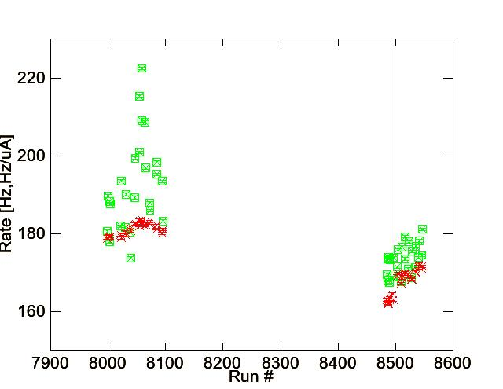
RAW and BCM NORMALIZED RATES
MottAnalysis Asymmetry and Raw Rate [Hz] Cuts
TOF_cut= [-2σ:+2σ]
G_fit=[8000:9000] => E_cut=[-0.5σ:2σ]
BCM Rate Normalizations [Hz/uA]
This systematic uncertainty is typically 1%

Slide 2
MOTT RUN I/II EXTRAPOLATION RESULTS
JANUARY 11, 2017
PLEASE SEE EITHER VERSION OF FILE FOR VALUES:
1.11.17_Run1Run2_ARC.ODS
1.11.17_Run1Run2_ARC.XLS
https://wiki.jlab.org/ciswiki/index.php/January_11,_2017_-_Mott_Group_Meeting

Slide 3
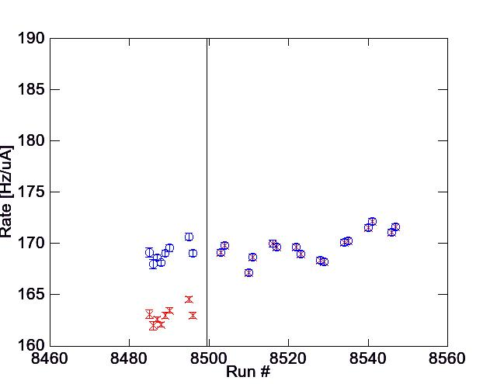
RATES CORRECTIONS FOR RUN II STEERING
Run II Rate Correction applied to stability runs:
1um (#15) stability runs 8495-8547
1um (#15) extrapolation runs 8485-8490
0.625um (#2) extrapolation runs 8491-8494
0.050um (#13) extrapolation runs 8497-8498
Rate after steering
168.702 ± 0.069 Hz/uA
Rate Correction
1.03719 ± 0.00083
Rate before steering
162.653 ± 0.112 Hz/uA

Slide 4
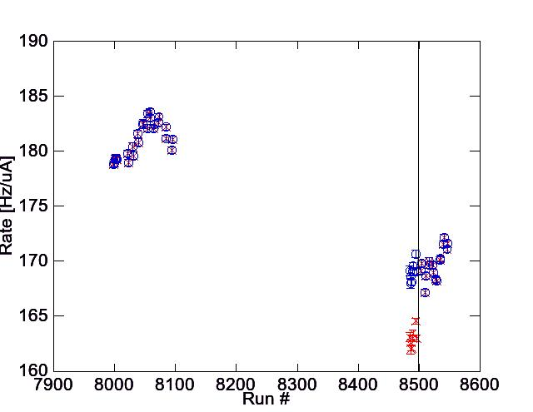
UNCERTAINTY IN RATE DUE TO DRIFTING RATE DURING RUN I OR II
DRIFT UNCERTAINTY = (MAX-MIN)/(MAX+MIN) = 1.32%
DRIFT UNCERTAINTY = (MAX-MIN)/(MAX+MIN) = 1.47%

Slide 5
FINAL RATE AND UNCERTAINTIES FOR RUN I AND II IN .ODS/.XLS FILES
Normalized rate and Normalized rate uncertainty is statistically calculated for each foil
Beam current uncertainty systematic is arithmetically averaged for each foil
Rate drift uncertainty is constant defined for each Run (I or II)
Run I
Run II

Slide 6
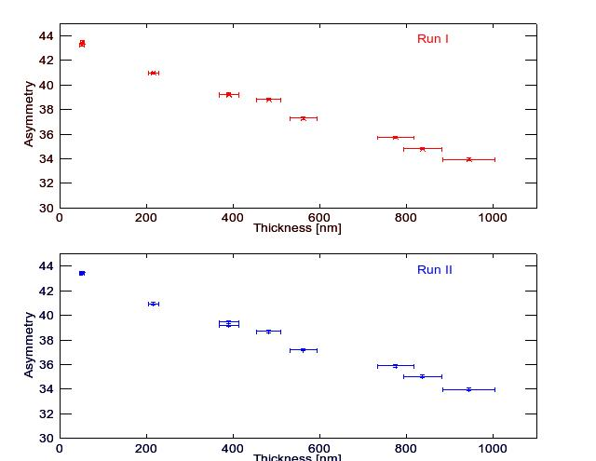
RUN I/II ASYMMETRY VS. FOIL THICKNESS (NOTHING NEW HERE)

Slide 7
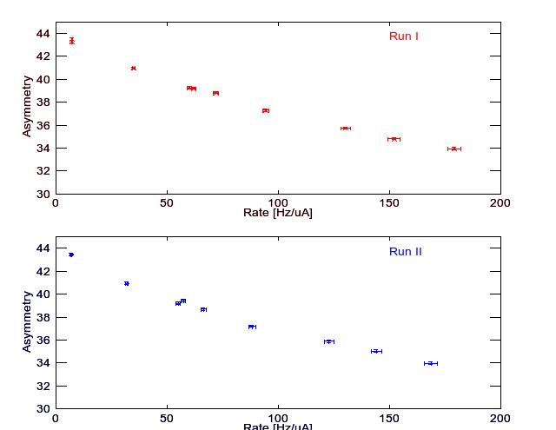
RUN I/II ASYMMETRY VS. FOIL NORMALIZED/CORRECTED RATE W/ STAT + SYST TOTAL SHOWN

