Slide 1
Gun2 with Tee electrode High Voltage conditioning to 200 kV w/o field emission
C. Hernandez-Garcia
February 2021

Slide 2
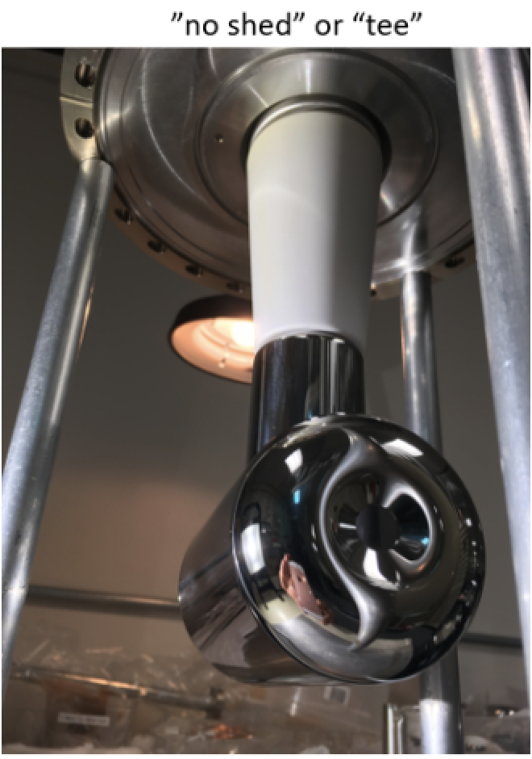
Present configuration.
No conditioning resistor inside HVPS tank
HVPS filled to 60 psig SF6 (need to check)
Electrode operated at 200 kV, no field emission back in Sept 24 2020
It took 2 shifts
But we are planning for 10 shifts because this time conditioning will start from 0 V and bakeout after anode flange vacuum work, rather than from 130kV as it was in Sept 2020
Who from CIS can help with HV conditioning shift?

Slide 3
Tentative schedule
Make sure backup electrode is available
It is safely stored in cabinet outside TL1137 clean room.
Gun bake
Regrease ceramic after bake
Install DecaRad and place detectors around gun
Connect anode to pico-ammeter for monitoring anode current during HV conditioning
R30 resistor tank
Currently in UITF
Evacuate SF6
Replace broken pressure gauge
Backfill to psig N2 and bubble test
Evacuate and back fill using UITF DILO cart to 10 psig of SF6
Crane tank down to tunnel
Connect tank to gun and to HVPS
Check HV interlock made up
HVPS setpoints/controls ready
HV conditioning (not sure yet start date, nor if 1 or 2 shifts per day)
2/15 | 2/22 | 3/1 | 3/8
 |  | PSS Certs

Slide 4
High voltage conditioning
NOTE: If field emission is encountered, pause the procedure and contact Carlos (757) 926-9133
The goal is to perform the procedure in vacuum conditions, if field emission cannot be extinguished up to 250kV, we’ll evaluate using krypton
Open Gun2 HVPS controls screen.
Set HV Op limit to 205kV and HVPS current limit to 0.2 mA.
Monitor DecaRad signals, Gun2 vacuum, anode current and HVPS currentas a function of HVPS voltage using LivePlot
Set the HV ramp up rate to 25 kV/min.
Ramp the voltage in 25 kV steps up to 100 kV soaking for a couple of minutes at each step
Set the HV ramp up rate to 5 kV/min
Ramp the voltage in 10 kV steps up to 130 kV
Soak for a few minutes to obtain a baseline for all the monitored signals.
Set the ramp rate to 2 kV/min
Increase the voltage by 5 kV and wait for about 1 minute before increasing the voltage again by 5kV.
Continue increasing voltage up to 200kV, keeping track of field emission, anode current, HVPS current and gun vacuum levels.
Upon reaching 200 kV, contact Carlos.

Slide 5
Tentative HV conditioning staffing schedule
MARCH | Mon 8 | Tue 9 | Wed 10 | Thu 11 | Fri 12
OWL | XXX | XXX | XXX | XXX | XXX
DAY | Carlos/Bubba | Carlos/Bubba | Carlos/Bubba | Carlos/Bubba | Carlos/Bubba
SWING | Eric Forman | Eric | Eric | Eric | Eric

