Slide 1
Improvements in Parity Quality Beam
Riad Suleiman
Center for Injectors and Sources
Science and Technology Review
Jefferson Lab
July 14-16, 2009

Slide 2
Center for Injectors and Sources
Group Leader – M. Poelker
Staff Scientists – J. Grames, M. Stutzman, R. Suleiman
Senior Technical Staff – P. Adderley, J. Hansknecht
Junior Technical Staff – J. Clark
PhD Students
J. Dumas (Joseph Fourier University, France): Polarized e+ Source
J. McCarter (University of Virginia): Photocathode Materials
K. Surles-Law (Hampton University, JLab staff): 200 kV Gun
ODU Research Experience for Undergraduates (REU)
H. Graffius (West Virginia Wesleyan University)
R. Powell (West Virginia Wesleyan University)
M. Ricketts (Merced Community College, CA)

Slide 3
Outline
Upcoming Parity Violation Experiments
Higher Gun Voltage & Inverted Gun for QWeak
Two Wien Slow Helicity Reversal for PREx
Fast Helicity Reversal
Other Improvements

Slide 4
Upcoming Parity Experiments
Experiment | Hall | Start | Energy (GeV) | Current (µA) | Target | A_{pv} (ppm) | Maximum Charge Asym (ppm) | Maximum Position Diff (nm)
HAPPEx-III | A | Aug 09 | 3.484 | 85 | ¹H (25 cm) | 16.9±0.4 | 1 | 10
PVDIS | A | Oct 09 | 6.068 | 85 | ²H (25 cm) | 63±3 | 1 | 10
PREx | A | March 10 | 1.056 | 50 | ²⁰⁸Pb (0.5 mm) | 0.500±0.015 | 0.100±0.010 | 2
QWeak | C | May 10 | 1.162 | 180 | ¹H (35 cm) | 0.234±0.005 | 0.100±0.010 | 2
Achieved |  |  |  |  |  |  | 0.4 | 1

Slide 5
Higher Voltage & Inverted Gun for QWeak
Increase gun voltage up to 150 kV to reduce space charge emittance growth at higher bunch charge (higher current)
Beam quality including transmission improves
Problem: Field emission at higher voltage degrades lifetime → solution: Inverted Gun
Inverted Gun will be installed in July 2009

Slide 6
Want to move away from “conventional” insulator used on all GaAs photo-guns today: expensive, months to build, prone to damage from field emission.

Slide 7
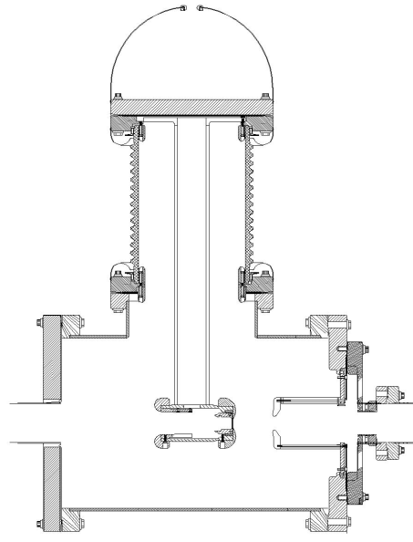
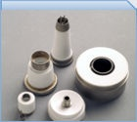
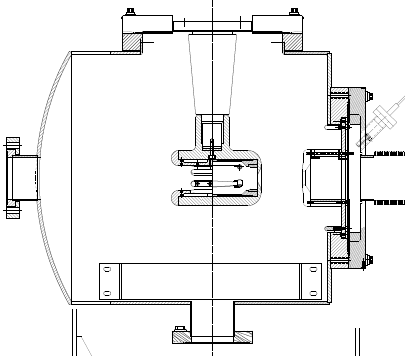
Medical x-ray technology
Present Ceramic
Exposed to field emission
Large area
Expensive ($50k)
e⁻
New Ceramic
Compact
$5k
e⁻
Inverted Gun

Slide 8
Two Wien Slow Helicity Reversal for PREx
Insertable Half Wave Plate (IHWP) provides slow helicity reversal of laser polarization:
Cancels Electronic cross talk and Pockels Cell Steering
Residual Linear polarization effects do not cancel
Spot size asymmetry, which we cannot measure, does not cancel
New: Slow helicity reversal of electron polarization using two Wien Filters and solenoid:
Wien settings constant
Solenoid rotates spin by ±90° with ±B but focuses beam as B²
Maintain constant Injector and Accelerator configuration
Cancels all helicity-correlated beam asymmetries from the Injector including spot size
Can be used up to maximum Gun voltage of 140 kV
Will be installed in January 2010

Slide 9
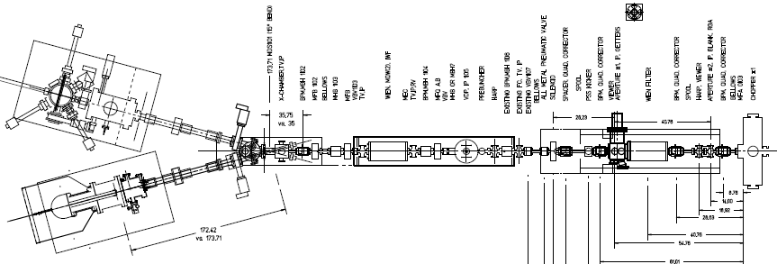
+ Solenoid current
- Solenoid current
“Spin Flipper”
Vertical Wien = 90°
Azimuthal Solenoid = ± 90°
“Long. Pol. for Halls”
Horizontal Wien = -90° → +90°

Slide 10
Fast Helicity Reversal
We have been using 30 Hz helicity reversal:
Power line 60 Hz frequency is major source of noise in parity experiments
For 30 Hz reversal, T_Stable (= 33.333 ms) contains exactly two cycles of 60 Hz line noise → this reversal cancels line noise
Problem:
There are other sources of noise at low frequencies, i.e., target density fluctuations, beam current fluctuations
→ Cause larger widths of helicity correlated distributions, double-horned distributions
Solution: Use fast helicity reversal (faster than 30 Hz)
Studied beam properties at 1 kHz (Oct 2008 – April 2009)
Fast reversal of helicity Pockels Cell was possible using new optically-driven fast high voltage switch designed by J. Hansknecht

Slide 11
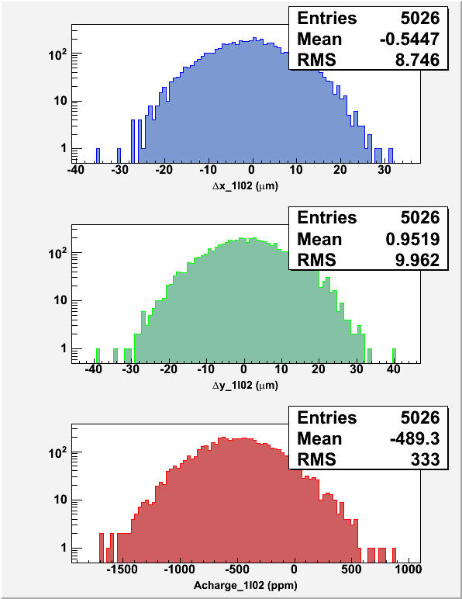
30 Hz, T_Stable = 33.333 ms, T_Settle = 500 µs
1 kHz, T_Stable = 0.980 ms, T_Settle = 60 µs

Slide 12
Summary of Fast Helicity Reversal Studies
Fast Helicity Reversal is needed:
Huge reduction of noise from target density fluctuations
Reduces noise on beam current by factor of 4
Reasonable reduction in beam position noise
Achieved Pockels Cell T_Settle of 60 µs
Future Parity Experiment:
New Helicity Board to be installed in July 2009
Experiment | Frequency | Clock | Pattern
HAPPEx III & PVDIS | 30 Hz | Line-Locked | Quartet
PREx | 240 Hz | Line-Locked | Octet
QWeak | 1 kHz | Free | Quartet

Slide 13
Other Developments
Charge Feedback: Ability to do Charge Feedback using either Pockels Cell or Intensity Attenuator without or with the option to correct for Pockels Cell hysteresis
Helicity Magnets: Ability to do Position Feedback using the newly commissioned helicity magnets located in the 5 MeV region of the Injector
Pockels Cell Motion: Pockels Cell is equipped with remote controlled x & y translational stage for minimizing position differences while measuring the position differences of electron beam
Photocathode Rotation: With Load-Locked Gun, now we can zero the offset term in the charge asymmetry caused by the vacuum window birefringence by rotating the photocathode

Slide 14
Summary
Jefferson Lab is an ideal place for parity violation experiments
We are getting better with many improvements in parity quality beam
Looking forward for even more demanding parity violation experiments at 12 GeV

