Slide 1
Gun2 with Tee electrode High Voltage push to 200 kV
C. Hernandez-Garcia
August 17 2020

Slide 2
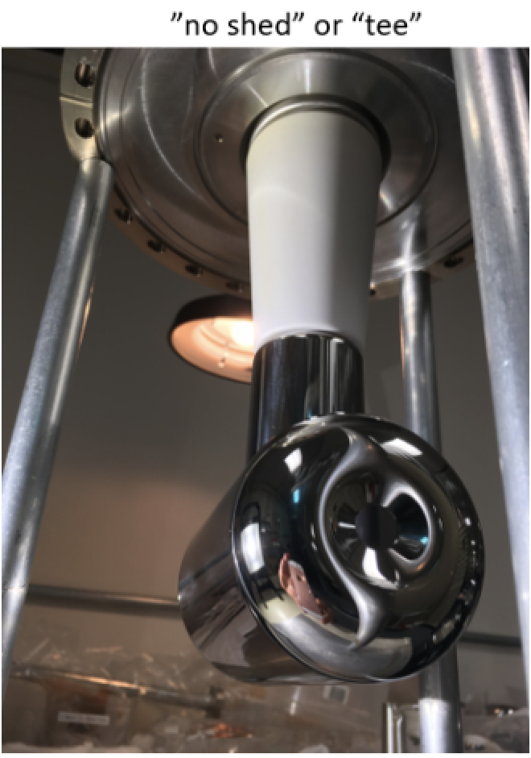
Present configuration.
No conditioning resistor
HVPS filled to 60 psig SF6
Electrode operating at 130kV, no field emission
Goal: Evaluate for field emission to 200kV

Slide 3
First: Insert conditioning resistor
If R30 resistor tank (Pig) ready ~2 hours
Ask Neil to crane the resistor tank & HV cables down to the injector tunnel
Bubba or Carlos to remove R350-R28 cable from HVPS to gun
Plug R350-R30 from HVPS to resistor tank
Plug R30-R28 from resistor tank to gun
If R30 resistor tank NOT ready (~10 hours)
Ask Neil to crane DILO cart down to the injector tunnel
Transfer SF6 from HVPS tank to storage bottles (5 hours)
Vent HVPS and replace short with conditioning resistor (1 hour)
Evacuate HVPS tank (1 hour)
Backfill HVPS to 60 psig of SF6 (2 hours)

Slide 4
High voltage evaluation: ~ 8hr shift
Under vacuum conditions.
Monitor DecaRad signals and Gun2 vacuum as a function of HVPS voltage
Increase voltage in steps of 5 kV. Record field emission onset voltage.
Continue increasing voltage up to 200kV. Record field emission and vacuum levels.
Joe: what do you want to do then?

