Slide 1
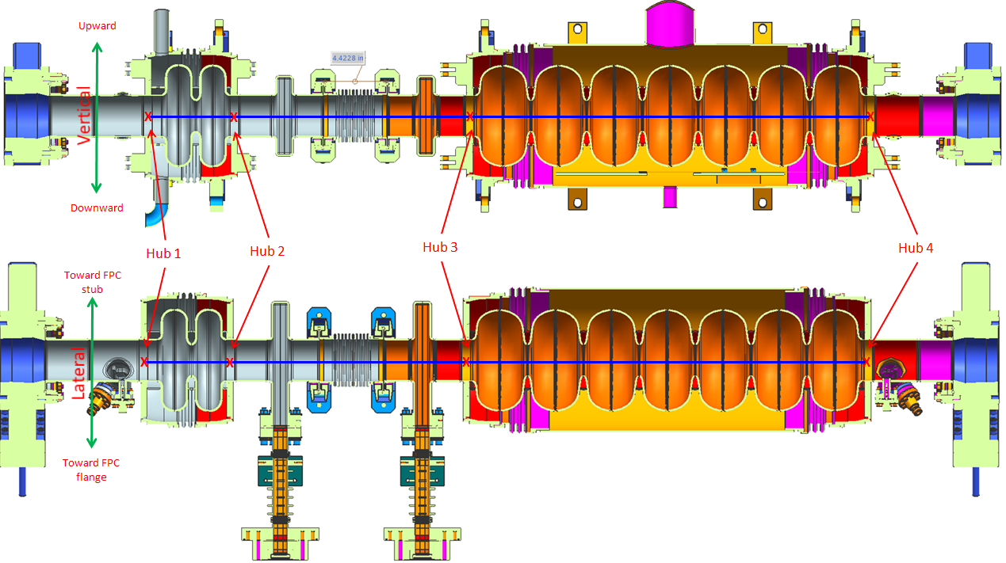
Test of Booster at UITF
Test of the New Injector Booster at UITF:
RF tests
Basic Beam Tests and Setup
Exploring the limits and Capabilities
Reza Kazimi (12/12/18)

Slide 2
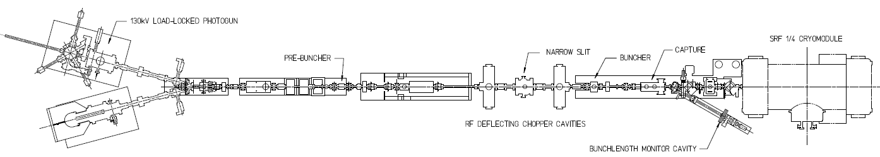
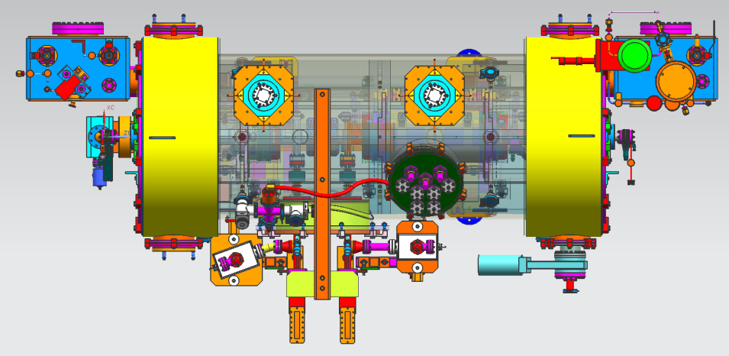
Injector Upgrade
200 kV
Increase gun voltage, modify Wien filters for 200kV operation
Improve baked beam line vacuum so gun does not pump on beam line
Locate H-Wien (energy filter) upstream of pre-buncher cavity
New SRF booster eliminates warm capture, RF deflection and x/y coupling
Our new “1/4 cryomodule”, or QCM:
2 cell capture section + 7 cell cavity,
should provide 10 MeV beam and introduce no x/y coupling, allow better matching, more adiabatic damping

Slide 3
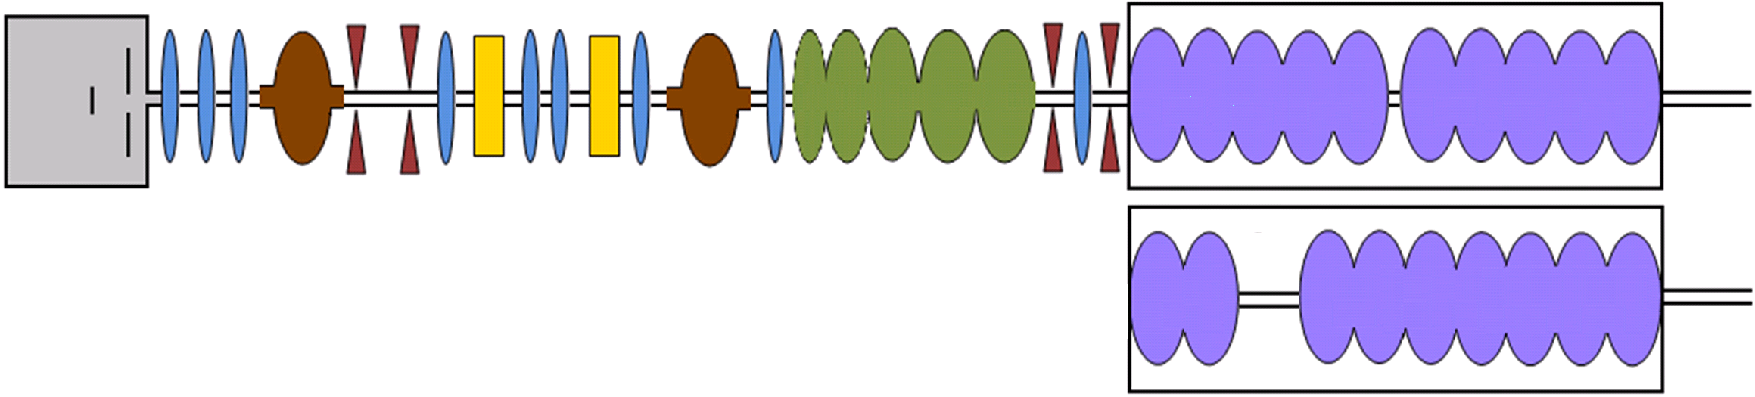
  200 kV gun and new (2-7) quarter injector
Prebuncher Cavity
Choppers
SC Booster Cavity
DC Gun
Solenoids
Apertures
Buncher
Cavity
NA-PAC2011 WEP288
IPAC2012 TUPPR055
INJECTOR LAYOUT
Particle distribution at cathode Gaussian distributions for t, x, y, p_{x}, and p_{y}:
  100 uA 1000 macroparticles
  Beam size 0.213 mm
  Laser pulse length 21.3 ps
  Transverse emittance 0.061 mm mrad
Cavity | Center distance from cathode (m)
Buncher | 8.875078
2-cell | 12.2337
7-cell | 13.0643
0L03-1 (omitted) | ~29.25 m
1D profiles for DC gun, RF elements, and solenoids

Slide 4
3D Mesh Space Charge

Slide 5
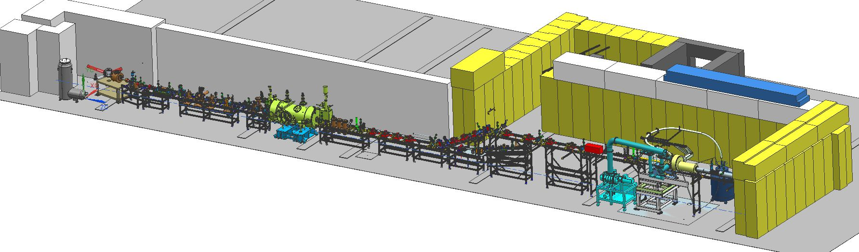
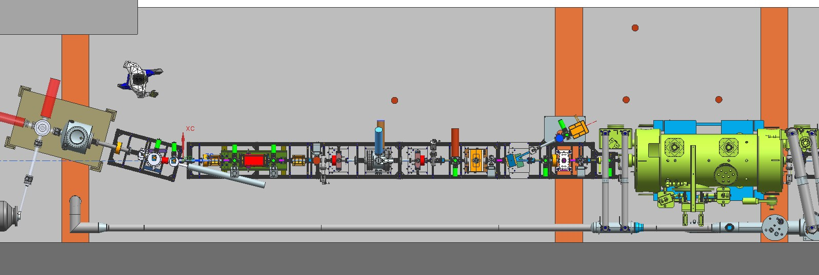
Upgraded Injector Test Facility - UITF
TEST HDIce
TEST NEW PHOTOGUNS
TEST 200 kV WIEN FILTER
COMMISSION NEW QUARTER CRYOMODULE
5

Slide 6
UITF 1 nA front end optimization
1 x 10
-3
-4
A
9 x 10
8 x 10
-4
7 x 10
-4
6 x 10
-4
k
-4
E
5 x 10
/
k
E
σ
-4
4 x 10
B
3 x 10
-4
C
2 x 10
-4
0
0.2
0.4
0.6
0.8
1
1.2
1.4
σ
(ps)
t

Slide 7
Phases relative to crest for 1 nA optimization
Vertical color-coded lines for A, B, and C example cases
CB A
)
s
20
e
e
r
0º crest
+
X*
g
0
Buncher
e
d
(
2-cell
t
-20
s
e
7-cell
r
c
-40
o
t
e
-60
v
i
t
a
l
e
-80
r
t
-90º zero-crossing
e
s
-100
f
f
o
e
-120
s
a
h
p
-140
0
5
10
15
20
25
30
35
40
45
simulation run id

Slide 8
Basic Beam Tests and Setup:
Drift through with both 2 and 7 cells off, checking basic beamline.
Set the phase and amplitude for 2-cell and 7-cell independently.
Check concerns such as alignments, possible tilt effects of cavities,etc.
Check bunchlength, delta E, beam size, …
Try different solutions from GPT simulations

Slide 9
Exploring the limits and Capabilities
Find minimum and maximum beam energy possible.
Stability: RF stability, Beam energy stability, bunchlength stability, …
Off-axis behavior,
Robustness with respect phase, amplitude, beam position, beam focusing, …
Current and space charge effects.
Try different gun voltages.
4K operation.

