Slide 1
GPT Simulations for Jay’s Solenoids
Alicia Hofler, Jay Benesch, Reza Kazimi, and Joe Grames

Slide 2
Outline
Jay’s solenoid models vs. beam measurements
Single solenoid behavior comparison
Solenoid behavior in chopper system
Conclusion

Slide 3
Fopt: Poisson vs. Opera3d Models of Installed Solenoids: FD, FA, FG, FL

Slide 4
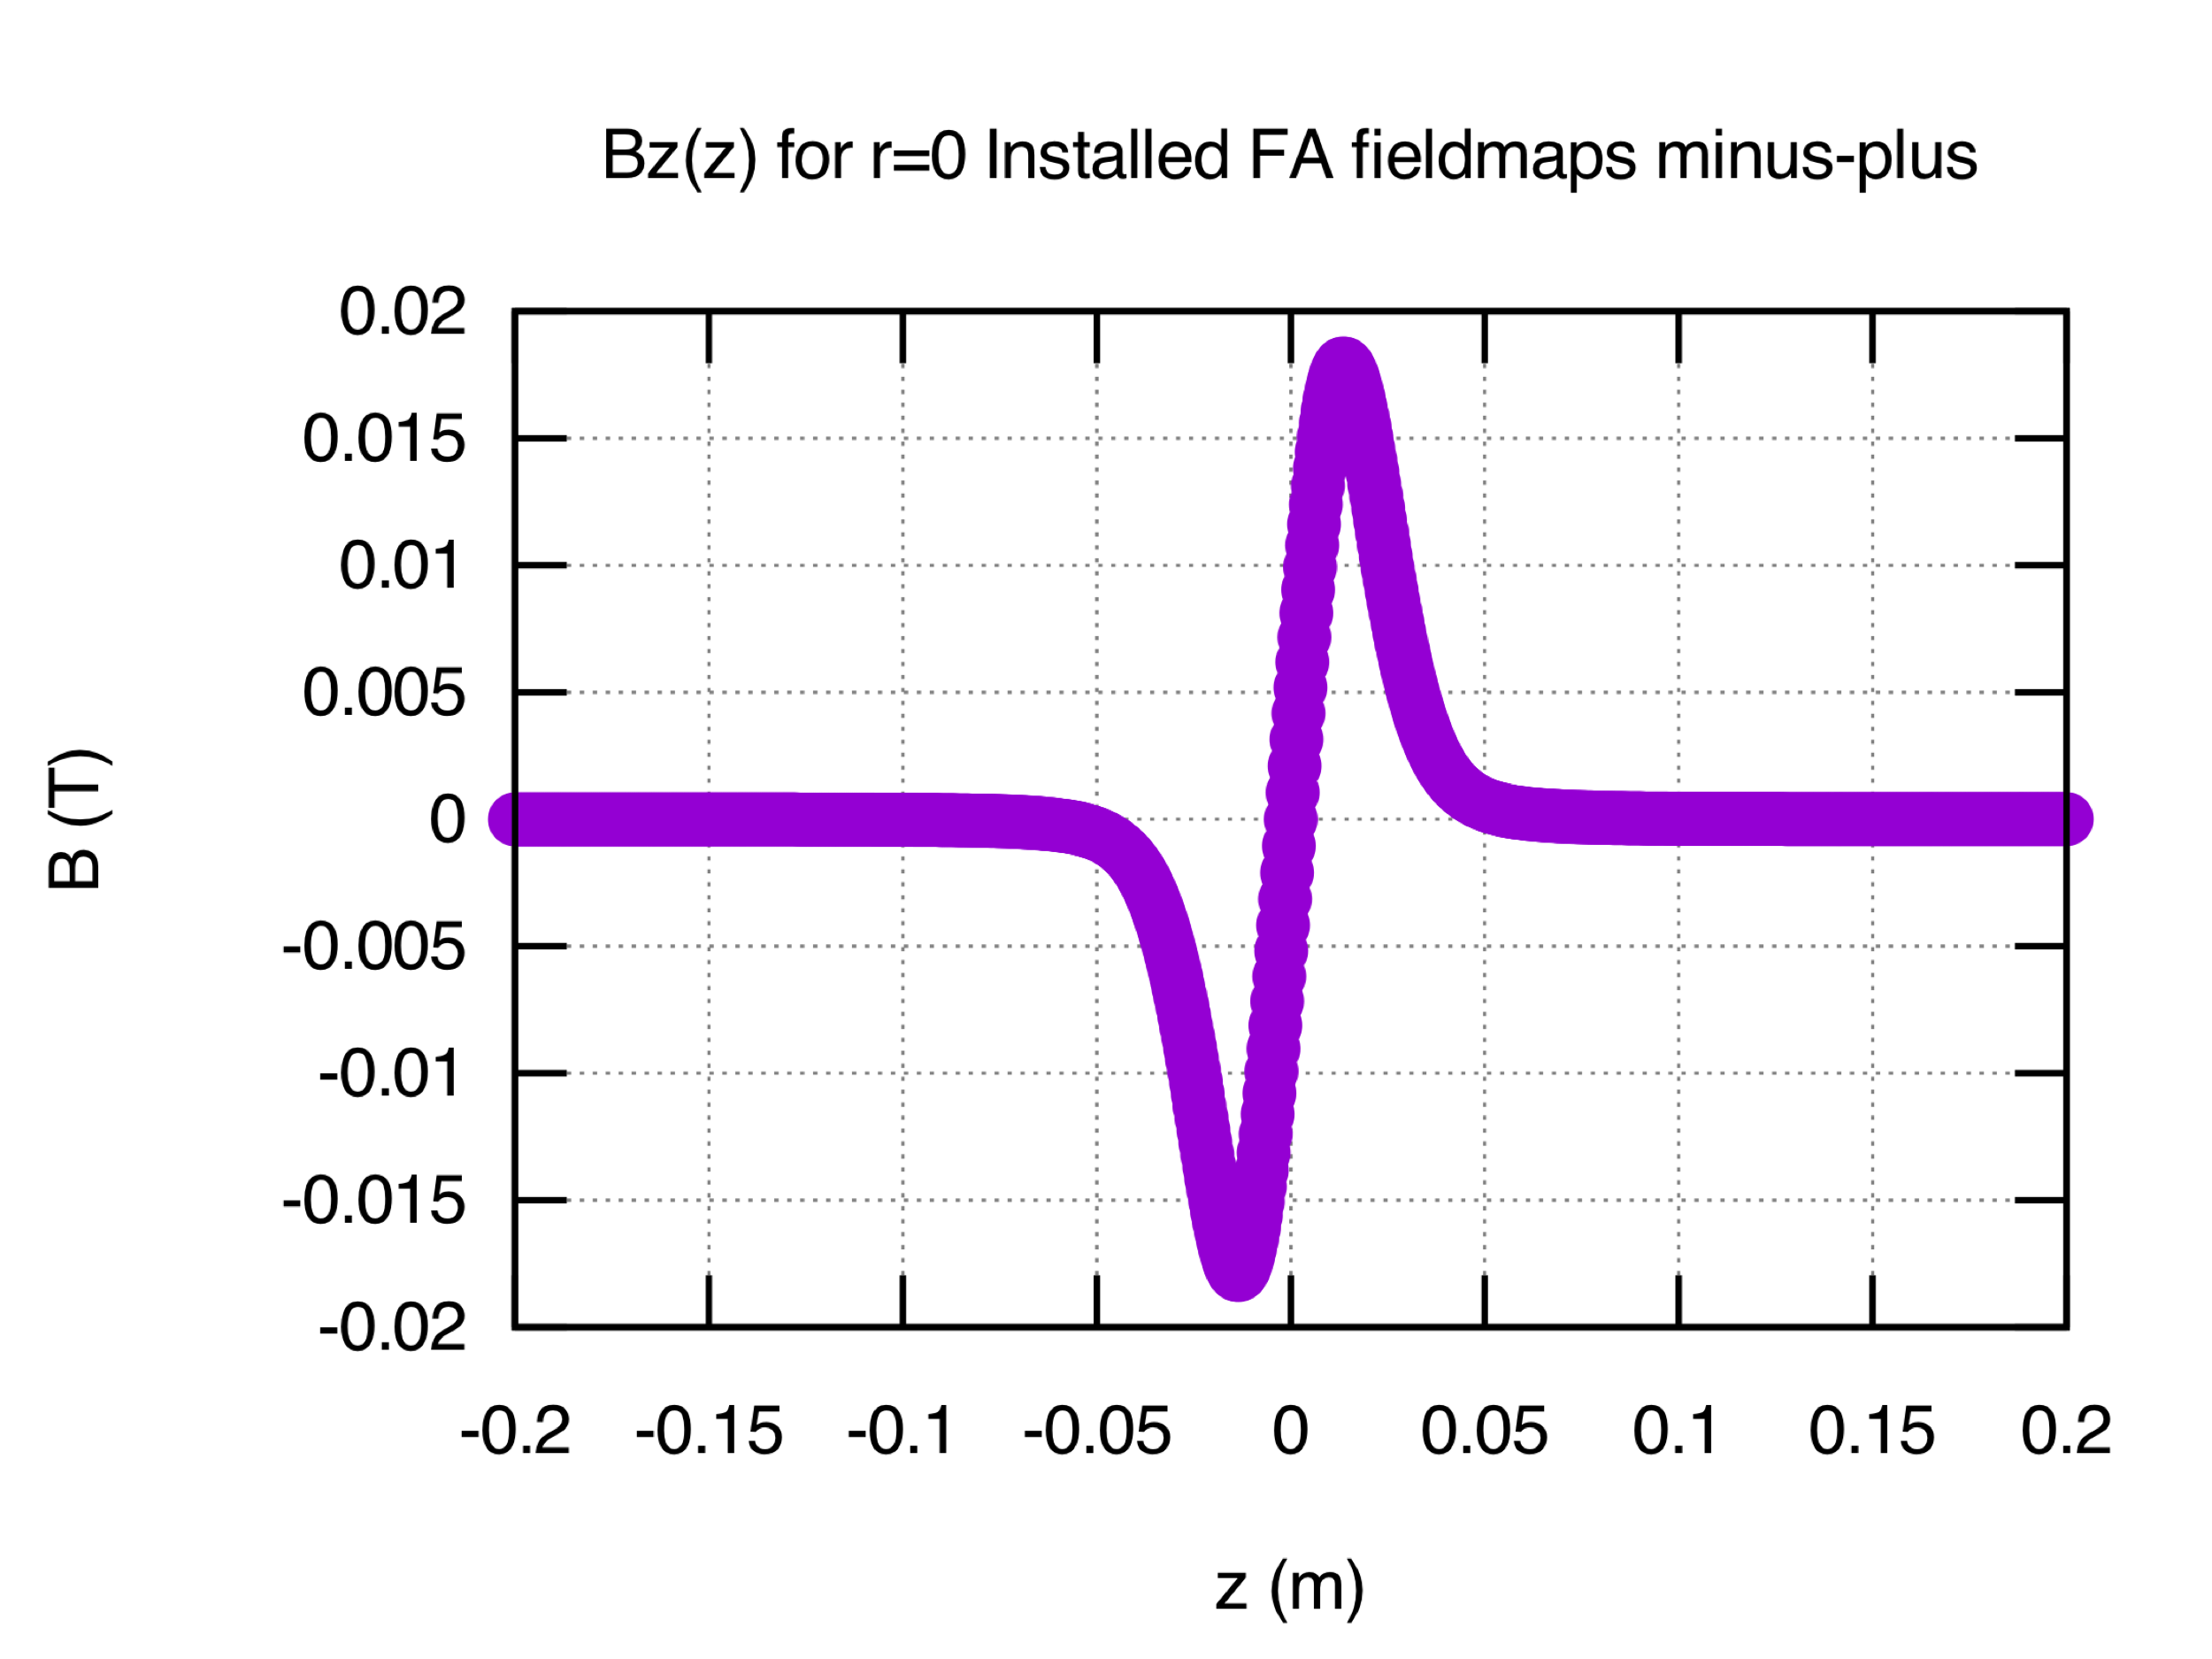
Jay’s New Design as FD and FA: Stand Alone Assessment

Slide 5
FD: Behavior at 15 mm

Slide 6
FD: Behavior at 15 mm

Slide 7
FA: Behavior Near Solenoid Center

Slide 8
FA: Behavior Near Solenoid Center

Slide 9
FD and FA: Residual Horizontal Displacement

Slide 10
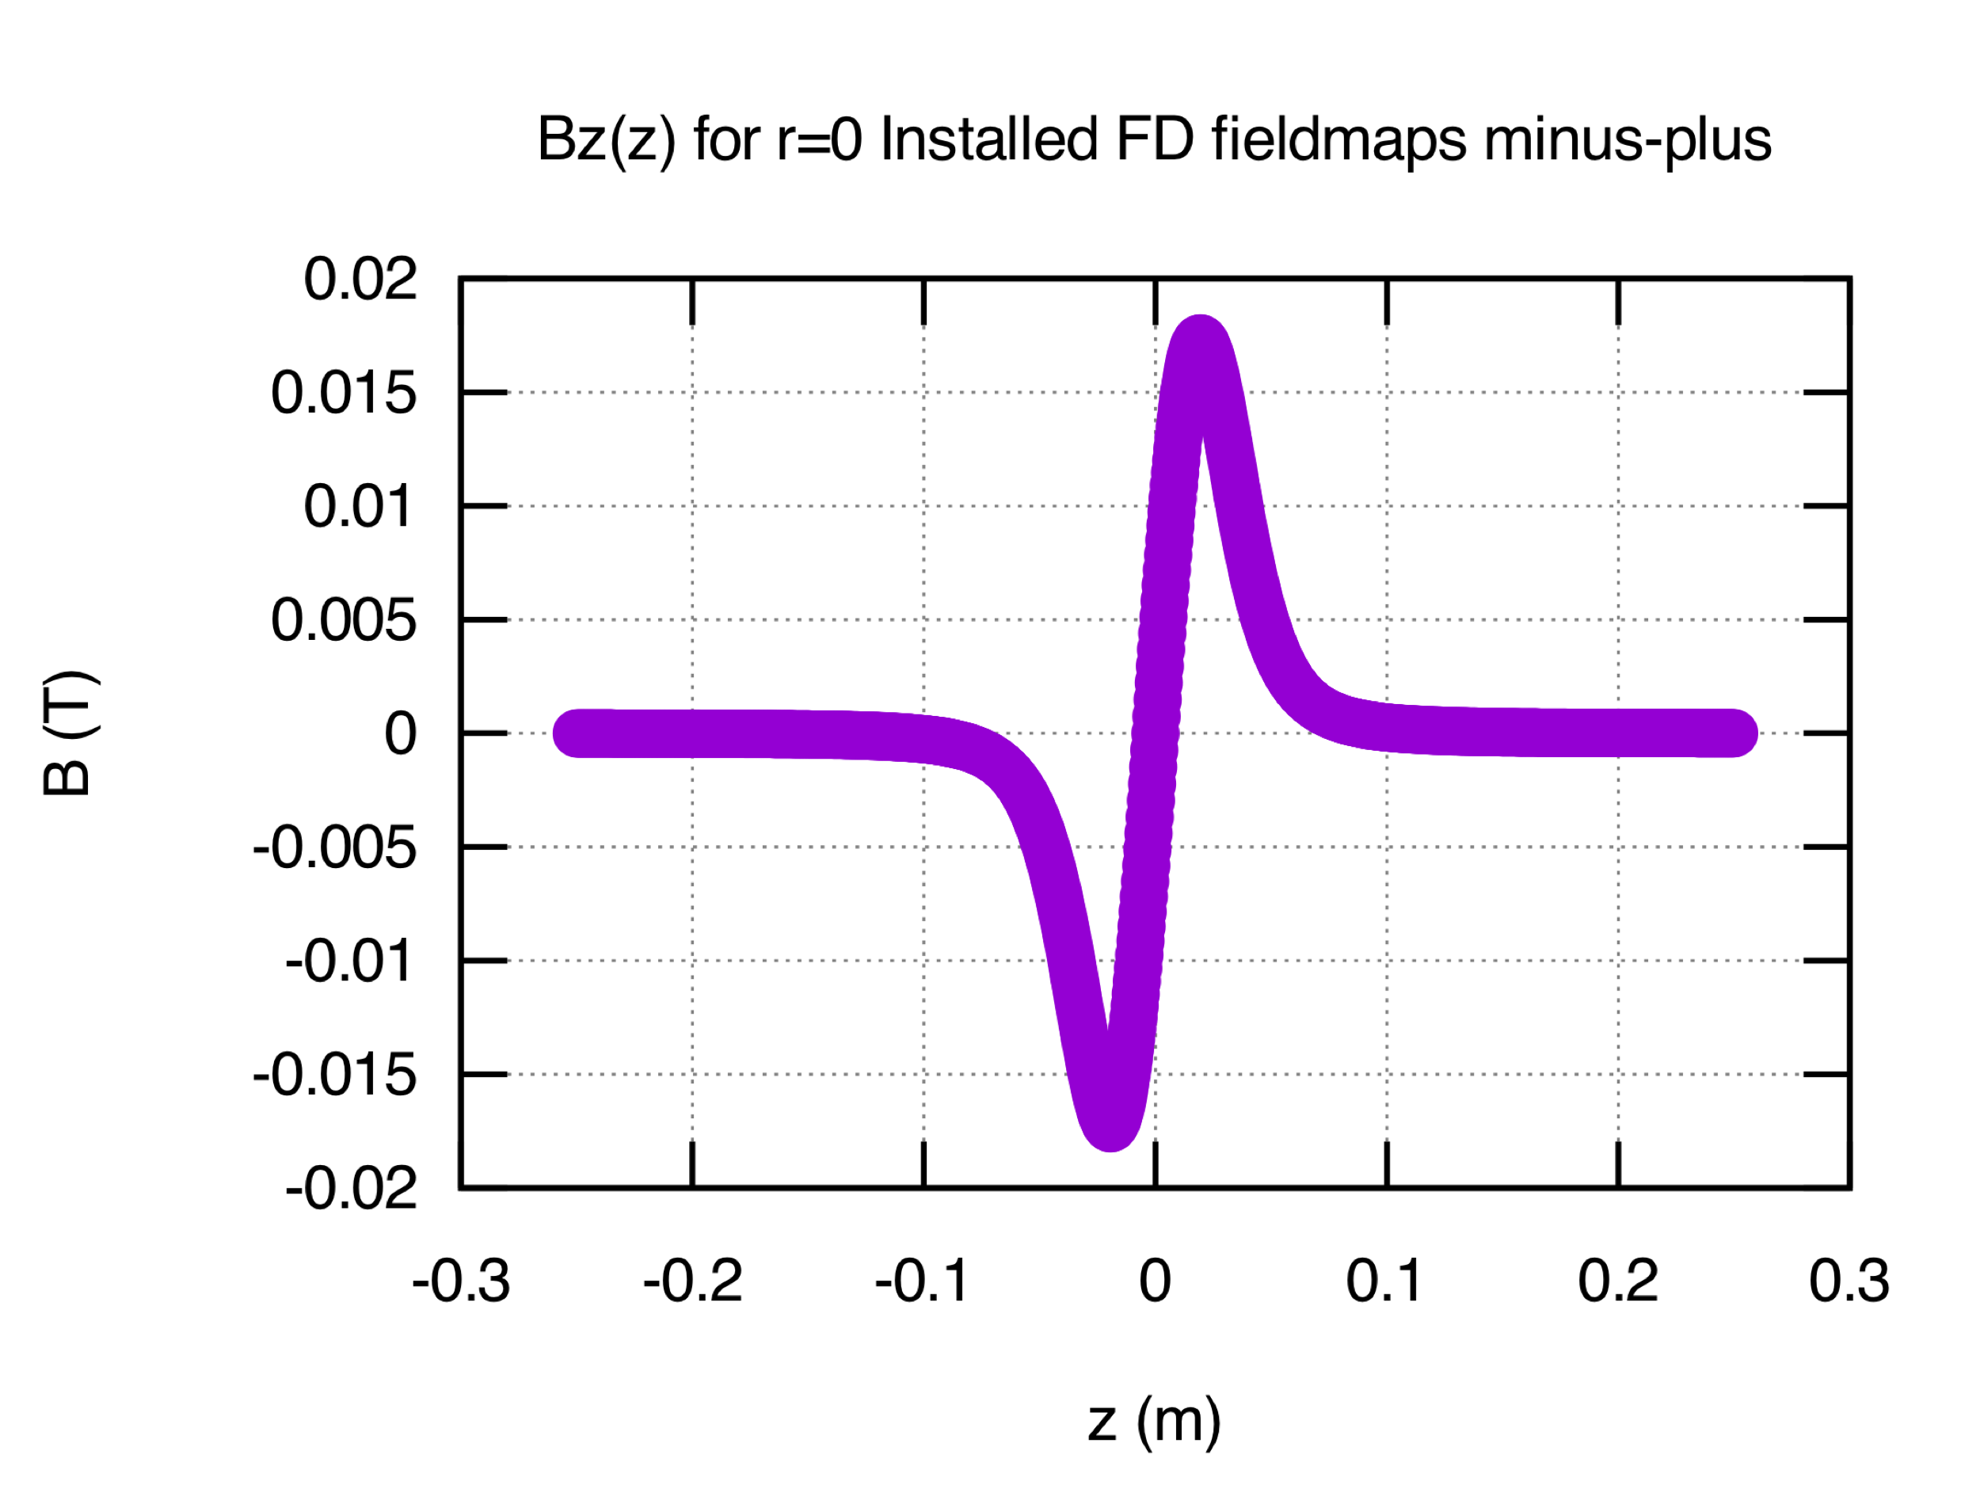
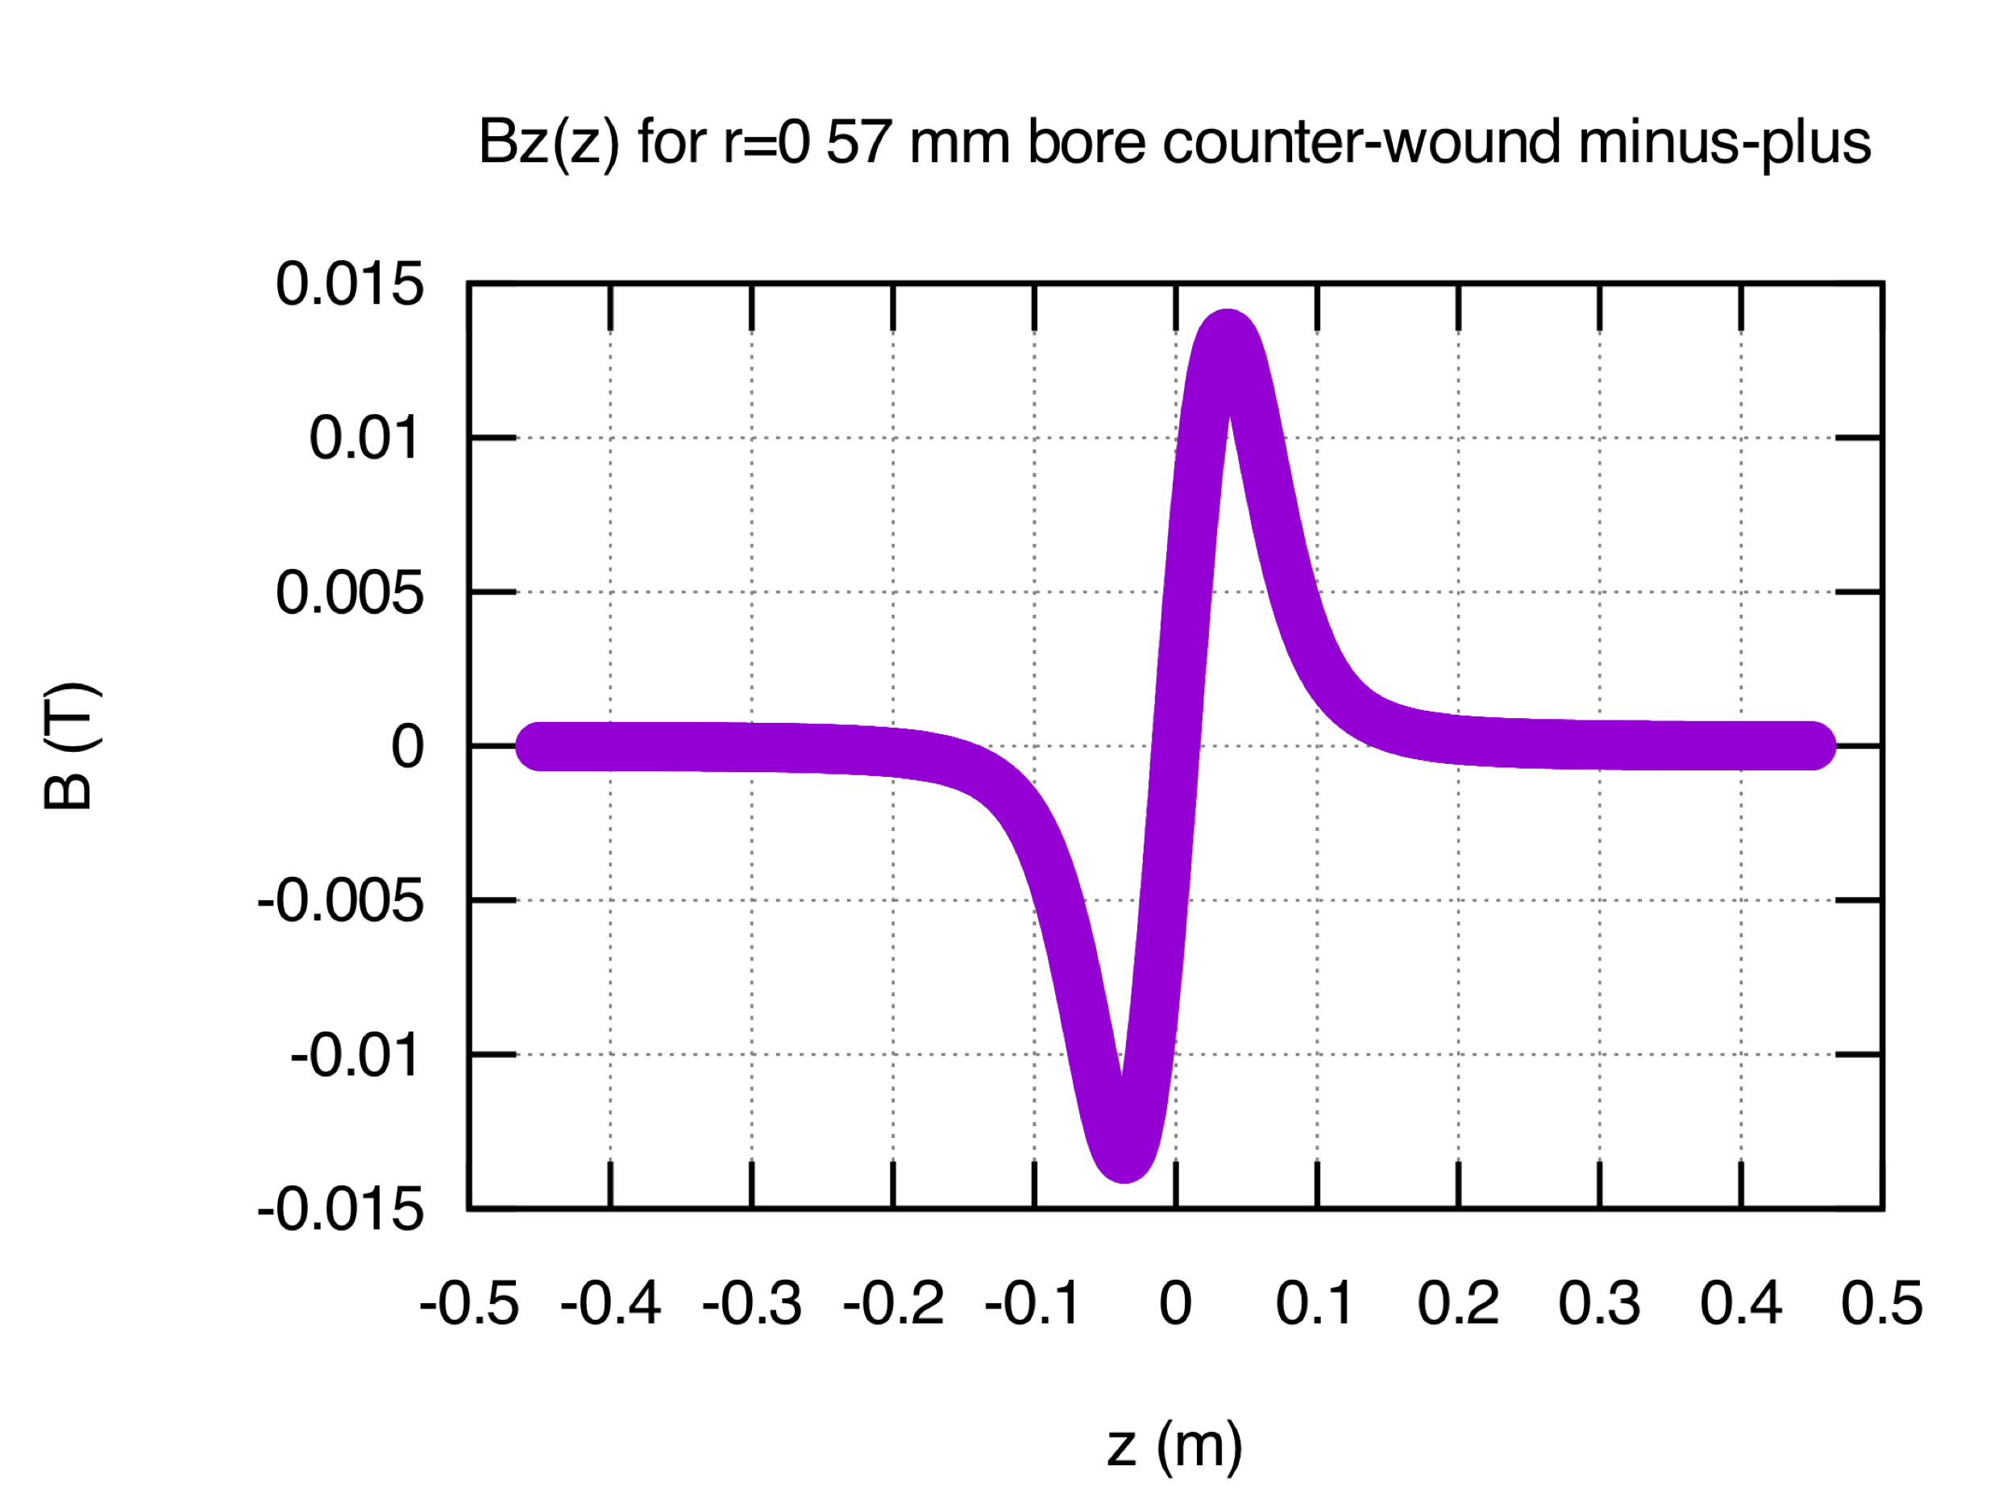
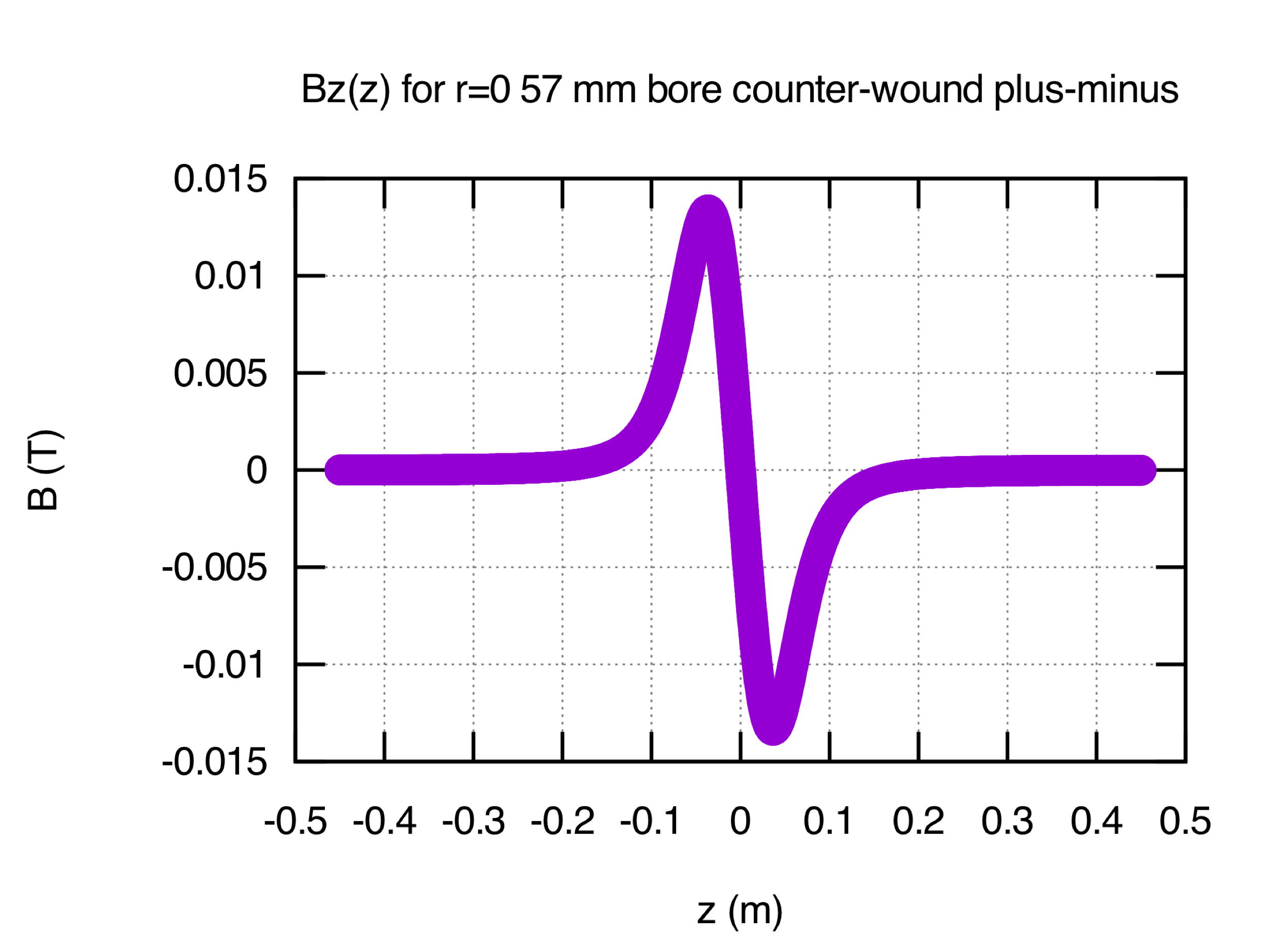
Jay’s New Design as an FD in Chopper System
Installed FD field sense (a.k.a. mpmp)
FD1: -Bz +Bz
FD2: -Bz +Bz
Compare new design
Following installed FDs
Alternate FD2: +Bz –Bz (a.k.a. mppm)

Slide 11
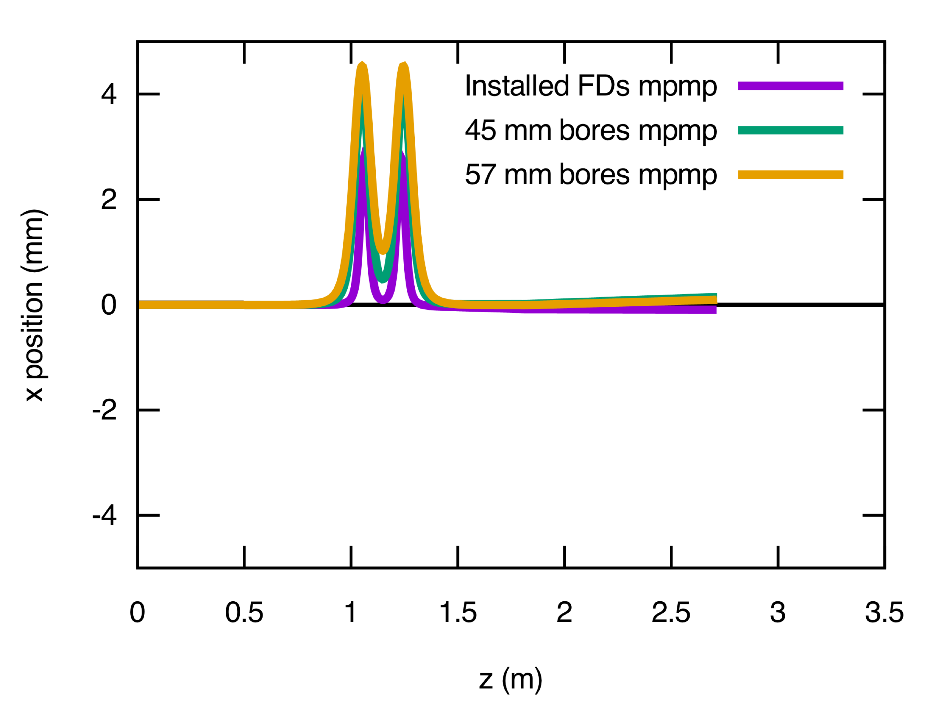
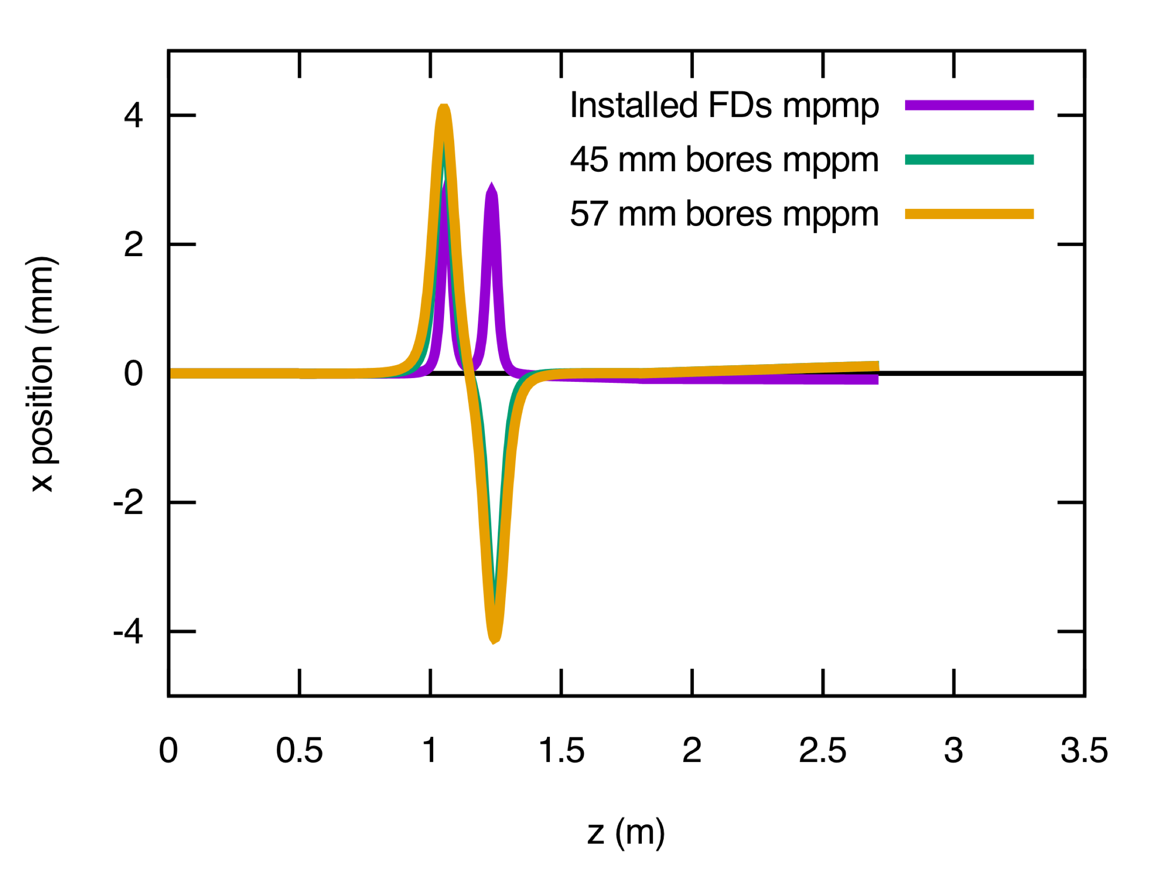
FD Relative Field Orientations: Optimal RF and Solenoids

Slide 12
Chopper 1 and 2 X/Y ON Optimal RF and Solenoids – Master Slit

Slide 13
Chopper 1 and 2 X/Y ON Lower RF Amplitude – Master Slit

Slide 14
Chopper 1 and 2 X/Y ON Higher RF Amplitude – Master Slit

Slide 15
Chopper 1 and 2 X/Y ON Optimal RF and Solenoids – Downstream CH2

Slide 16
Chopper 1 and 2 X/Y ON Lower RF Amplitude – Downstream CH2

Slide 17
Chopper 1 and 2 X/Y ON Higher RF Amplitude – Downstream CH2

Slide 18
Chopper 1 and 2 Y ON Optimal RF and Solenoids – Master Slit

Slide 19
Chopper 1 and 2 Y ON Lower RF Amplitude – Master Slit

Slide 20
Chopper 1 and 2 Y ON Higher RF Amplitude – Master Slit

Slide 21
Conclusion
Jay’s new design is a viable replacement for all injector solenoids
The change from mpmp to mppm for the two choper solenoids is necessitated by the longer Bz field inherent in flatter focusing vs. radius and the z displacement of hall slits.
Sign can be flipped on second FD for a feasibility check with beam in present injector
not a full test since FD was designed to have no Bz a cm beyond the magnet.
An alternative which would eliminate this risk (and lower RF drive on chopper cavities for 200 kV or 275 kV KE beam) would be to increase the chopper cavities separation by perhaps 50 cm, allowing the FD replacements to be moved 10 cm farther from the slits and each other.

