Slide 1
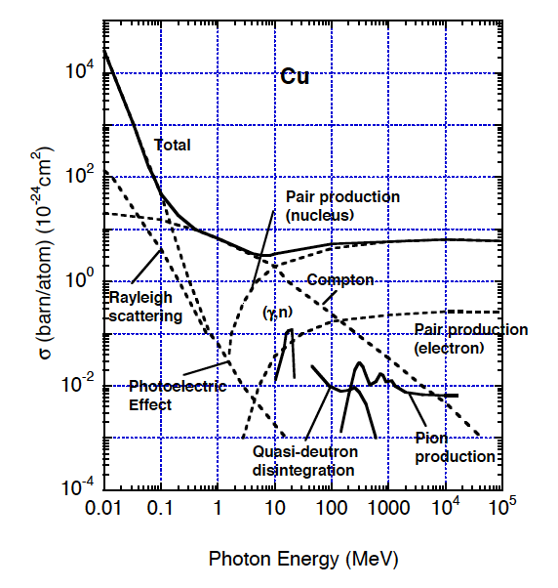
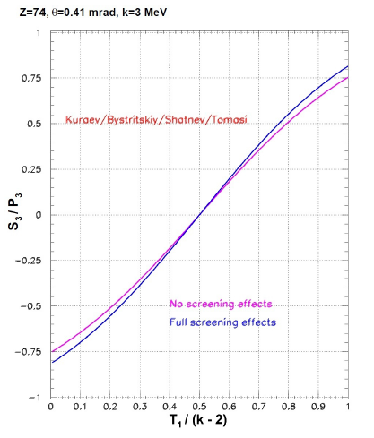
Polarized Pair Creation
JLab
σ ~ Z²
θ ~ mc²/E_{γ}

Slide 2
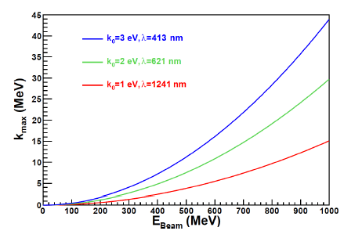
How to create the polarized gamma-rays ?
Polarized undulator (ILC): E_{th} = 17 GeV
Polarized Compton Backscattering :
Laser provides Polarization & Intensity
Electrons provide Energy & Intensity
Polarized Bremsstrahlung :
Electrons provide Polarization & Energy & Intensity

Slide 3
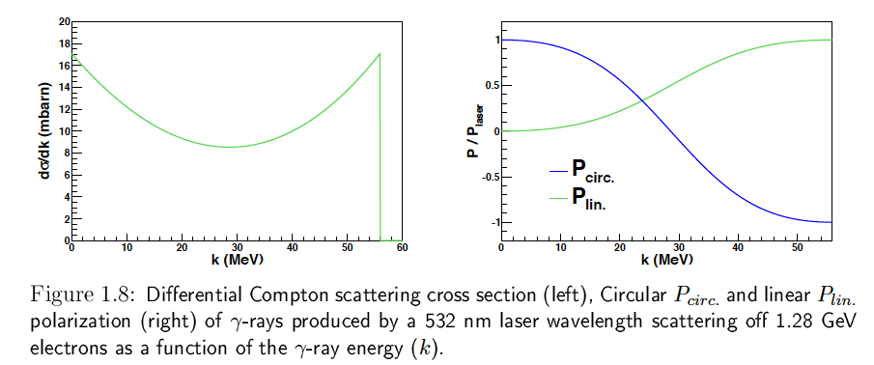
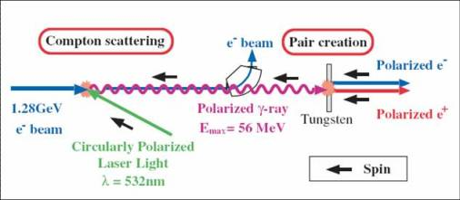
Polarized Compton Backscattering
T. Hirose et al., Nucl. Inst. Meth. A 455 (2000) 15.

Slide 4
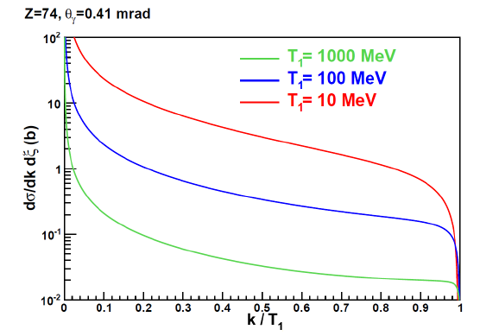
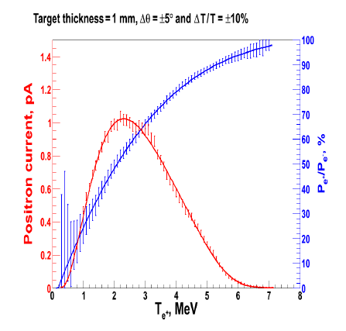
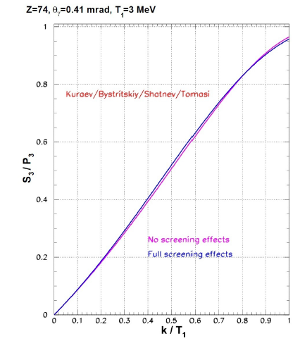
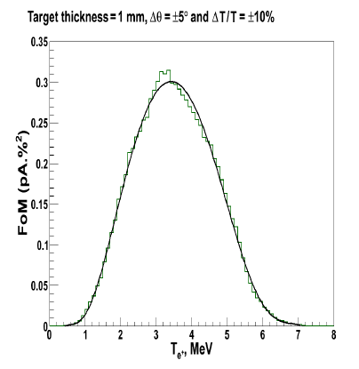
Polarized Bremsstrahlung

Slide 5
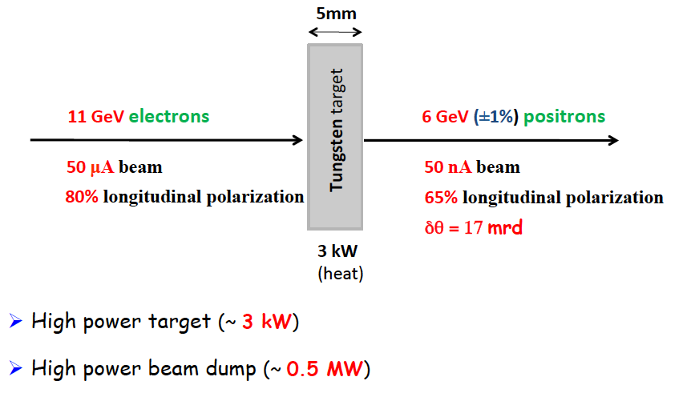
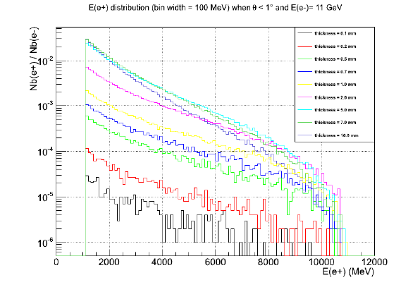
Exploring PEPPo for Hall B

Slide 6
Rolf says physics requirements for positron beam are:
Luminosity > 10³³ cm⁻²s⁻¹
Positron Polarization > 40%
injector pulse train up polarization from gun
injector pulse train down polarization from gun
22.7 MHz bunch train, 3.23µs,
73 bunches (I_{pulse} = 50 μA)
22.7 MHz bunch train, 3.23µs,
73 bunches (I_{pulse} = 50 μA)
~ 2.2 pC bunch
44 ns
……
……
τ_{d}=20ms
τ_{d}=20ms
25 Hz, 40 ms, I_{ave}=8.1 nA
Positron
Polarization | % | > 40
Pulse current I_{pulse} | μA | 50
Bunch charge | pC | 2.2
Bunch rep. rate in pulses | MHz | 22.7
Bunch spacing in pulses | ns | 44
Pulse rep. rate | Hz | 25
Average current I_{ave} | nA | 8.1

Slide 7
Case Estimates Using Bremsstrahlung
Parameter | Unit | Dumas | Golge | Mazouz
Electron Energy | MeV | 8.000000 | 123.000000 | 11000.000000
Target | Z | 74.000000 | 74.000000 | 74.000000
Thickness | mm | 1.000000 | 1.000000 | 5.000000
dP/P | % | 10.000000 | 2.000000 | 1.000000
Δθ | deg | 10.000000 | 10.000000 | 1.000000
N(e+)/N(e-) | # | 0.000003 | 0.000300 | 0.001000
<E> | MeV | 4.000000 | 15.000000 | 6000.000000
<P> | % | 65.000000 | 0.000000 | 65.000000
e+ bunch charge | pC | 2.200000 | 2.200000 | 2.200000 |  | JLEIC
e+ rep rate | MHz | 22.700000 | 22.700000 | 22.700000
e- rep rate | MHz | 22.700000 | 22.700000 | 22.700000
e- bunch charge | nC | 733.333333 | 7.333333 | 2.200000
e- current | Amp | 16.646667 | 0.166467 | 0.049940
e+ bunch charge | pC | 0.000100 | 0.000100 | 0.000100 |  | CEBAF
e+ rep rate | MHz | 499.000000 | 499.000000 | 499.000000
e- rep rate | MHz | 499.000000 | 499.000000 | 499.000000
e- bunch charge | nC | 0.033333 | 0.000333 | 0.000100
e- current | Amp | 0.016633 | 0.000166 | 0.000050

Slide 8
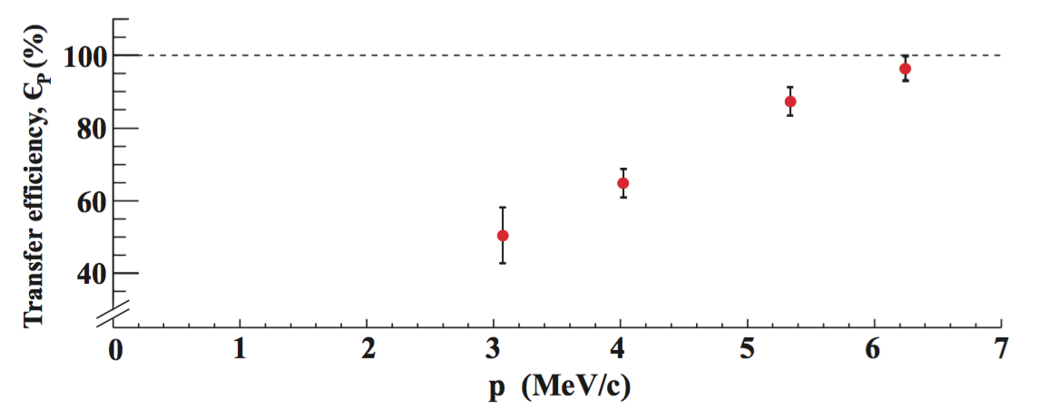
10 MeV Test @ UITF (100uA) or LERF (1mA) ?
PEPPo : demonstrated polarization transfer
(submitted PRL 3/2016)
PEPPo-II : demonstrate cw e+ beam and characterize (ε, δp/p, p, δt/t, Y, P) for RF acceleration
#5: cw beam diagnostics
#2 : Beam Power Converter
#1 UITF:
10 MeV, 1-100 uA
Polarized
#3 Radiator:
W foils
Niowave LBE
#4 Collector:
PT Solenoid
AMD
A
ε
Y, P, δt/t
Q
RF
Y, P
A
δp/p, p

