Slide 1
Highly spin polarized electron and positron beams at a compact accelerator facility
Overview
Big Science vs. Compact Facilities
Polarized electron beams
Jefferson Lab’s UITF
Polarized positron beams
Joe Grames, Jefferson Lab
This work was authored by Jefferson Science Associates 1498 under U.S. Department of Energy Contract No. DE-AC05- 1499 84ER40150.

Slide 2
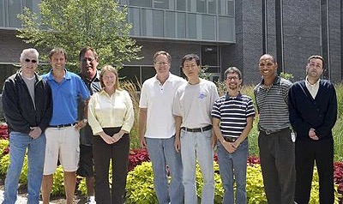
Center for Injectors and Sources
Building reliable dc-high voltage photo-guns that provide high current electron beams and high spin polarization
Nuclear Spin Physics
Parity Violation Experiments
Partnerships with EIC & HEP
Polarized Positrons
P. Adderley, D. Bullard, C. Hernandez-Garcia, M. Mamun, M. Poelker, M. Stutzman, R. Suleiman, S. Windham, S. Zhang
PhD Students: S. Habet, G. Palacios-Serrano, M. Stefani,
S. Wijethunga, J. Yoskowitz

Slide 3
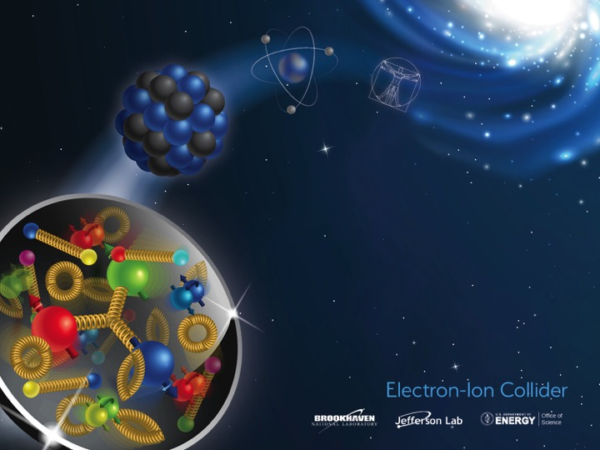
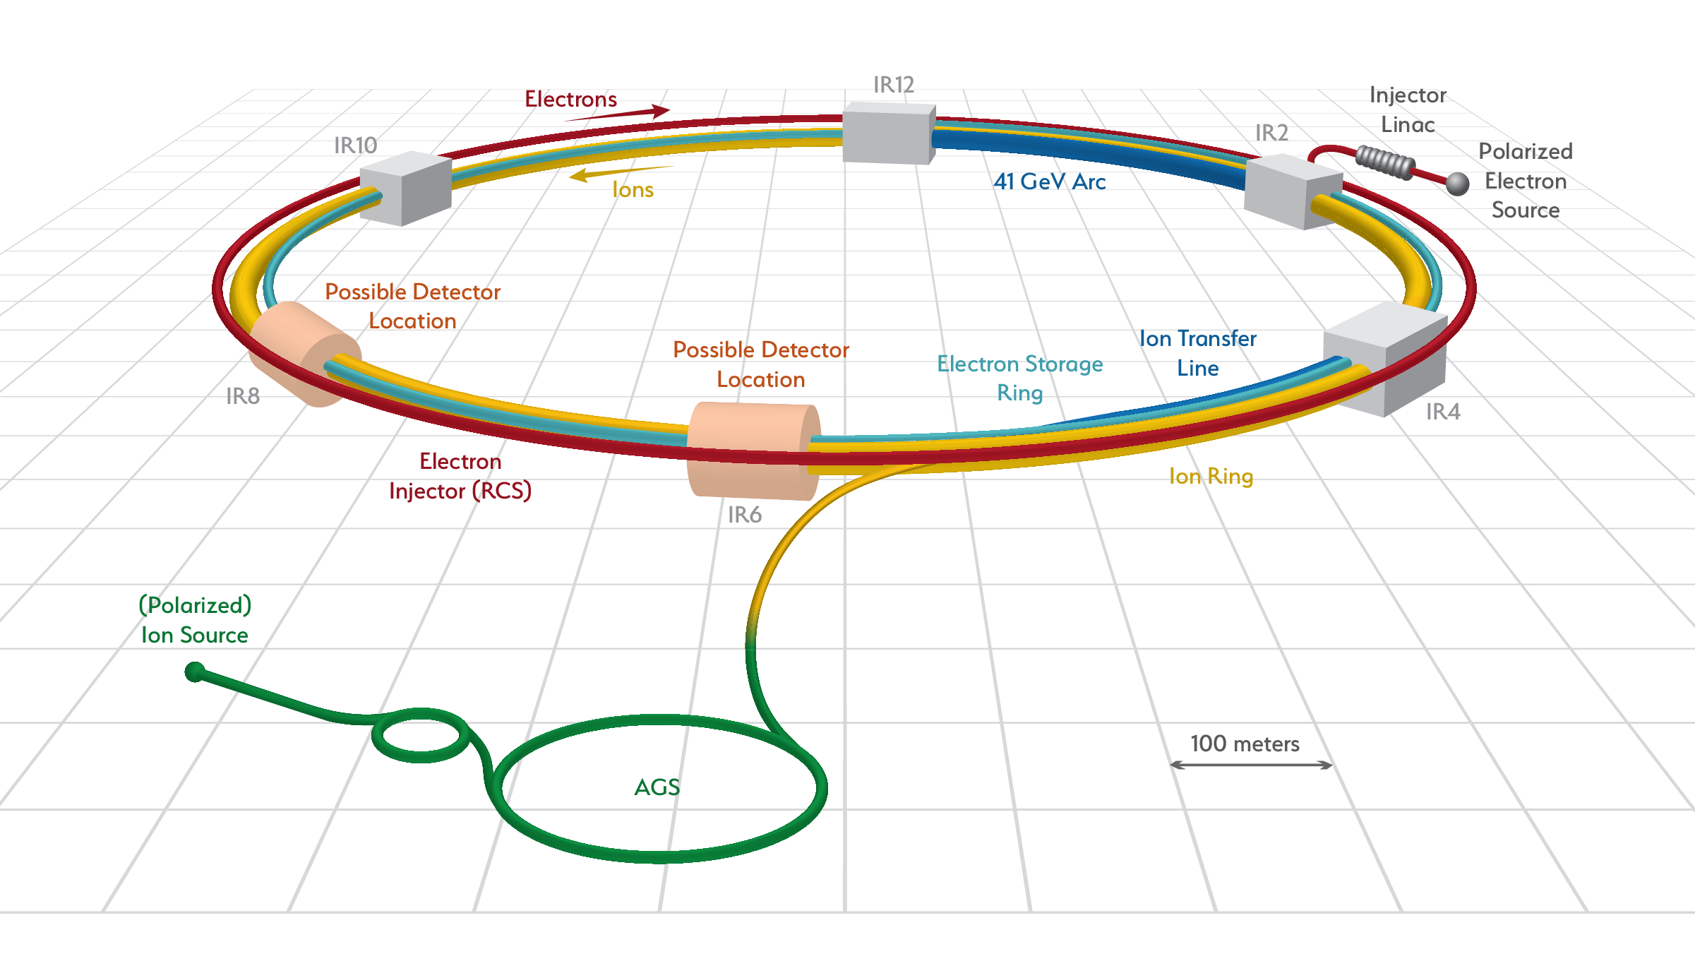
Big Science : Electron Ion Collider accelerator facility
Polarized electron beams (>80%) with very high bunch charge (10-28 nC) from a 350 kV dc-high voltage photogun accelerated to 5-18 GeV .

Slide 4
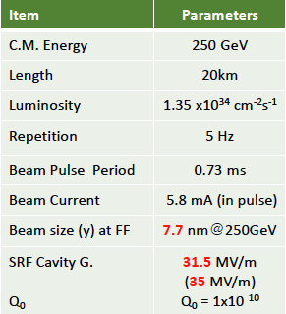
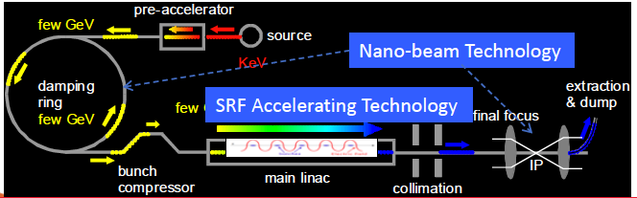
Big Science : ILC 250 accelerator facility
ILC requires polarized electron (90%) and polarized positron (30%) beams with very high peak currents accelerated to 250 GeV.
e- Main Linac
e+ Source
e- Source
Damping Ring
e+ Main Linac
8,000 SRF cavities will be used.

Slide 5


Big Science : CEBAF 12 GeV accelerator facility
Polarized Electron Source
Max Energy: 12 GeV – (2) 1.5 GHz SRF linacs
2.1K Helium: Two 4500 Watt cryo-plants
Max Power: 1 Megawatt – 170 μA
Multiplicity: 4 Halls Simultaneously
Repetition Rate: 499 and 249.5 MHz beams
Electron Polarization: 90% from GaAs/GaAsP
Over 1500 Users from 230 Institutions, 30 Countries & 1/3rd of U.S. Ph.D’s in NP

Slide 6


So can compact accelerator facilities have this too?
Yes!
….but, need to have expertise in these areas
  Drive lasers
  Photocathodes
  High voltage
  Excellent vacuum

Slide 7
Polarized electron beams for any sized accelerator
Accelerators require
small beam emittance (“laser like” properties)
rf-structured electron bunches for rapid acceleration
reliable technologies (materials, lasers, high voltage, vacuum)
Users require
high spin polarization with sufficient and sustainable beam current
rapid and fast electron beam helicity reversal
reliability and reproducibility
Sokolov-Ternov Effect
Electron Scattering (Mott)
Photo-ionization: Fano Effect
Photo-ionization of alkali atoms
Optically Pumped He Discharge
Field Emission from EuS
Photoemission from GaAs
1970’s landscape was a hotbed of activity … GaAs photo-guns “saved the day” and still does!

Slide 8
Optically pumping spin states in GaAs
E
E
J
S_{1/2}
-1/2
+1/2
S_{1/2}
σ+
σ-
E_{gap}=1.42 eV
3
1
1
3
P_{3/2}
E_{F}
P_{3/2}
Δ=0.34 eV
-3/2
-1/2
+1/2
+3/2
P_{1/2}
-1/2
+1/2
P_{1/2}
k
σ+: Right circularly polarized light
σ- : Left circularly polarized light
m_{j}
Laser excitation from P_{3/2} to S_{1/2} : E_{gap} < E_{γ} < E_{gap}+Δ
Electron Polarization:
Reverse electron polarization by reversing light polarization

Slide 9
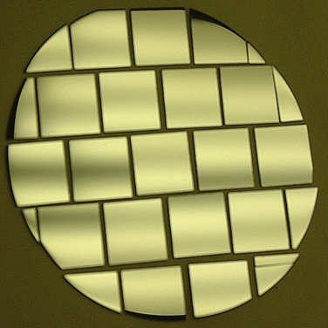
Negative Electron Affinity
Bare GaAs surface
Large Work Function
Positive Electron Affinity (PEA)
NEA Surface Activation
Dipole layers of
Cesium + NF₃
Reduce Work Function
Negative Electron Affinity (NEA)

Slide 10
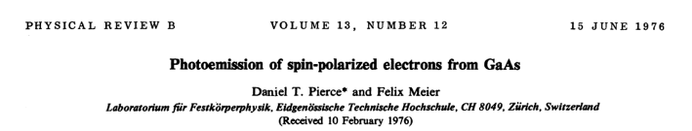
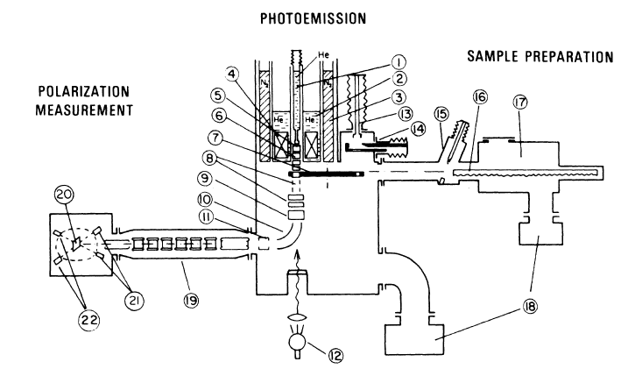
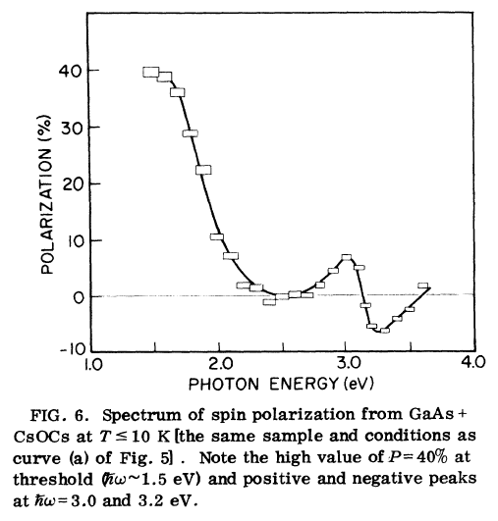
The first polarized electron source based on GaAs
NIR

Slide 11
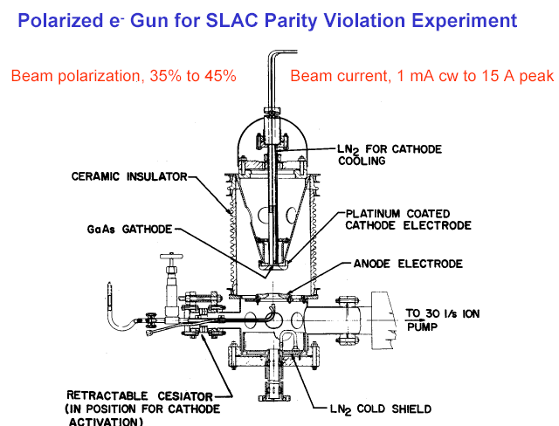
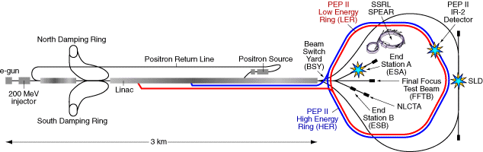
The first GaAs photo-injector
Built for SLAC parity-violation experiment E122
Dec 1977 – Polarized electrons accelerated
June 1978 – E122 announces parity violation an important verification of the Standard Model
Beam polarization, 35% to 45%
Beam current, 1uA to 15 A peak

Slide 12
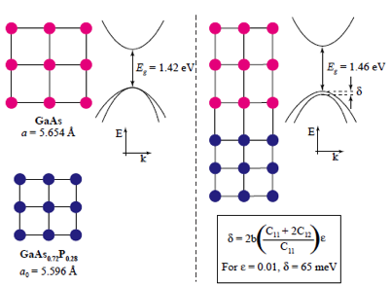
Electron beam polarization at CEBAF from GaAs (1997 – 2020)
Strained GaAs (breaks 50% barrier)
Strained Superlattice GaAs (high QE + P)
Pablo Saez, PhD Thesis, SLAC Report 501, 1997
Aaron Moy, SVT Assoc and SLAC, PESP 2002
GaAs

Slide 13
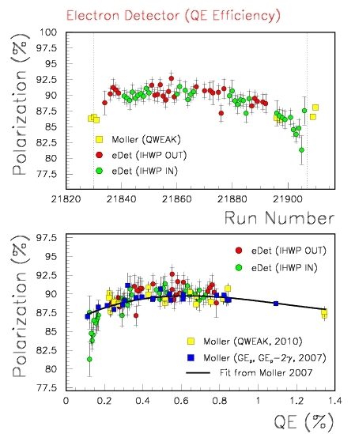
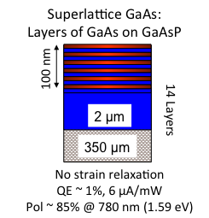
User program requires reliable and routine performance
Polarized beam to 4 Users simultaneously means providing average current > 200 μA
Delivering 20C/day for weeks without invasive interruption means achieving 1/e charge lifetimes that are > 200 C
Parity violation experiments benefit from a polarized source that remains constant over long periods of time.

Slide 14
Parity Violation experiments motivated polarized source improvements
25 years
2020

Slide 15
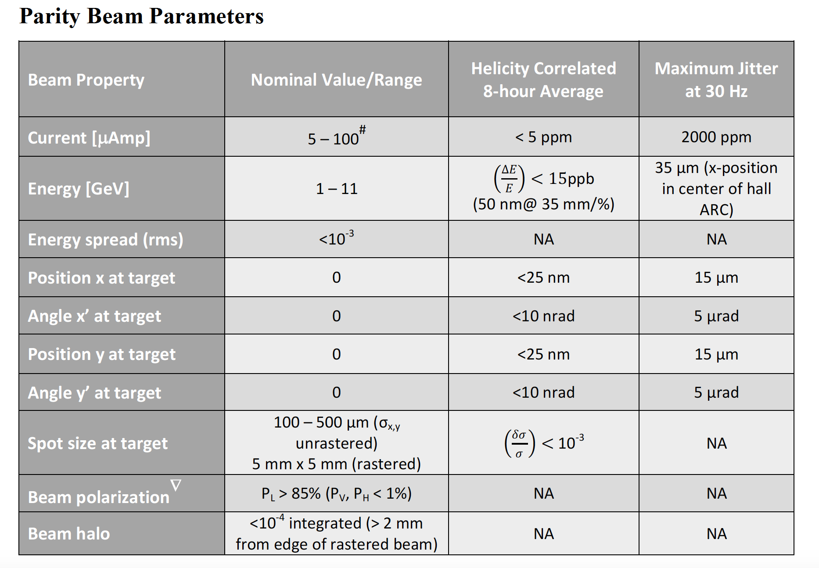
Helicity correlated beam control
The exact same beam helicity controls are available at the compact accelerator:
Fast kHz Reversal – laser polarization, intensity, position and size
Slow Reversal – laser polarization and 4π control of the electron polarization

Slide 16

Compact facilities have equal access to these developments
Technologies are developed and reliable (of course we still like to “push the limits”!)
”Load-Lock” vacuum system isolates and optimize functionality (load, activate, beam)
Best vacuum inside HV Chamber, which is never vented except to change electrodes
Inverted insulator ceramic and commercial high voltage cables improves reliability
Activation Laser
Load Photocathodes
Create “NEA” condition depositing monolayer of alkali + oxidant atoms
Apply HV using commercial power supply, cables and insulators.
Store extra
photocathodes

Slide 17
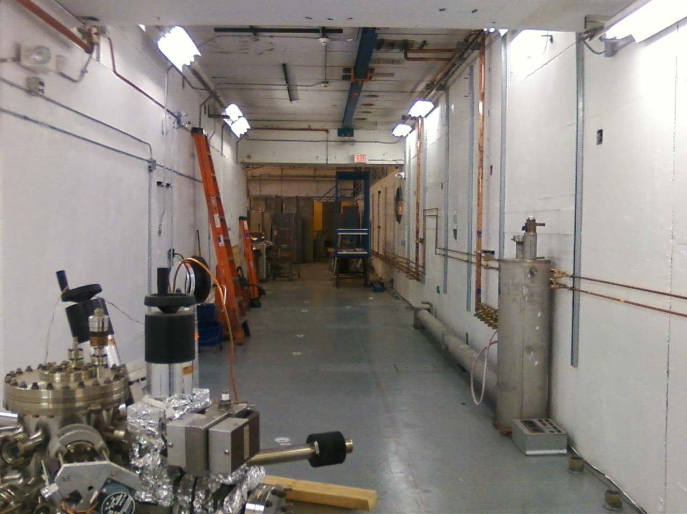
Upgraded Injector Test Facility
5 years ago our compact spin polarized 10 MeV photoinjector…
…began with a vision, a gun test cave, and a polarized electron source.
Photo taken September 24, 2015

Slide 18
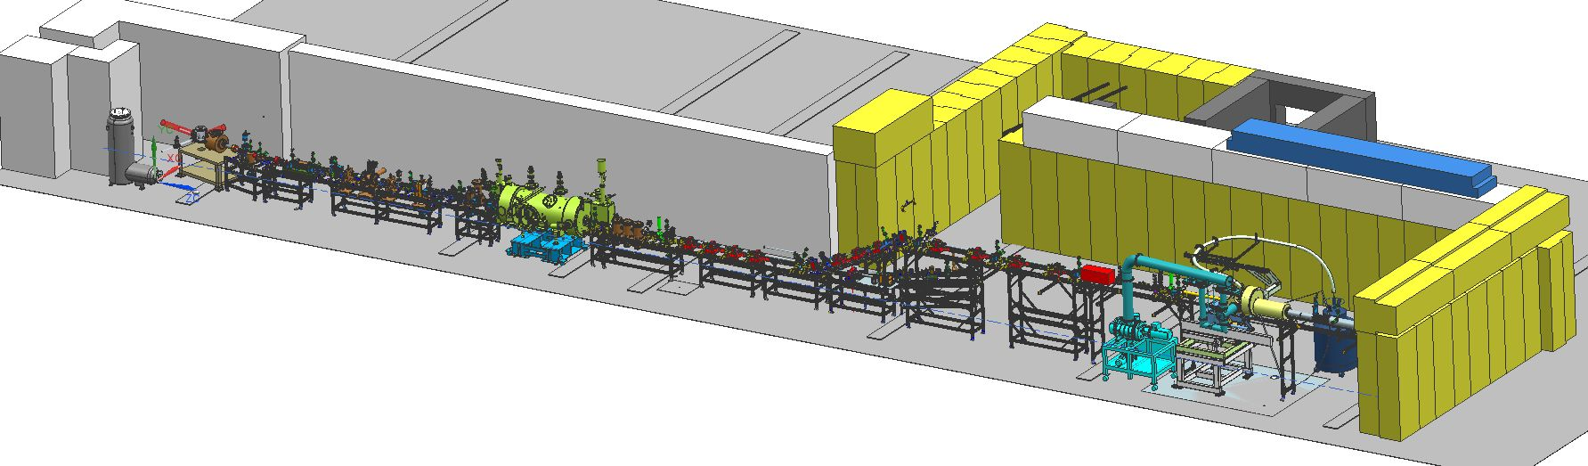
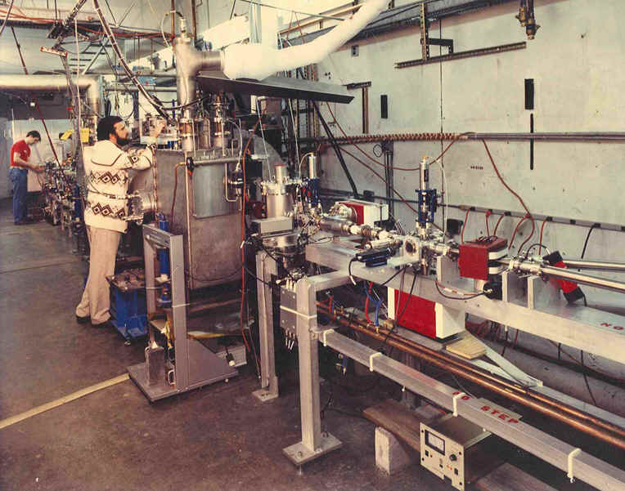
UITF = Re-inventing an old NASA test cave
Cave1 (old)
Cave2 (new)
keV
MeV
“Cave1” has a long history, starting with NASA cyclotron, then used to demonstrate the CEBAF thermionic injector in early 1990s, and later to commission our “inverted-insulator” DC high voltage photoguns
In 2015 we added “Cave2”: ideal proximity to our vacuum lab and crane access

Slide 19
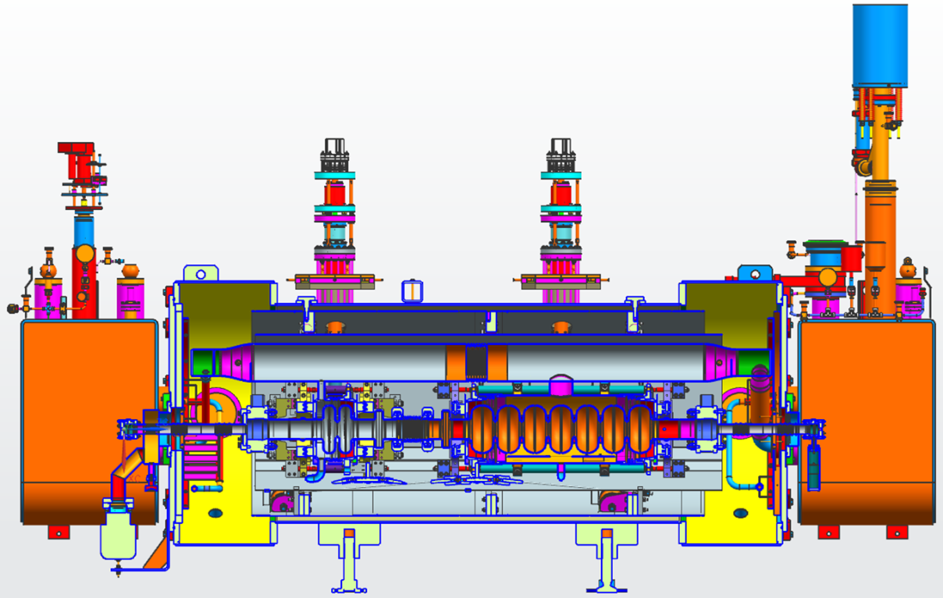
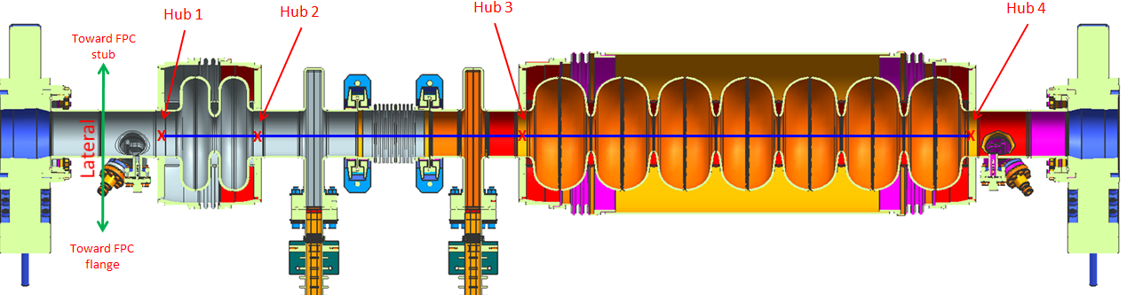
Booster SRF cryomodule for CEBAF injector upgrade
New 2-cell β_{g}=0.6 cavity design, SRF “capture” cavity
Refurbished low loss 7-cell (β_{g}=0.97) cavity from Renaissance
Free of skew quadruple (x-y coupling)
Minimization of RF x-kick
Full use of C100 cavity components and techniques
G. Ceng, etc, Mechanical Design of a New Injector Cryomodule 2-cell Cavity at CEBAF, WEPAC47, NA-PAC 2013,
H. Wang, et al, Injector Cavities Fabrication, Vertical Test Performance and Preliminary Cryomodule Design, WEPWI030, IPAC 2015,

Slide 20
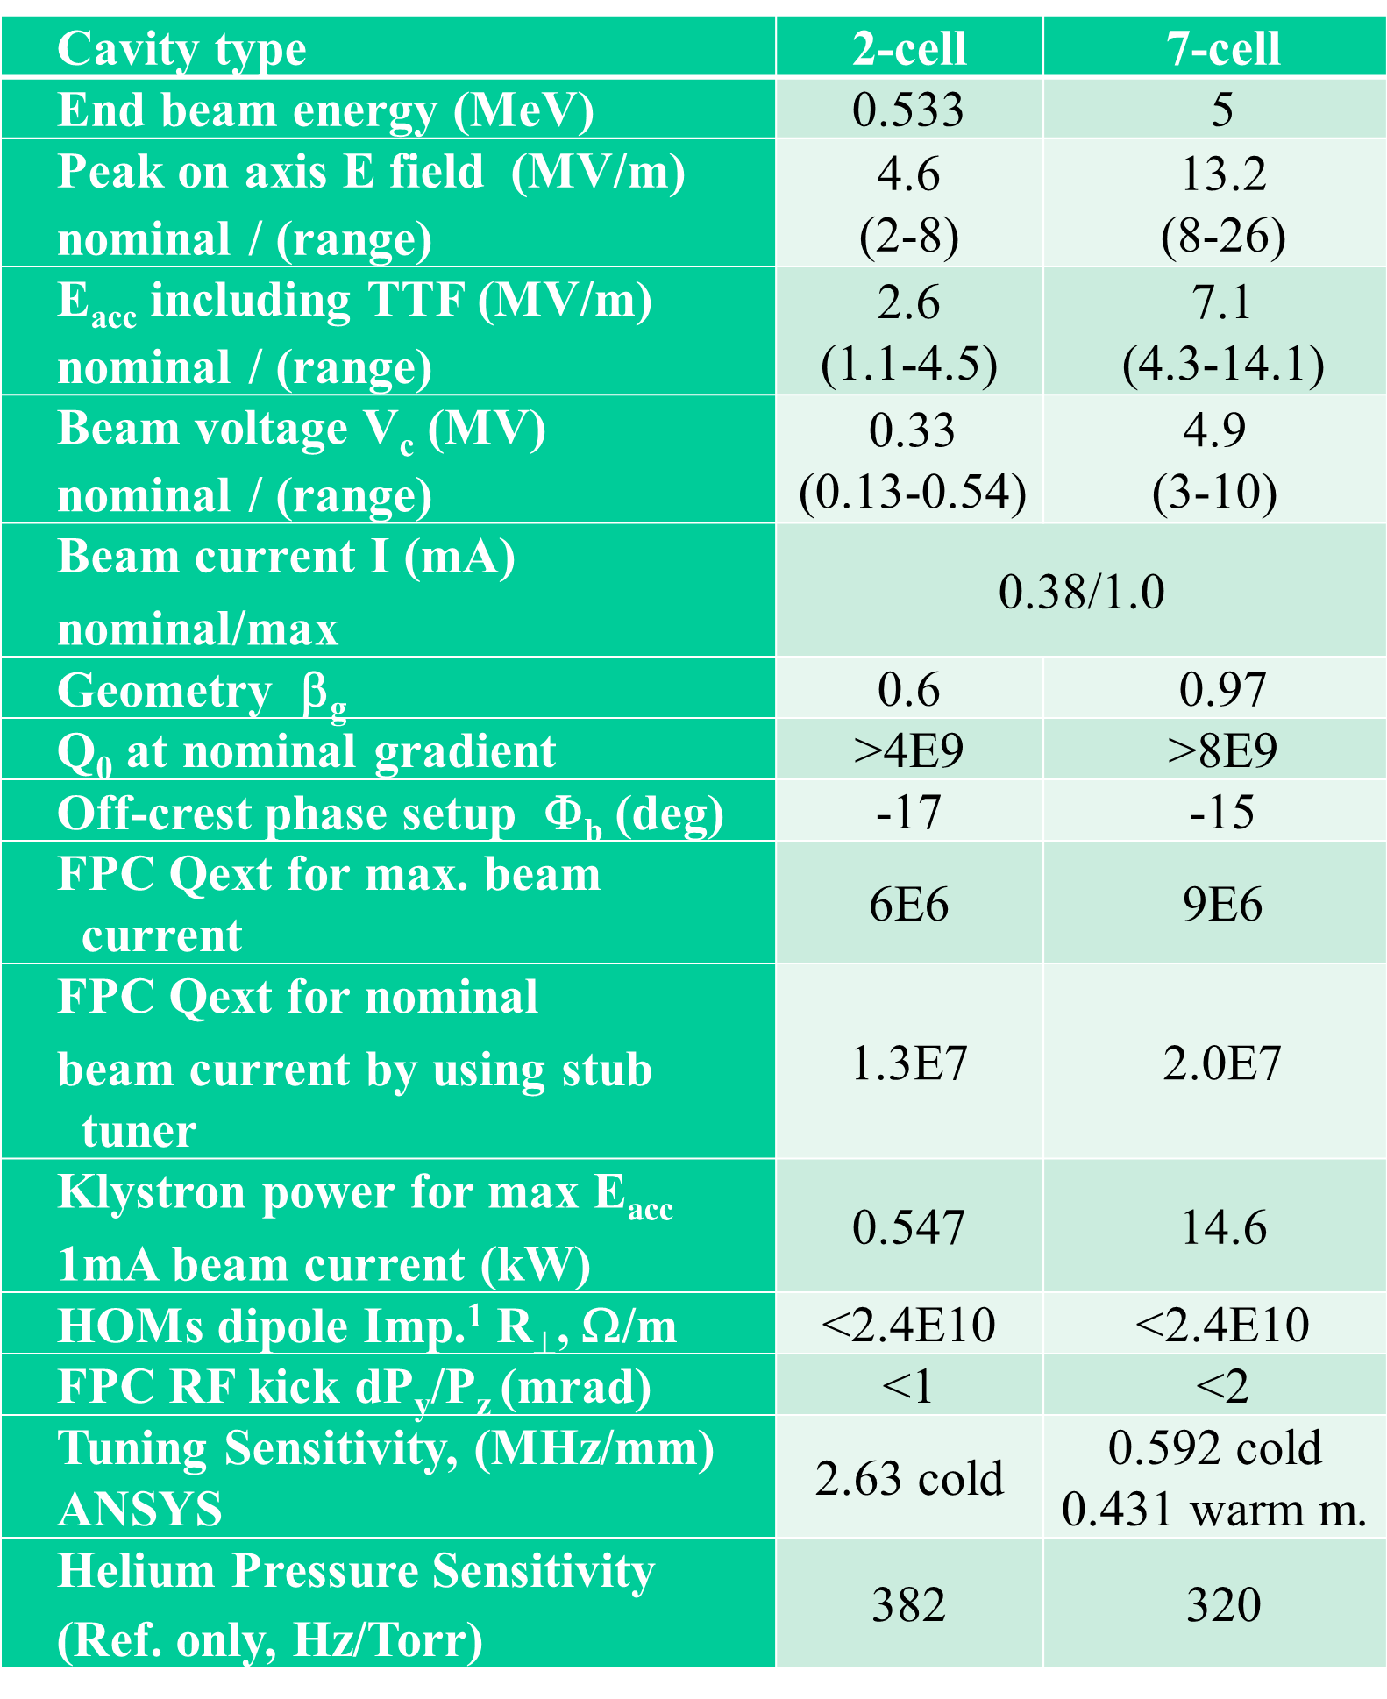
Booster specifications and commissioning results
Commissioning results – no beam
parameter | 2-cell | 7- cell
Q_{ext}FPC | 6.2E+06 | 9.7E+06
Q_{ext}FP | 2.4E+12 | 3.0E+12
E_{max} (MV/m) | 15.1 | 15.2
E_{maxop} (MV/m) (1 Hour run) | 14.5 | ~ 14.0
Limit | Quench | Max-ed out RF drive
FE onset (MV/m) | 11.5 | 16.0
RF heat load at typical operating gradients | 9.5E+09 < 1W at 6 MV/m | 1.2E+10 ~12 W at 6 MV/m
Static heat load | 20 W
2-cell effective length 0.12 m
7-cell effective length 0.7 m
We have plenty of gradient

Slide 21
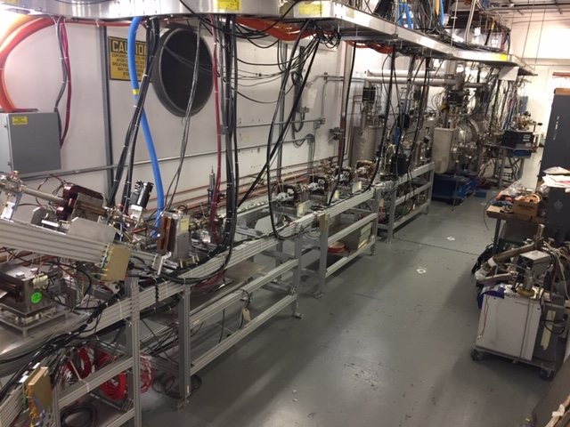
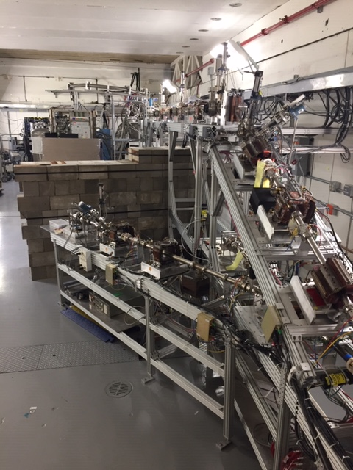
The compact accelerator today…much different.
HDIce
“booster” and 200 kV photogun
MeV spectrometer
(future experiment beamline)
200 kV DC high voltage spin-polarized photogun
SRF Booster: 2-cell capture section and 7-cell
With spin manipulator, temporal chopper and buncher: 10 meter-long polarized photoinjector
HDIce must rotate vertical to remove/install targets, necessitated elevated beamline and removable roof tile shielding

Slide 22
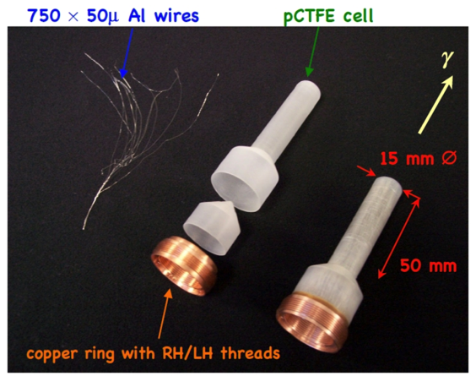
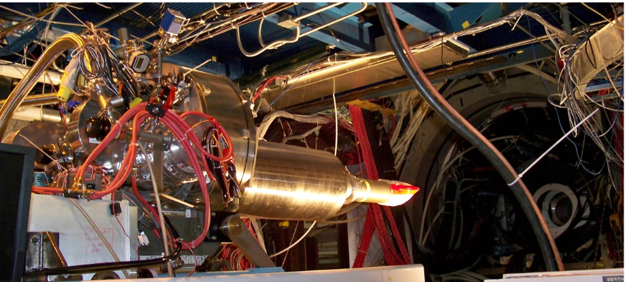
HDIce : our first User!
A new type of frozen spin target.
Target material consists solely of polarizable protons and neutrons => no dilution factor coming from target material and a T1 on the order of years (no repolarization needed).
Is a very complicated system requiring many steps in the production of a polarized target.
UITF tests will focus on the polarization reliability when subject to beam heating
Thanks C. Hanretty and A. Sandorfi for this slide

Slide 23
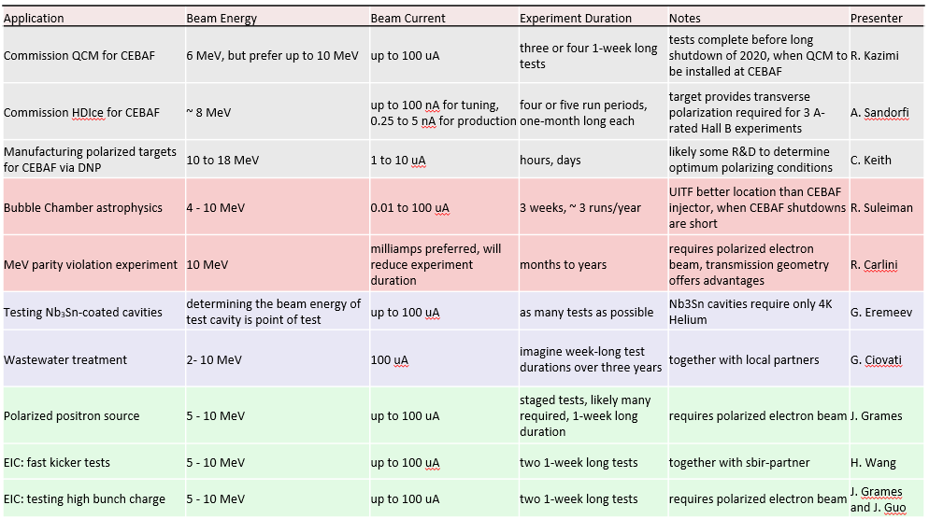
What else can we do at UITF ?
Matt Poelker (poelker@jlab.org), UITF Director of Operations

Slide 24
Continuous Positron Beam Accelerator Facility ?
The JLab Positron Working Group was created in 2017 to promote the physics case using positron beams at Jefferson Lab.
It is now about 200 physicists (users and staff) from 59 institutions supporting a program of studies using polarized or unpolarized positron beams.
  Generalized Parton Distributions
  2γ-exchange physics
  Test of the Standard Model
Can polarized positrons beams also play a significant role at a compact accelerator?
I believe the answer to this is also… yes!

Slide 25
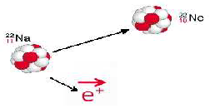




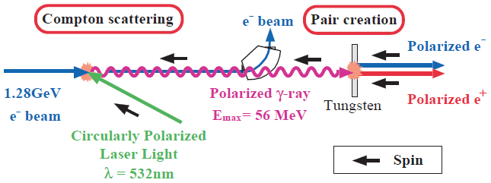
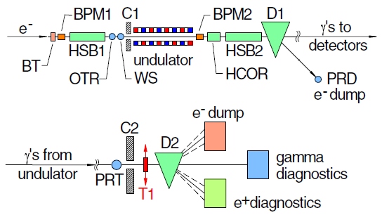
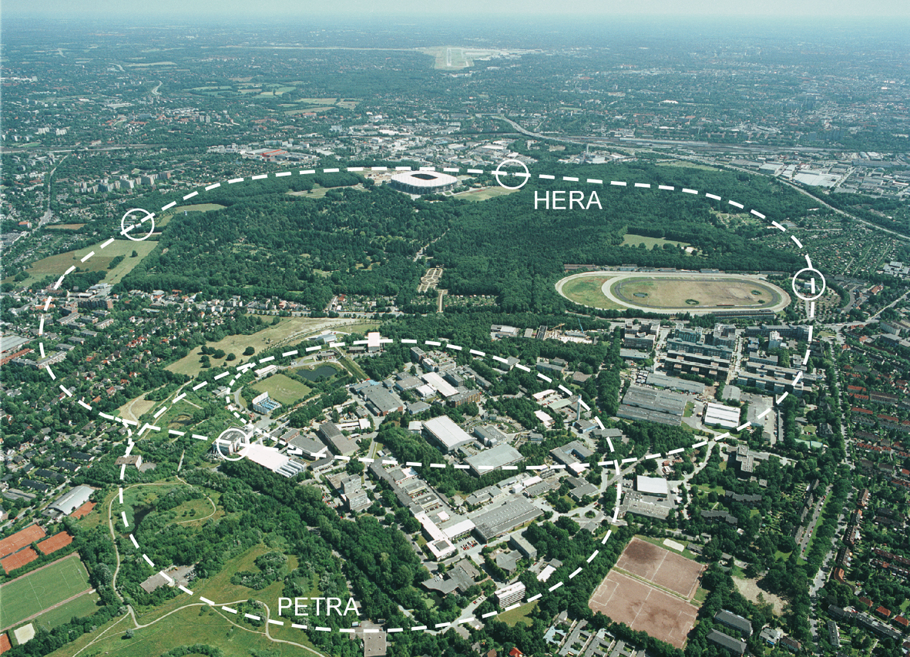
Big (and ”Little”) Science, again.
Polarized β⁺ Decay
L.A. Page & M. Heinberg. Phys. Rev.
106(6):1220-1224 (1957)
Sokolov-Ternov Effect
D. Barber , AIP Conf. Proc. 588, 338 (2001)
Polarized due to parity non-conservation in the weak interaction
HERA 27.5 GeV e+/e-
P(e⁺) ~ 40 %
P(e⁺) ~ 70 %
Compton Backscattering (KEK)
T. Omori et al, PRL 96 (2006) 114801
Helical Undulator (SLAC E166)
G. Alexander et al, PRL 100 (2008) 210801
KEK 1.28 GeV
SLAC 47.7GeV
P(e⁺) = 73 ± 15_{(stat)} ± 19_{(syst)} %
P(e⁺) = 80 ± 7_{(stat)} ± 9_{(syst)} %

Slide 26
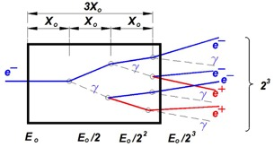
Polarized Electrons for Polarized Positrons (PEPPo)
At Jefferson Lab we are exploring how to efficiently use Polarized Electrons to produce Polarized Positrons.
In an electromagnetic shower:
e-/e+ primarily emit bremsstrahlung photons
Photons > ~few MeV dominate pair production

Slide 27
PEPPo : Feasibility demonstration at the CEBAF injector
The purpose of the PEPPo (Polarized Electrons for Polarized Positrons) experiment at the CEBAF Injector was to demonstrate the feasibility of using bremsstrahlung radiation of MeV energy Polarized Electrons for the efficient production of Polarized Positrons.
J. Grames, E. Voutier et al., JLab Experiment E12-11-105 (2011)

Slide 28
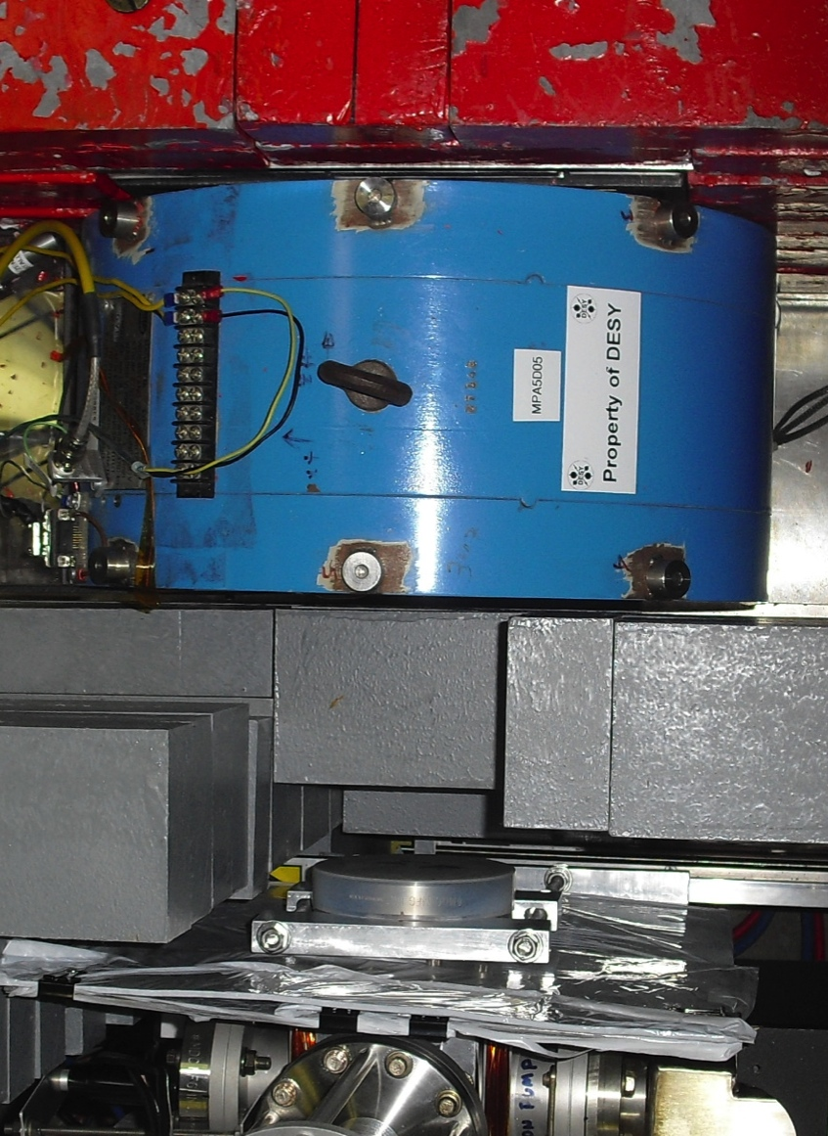
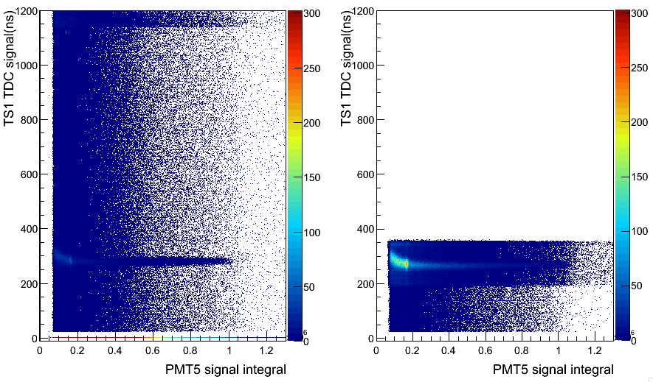
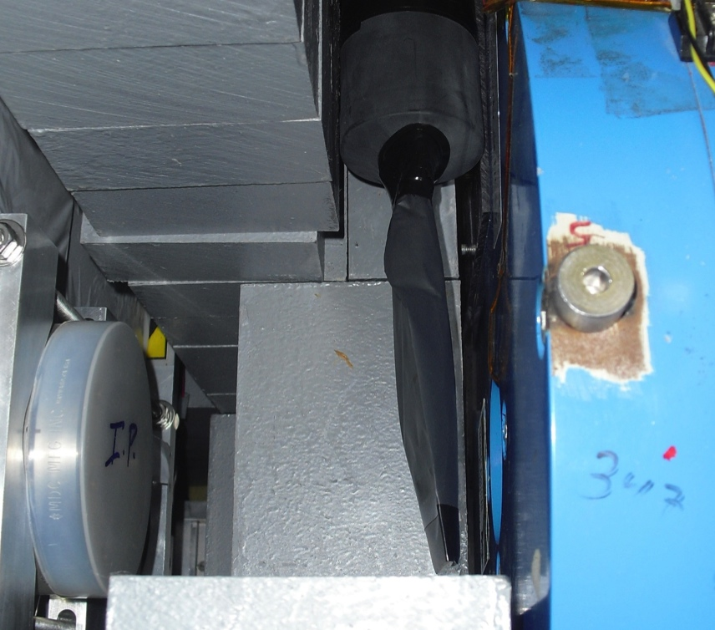
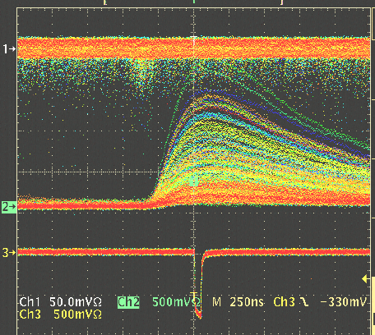
Measuring the positron polarization
Positrons are detected by coincidence between a thin charge sensitive scintillator in front of the reconversion target and the central polarimeter crystal.
Compton Scattering Transmission Polarimeter
C
A
L
O
R
I
M
E
T
E
R
WITHOUT
Coincidence
Background
e+
γ
Reconversion
Target
10mil Al window
Trigger Scintillator
Trigger Scintillator
WITH
Coincidence
Calorimeter
Coincidence

Slide 29


Highest spin polarization demonstrated at particle accelerator
(PEPPo Collaboration) D. Abbott et al. , Phys. Rev. Lett. 116 (2016) 214801
PEPPo demonstrated efficient polarization transfer of 8.2 MeV/c polarized electrons to positrons, expanding polarized positron production using MeV electron beam energies.
electron beam polarization
85.2 ± 0.6 ± 0.7 %
Whenever producing e⁺ from e⁻, polarization is coming for free, if initial electrons are polarized.

Slide 30
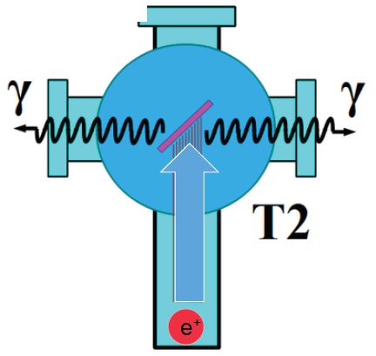
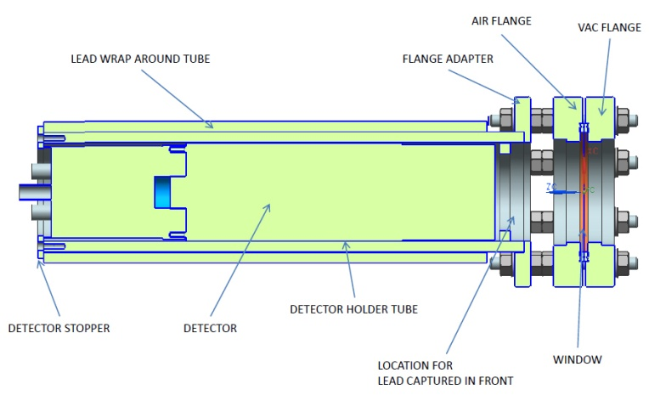
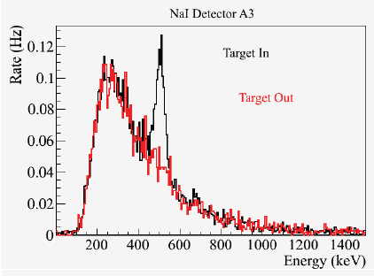
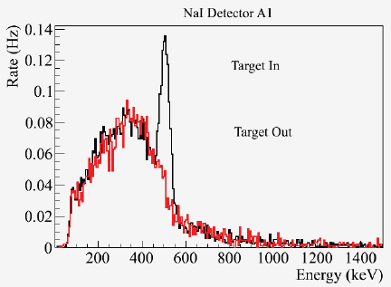
Measuring the positron intensity at 4 MeV/c
S₁
Two NaI detectors measured coincidence of back-to-back photons emitted by annihilation of positrons in a viewscreen.
e⁻
e⁺
D
T₁
p_{e-}= 8.2 MeV/c
A3
Viewscreen 0.011 thick @ 45 deg to beam line
99.5% aluminum oxide Al₂O₃
0.5% chromium doped Al₂O₃/Al₂O₃Cr₂O₃
D
e⁺
T₂
S₂
p_{e+}= 4 MeV/c
A1
For these data we had a yield of ~10⁻⁵ e⁺/e⁻
A3
A1

Slide 31



Possibilities at compact accelerator facility (<100 MeV)
The polarization distribution of generated positrons is dominated by low-energy events.
The positron energy at the optimum FoM (P²I) is about half of the electron beam energy.
Producing highly polarized positron beams with intensities > 100 nA with typical injector energies (10-100 MeV) requires polarized electron beam intensities of >1-10 milliAmps
Optimum
FoM
Optimum energy

Slide 32
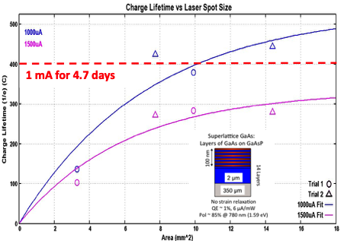
Technology is capable to sustain mA’s of high polarization days

Slide 33
Recent events
The “e+@JLab White Paper: An Experimental Program with Positron Beams at Jefferson Lab” (https://arxiv.org/abs/2007.15081) was published in July.
An LDRD proposal “A polarized positron source for our future” was submitted in March and recently funded. This two-year project addresses the most critical aspect of positron beams at CEBAF, the positron source.

Slide 34

Thank you for your attention.

