Slide 1
JLEIC Interaction Region
Vacuum system design and modeling for the
Jefferson Lab
Electron Ion Collider
Interaction Region
Marcy Stutzman for the
JLEIC IR working group
Friday July 5, 2019

Slide 2
US Department of Energy National Labs
Jefferson Lab
Newport News
Virginia, USA

Slide 3
Thomas Jefferson National Accelerator Facility
12 GeV electrons, recirculating linear accelerator
Up to 90% polarization from DC photoemission source
Electron currents to 200μA beam (CW) to four experimental halls
Study nucleon structure and interactions
Source
Halls A, B, C
Hall D

Slide 4
July 2018: National Academy of Science Priority
Recommendation of US-Based Electron Ion Collider
High-energy, high-luminosity polarized beams
Brookhaven National Laboratory and Jefferson Lab have already developed preliminary plans for EICs that would take advantage of existing on-site accelerators.
EIC goals: answer questions in quantum chromodynamics (QCD)
Nucleon mass
Spin properties of nucleons
Gluon role within nuclei
Build on experiments from
RHIC at BNL
CEBAF at Jefferson Lab
HERA at DESY

Slide 5
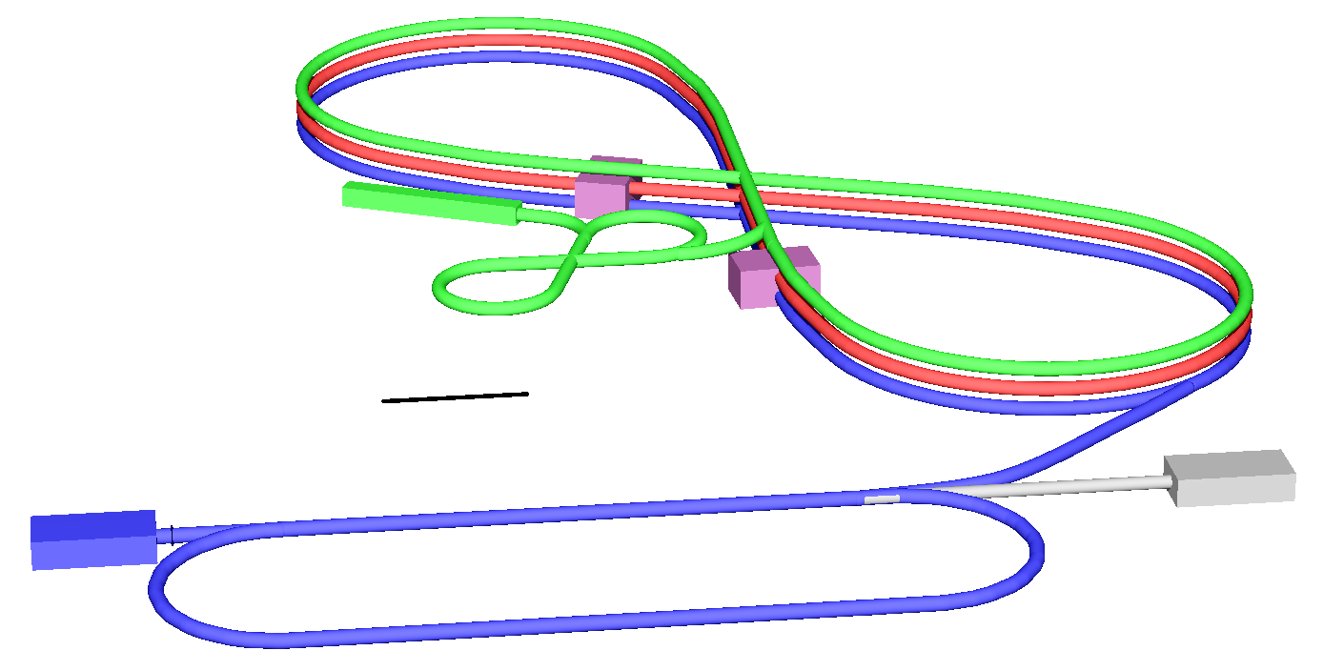
JLEIC Layout
Electron complex
CEBAF
Electron collider ring
3000 mA @ 5GeV/c
400 mA @ 12GeV/c
Up to two detectors at minimum background locations
Crab Crossing for Luminosity
Figure 8 for Polarization Preservation
Ion complex
SRF linac: 150 MeV for protons
Low / High Energy Boosters
Ion collider ring: 100 (200) GeV/c
Interaction
point
Ion Source and booster
100m
Electron source
12 GeV CEBAF

Slide 6
HERA Interaction Region Vacuum
Luminosity upgrade dealt with background issues
Synchrotron Radiation
Degradation of vacuum
Beam gas interactions
Radiation / beam spread
Higher order mode losses
Heating
Degradation of vacuum
Lessons Learned
Need Excellent Vacuum System
Need careful design of IR and masks
Ref: Uwe Schneekloth, EIC workshop 2008

Slide 7
JLEIC interaction region working group
“R&D Proposal for EIC Background Studies and the Impact on the IR and Detector design”
Simulations of synchrotron radiation and beam-gas interactions
Latifa Elouadrhiri: JLab physics
Charles Hyde: ODU physics
Vasiliy Morozov: JLab accelerator
Christine Ploen: ODU physics
Marcy Stutzman: JLab accelerator
Mike Sullivan: SLAC physics
Yulia Furleova: JLab physics
Mark Wiseman: JLab engineering
Andrey Kim: UConn physics
Vitaly Baturin: ODU physics
Youri Sharabian: JLab physics
Nick Markov: JLab physics
Kyungseon Joo: UConn physics
Pavel Degtiarenko: JLab RadCon
Frank Marhauser: JLab RF
Collaboration between
Accelerator optics
Detector experts
Engineering
Radiation Control
Notable quotes
“There have to be stanchions to support the beam pipe?”
“That background radiation from the electron beam hitting the ion beam is my physics result!”

Slide 8
JLEIC Interaction Region Design Iterations
Ion
beam
Elctron
beam
Central IR chamber
Change from hourglass shape to funnel
Reduce impedance heating
Reduce outgassing, required pumps
old
Synchrotron radiation mask
40 mm ID ion beam entrant tube
beryllium central chamber
~2390 mm
60 mm ID electron beam entrant and exit tube
60 mm ID ion beam exit tube

Slide 9
Interaction Region Detector System
e-
Solenoid magnet
Calorimeter for e- endcap
GEM tracker surrounding IR
Cryostats upstream & downstream for superconducting quadrupoles
Vacuum pumps need to fit in there
Pumps

Slide 10
Interaction Region: Molflow+ pressure simulations
CAD design has been integrated into Molflow+
Assumptions
Outgassing rate 1x10⁻¹² mbarLs⁻¹cm⁻²
Idealized pumps now
NEG/ion pumps later
Cryogenic sections at 4.5K
Outgassing rate ~0
Sticking factor ~0.1
Cryogenic transition sections from 293 to 4.5K
Approximated as 77 K
Sticking factor 0.01
Molflow+ model of IR

Slide 11
Room temperature beamline pressure distribution
1500 L/s
650 L/s
ion
200 L/s
150 L/s
130 L/s
200 L/s
1500 L/s
e-
750 L/s
2500 L/s

Slide 12
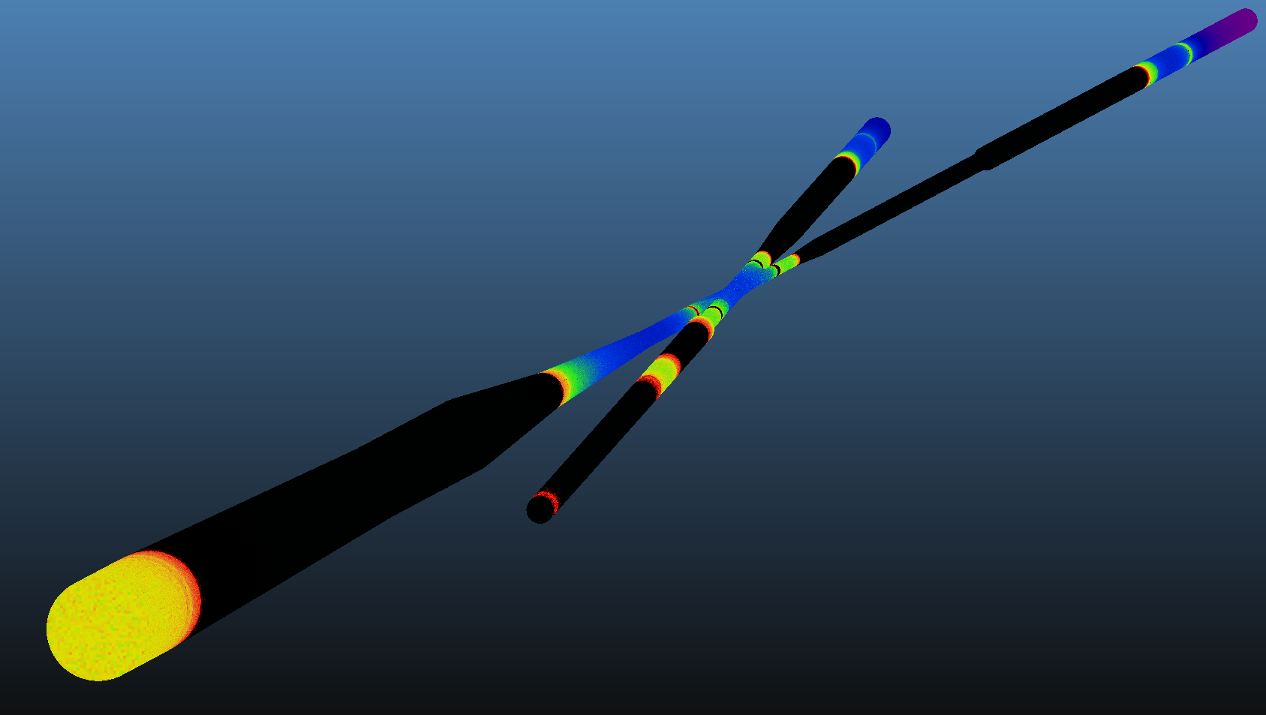
Beamline pressure distribution: magnets cold
ion
Cryogenic transition: 293 to 4.5K
Approximated as 77 K
Sticking factor 0.01
Cryogenic sections at 4.5K
Outgassing rate ~ 0
Sticking factor ~ 0.1 (underestimate)
e-

Slide 13
Pressure profiles: 293K and 4.5K static vacuum
Significant cryopumping due to quadrupole beamline at 4.5K
IR pressure ~3x10⁻¹⁰ mbar
Highest pressure
1x10⁻⁹ mbar, upstream ion line
Background from ion gas interaction: detector background?
GEANT4 simulations in parallel for detector background rates
ion

Slide 14
Cold Magnet Bore Saturation: Cryopumping on bare steel
Time to Monolayer formation depends on
Pressure
Gas composition
Temperature
Sticking coefficient
Surface area
Time to monolayer formation
t(saturation) < 1month ion upstream
t(saturation) > 1 year ion downstream
Mitigation required?
Differential pumping
Cryosorber in beamline
Refs. Kersevan JUAS 2017
Crawford Hydrogen in the LCLS2 Beamline Vacuum

Slide 15
HERA synchrotron radiation Molflow+/Synrad Benchmark
HERA High Lumi upgrade
Summer student, published literature
Beamline cross sections
Magnet strengths
Ideal electron beam
Quad/Dipole simplified to Dipole
Comparisons to published
Synchrotron radiation power
Vacuum performance
ongoing
Power (W/cm²)
Ion / e+
e-
~ 6kW
Preliminary
Geometry, simulation by Adam Hutchinson
Louisiana State University through the US DOE
SULI summer undergraduate research program

Slide 16
Applying lessons learned from HERA
Synchrotron Radiation
Last e- dipole ~75m upstream
Beam gas interactions
Design upstream ion line vacuum to minimize gas
Studying ion & e- beam induced synch. radiation
Higher order mode losses
Chamber material
Collimator size, position

Slide 17
Synrad model of JLEIC Interaction Region: 12 GeV
End of simulation
(100% absorbed)
12 GeV beam, 390 mA current
e- optics, 3 upstream quads
Collimator
12 mm radius, 1 m upstream
Synchrotron radiation
Collimator max 100 W/cm²
Collimator total power <10W from quad synch rad
IR walls μW/cm²
Downstream absorber mW/cm²
Synch light from Beam gas interactions? GEANT4 simulations
ion
collimator
e-

Slide 18
Conclusions
SUMMARY
JLEIC IR Background working group: physics, engineering, accelerator, radcon
Detectors, cryogenic quadrupoles: little room for pumping
Experience at HERA shows vacuum, synchrotron radiation management critical
Molflow+ calculations for vacuum distribution
First try for static warm & cryo
Synchrotron radiation calculations
Synrad compared to 2D code from SLAC
Molflow+/Synrad calculations for HERA: benchmark
FUTURE
Effect of Beam: radiation/heating
Engineering design of pumping
Space constraints
Bremstrahlung from beam gas interactions: ions and electrons
Refine Gas load into cryogenic magnets
Collimator optimization
DownSelect between
Jefferson Lab JLEIC
Brookhaven eRHIC
Questions?

Slide 19
Backup

Slide 20
Comparing JLEIC and HERA beam parameters
JLEIC
Electrons
5 GeV electrons 3000 mA
12 GeV electrons 390 mA
Ions
40 GeV at 450 mA
200 GeV ions at 750 mA
Luminosity > 2x10³⁴ cm⁻²s⁻¹
High Polarization: figure-8 ring design
Complete cancellation of spin precession in left/right arcs (net spin precession zero, energy-independent)
Spin easily controlled by small magnetic fields for any particle species
Full acceptance primary detector including far-forward acceptance
HERA
27.5 GeV electrons, 58 mA
820 GeV positrons, 140 mA
Luminosity 7x10³¹ cm⁻²s⁻¹
Beam Design
High repetition rate
Low bunch charge
Short bunch length
Small emittance
IR Design
Small β*
Large beam-beam
Crab crossing
Damping Design
Synch. radiation
Beam cooling

Slide 21
JLEIC Parameters and Luminosity Performance
CM energy | GeV | 21.9 |  | 44.7 |  | 63.3 |  | 89.4 |  | 98
 |  | p | e | p | e | p | e | p | e | p | E
Beam energy | GeV | 40 | 3 | 100 | 5 | 200 | 5 | 200 | 10 | 200 | 12
Collision frequency | MHz | 476 |  | 476 |  | 476/2=238 |  | 476/4=119 |  | 476/4=119
Particles per bunch | 10¹⁰ | 0.59 | 3.9 | 0.98 | 4.7 | 1.97 | 6.8 | 3.93 | 4.2 | 3.93 | 2.05
Beam current | A | 0.45 | 3 | 0.75 | 3.5 | 0.75 | 2.58 | 0.75 | 0.8 | 0.75 | 0.39
Polarization |  | 85% | >85% | 85% | >80% | 85% | >80% | 85% | ~80% | 85% | ~80%
RMS bunch length | cm | 2.5 | 1 | 2.5 | 1 | 2.1 | 1 | 4 | 1 | 4 | 1
Norm. emitt, hori. | mm mrad | 0.5 | 18 | 0.65 | 83 | 0.96 | 83 | 3.1 | 664 | 3.1 | 1145
Norm. emitt, vert. | mm mrad | 0.2 | 3.6 | 0.13 | 16.6 | 0.25 | 16.6 | 1.5 | 133 | 1.5 | 229
Horizontal β* | cm | 8 | 30 | 8 | 5.72 | 21 | 11.2 | 21 | 9.1 | 21 | 6.6
Vertical β* | cm | 1.3 | 9.8 | 1.3 | 0.93 | 1.6 | 1.1 | 1.6 | 1.65 | 1.6 | 1.15
Beam-beam, hori. |  | 0.015 | 0.12 | 0.015 | 0.045 | 0.015 | 0.09 | 0.003 | 0.02 | 0.0013 | 0.014
Beam-beam, vert. |  | 0.01 | 0.15 | 0.013 | 0.041 | 0.008 | 0.065 | 0.001 | 0.02 | 0.0005 | 0.012
Laslett tune-shift |  | 0.055 | small | 0.018 | small | 0.008 | Small | 0.0014 | Small | 0.0014 | Small
Hour-glass (HG) |  | 0.85 |  | 0.73 |  | 0.82 |  | 0.73 |  | 0.67
Peak lumi., w/ HG | 10³³/cm²s | 3.2 |  | 14.7 |  | 15.5 |  | 1.9 |  | 0.86
Average lumi.* | 10³³/cm²s | 2.3 |  | 10.6 |  | 9.3 |  | 1.6 |  | 0.71
* Average luminosity was calculated assuming a one or two hour proton beam store without or with high energy bunched beam electron cooling plus 5 min beam formation time (mainly due to detector overhead), and a 75% duty factor of machine operation.

Slide 22
Synchrotron Radiation Collimator
Limit Synchrotron radiation at IR
Pumping constriction
Impedance heating

Slide 23
Synchrotron radiation power

Slide 24
Marcy Stutzman
Thomas Jefferson National Accelerator Facility
marcy@jlab.org
SUMMARY
JLab Electron Ion Collider interaction region background working group: physics, engineering, accelerator, radcon
Detectors, cryogenic quadrupoles: little room for pumping
Experience at HERA shows vacuum, synchrotron radiation management critical
Molflow+ calculations for vacuum distribution
Dynamic vacuum with heating
Synchrotron radiation calculations
Synrad compared to 2D code from SLAC
Molflow+/Synrad calculations for HERA: benchmark

