Slide 1
Beam Heating in Cu Raditor
For 100 micro Amps on 0.1 mm Cu radiator
10 watts
For 0.20 mm beam spot power density is 3.2e+12 W/m^3
For 100 micro Amps on 0.02 mm Cu radiator
2 W
Material Cu C10100 (99.99% Copper)

Slide 2
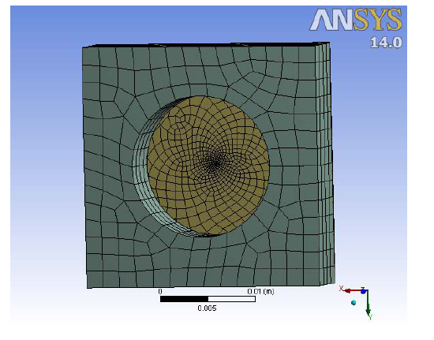
Mesh for thermal model 0.2mm beam spot

Slide 3
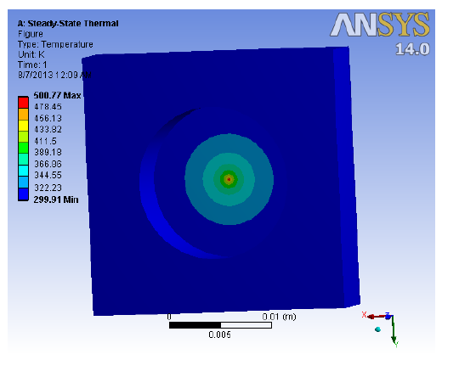
Thermal analysis 0.2mm beam spot
Edges held at 300K. Max temp on foil is 500K

