Slide 1
CEBAF Horizontal Wien Magnetic Field Map
Results of magnet mapping on January 22, 2021 with new end-plates
Riad Suleiman

Slide 2
Field Map, Background
From “old plates” map
Degaussed, Power Supply OFF

Slide 3
Field Map, I=0.00 A
Hysteresis ±19.9 A

Slide 4
Field Map, I=0.00 A
$$L_{B}=\frac{\int_{−30 cm}^{+30 cm}{Bdz}}{B_{center}}$$
With Background Subtraction

Slide 5
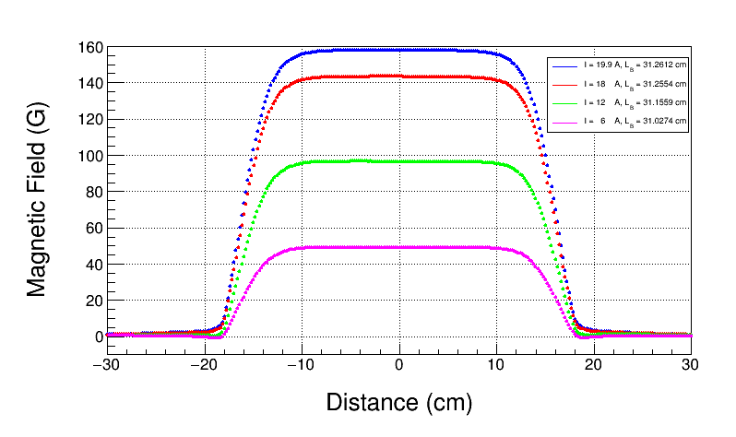
Field Map, No Background Subtraction

Slide 6
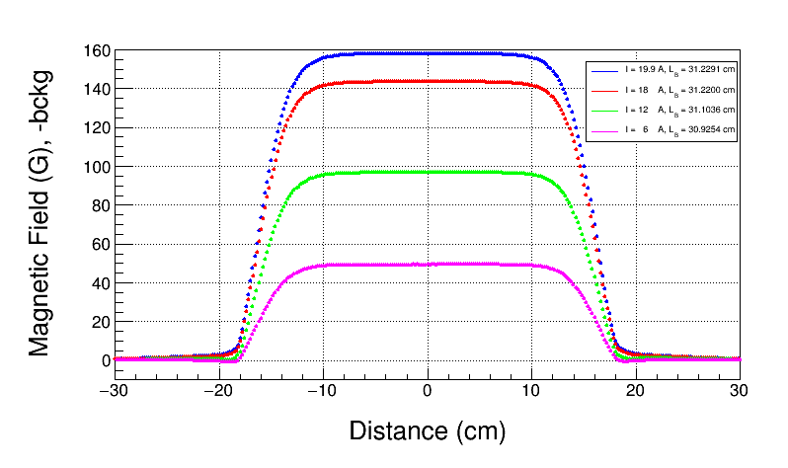
Field Map, with Background Subtraction
With Background Subtraction

Slide 7
Field Map, No Background Subtraction

Slide 8
Field Map, with Background Subtraction
With Background Subtraction

Slide 9
Field Map, 19.9 A, Repeat Measurements
With Background Subtraction

Slide 10
Normalized Field Map, 19.9 A, Repeat Measurements
With Background Subtraction

Slide 11
Field Map, 19.9 A, x Transverse

Slide 12
Core (Center) Magnetic Field vs Current
With Background Subtraction

Slide 13
Core Magnetic Field Residuals (B-p1*I)

Slide 14
Hysteresis Loop

Slide 15
Modified Hysteresis Loop
A second Modification:
subtract -0.017 A offset from Magnet Current

Slide 16
Magnetic Field Effective Length
No Background Subtraction

Slide 17
Magnetic Field Effective Length
With Background Subtraction

Slide 18
Magnetic Field Modified Effective Length
With Background Subtraction, -0.15 G Core Offset and -10.0 G Bdl Offset
Vertical Wien Effective Length = 31.2±0.1 cm

Slide 19
Vertical Wien Magnetic Field Map
Use B core (center) vs I measurement with these two modifications:
Subtract -0.017 A offset from Magnet Current:
$$New I=I −(−0.017)$$
Subtract background core field offset of -0.35 G (-0.2 + -0.15)
Use measured effective length to calculate Bdl:
$$New Bdl=\left(B −\left(−0.35\right)\right)×31.2$$

Slide 20
Summary
Had to use background field map of Horizontal Wien with old plates
With background Bdl subtracted, Magnetic Effective Length of 31.2±0.1 cm is now independent of magnet current (Electric Effective Length is 31.20 cm)
These three measurements are important in understanding field maps:
Magnet at I=0 and on loop
Magnet degaussed with power supply off
Magnet off stand but leaving everything else as is
Hysteresis loop study of Vertical Wien magnet showed that magnet current during mapping was off by -0.017 A – fix by subtracting this offset from map current
New Field map was generated

Slide 22
How to calculate power supply current offset
How to calculate power supply current offset when examining field maps:
Start with B (or Bdl) vs I data
First, correct first background fields: B = B - bckg
Fit with B=a1*I, or B = a0 + a1*I or higher order polynomial (you want the linear coefficient)
Calculate hysteresis curve: h= B - a1*I
Plot h vs I
Calculate opposite hysteresis curve with: neg_h = -h and neg_I = -I
Plot neg_h vs neg_I
If end-points do not overlap then there is a current offset
Guess an offset, re-calculate I as: I = I - CurrentOffset
Re-calculate h as: h = B - a1*(I - CurrentOffset)
Re-calculate neg_I as: neg_I = -I
Re-calculate neg_h as: neg_h =-h
Repeat for few values of current offset, till there is overlap at end-point currents

