Slide 1
PRE-CONCEPTUAL DESIGN OF A CW POSITRON SOURCE FOR JLAB
(2013-LDRD-02)
JOE GRAMES
LDRD PROPOSAL REVIEW - JULY 17, 2013
PROJECT OVERVIEW
THE TEAM
LDRD EVALUATION CRITERIA
REVIEWER QUESTION
BUDGET

Slide 2
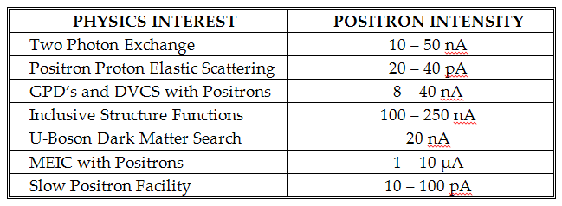
PHYSICS MOTIVATION
(bullets refer to letters of endorsement)
12 GEV CEBAF - The merits of positrons, polarized and/or unpolarized, for the Nuclear Physics program at JLab is comparable to the benefits of polarized with respect to unpolarized electrons.
Dr. Volker Burkert, Principal Staff Scientist and Head of Hall B, JLAB
NEXT GEN FACILITIES - Unpolarized and polarized positrons in the next generation of accelerators (MEIC, ILC, LHeC) have been identified as either necessary or complementary tools for the completion of their Physics program.
Dr. Yuhong Zhang, Senior Staff Scientist, MEIC Accelerator Design Study, JLAB
Dr. Alessandro Variola, Accelerator Department Director, LAL Orsay
NEW DIRECTIONS - There exists a long standing and never satisfied interest of the Material Science Community in an intense low energy (0.05-1.00 MeV/c) positron beam, as a characterization tool of material structure.
Dr. Kelvin Lynn, Director for the Center for Materials Research, Washington State University, Boeing Chair for Advanced Materials

Slide 3
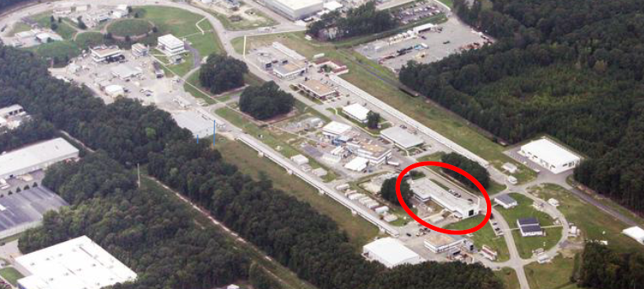
POSITRON SOURCE CANDIDATES
WHAT CHARACTERIZES A POSITRON SOURCE CANDIDATE ?
We believe a conventional design is best suited for Jefferson Lab
EXAMPLES OF A “SUITABLE ELECTRON DRIVE BEAM”
Suitable Electron Drive Beam
High Power Beam Absorber
Optimized Integrated Collection
Facility Integrated
Acceleration
Well Defined User Beam Specifications
CEBAF INJ (100 MeV)
FEL (100MeV)
CEBAF (12 GeV)

Slide 4
HIGH POWER BEAM ABSORBERS
HIGH POWER ABSORBERS ARE CHALLENGING
Highly localized beam power (10-100 kW) to be dissipated
Radiation management is a priority, specifically to cost and operability
ABSORBER TECHNOLOGY BALANCES MANY IMPORTANT PARAMETERS
Heat - energy absorption and heat dissipation in target
Radiation - prompt radiation and material activation around target
Accelerator Integration - collection beam line after target
NEW DIRECTIONS
A novel or original implementation of a positron source is likely
Study applicability of recently issued JLAB patents
Introduce “split two target” design
first (optimize bremsstrahlung) – high radiation
second (optimize positron production/collection) – low radiation footprint

Slide 5
MOGA SOURCE OPTIMIZATION
DIVERSE SET OF PARENT PARAMETERS
Electron Drive Beam (energy, intensity, radiation, polarization)
Single- & Double- Targets (bremsstrahlung and e+/e- converters)
Electron Beam Power (radiation, activation, thermal management)
Positron Collection (adiabatic matching, acceleration, optics)
Positron Beam (emittance, damping, transport, acceleration)
Positron Polarization (PEPPo concept, self-polarization)
Value (cost, size, scale)
IMPLEMENT MULTI-OBJECT GENETIC ALGORITHM (MOGA)
Principles of biological evolution to optimize multi-dimensioned non-linear problems
Application to modern sophisticated problems
Operating highest brightness high current photoinjector (Cornell)
Design of optimized luminosity for ILC
Optimized design and operating costs of an SRF linac
JLAB expertise

Slide 6
TECHNICAL REVIEW & PRE-CONCEPTUAL DESIGN REPORT
DOWN SELECTION (CLOSED LOOP PROCESS)
Technical Review
Internal and External reviewers
Review materials provided well in advance
One day agenda split between presentations and reviewer assessment
Committee Charge
Assess and recommend scenario(s) for detailed study
Reduce to 1 or at most 2 concepts
SHIFT EFFORT FROM CANDIDATES TO PRE-CONCEPUTAL DESIGN
Limited to design and analysis of most critical components
Absorber
Collection
Optimization
Explore prototype engineering plan
Critical path R&D
Positron source systems (targets, magnets, SRF, vacuum, shielding)
Facility integration
Risk assessment

Slide 7
THE TEAM
User Physics
Eric Voutier
Visiting Nuclear Physicist
LPSC, Grenoble
(5-10%)
High Power Absorbers
Pavel Degtiarenko
Radiation Physicist (SS)
ESH&Q
(5-10%)
Source Optimization
Joe Grames
Injector Physicist (SSIII)
ACC/CIS
(5-10%)
Scientific Lead
New
Post-Doctoral
Research Associate
(100%)
Engineering Analysis
Mechanical Engineer (ME II)
ENG
(7-15%)
“The ultimate deliverable of this proposal is a technically well-developed Pre-Conceptual Design Report based upon physics-motivated User input, with alignment and feasibility to the existing CEBAF and FEL facilities, and including an optimization and technical review of candidate design schemes.”

Slide 8
LDRD EVALUATION CRITERIA
POTENTIAL IMPACT ON JLAB
High
Grows and strengthens core expertise in (polarized) particle sources for CEBAF NP
Potential for center of growth in low energy or material science and collaboration
LIKELIHOOD TO ACHIEVE GOALS
Strong
Builds upon JPOS’09, University Collaborators, 2 PhD’s, JLab patents, ILC support, PEPPo
PROSPECTS FOR ATTRACTING FUTURE FUNDING
New funding for future NP program
HEP funding to support high energy e+ colliders
US interests in materials sciences to compete with European leadership
STRATEGIC VALUE OF YOUR PROJECT TO JLAB
Entirely new aspect to CEBAF NP program
Support MEIC at JLab with positrons
LEVEL OF INNOVATION IN SCIENCE AND/OR TECHNOLOGY
First ever CW positron source
New technology to produce polarized positrons at low energy
Evolution of high power beam absorbers

Slide 9
REVIEWER QUESTION
Analyze the pro and cons of stretching the funding over 3 years.
PROS
3 year is preferable (submitted 2 year proposal to be most compact)
Improved task flow (more serial, less parallel)
Better synchronization with post-doctoral scientist search and funding term
CONS
Deliverable delayed by one 1 year

Slide 10
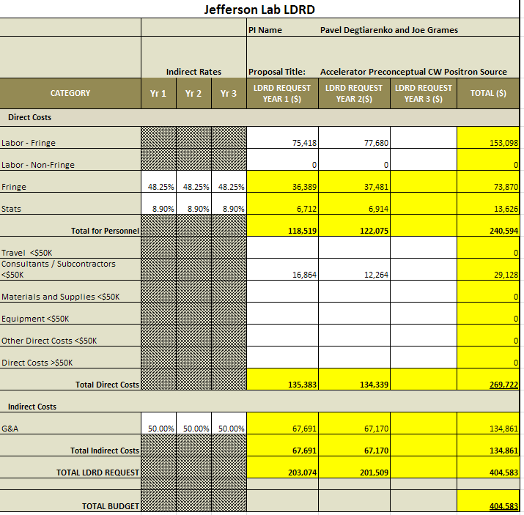
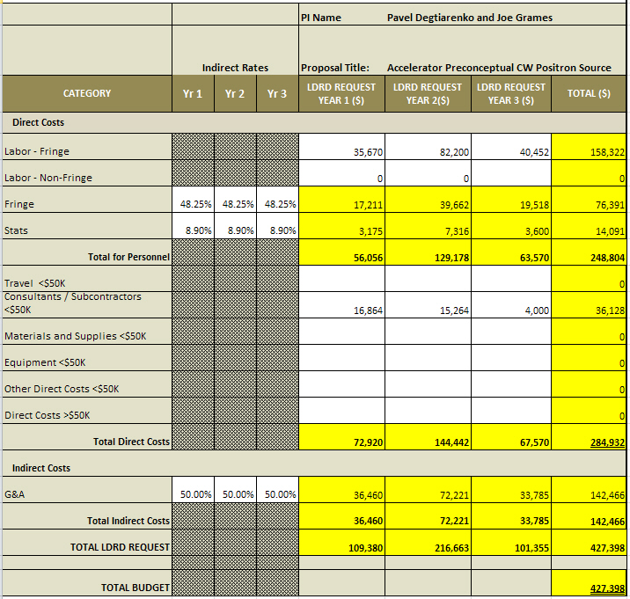
BUDGET
2 YEAR (SUBMITTED)
3 YEAR (QUESTION)

