Slide 1
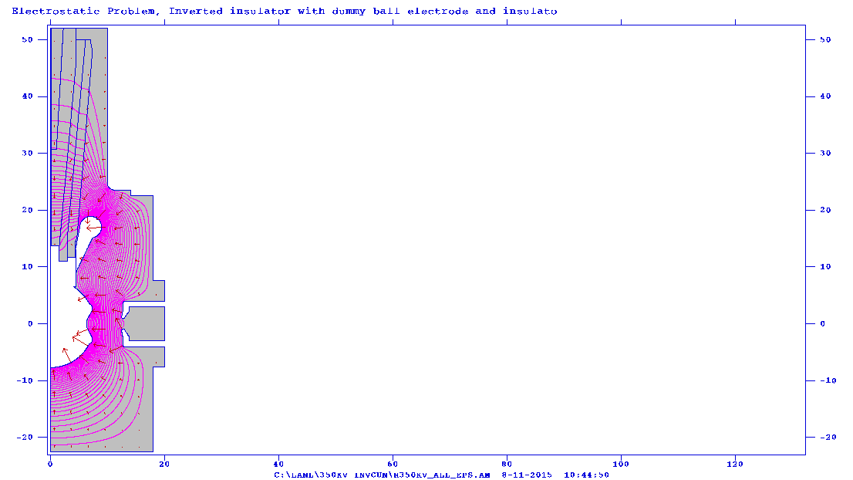

Slide 2
R30 no plug

Slide 3
R30 plug epsilon =100

Slide 4
R30 plug epsilon = 2.7

Slide 5
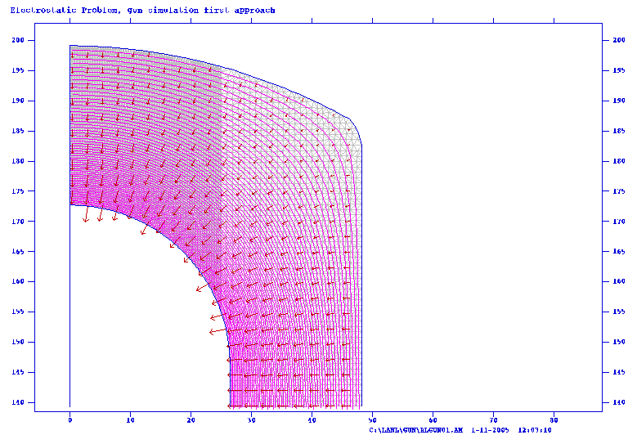
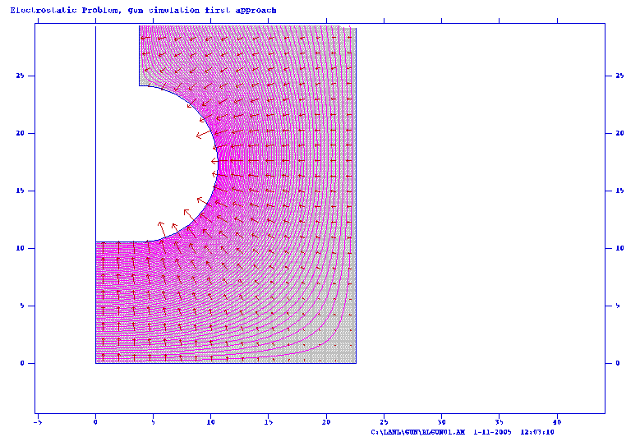
FEL GUN

Slide 6
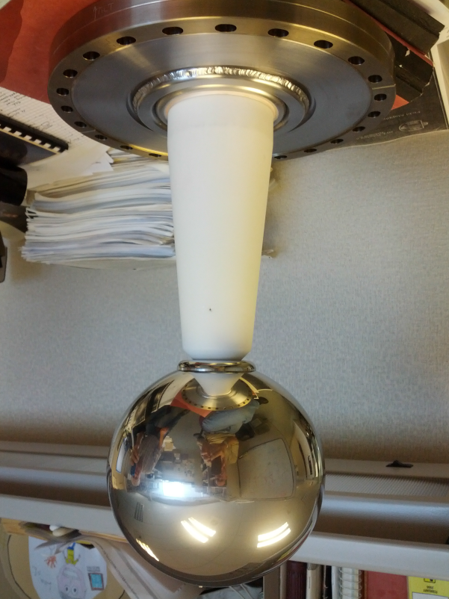
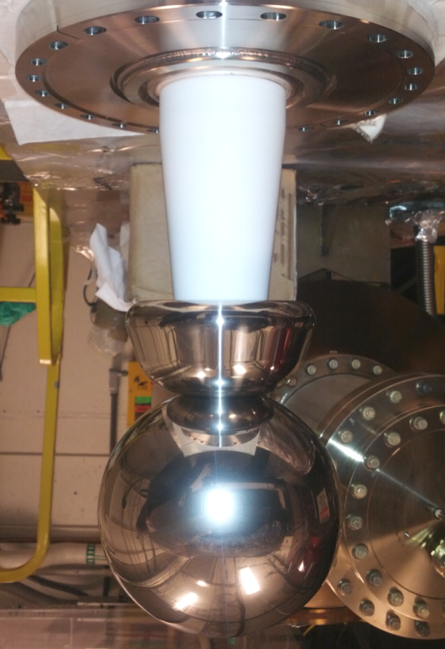
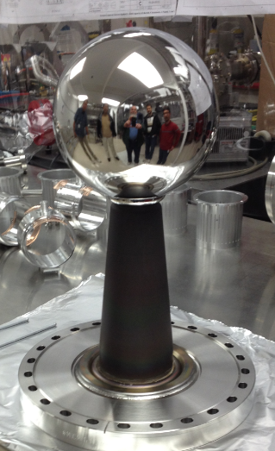
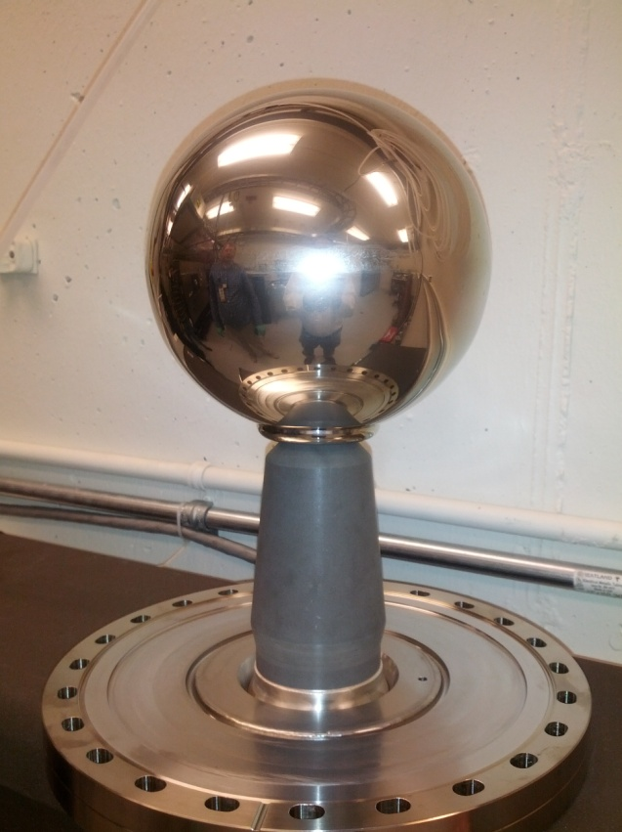
Plan A
Two insulators damaged at 315kV
Plan B
Small field emission at 350kV
Plan C
Higher level of field emission at 350kV
Plan D
ZrO coating,
Under test
Dummy balls are different from our actual gun electrodes. Dummy balls use a different “support collar” to attach to insulator…..

Slide 7
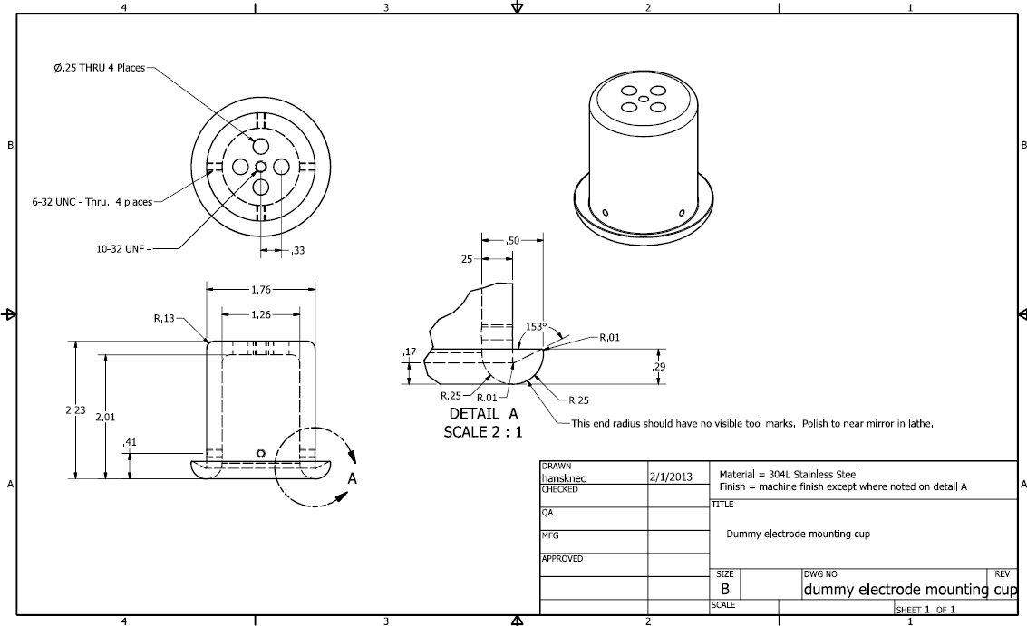
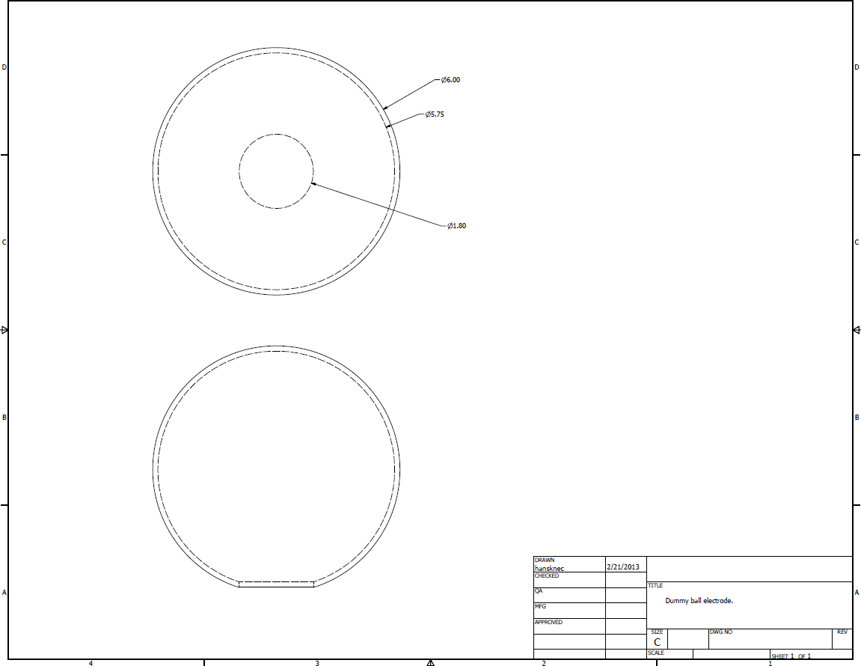
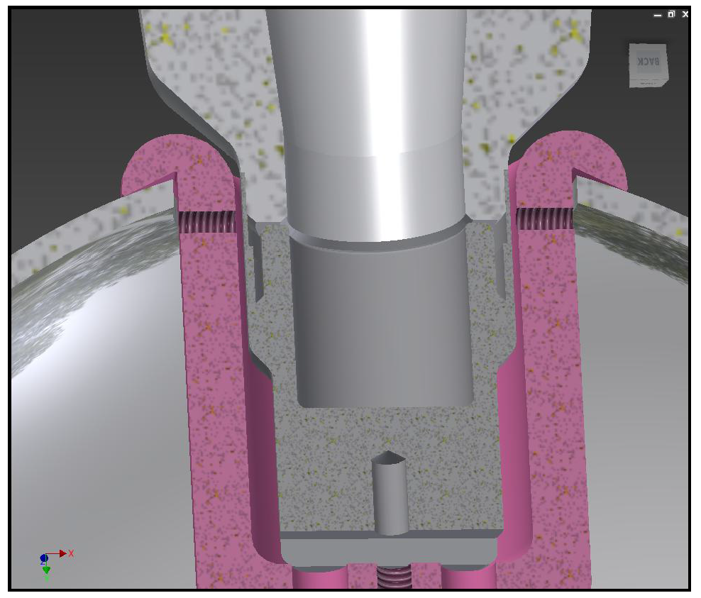

Slide 8
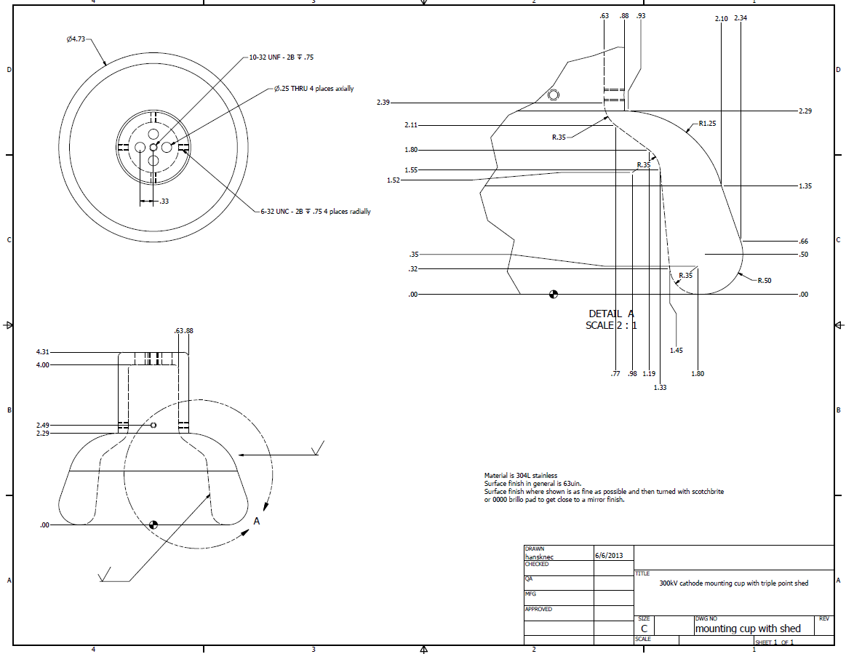

Slide 9
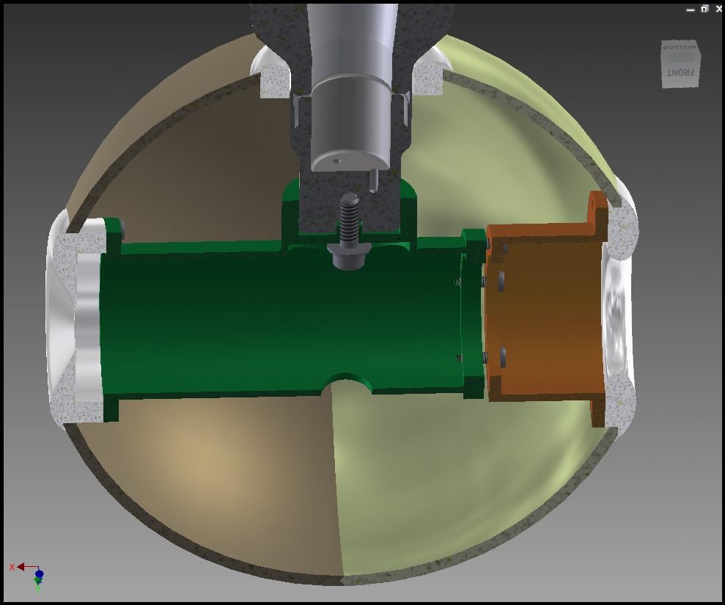

Slide 10
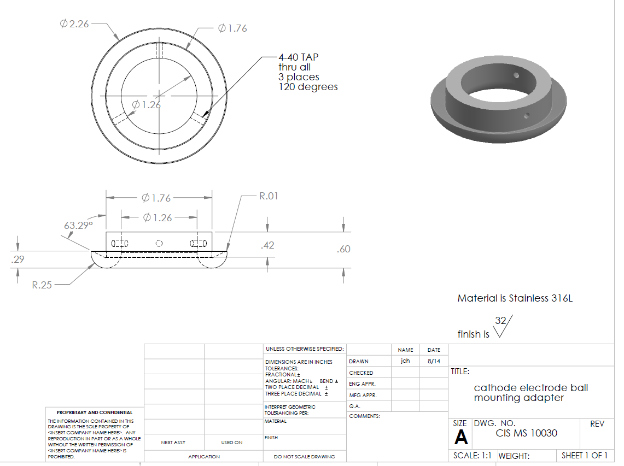
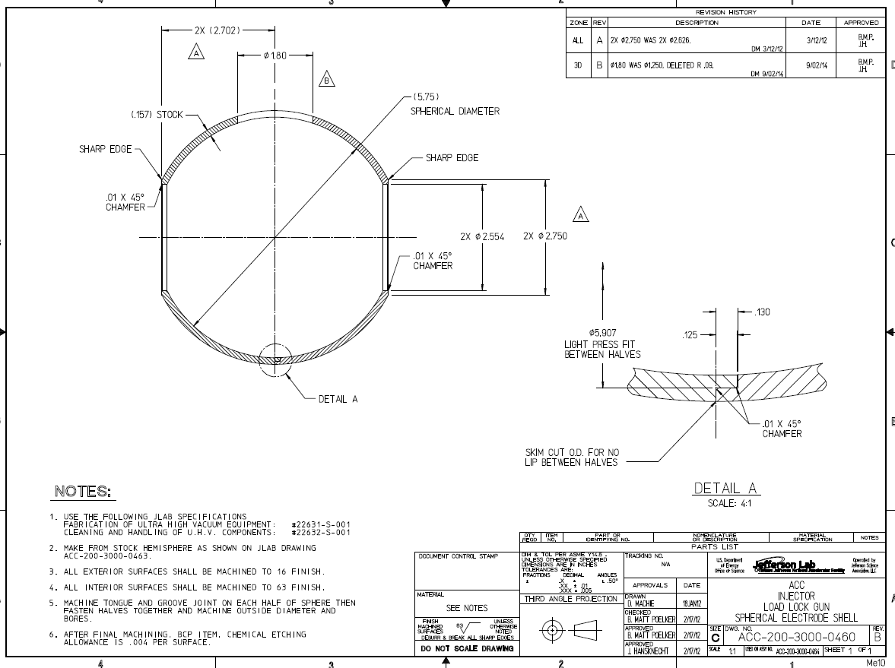
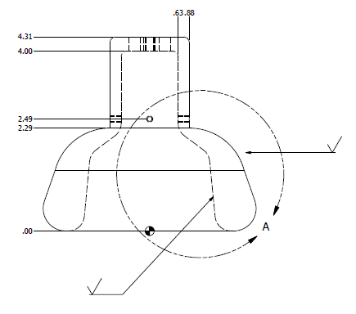

Slide 11
Why did we not appreciate the significance of a past result?
We reached 370kV using white R30 insulator and shed. People with more self-esteem might have concluded victory!
Yes, there was “significant” field emission and it wouldn’t diminish with processing. Quantify “significant”, how did it compare to other tests. > 40,000 cps on all 8 geiger tubes?
The shed was not DPP-d
Modify the shed, DPP it, and use an actual gun electrode, repeat the test while we wait for Plan Z
(could also repeat previous test with dummy ball and a DPP-d shed….)

