Slide 1


Positron R&D Update
Outline
Physics Motivation
Positron LDRD
Research Plan
Recent Synergies
Joe Grames

Slide 2
Motivation
The JLab Positron Working Group was created in 2017 to promote the physics case using positron beams at Jefferson Lab.
It is now about 200 physicists (users and staff) from 59 institutions supporting a program of studies using polarized or unpolarized positron beams.
  Generalized Parton Distributions
  2γ-exchange physics
  Test of the Standard Model
  And more

Slide 3
Positron Beams at JLab
In 2018 the Jefferson Laboratory Accelerator Advisory Committee (JLAAC) issued two recommendations:
“R26: Make an initial overall layout of what a full positron complex would look like at CEBAF including injectors, targets, capture regions, electron dumps, diagnostics, and new halls to see if an important design item has been missed.”
“R27: It would be a good time to re-verify if the following possibility is not better: Making polarized positrons from a 1.5 GeV polarized electron beam (i.e. a single pass in the North Linac) and sending this beam into a target or through a helical undulator to make polarized gammas.”

Slide 4
Recent Events
The “e+@JLab White Paper: An Experimental Program with Positron Beams at Jefferson Lab” (https://arxiv.org/abs/2007.15081) was published in July.
Two “flag ship” positron beam experiments were presented to PAC48 in August
    Polarized, 100 nA – “Beam Charge Asymmetries for Deeply Virtual Compton Scattering on the Proton at CLAS12”
    Unpolarized, 5 μA – “Deeply Virtual Compton Scattering using a positron beam in Hall C”
Both proposals received Conditional Approval (C2), to return to the PAC when a scheme for providing positron beams at CEBAF are developed.
An LDRD proposal “A polarized positron source for our future” was submitted in March and recently funded. This two-year project addresses the most critical aspect of positron beams at CEBAF, the positron source.

Slide 5
We already know the best method for CEBAF
Circularly polarized MeV energy photons generate polarized positrons via pair-creation within a high-Z target.
Compton scattering, PRL 96 (2006) 114801 => P(e⁺) = 73 ± 15_{stat} ± 19_{syst} %
Helical undulator, PRL 100 (2008) 210801 => P(e⁺) = 80 ± 7_{stat} ± 9_{syst} %
Polarized bremsstrahlung, PRL 116 (2016) 214801 => P(e⁺) = 82 ± 2.7_{stat} ± 1.3_{syst} %
PEPPo @ CEBAF
Compton scattering (>MW’s laser power) or a Helical undulator (>10’s GeV electron energy) are either far less practical or incompatible with CEBAF.
PEPPo is always highly polarized, and the intensity limited only by available e-beam power (energy x current), i.e. accessible at CEBAF today.

Slide 6
LDRD evaluates best tunability for intensity and polarization
e⁻ → γ → e⁻ + e⁺
Take advantage of the fact that the positron yield increases dramatically as the positron energy is a smaller and smaller fraction of the electron beam energy (color code in this figure)

Slide 7
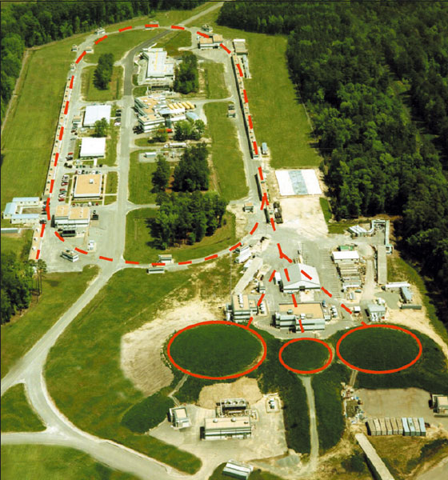
LDRD evaluates best electron energy and target power
1 GeV
1 GeV
100 MeV
10 MeV
100 MeV
10 MeV

Slide 8
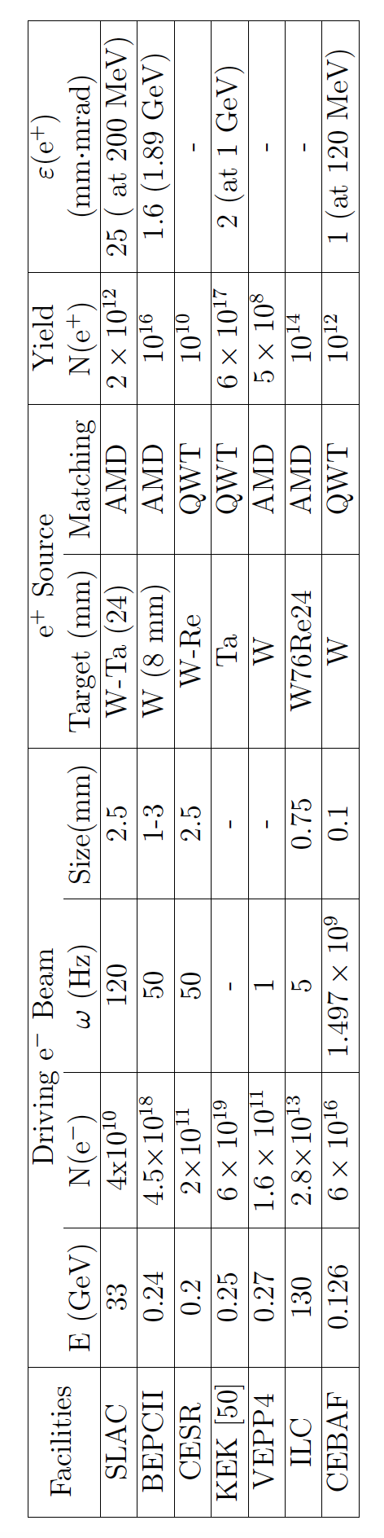
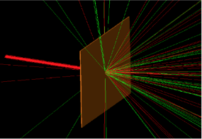
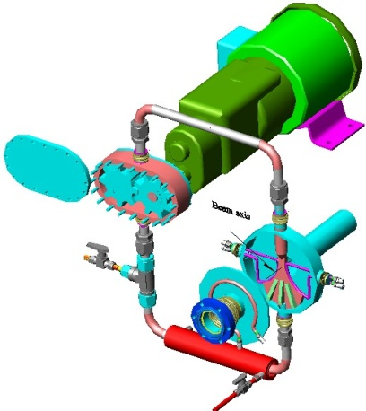

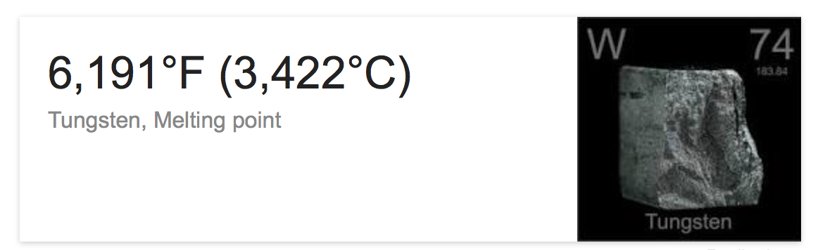
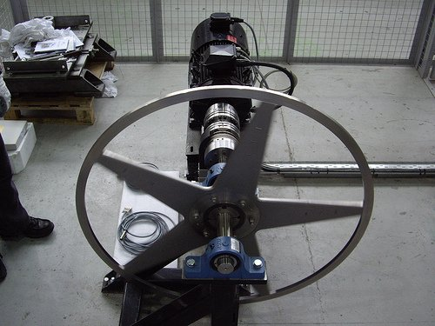
Evaluating and optimizing the other “bests”

Slide 9
LDRD Deliverables
The three deliverables of this 2 year LDRD proposal are:
technical evaluation of critical design parameters of a polarized positron source suitable for CEBAF, i.e., a positron source providing transverse and longitudinal emittance compatible with existing CEBAF linac structures (electron beam energy, pair-production target, positron collection layout)
multi-object genetic algorithm optimization software of a positron source layout that offers tunability between high intensity and high polarization
conceptual layout of a proof-of-principle “PEPPo-II” experiment to test yield and polarization performance of a positron source

Slide 10
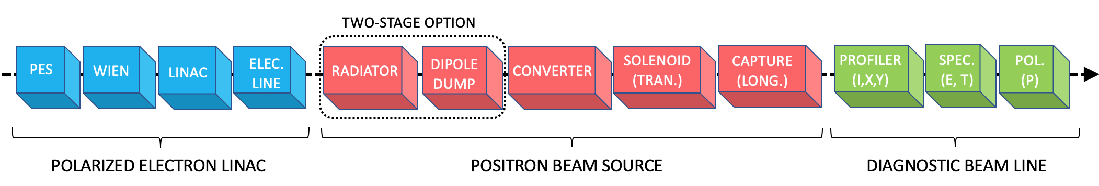
LDRD Approach
The 5 R&D topics of this 2 year LDRD :
  Accurate polarized electro-magnetic cross-sections
      Implement polarized cross-sections of E. Kuraev et al., Phys. Rev. C 81, 055208 (2010) in Geant4
  Modeling positron collection system with polarization
      Implement spin tracking in General Particle Tracer (GPT-Spin)
      Design positron source model : Geant4 generator + GPT-Spin beam line with QWT/AMD and RF capture
  Simulations using multi-object genetic algorithm
      Implement MPI genetic of GPT-Spin on Scientific Computing farm
      Technical evaluation off positron source yield & polarization tunability vs. beam energy
  Managing high beam power at conversion target
      Evaluate thermal and radiological target limitations for 10, 100, 1000 MeV options
      Evaluate single- vs. two- target system (for 100 and 1000 MeV options)
  Design of a PEPPo-II prototype

Slide 11
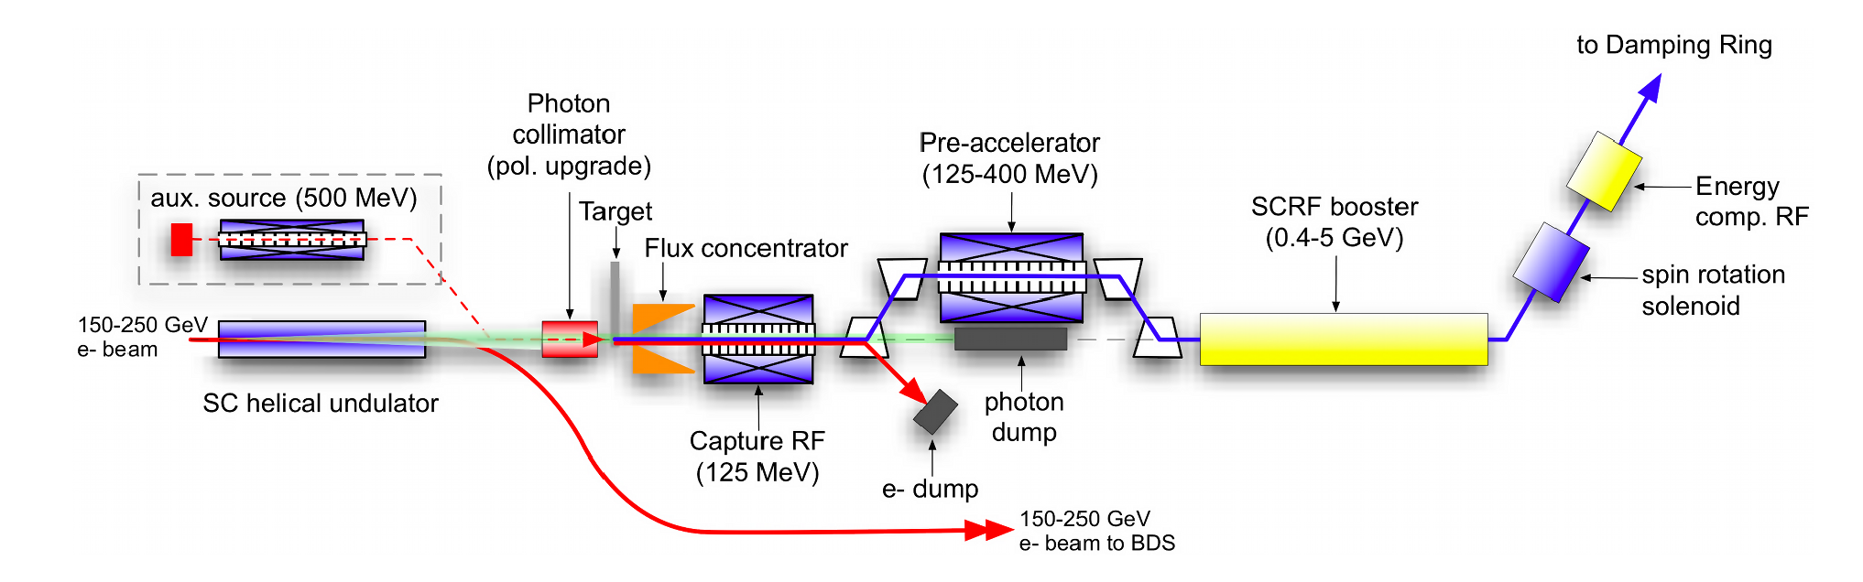
US – Japan HEP Sources Collaboration
Since 2019 we have participated with the Linear Collider and ILC communities through collaboration on polarized sources (electron & positron).
Topic 1 – High polarization photocathodes (tests of DBR GaAs/GaAsP w/ QE>6%)
Topic 2 – High voltage (>400 kV) polarized electron source
Topic 3 – Evaluating PEPPo for the ”backup” auxiliary e-driven unpolarized positron source
The International Linear Collider - TDR, Vol. 3.II : Accelerator Baseline Design

Slide 12
PEPPo for e-driven ILC
If the e-driven source were polarized, then some degree of spin polarization should be transferred to the collected positrons.
Two simulation exercises could be interesting:
Compute spin polarization for baseline parameters of e-driven source.
Explore if there is an optimum by adjusting the drive beam or collection energy
E(e+)=150 MeV, W=16mm
E (e-) | N(e+)/N(e-) | <Sz> | P (%)
3 GeV | 0.436 | 0.23 | 21
1 GeV | 0.091 | 0.44 | 40
We began these exercise late 2019 preparing for a presentation at IPAC’20, but were derailed by COVID.
J. Grames, LCWS 2019 Sendai Japan

Slide 13
Essential Polarized Electron Source R&D
Development of high polarization GaAs-based photocathodes (P>85%, QE>1%) essential to transfer large fraction of polarization to positrons
There is presently no commercial vendor, e.g. JLab maintains a modest inventory
EIC is driving new R&D (see other talks), this is excellent for the community.
But, it’s not only EIC. Many others are interested … JLAB, SUPERKEK-B, MESA, ILC
We continue R&D to suppress QE degradation. Sustained milliampere beam intensities will be essential for an e-driven source at lower energies (<100 MeV)
Positively biased gun anode to repel ions
Increased laser size to dilute ion damage
Measuring e-polarization at high current
DOE HEP Accelerator Stewardship Award – Cornell/Jlab “Demonstrating improved lifetime in superlattice photocathodes with robust activating coatings for high current, highly spin-polarized beam production”
SBIR (proposal submitted) – Euclid/JLab “Diamond Mott polarimeter” for milliamp polarimetry

Slide 14
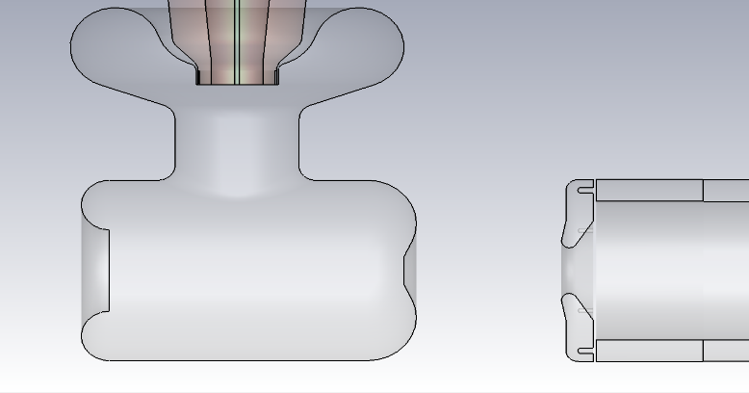
Biased Anode to Extend GaAs-Photocathode Lifetime
PhD thesis work of Josh Yoskowitz (ODU)
Anode
+1 kV
The electron beam in a high-voltage dc photo-gun will ionize residual gas in the cathode-anode gap, and downstream beamline.
Applying a modest positive bias to the anode should repel downstream ions from reaching and damaging photocathode quantum efficiency.
Measurements performed in 2019 at the CEBAF accelerator injector demonstrated an improvement in charge lifetime by about 50%.
Further measurements were made during the 2020 Physics runs, results are being prepared for publication in Phys. Rev. Accel. & Beams.
Ions
Ions
Cathode
-130 kV
e-beam

Slide 15
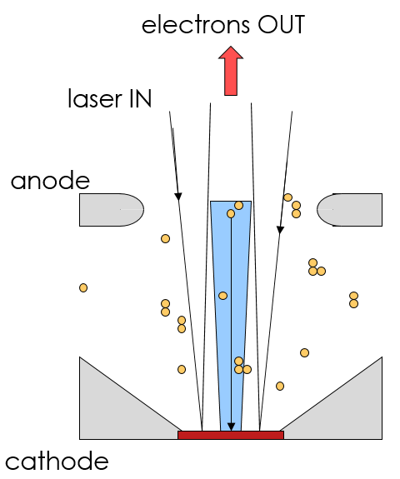
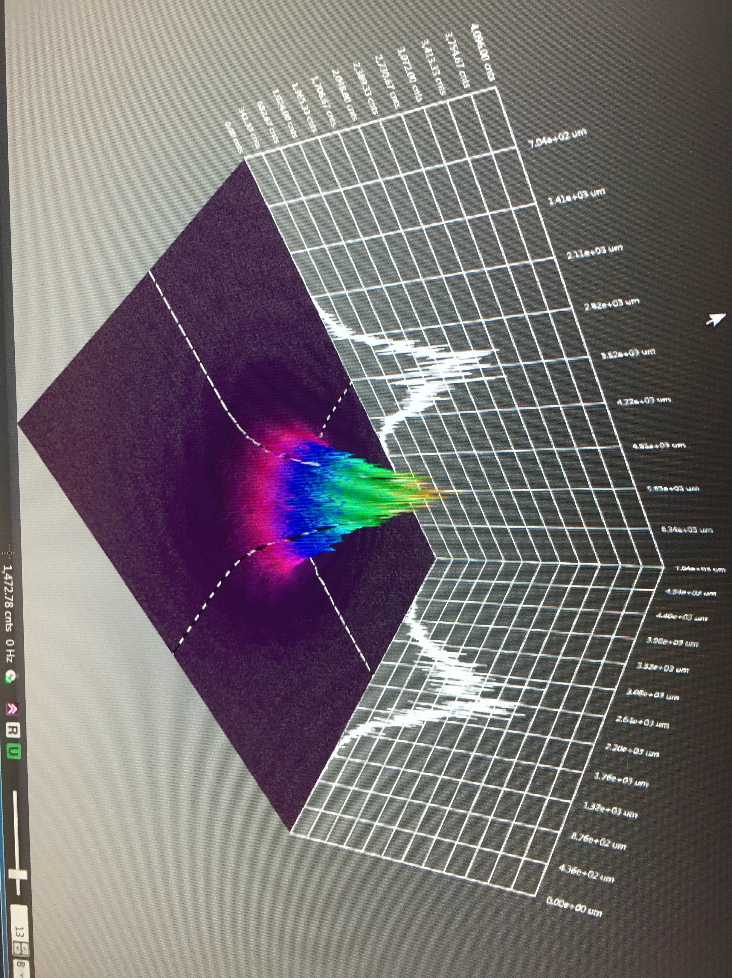

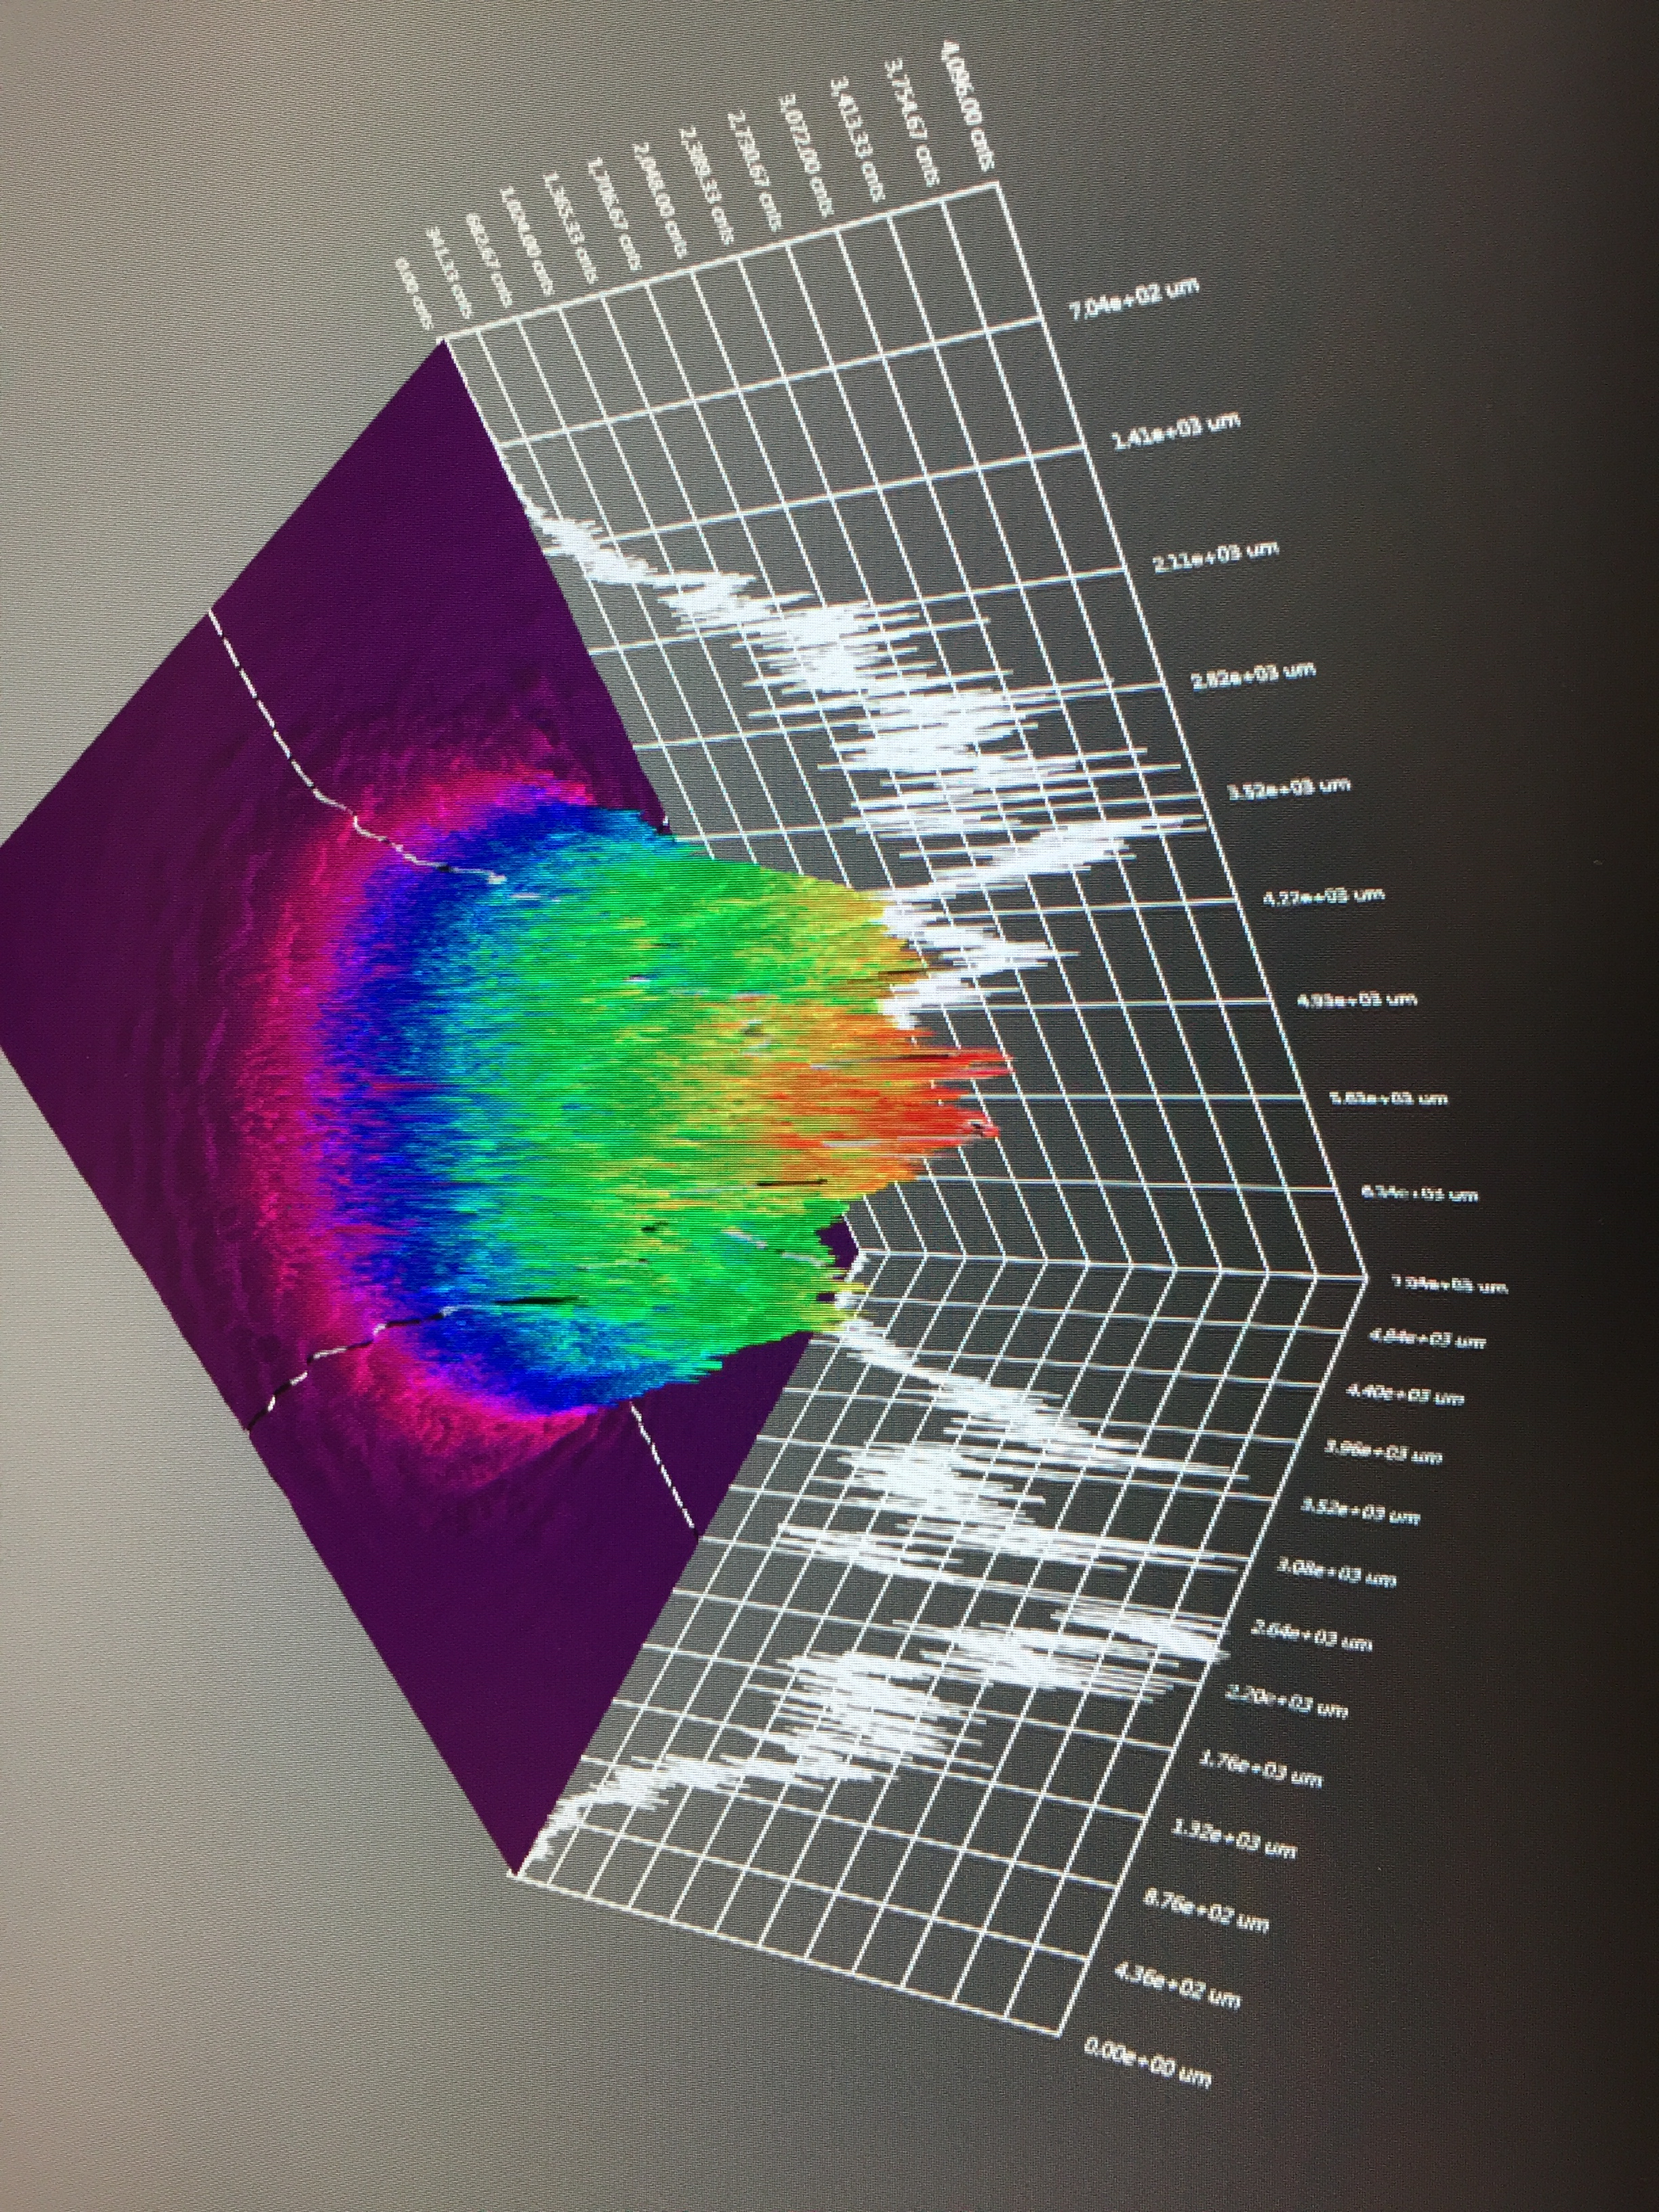
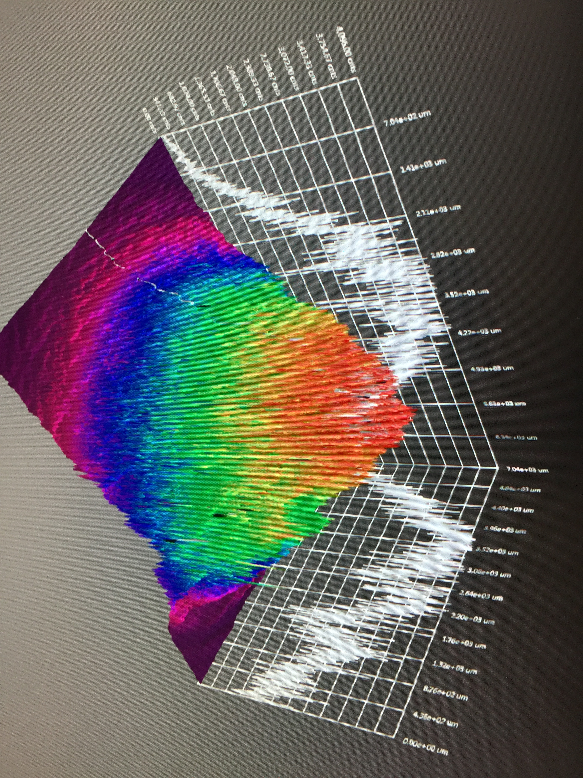
Testing the limits of charge lifetime vs. laser spot size
Bombardment of photocathode by ionized gas leads to loss of QE

Slide 16

World record highly spin polarized beam intensity
  CEBAF charge lifetime improves with larger laser size, as expected, but eventually beam size becomes “too large”
  Small amounts of beam loss adversely impact lifetime – to reap the reward of large laser spot size, no beam loss allowed!!
1 mA for 4.7 days
1mA(2007)
CEBAF
X-ray detectors identify correlation at ppm level when laser spot is “too big”
4mA(2011)

Slide 17

Electron beam polarization at 1 mA from GaAs/GaAsP
First measurement of beam polarization at JLab from strained superlattice GaAs/GaAsP photocathode at milli-Ampere current
No sign of spin depolarization when QE ~ 1%, with strong band-bending region. More measurements planned at lower QE.
CEBAF 5 MeV Mott Polarimeter
PEPPo (1uA)
JLab e- (200uA)
JLab e+ (1-10 mA)
?

Slide 18
Conclusions
The JLab user community is engaged and investing growing efforts to the possibility for using positron beams at CEBAF 12 GeV.
The recent positron LDRD award, similar to the support leading to the PEPPo experiment, demonstrates the lab’s commitment to take positron beams at JLab to the next level.
Polarized electron source R&D which supports an e-driven polarized positron source remains healthy, in part to meaningful collaborations with US and International labs, as well as industry.

