Slide 1
GPT -s
CF Optimization observations
Mark Stefani

Slide 2
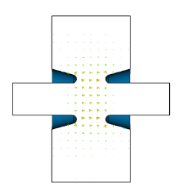
Optimizations currently in progress
The initial idea
Target moves inside the FC, field strength vs element length effects Polarization
Length ~20 cm Optimal
Solenoid optimal values seem to match and extend the field from FC
Capture/buncher cavity(s)… still looking for sensible solutions.

Slide 3
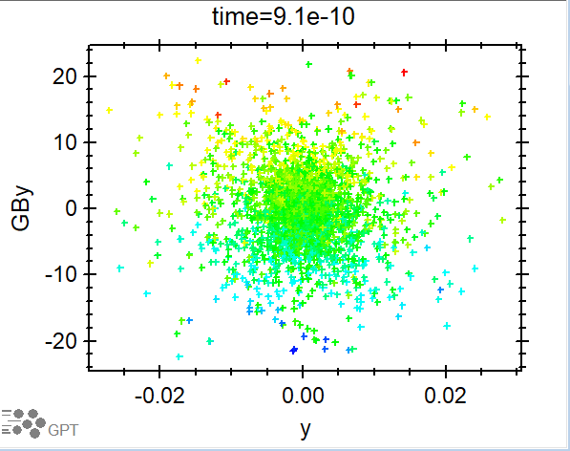
Magnetized
Charged particles generated in magnetized field have couple emittance. True here

Slide 4
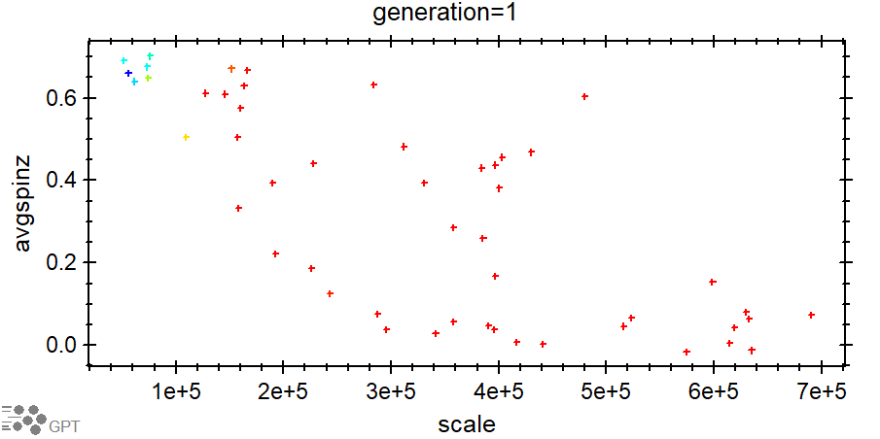

Slide 5
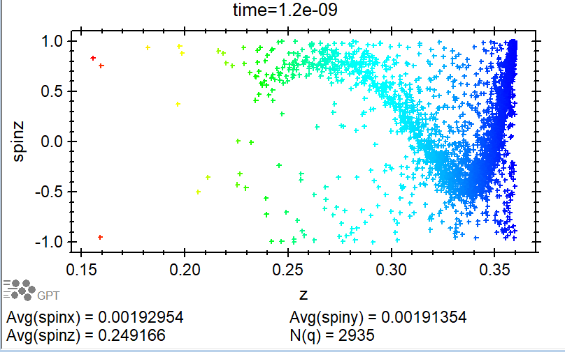
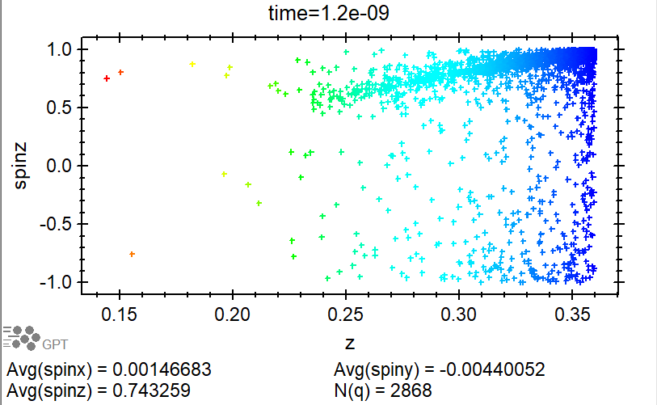

Slide 6
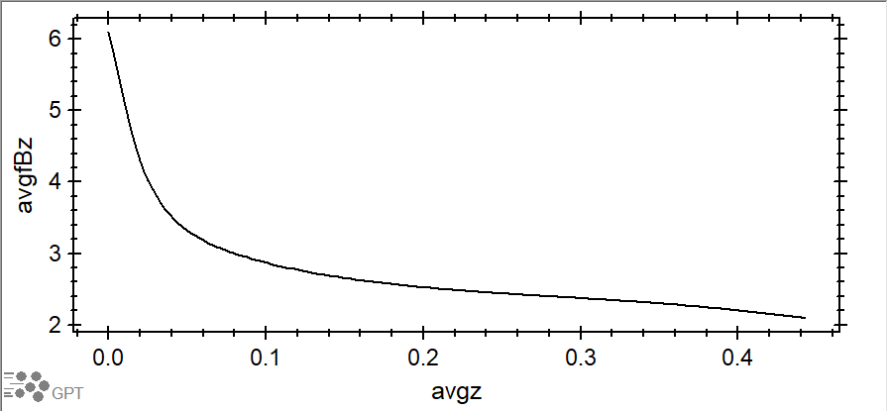
125 MeV e- ….. ~5-30 MeV e+

Slide 7
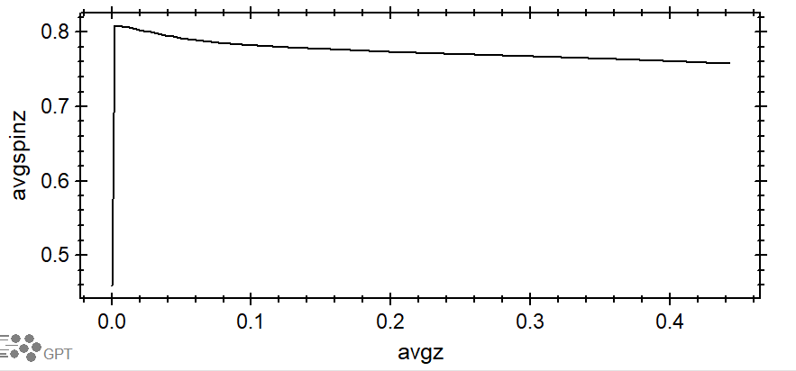
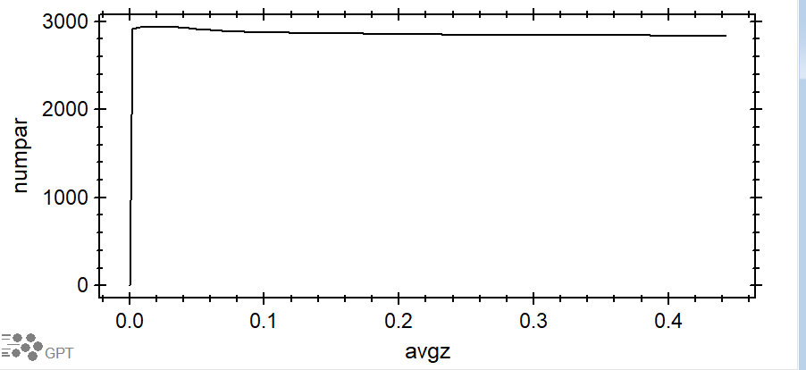

Slide 8
