Slide 1
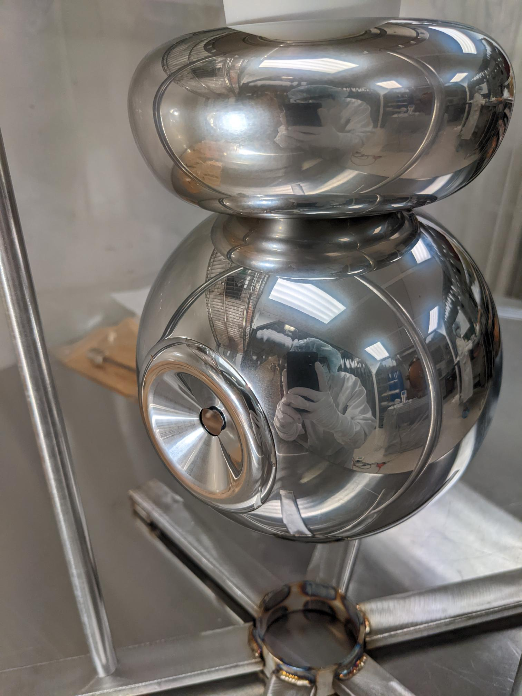
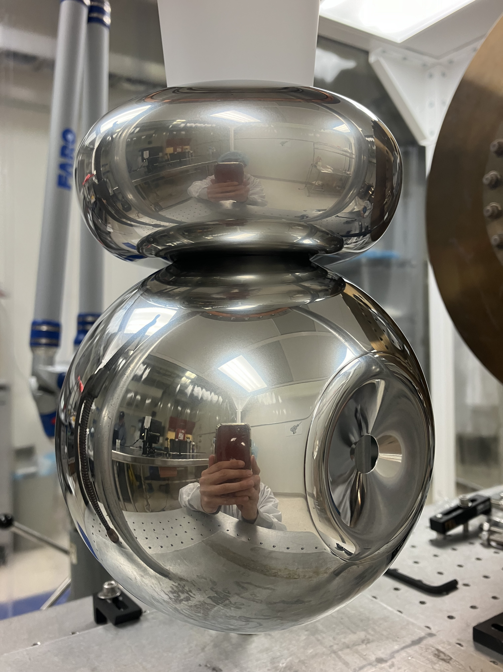
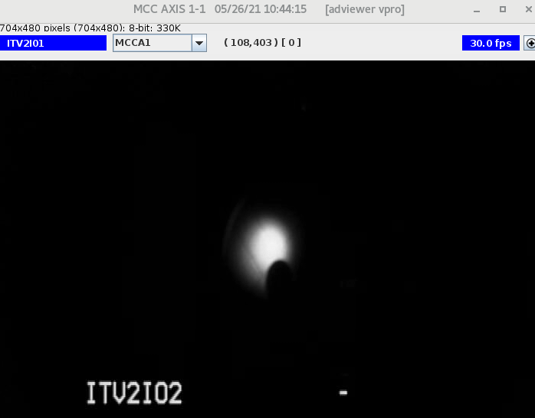
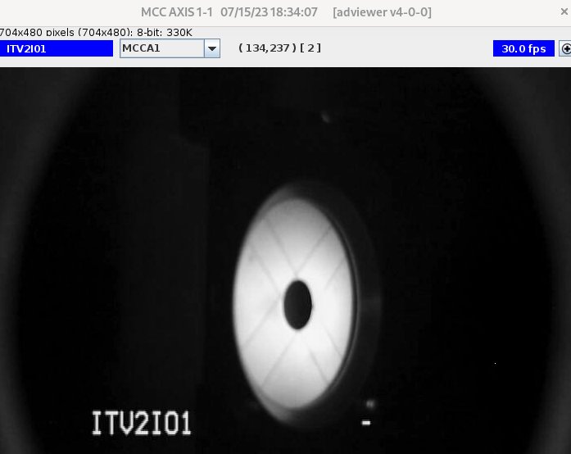
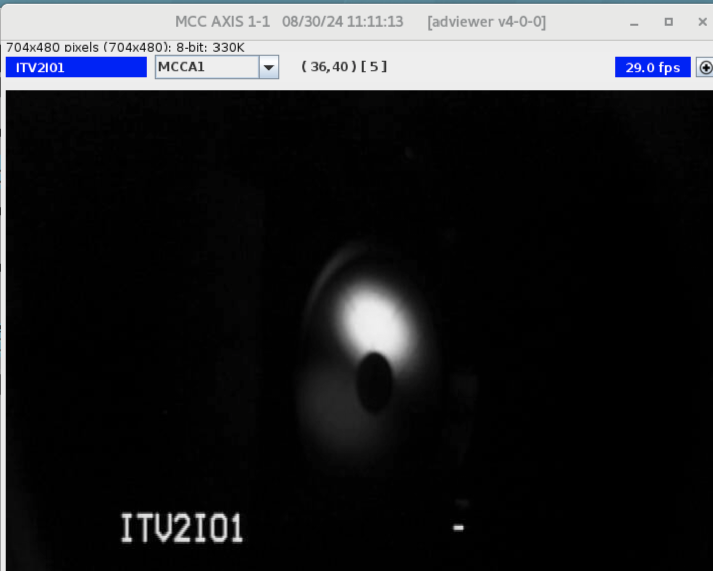
R28 gun
R30-3 gun
R30-4 gun
25˚ focusing
electrode
25˚ focusing
electrode
16˚ focusing
electrode
130 keV beam May-26-2021
200 keV beam Jul-15-2023
200 keV beam Aug-30-2024
MFX2I01 turned off
MFX2I01 turned off
MFX2I01 turned off

