Slide 1
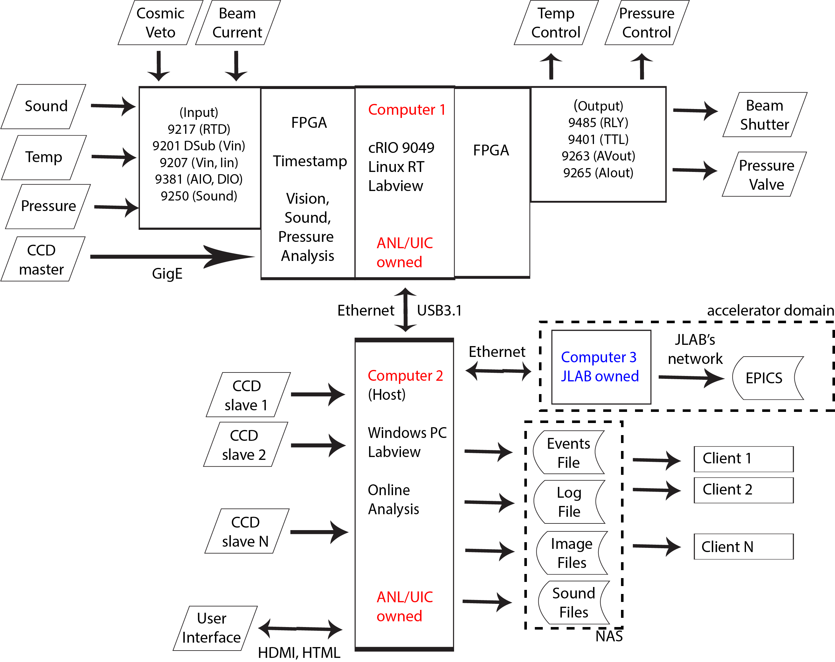

Slide 2
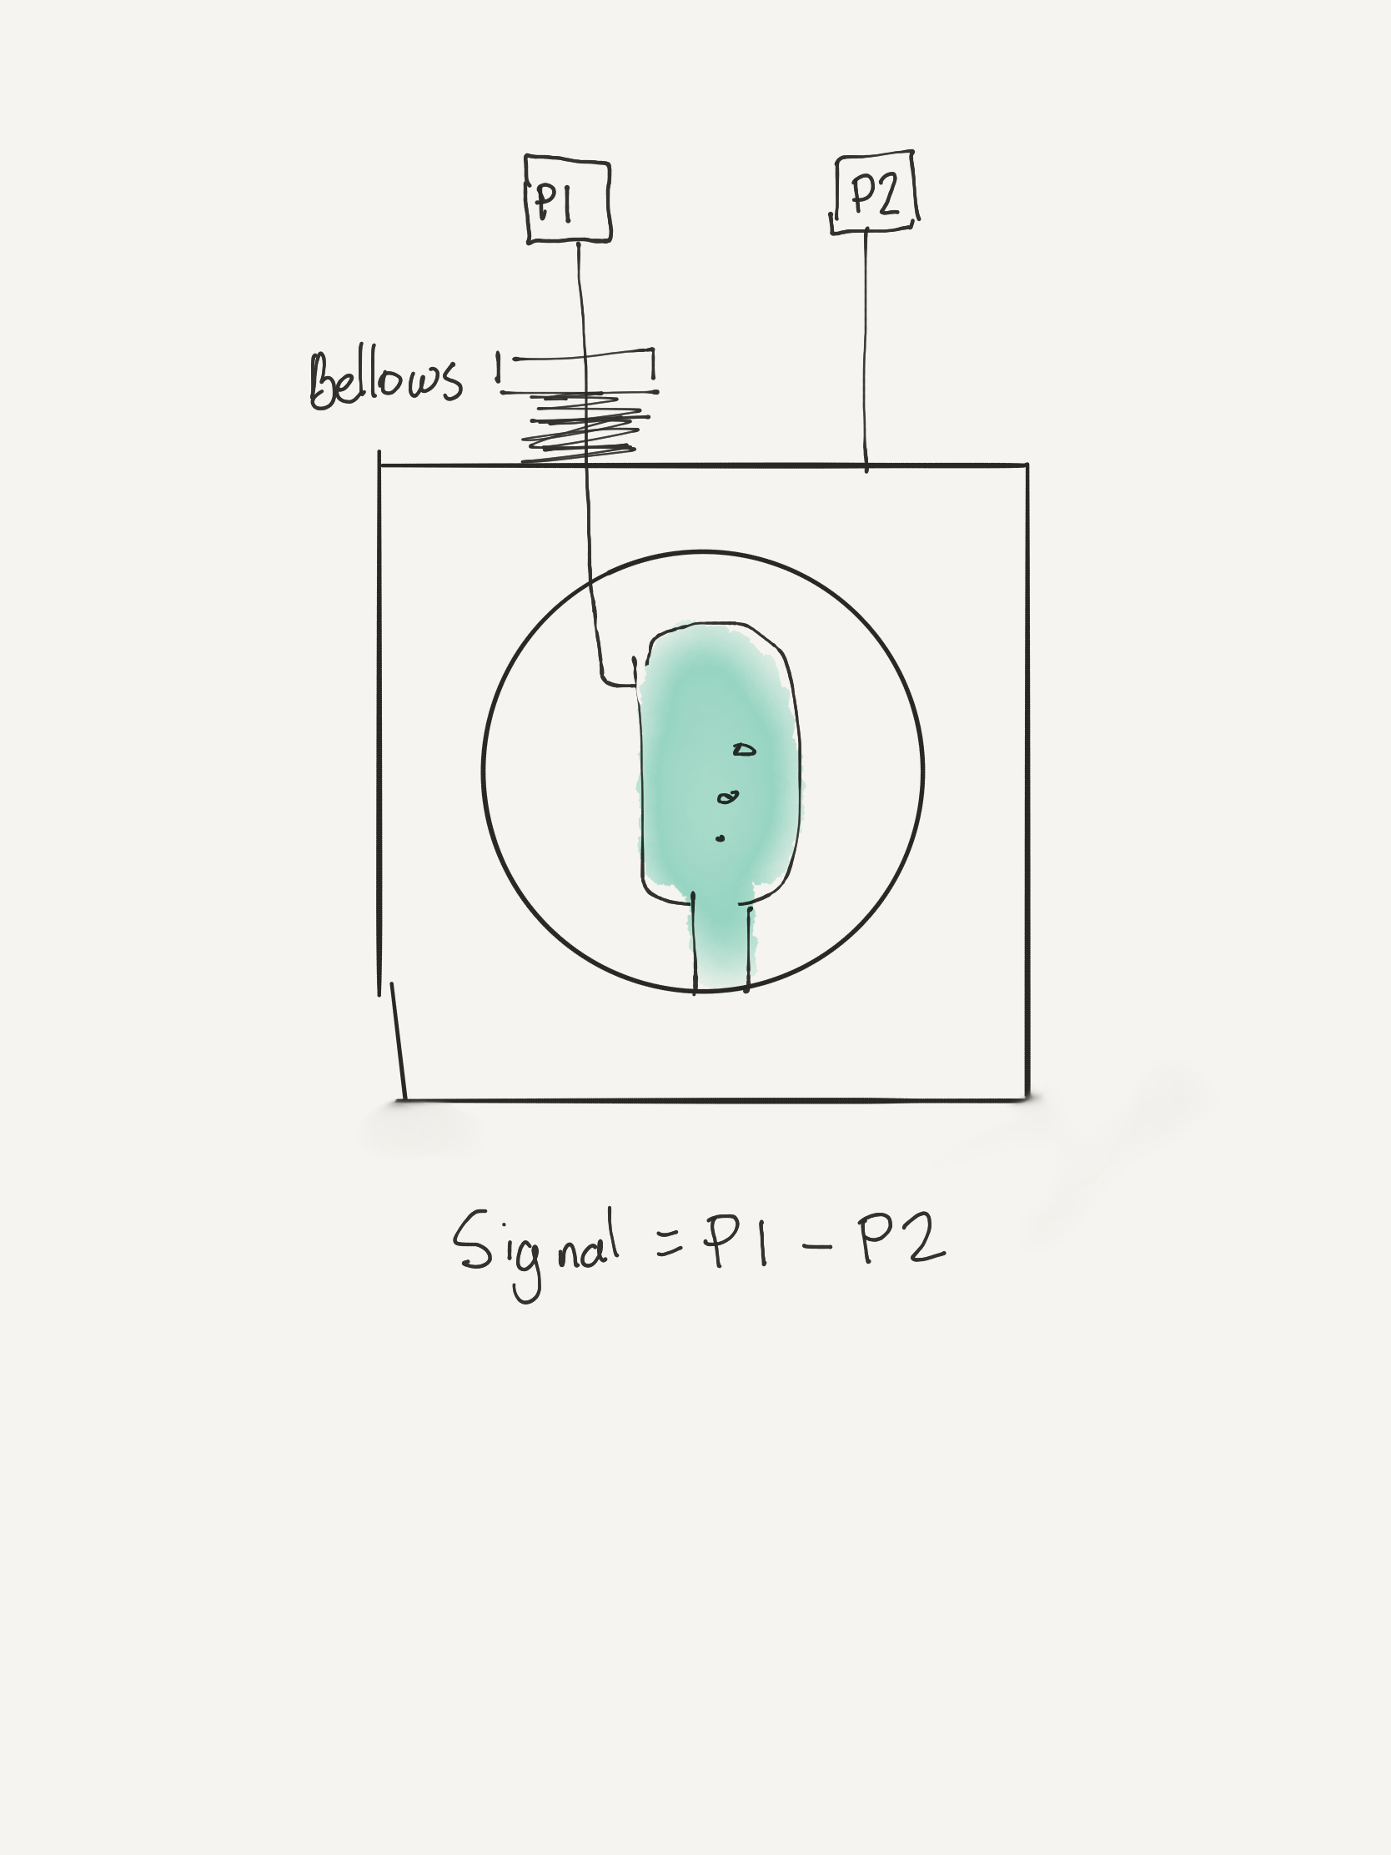
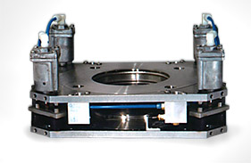
Acoustic discrimination with active noise cancellation
Bellows:
NEC VI-2. Pneumatic suspension.

Slide 3
Piezoceramics
FERROPERM
Look at 3-25 kHz band
Szydagis et al. 2011
FFT -> Amplitude +
Frequency content

