Slide 1
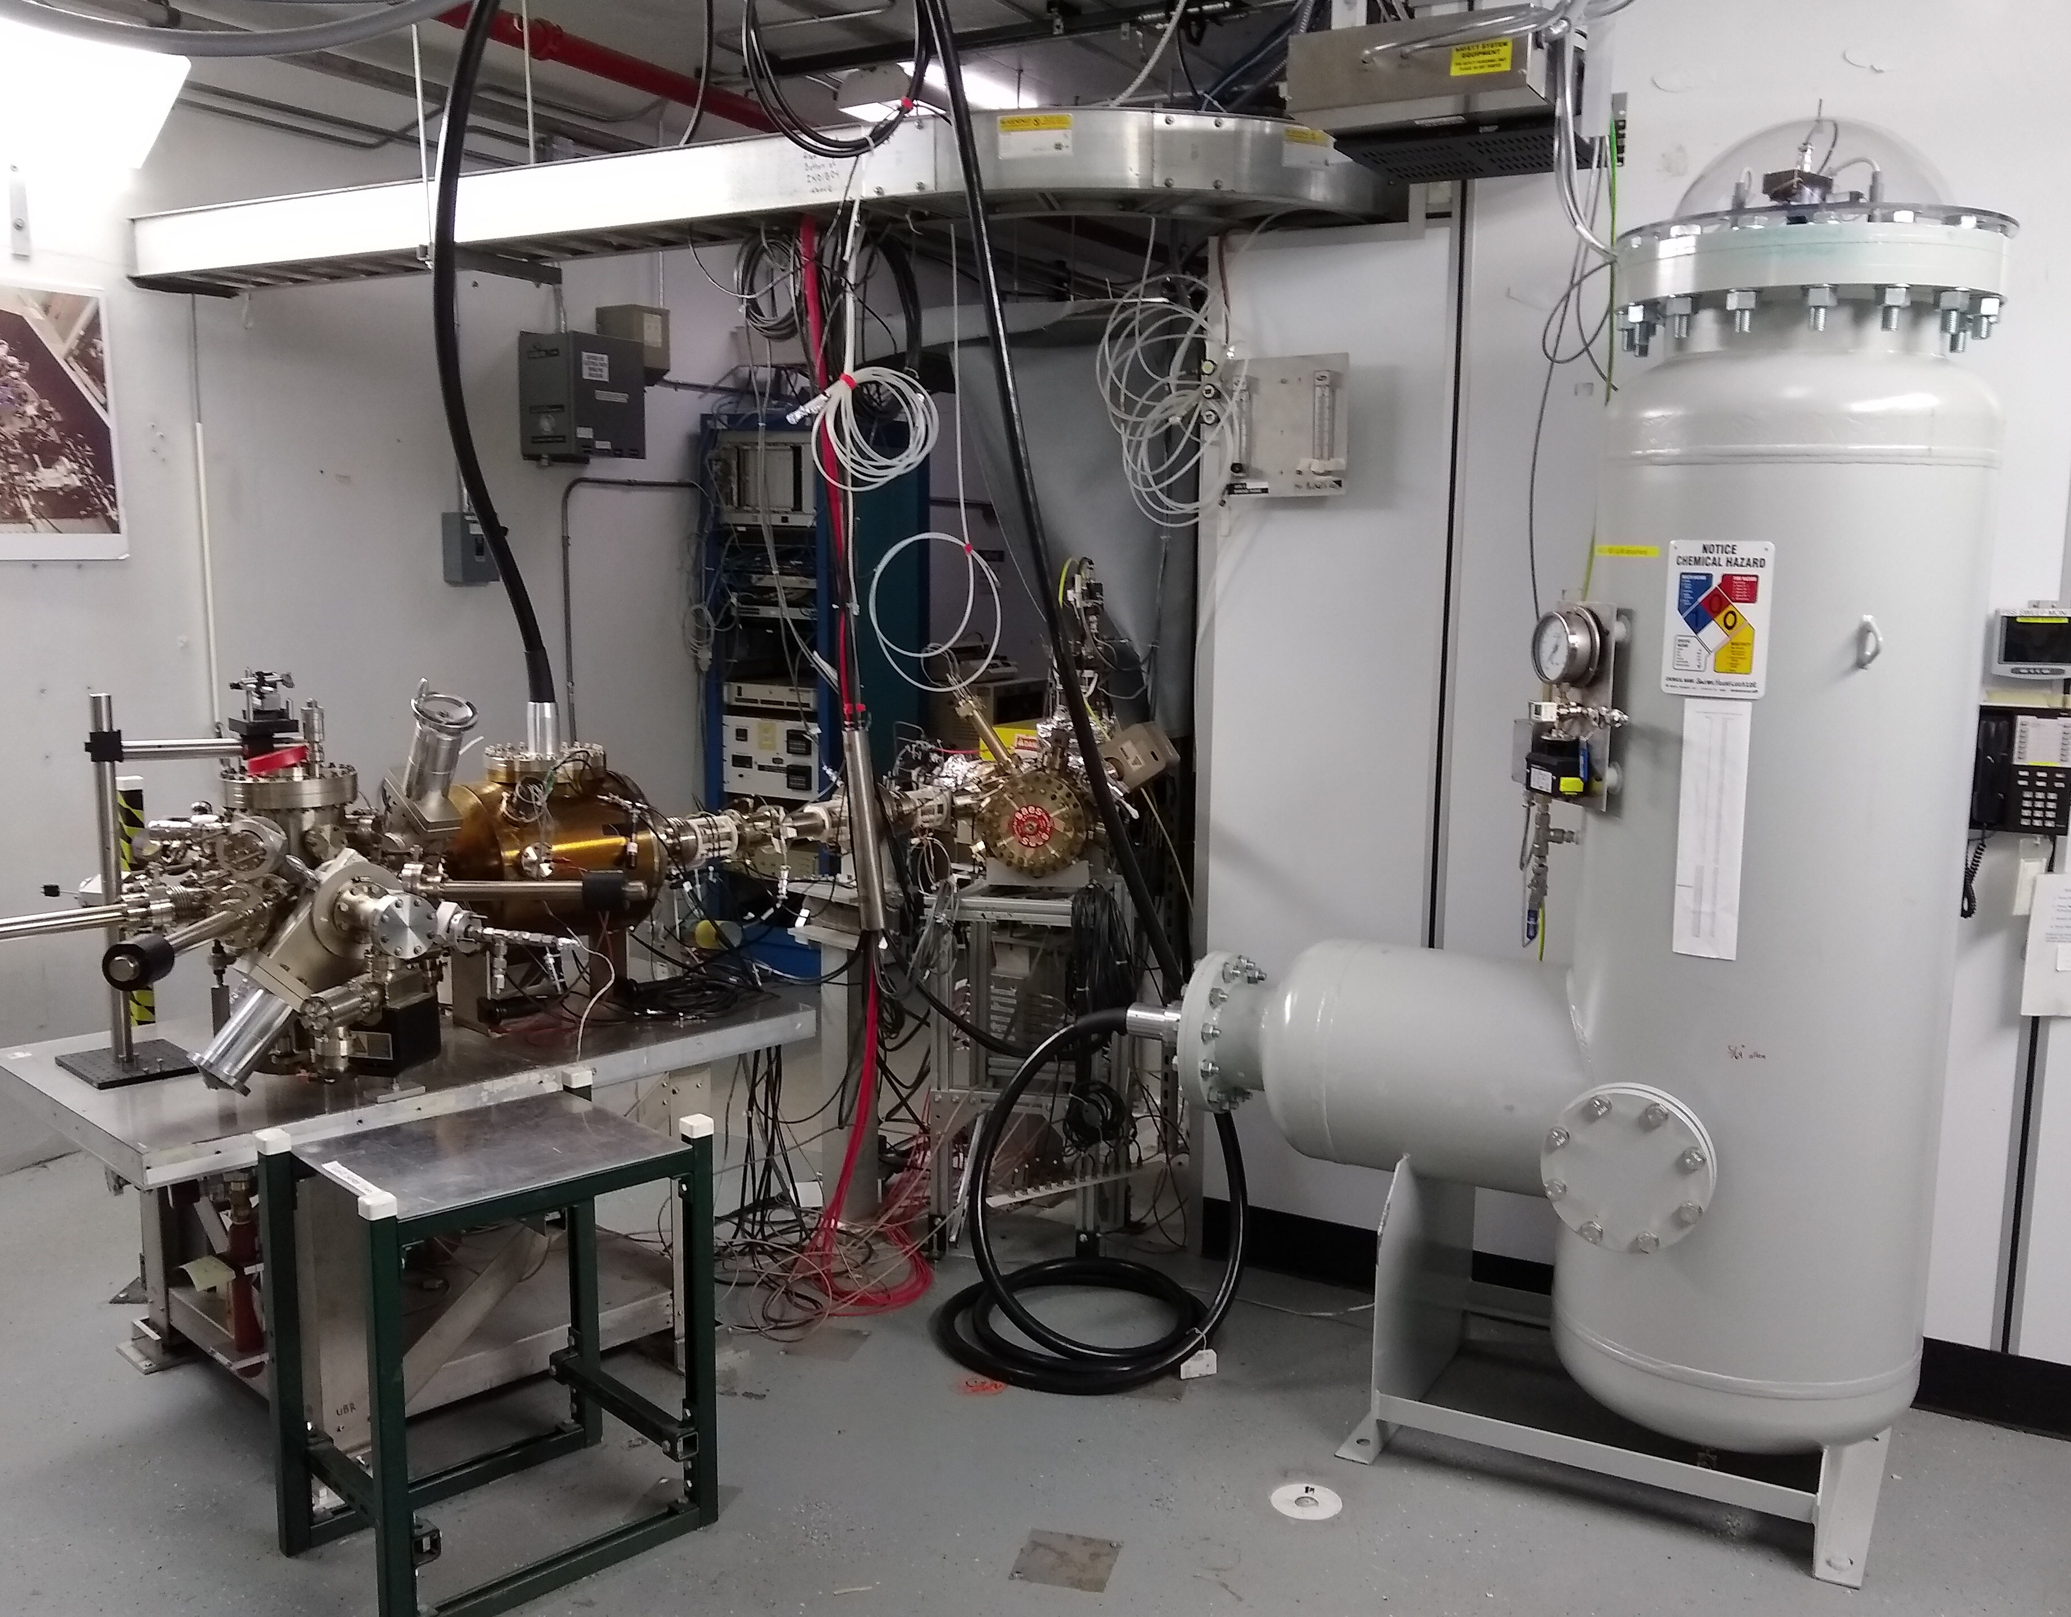
Polarized Source: Recent Activities
Fall Program 2018
Source has operated reliably, providing high polarization >85% & 4-hall ready all the time
A new cathode electrode w/ shed operated well @ 130kV w/ good QE lifetime @ 50-100uA
The new 350 kV HVPS (for eventual 200kV gun) operated very well, w/ high reliability
New NEG BPM’s useful for PQB measurements & injector setup
Winter SAD 2019
Photocathode re-activated, yielding ample QE~0.7% for Spring program.
UVA installed new electro-optic polarization Pockels cell and controls to enable faster helicity reversal & capability for both HC charge & position feedback
Helicity magnets re-installed, ready for testing position feedback (see Riad’s slide)
Polarized Source (Jan 2019)
RTP EO Cell (Jan 2019)

Slide 2
Polarized Source & Injector 6 month Forecast
Spring Program 2019 (Feb-Apr)
Polarized source is ready for Spring program (recent Mott measurement => 87%)
ATLIS tasks submitted for Beam Studies (characterize Pockels cell and Helicity Magnets)
Spring SAD 2019 (Apr-May)
Bubble Chamber Experiment engineering run planned (3 weeks)
Beam based measurements of present cathode electrode for PhD thesis (1 week)
Photocathode heat and reactivation before PREX run to improve QE uniformity
Final PQB setup of laser & photocathode in advance of machine restoration for PREX
Summer Program 2019 (Jun-Jul)
Hall A PQB laser table controls (Pockels cell, IHWP, RWP, IA’s for ABC) are ready
Helicity board ready for faster reversal rates (120 or 240 Hz) and Line Sync bug resolved
Summer SAD 2019 (Aug-Sep)
Install optimized 200kV cathode electrode and bake gun
HV condition electrode to 200kV to achieve no field emission
Produce 200keV beam to test chopper and explore option w/ existing SRF acceleration
Return gun to 130kV for the Fall CREX run period
We may deploy improved polarization maintaining seed/preamp laser oscillator

Slide 3
CEBAF Injector Upgrade: 2020
The injector upgrade is planned to start in May 2020 and last about 6 months.
The Polarized Source beamline must be rebuilt to include two 200kV Wien filters upstream of the prebuncher and new PSS kicker magnet. It may also include improved magnets and NEG coated vacuum chambers and beam pipes.
The Booster beamline must be rebuilt to include the new SRF booster module (replaces capture + existing ¼ cryounit) and retain injector PSS segmentation. It may also include improved magnets and diagnostics.
Weekly meetings with ME have begun, to sort and establish a baseline design for purposes of simulations, designing components and developing a commissioning plan and schedule.
Polarized Source Beamline
Booster beamline

