Slide 1

Injector Upgrade Update
SAD 2018 : Gun2
Joe Grames
July 11, 2018

Slide 2
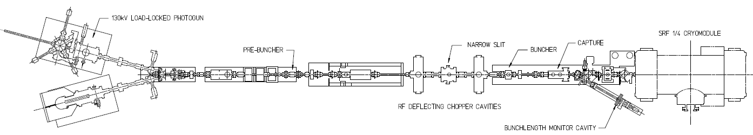
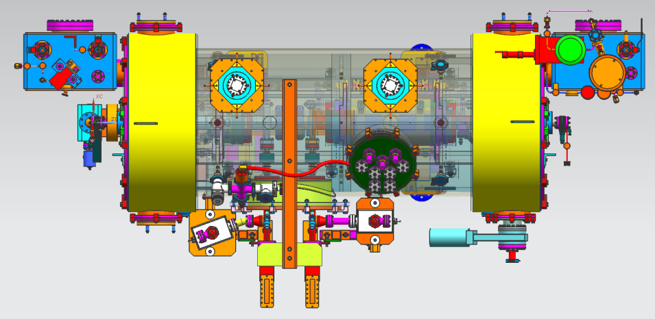
Injector Upgrade Project
200 kV
Stage 1 - Increase gun voltage and Wien filters for 200kV operation
Stage 2 - Locate Wien filters (energy filter) upstream of pre-buncher cavity
Stage 3 - New SRF booster eliminates warm capture, RF deflection and x/y coupling
Our new “1/4 cryomodule”:
2 cell capture section + 7 cell cavity,
should provide 10 MeV beam and introduce no x/y coupling, allow better matching, more adiabatic damping

Slide 3
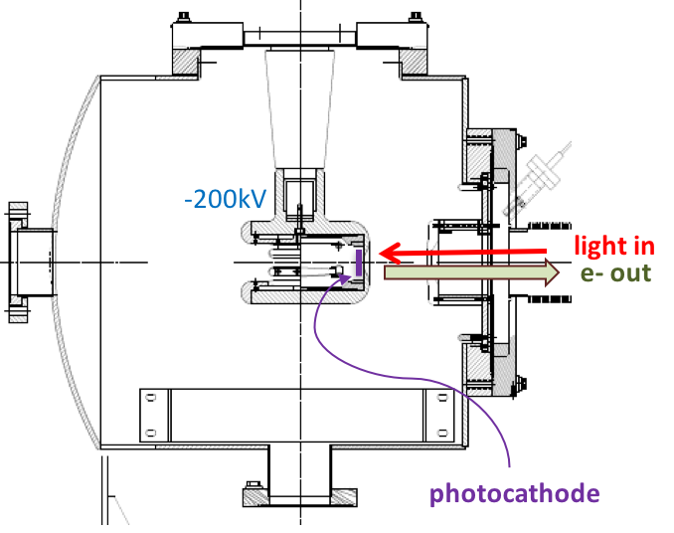

200 kV Gun Design Goals
Modify spare CEBAF/ILC gun for reliable 200 kV operation
  Retain extreme high vacuum (XHV) 1E-12 Torr
  Reliable 200 kV operation w/o field emission
Work of G. Palacios, C.H. Garcia

Slide 4
COMSOL model of gun improvements
Original CEBAF Inverted Electrode @ 200 kV
Upgraded Electrode @ 200kV
Pure alumina insulator
No triple point shielding
Mildly conductive alumina insulator for charge dissipation
Triple point shielding to prevent arcing across HV plug
Work of G. Palacios, C.H. Garcia

Slide 5
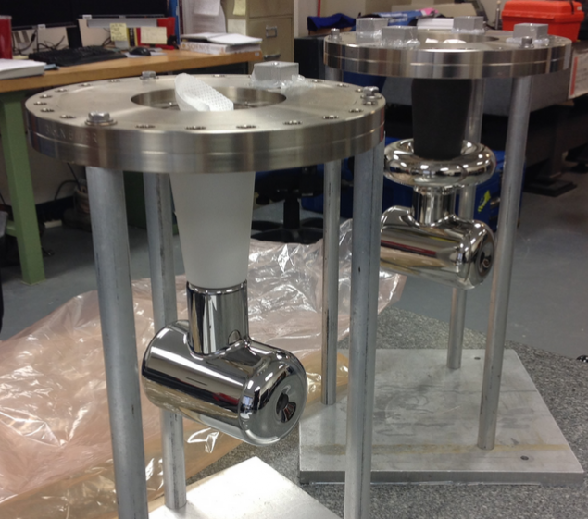
Gun2 Electrodes (May 2018)
The cathode electrode used in Gun2 at 130 kV during the 6 GeV era, and so far during the 12 GeV program.
New cathode electrode, first operated at the UITF @ 200kV and now installed in Gun2. The addition of the annular “shed” limits field gradient at the ceramic - vacuum - metal interface below.

Slide 6
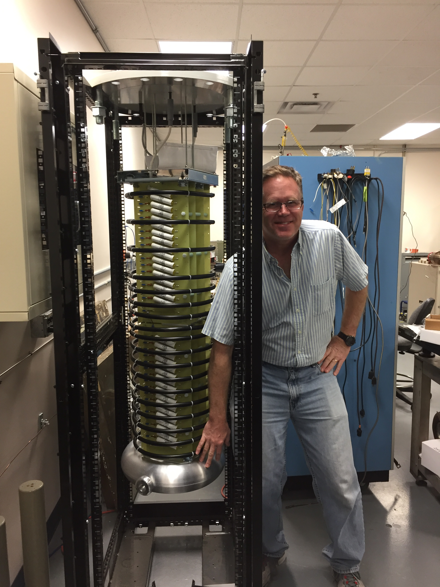
CEBAF Glassman 350 kV HVPS
High Voltage Ops (Power/Beam)
HVPS Enabled = Making Beam
Stages rectify 5 kV AC waveform
Max voltage at torus : -350 kV
Max current at torus : 4.5 mA
Low Voltage Ops (Restricted)
HVPS Disabled = QE Wafer Scan
Stages rectify 18V AC waveform
Max voltage at torus : -28 V
Max current at torus : 6 microAmp

Slide 7
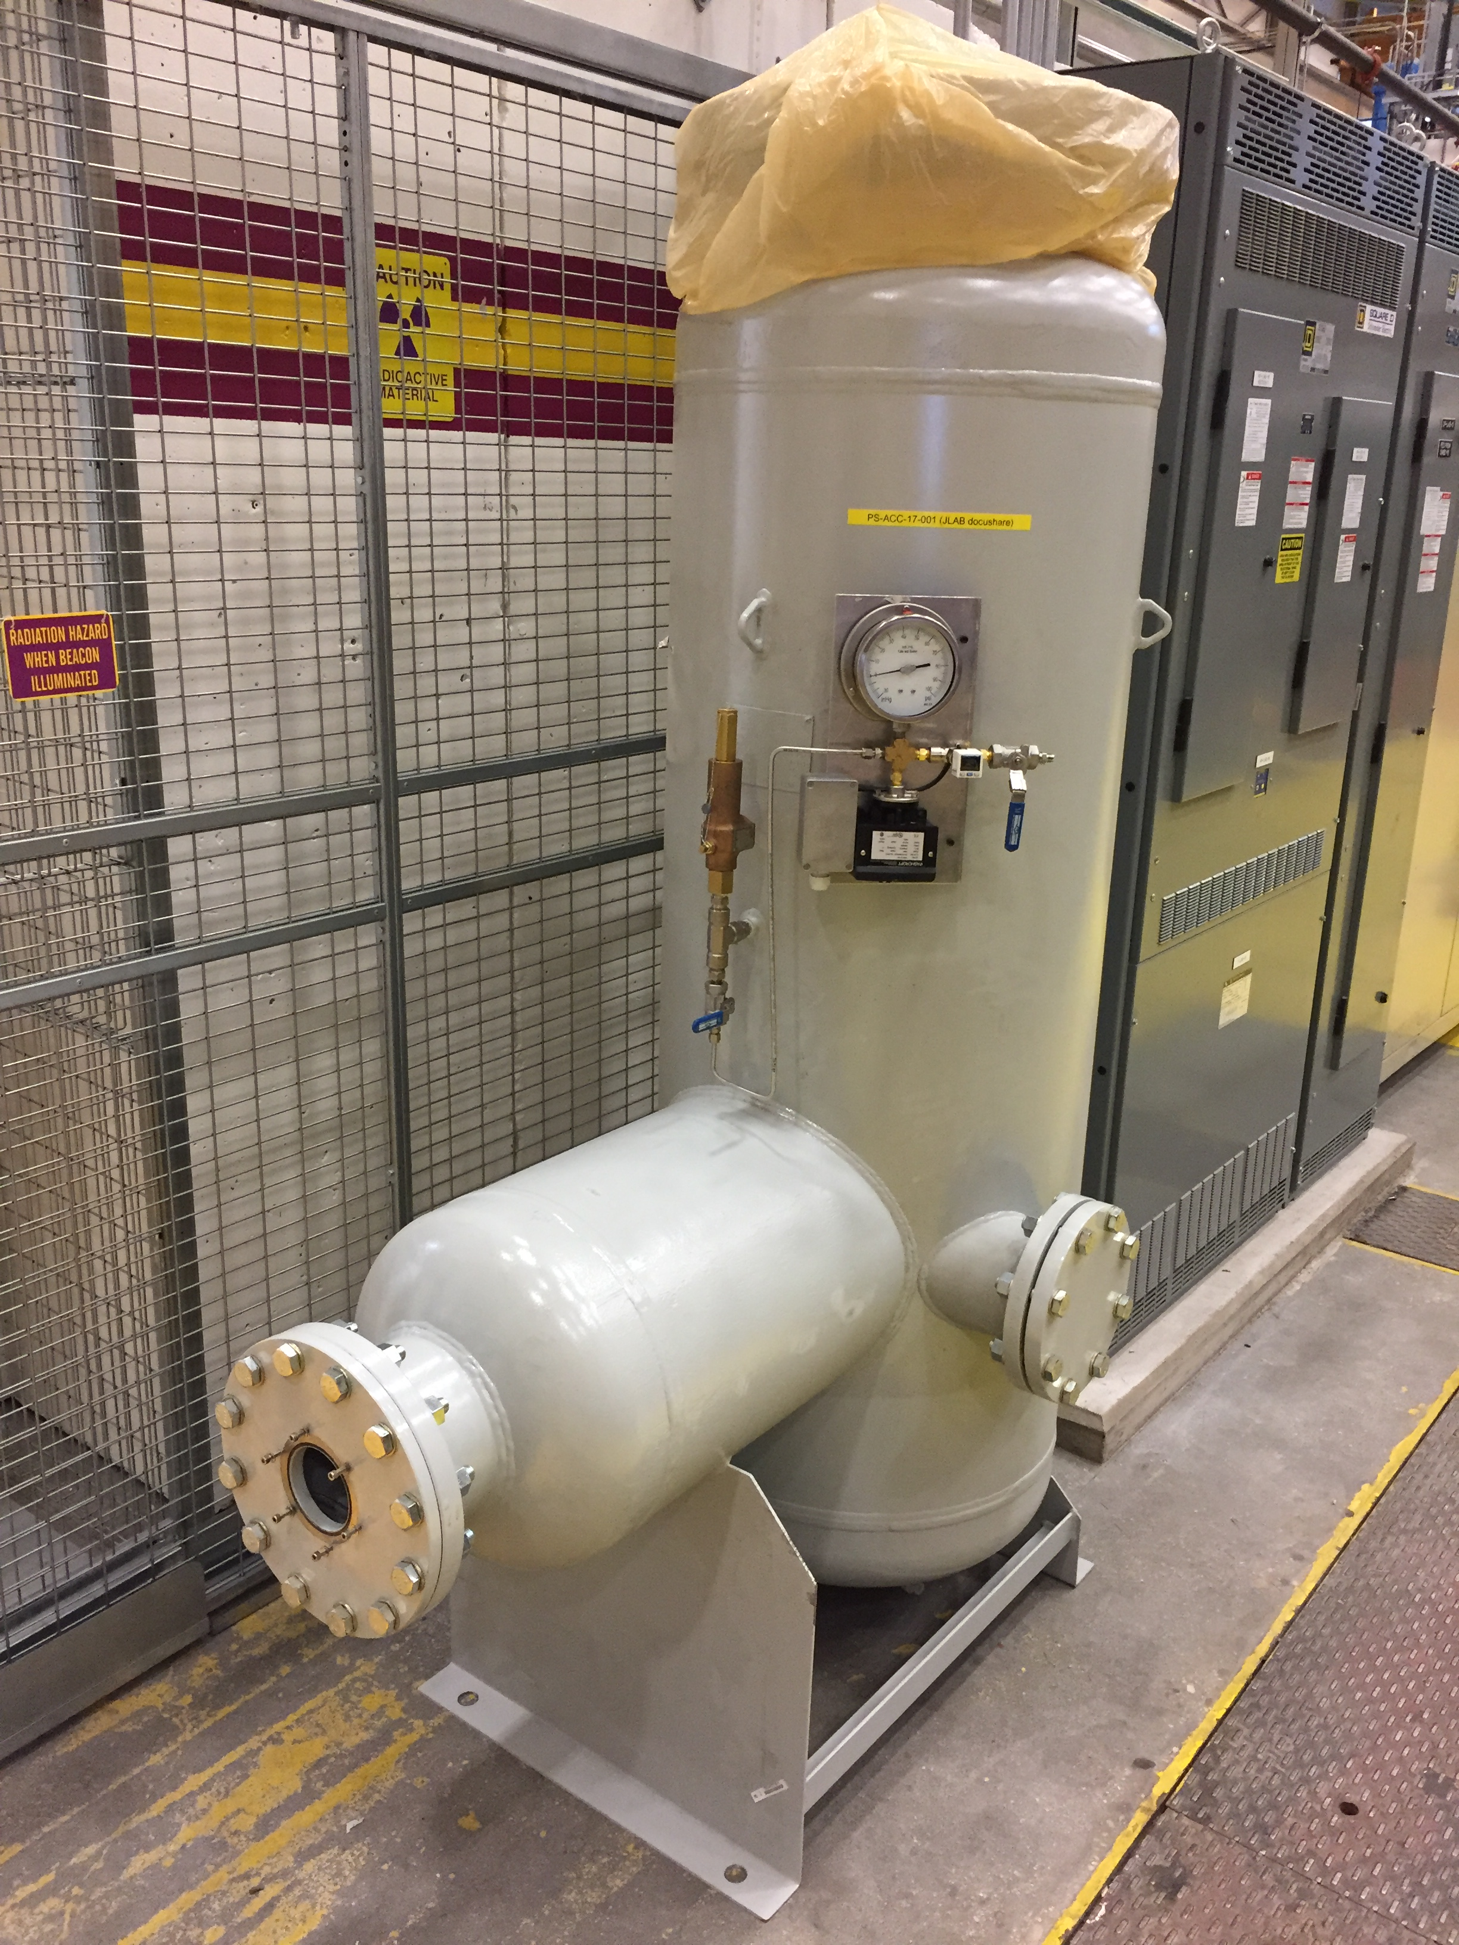
SF6 Pressure Tank
Design Authority : George Biallas
Docushare : PS-ACC-17-001
Parameter | Pressure
Vessel rating | 100 psi
Burst valve | 75 psi
Operating | 60 psi
HVPS Interlock | 55 psi

Slide 8
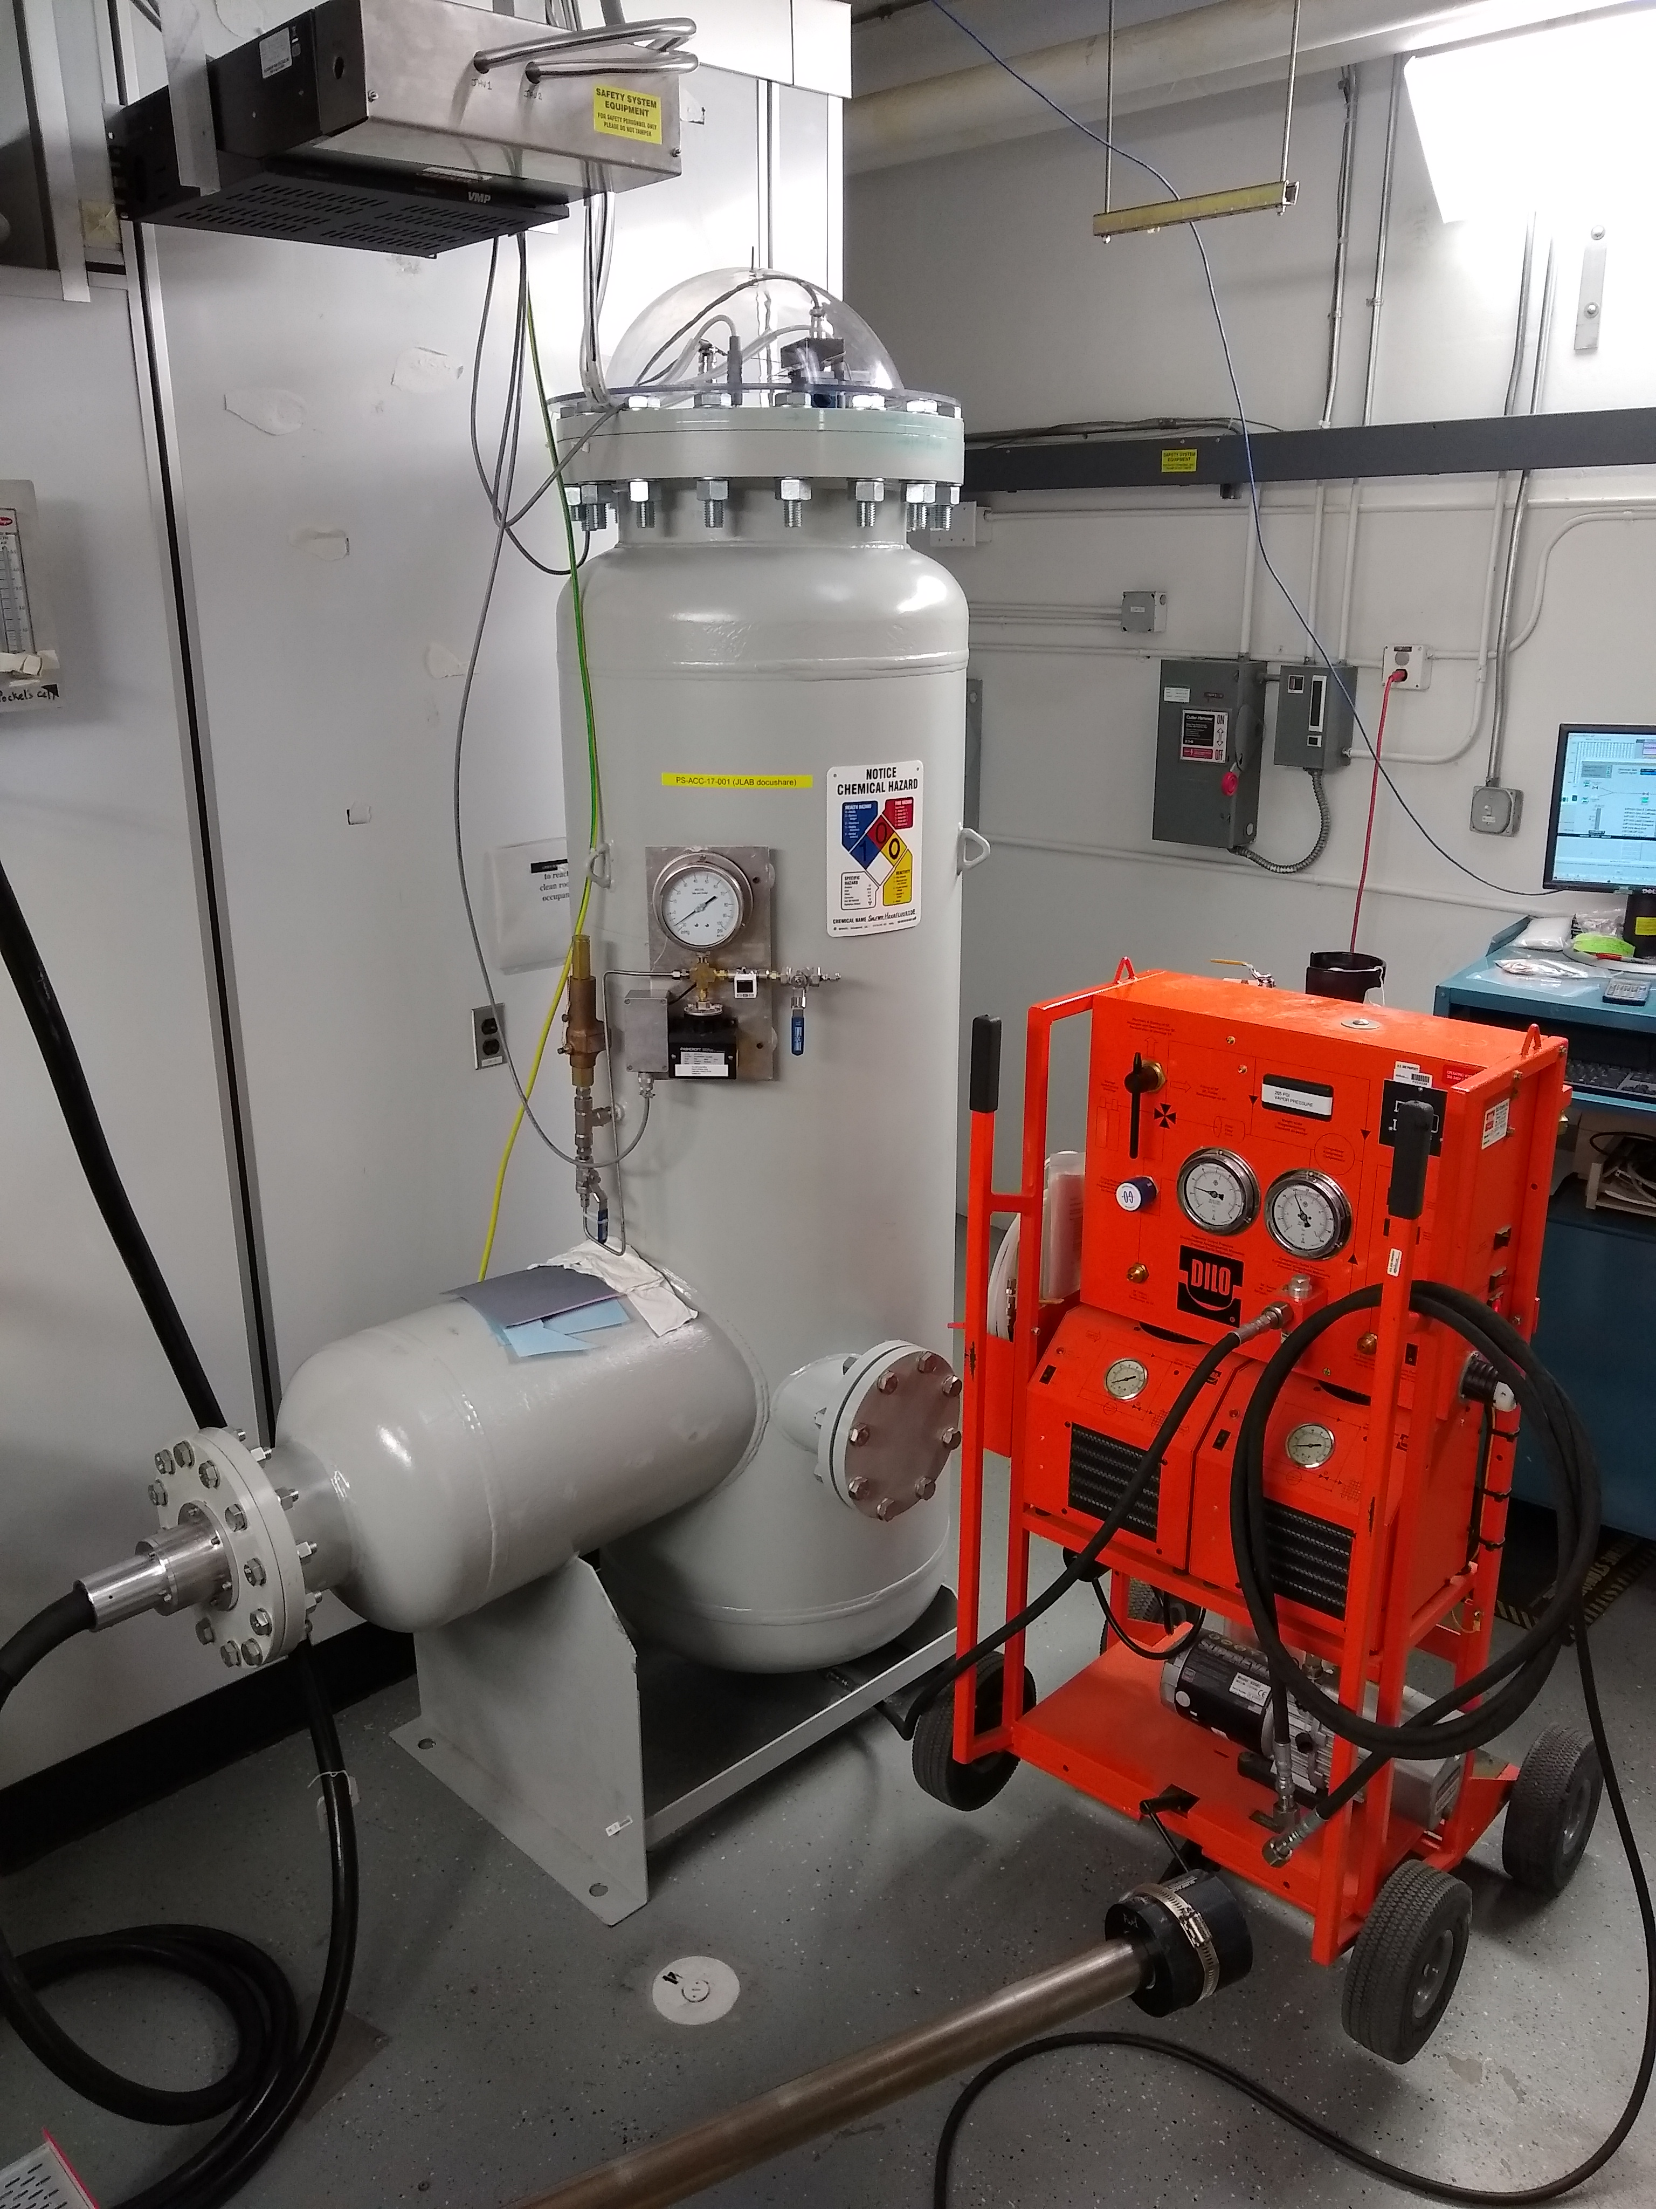
SF6 Recovery System (June 11, 2018)
J. Hansknecht, “SF6 Gas Transfer Tech Note” (February 1, 2017)
SF6 transfers are performed using the DILO D-320-R006 B143R01 Gas transfer and recovery unit.
Charging : SF6 Alum. Cylinder to Tank
Recovery : Tank to SF6 storage
Pumpdown : Tank evacuation (venting)
Parameter | Value
Tank Volume | 25 cf
SF6 weight (60psi) | 47 lb
Alum. Bottle Capacity | 75 lb
Alum. Bottle Lifetime | 5 years
J. Willliams (EHS&Q) formalizing SF6 spill assessment – amounts to < 3” above floor surface.

Slide 9
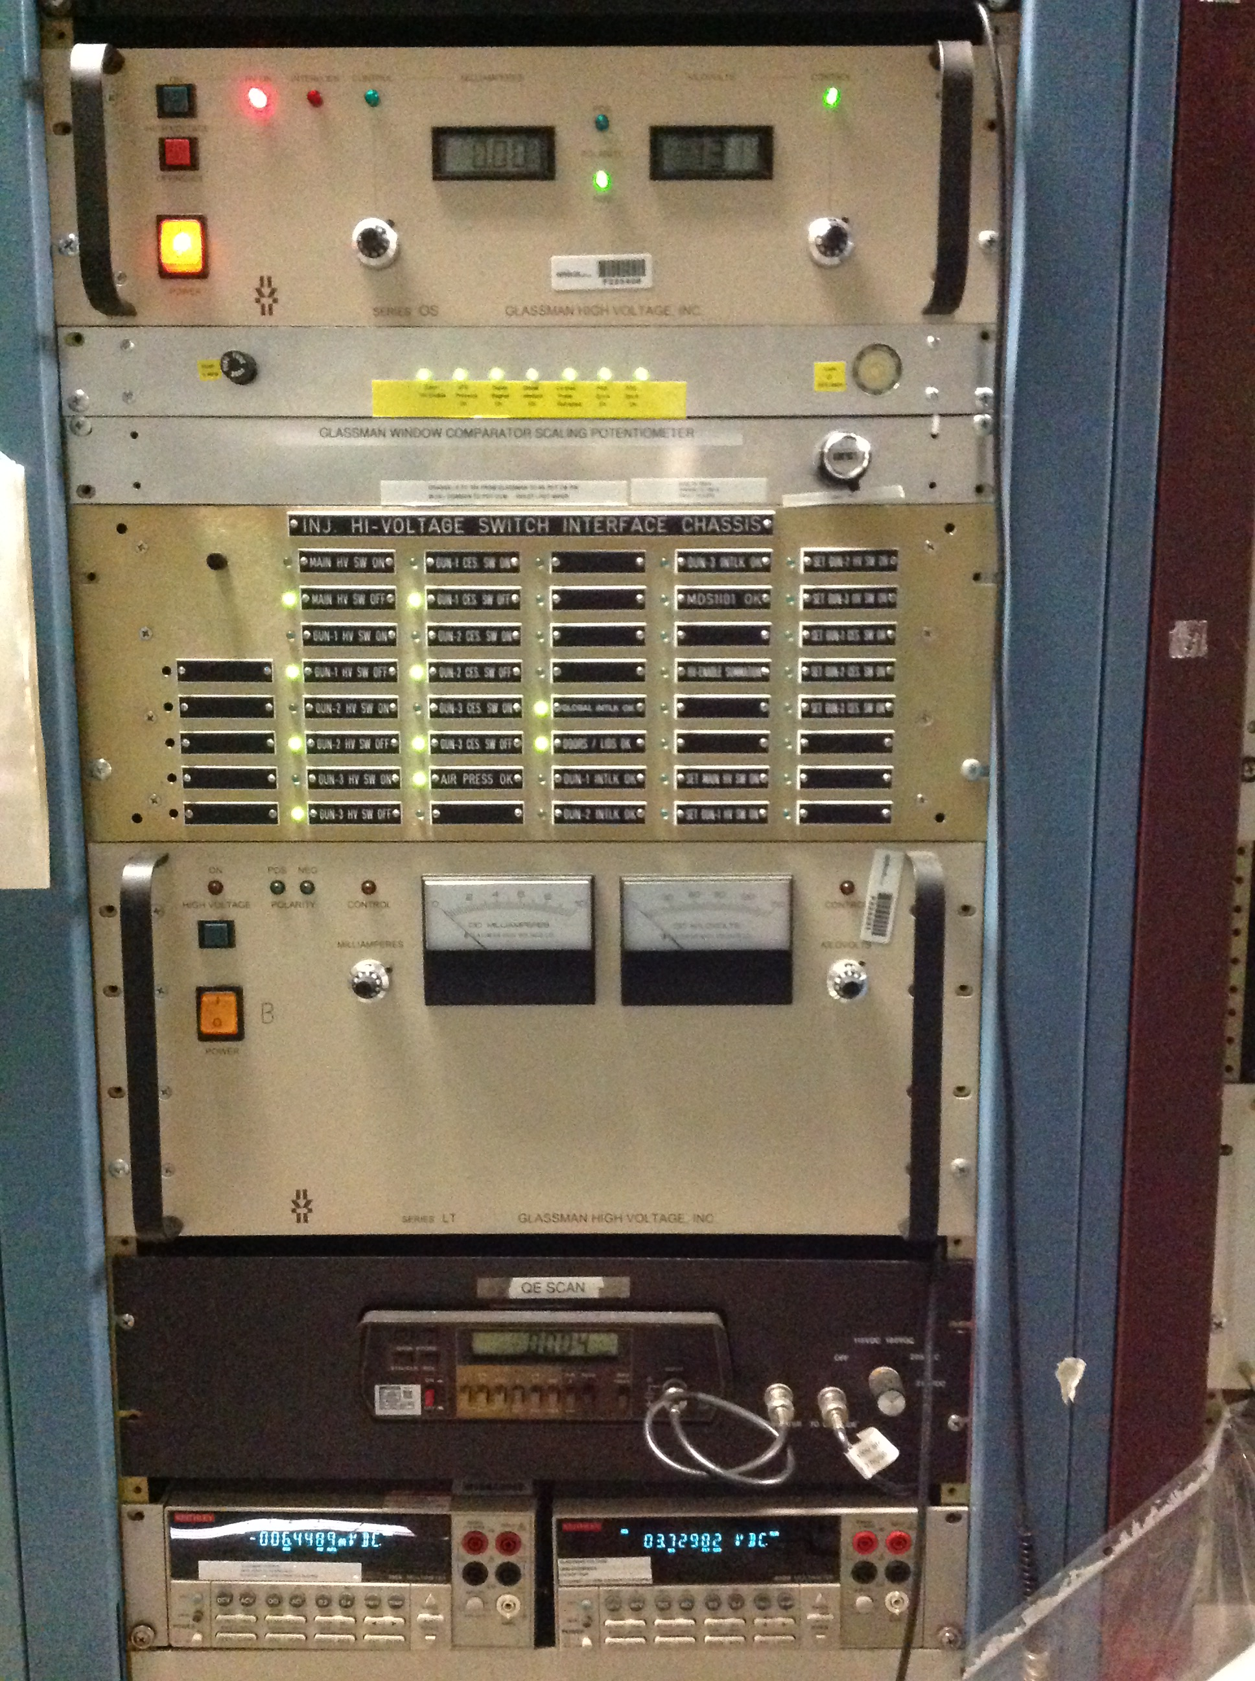
150kV/350kV HVPS Controls (IN01B01)
Glassman 350 kV Controller
350 kV Interlock Interface Unit
150 kV Interlock Interface Unit
Glassman 150 kV Controller/Supply
Multimeters (PS Voltage/Current)
Same for 150/350 kV Systems

Slide 10
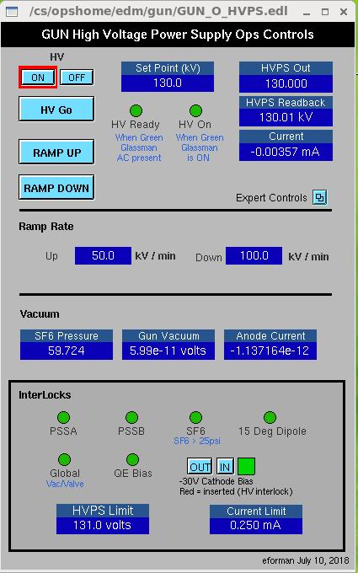
350 kV HVPS Operations Control (Software)
Glassman Interface
Turn supply ON/OFF (when HV Ready)
Set and Read PS Voltage and Current
Controls Ramp rates
Monitors Gun Performance + SF6
HV Enable Interlocks (PSS, SF6, Dipole, Gun Valve, Gun Vac, Bias Circuit)
Writes limits to Glassman controller

Slide 11
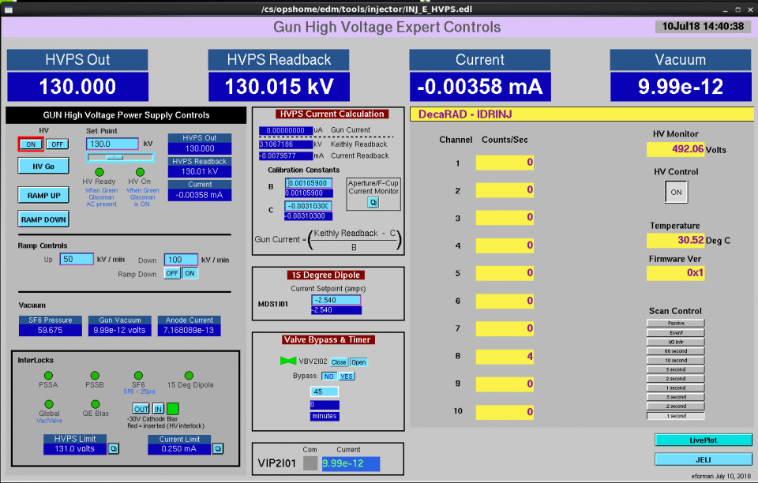
350 kV HVPS Operations Control (Software)

Slide 12
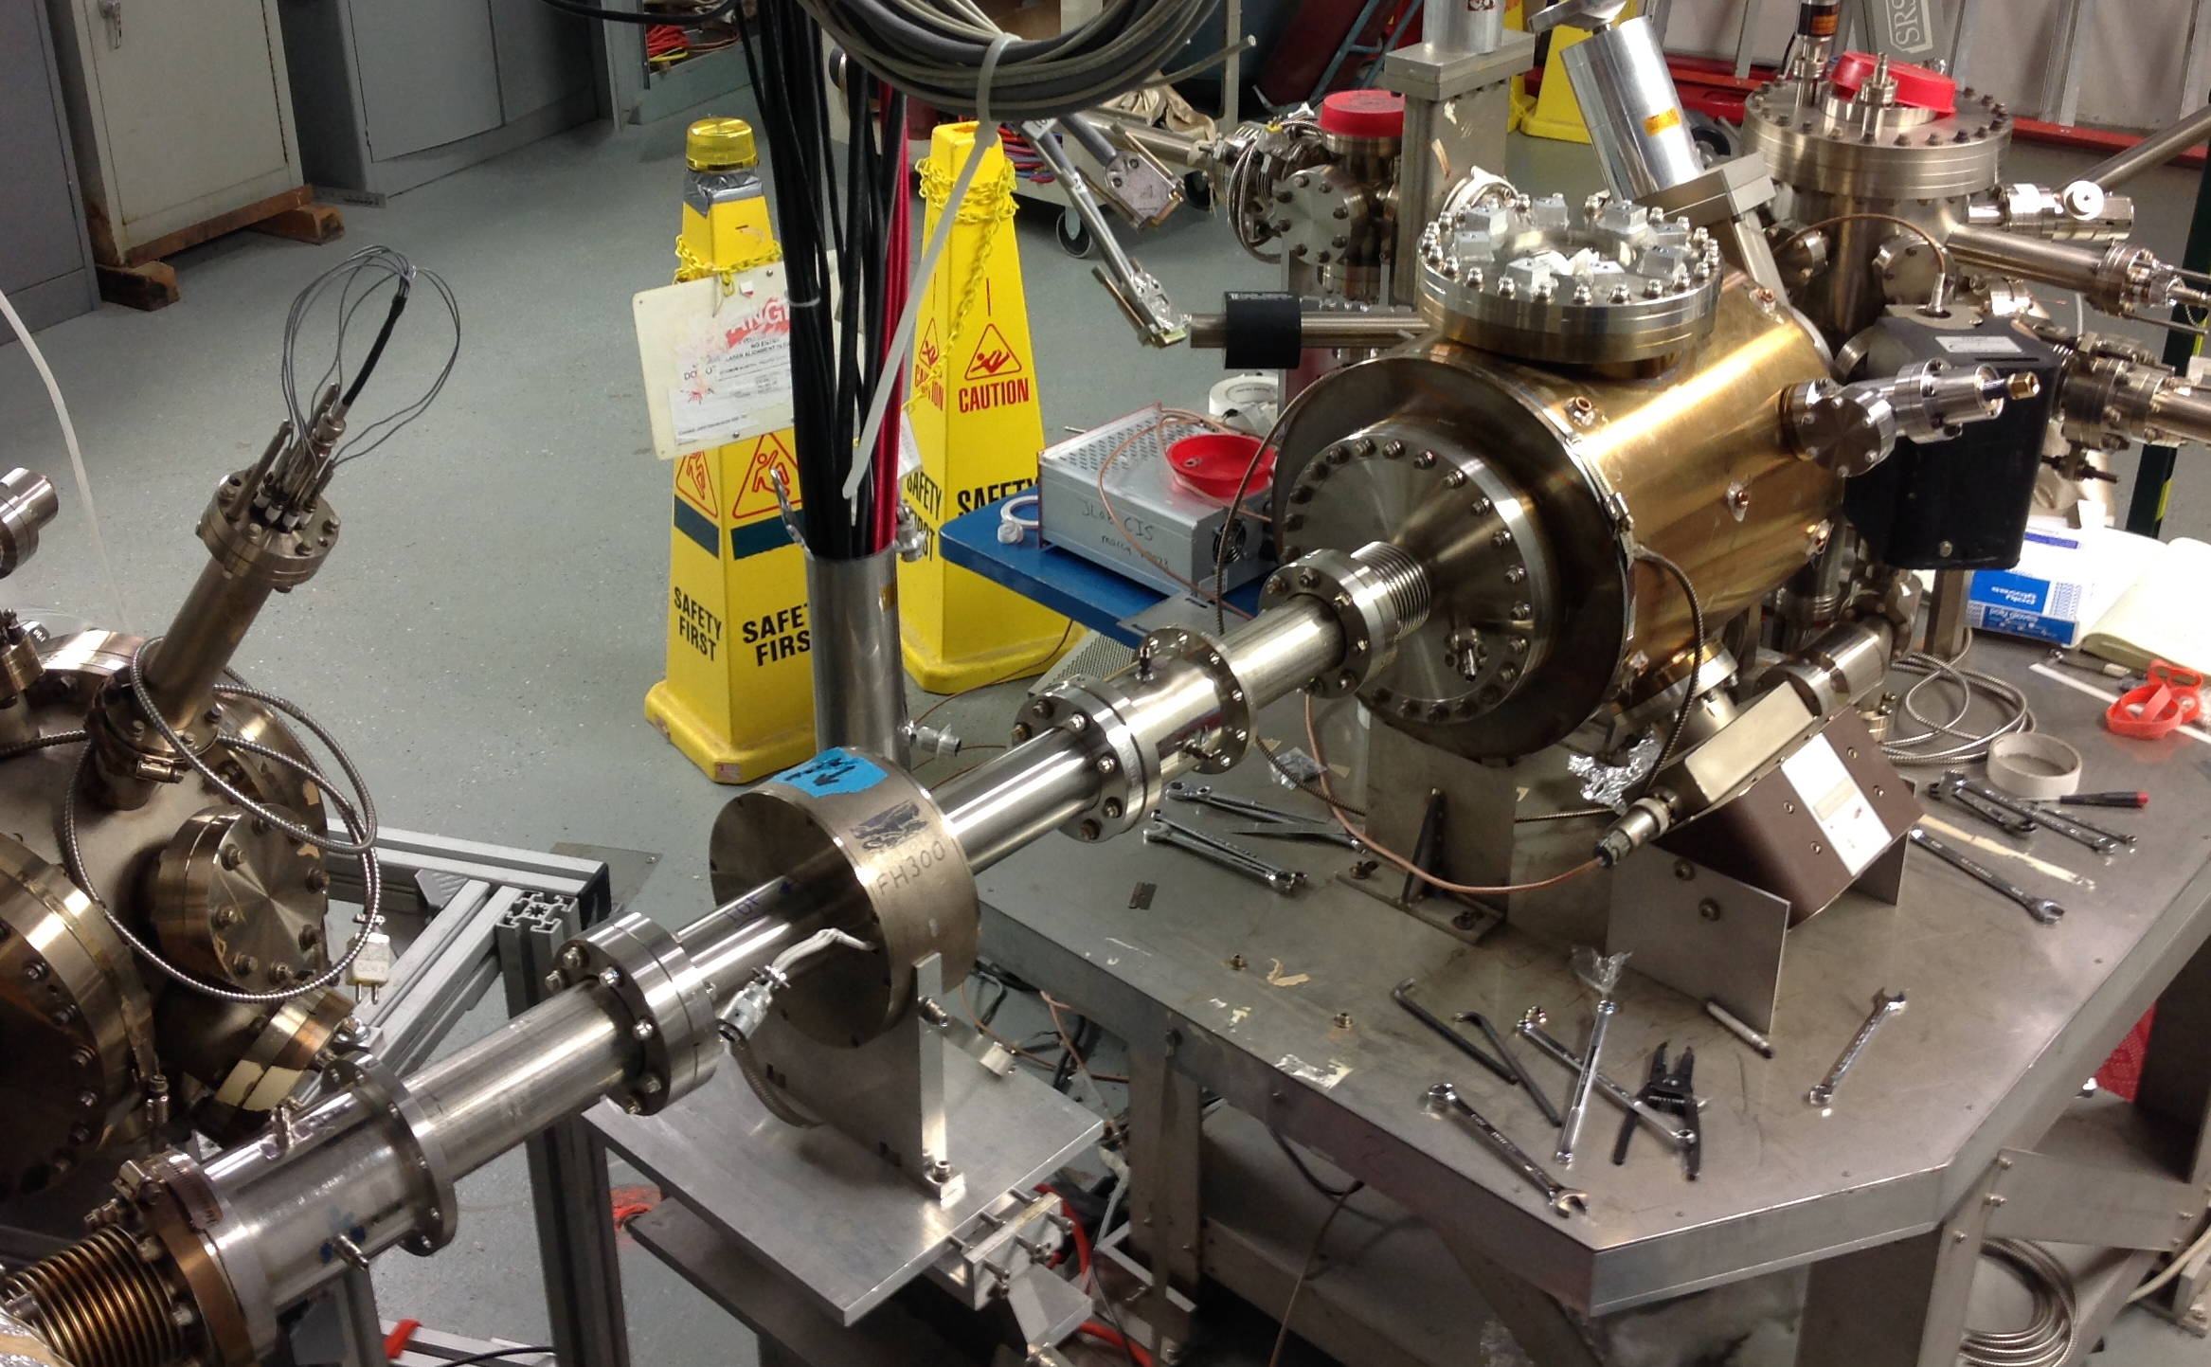
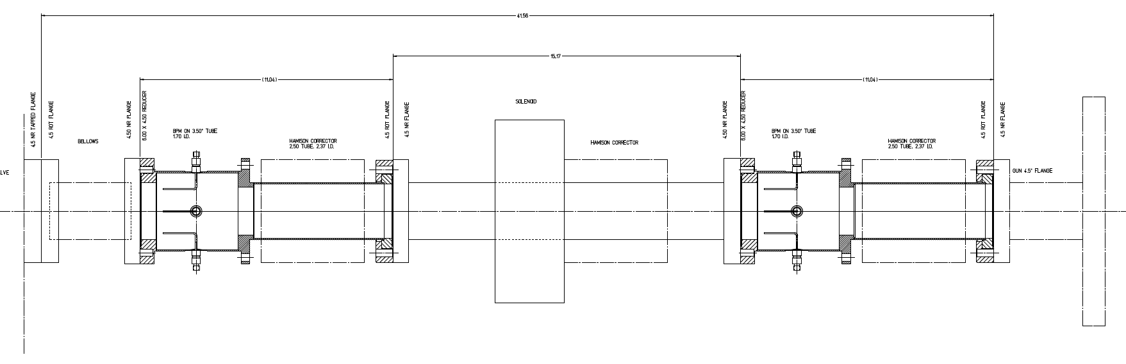
Adding Modified M20 BPM’s to the NEG tube
Augment NEG tube w/ BPM’s
Improve gun monitoring
Restore “Spot Move Steer”
Include S/H cards for PQB tests
Mapped on Gabou test stand
Explore 2nd moment

Slide 13
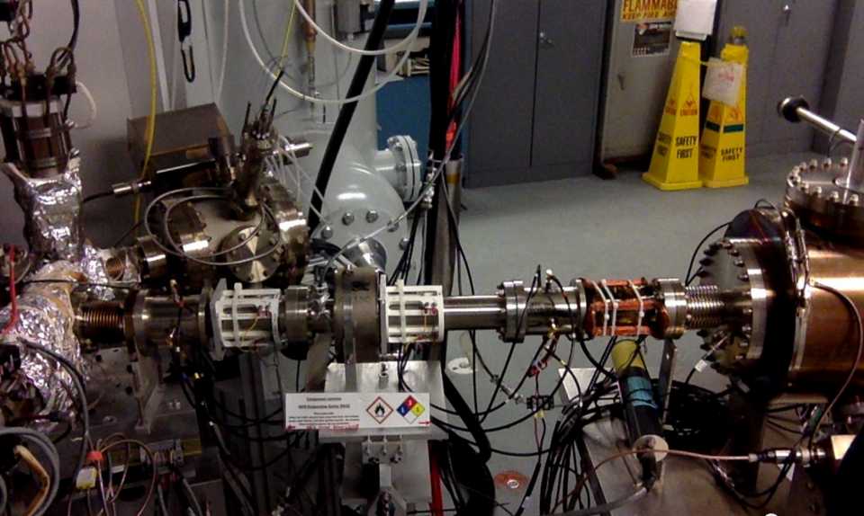
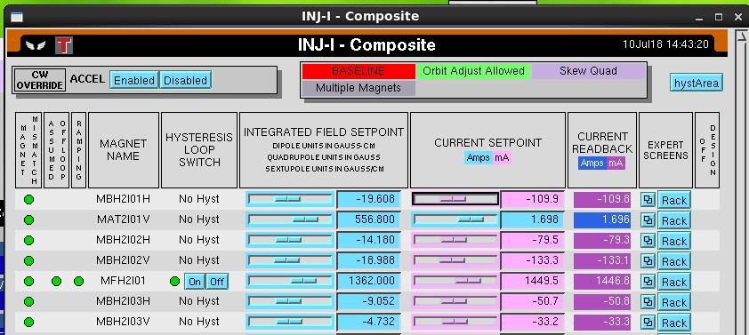
Adding Modified M20 BPM’s to the NEG tube

Slide 14
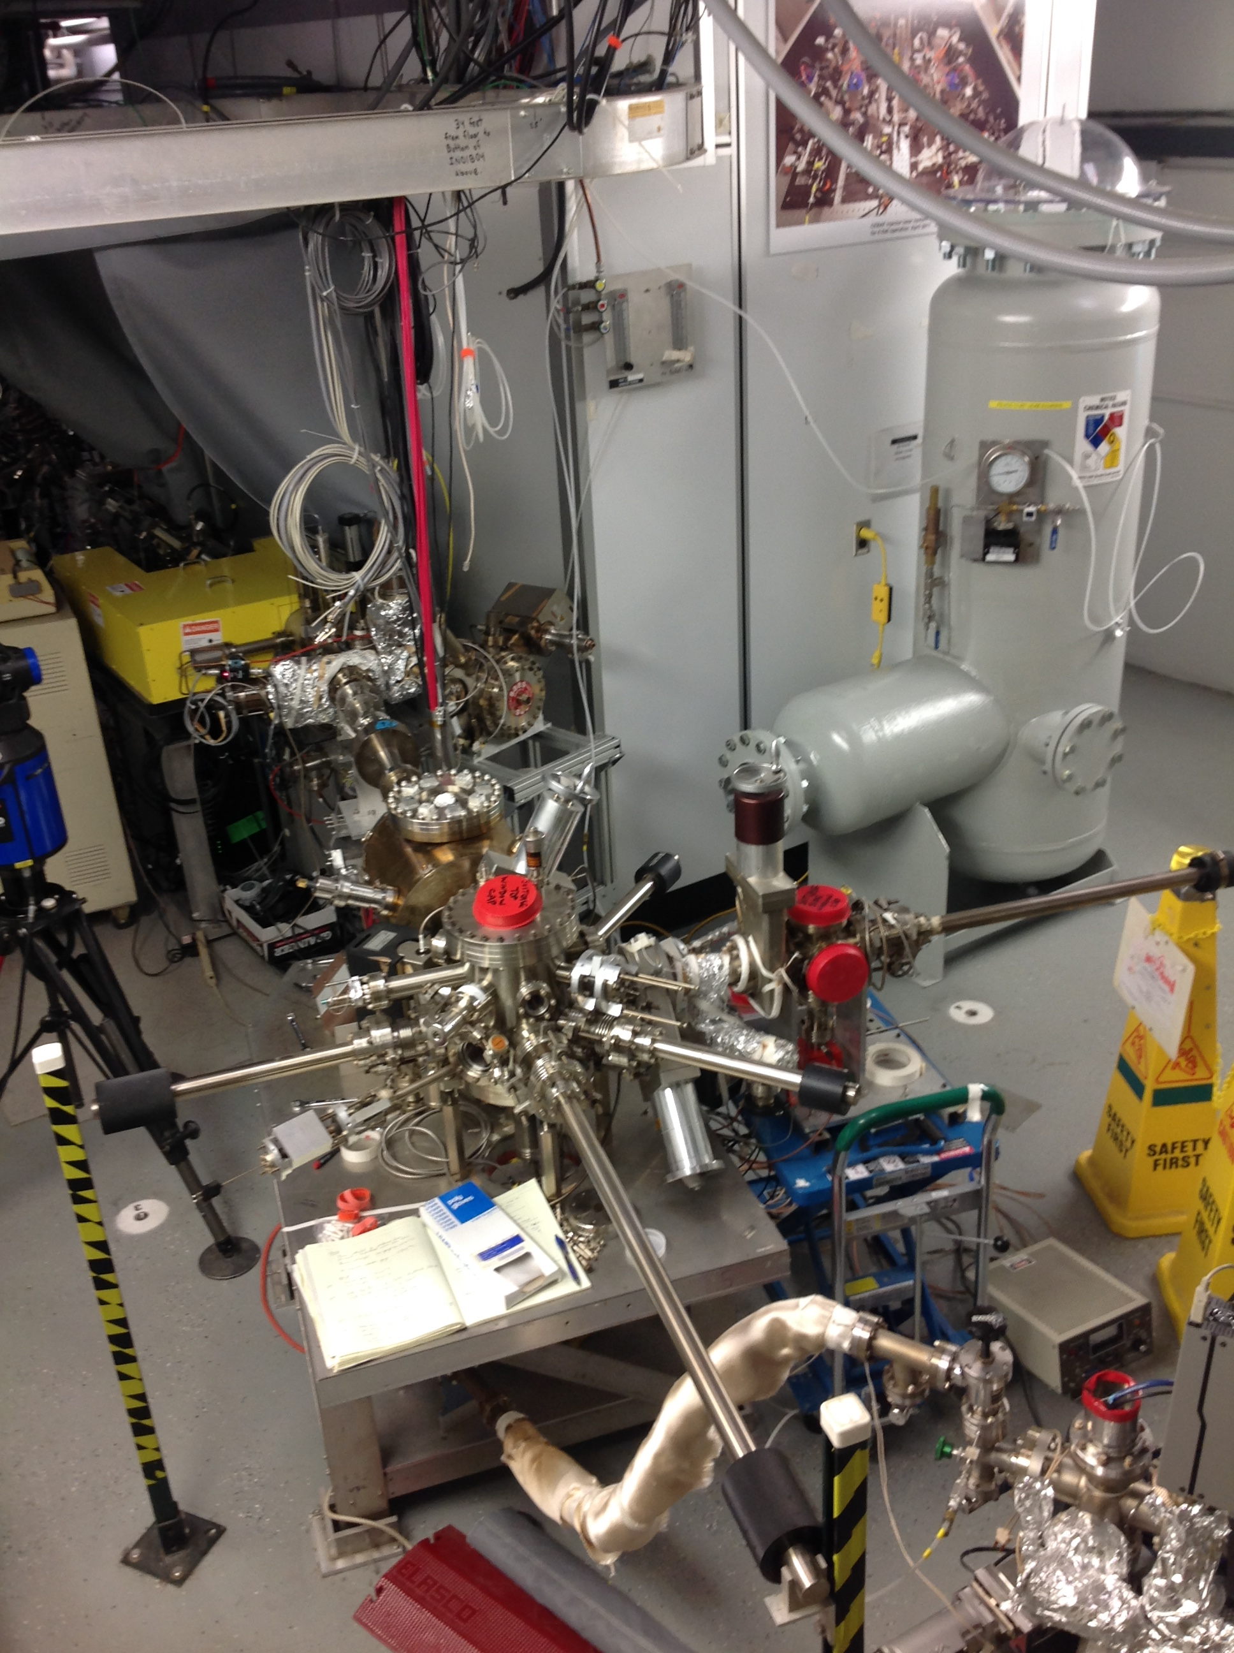
Summer 2018 SAD Status
May – June
  Replaced Gun2 with an electrode optimized to reach 200 kV
  Replaced 150kV PS with a 350 kV PS that now sits beside Gun2 in SF6 tank
  Added two new BPM’s to the NEG tube just downstream of Gun2
June – July
  Conditioned Gun2 electrode for beam tests to 180 kV (limited time this SAD)
  Tested magnets, PSS kicker and chopper w/ 180 keV beam for higher voltage operation
  Restored Gun2 operation for 130 kV and delivered beam to FC2 at 6.3 MeV
  High polarization photocathode used during Spring run activated and ready in Gun2
  Injector setup scheduled for early August

