Slide 1
200 kV gun GPT simulations Tee, mushroom and sphere cathodes CEBAF beam parameters
Gabriel Palacios
gabrielp@jlab.org 08/12/18

Slide 2
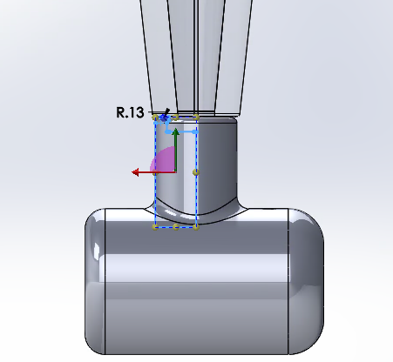
Solidworks geometry modifications: No shield

Slide 3
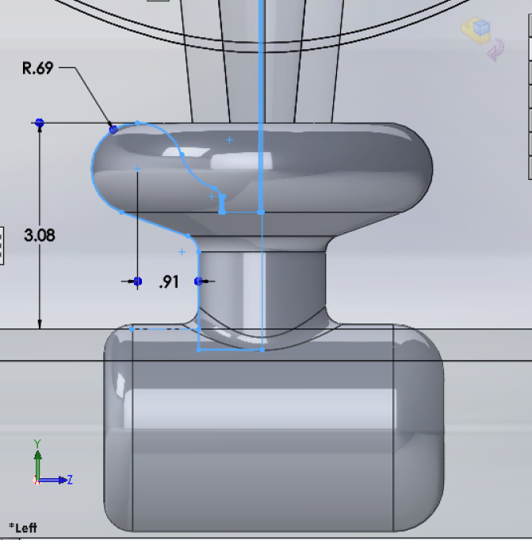
Solidworks geometry modifications: Original

Slide 4
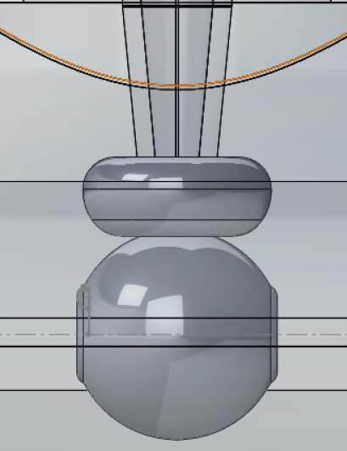
Solidworks geometry modifications: GTS with small anode

Slide 5
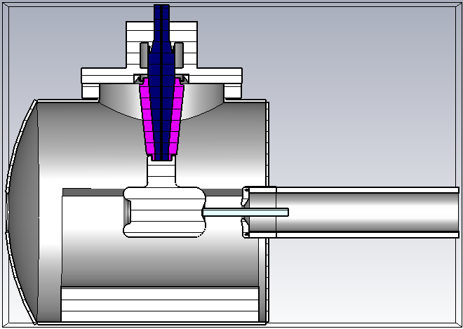
Solidworks geometry modifications: No shield

Slide 6
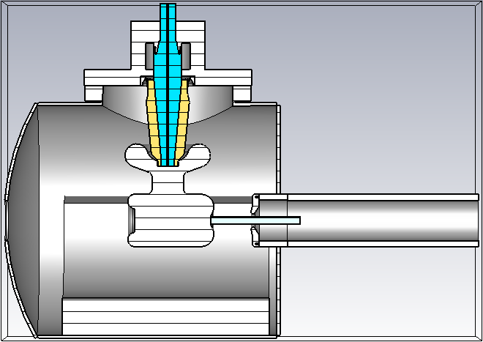
Solidworks geometry modifications: Original

Slide 7
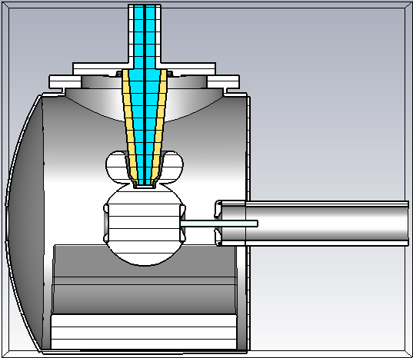
Solidworks geometry modifications: GTS with small anode

Slide 8
Preliminary results
Field maps: T-shape

Slide 9
Preliminary results: Fields maps

Slide 10
Preliminary results: Fields maps

Slide 11
Preliminary results: Fields maps

Slide 12
Preliminary results
Field maps: Mushroom

Slide 13
Preliminary results: Fields maps

Slide 14
Preliminary results: Fields maps

Slide 15
Preliminary results: Fields maps

Slide 16
Preliminary results
Field maps: Sphere

Slide 17
Preliminary results: Fields maps

Slide 18
Preliminary results: Fields maps

Slide 19
Preliminary results: Fields maps

Slide 20
Preliminary results
y [mm] vs y [mm]: T-cathode

Slide 21
Preliminary results: x vs y

Slide 22
Preliminary results
y [mm] vs y [mm]: Mushroom

Slide 23
Preliminary results: x vs y

Slide 24
Preliminary results
y [mm] vs y [mm]: Sphere

Slide 25
Preliminary results: x vs y

Slide 26
Preliminary results
Trajectories: T-shape

Slide 27
Preliminary results: Trajectories

Slide 28
Preliminary results: Trajectories

Slide 29
Preliminary results
Normalized transverse emittance: T-cathode

Slide 30
Preliminary results: Normalized transverse emittance

Slide 31
Preliminary results: Normalized transverse emittance

Slide 32
Preliminary results: Normalized transverse emittance

Slide 33
Preliminary results: Normalized transverse emittance

Slide 34
Preliminary results
Normalized transverse emittance: Mushroom

Slide 35
Preliminary results: Normalized transverse emittance

Slide 36
Preliminary results: Normalized transverse emittance

Slide 37
Preliminary results: Normalized transverse emittance

Slide 38
Preliminary results: Normalized transverse emittance

Slide 39
Preliminary results
Normalized transverse emittance: Sphere

Slide 40
Preliminary results: Normalized transverse emittance

Slide 41
Preliminary results: Normalized transverse emittance

Slide 42
Preliminary results: Normalized transverse emittance

Slide 43
Preliminary results: Normalized transverse emittance

Slide 44
Fin.

Slide 45
Additional:

