Slide 1
Polarized Electron Source:
A brief introduction
Joe Grames

Slide 2
Outline
Part I - Photocathodes
  Electron emission
  GaAs
  PEA & NEA & QE
  Polarization
  Higher polarization
  Even higher polarization
Part II - Photoguns
  High Voltage
  Drive Laser
  Extreme High Vacuum
2

Slide 3
Accelerators need “free” electrons !
How might we acquire them?
Field Emission (electronic energy)
Thermionic Emission (thermal energy)
Photo Emission (optical energy)
All are manifestations of electromagnetism
3

Slide 4
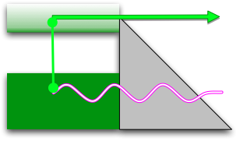

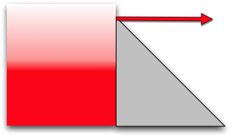

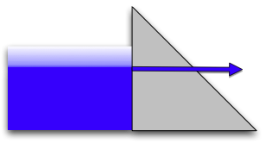

The Canonical Emission Equations
(slide courtesy of Dr. K. Jensen, Naval Research Laboratory)
Photoemission
Fowler-Dubridge
L.A. DuBridge
Physical Review 43, 0727 (1933).
Thermal Emission
Richardson-Laue-Dushman
C. Herring, and M. Nichols,
Reviews of Modern Physics 21, 185 (1949).
Field Emission
Fowler Nordheim
E.L. Murphy, and R.H. Good,
Physical Review 102, 1464 (1956).
4

Slide 5
Photo Emission from GaAs
Dipole layers of
Cesium + NF₃
Reduces Work Function
Negative Electron Affinity (NEA)
Bare GaAs surface
Large Work Function
Positive Electron Affinity (PEA)
NEA Surface Activation
PEA=4.07 eV
-
Conduction
Band
-
χ^{NEA} ~ 0.2 eV
E_{gap}
Valence
Band
+
Light
GaAs
Vacuum
GaAs
Vacuum
5

Slide 6
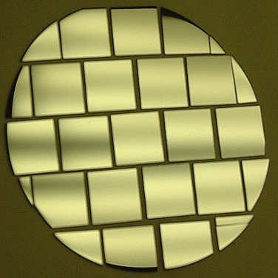
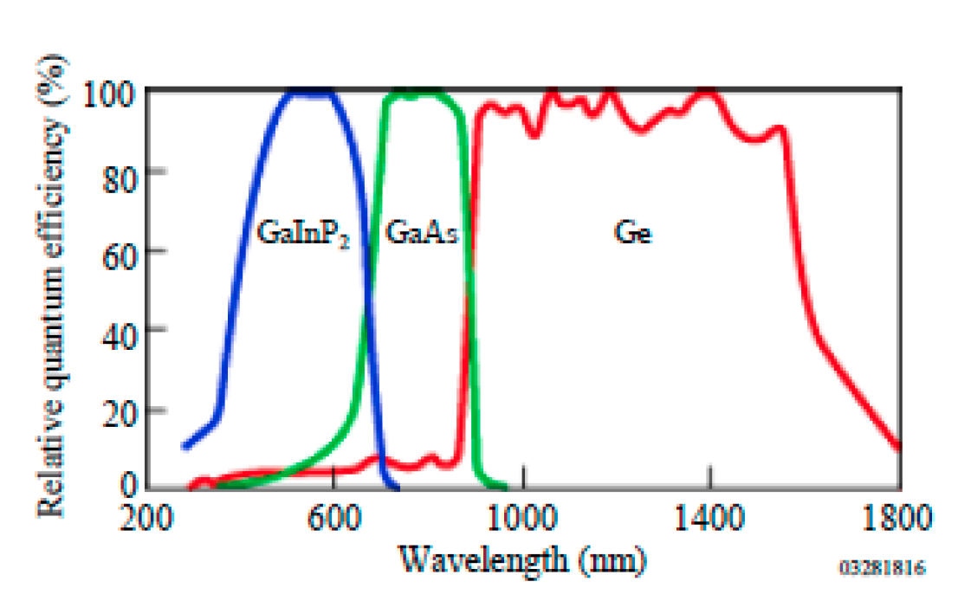
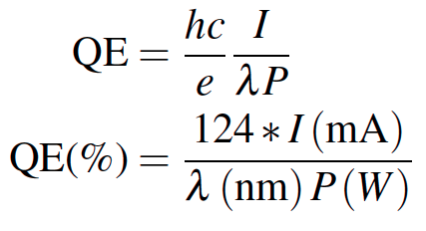
Quantum Efficiency
Photons IN
Electrons Out
In practical terms, the quantum efficiency “QE” is the metric used to assess the number of electrons emitted per number of illuminating photons.
Al-Naser, Qusay & Hilou, Hassan & Abdulkader, Abbas. (2009). The last development in III-V multi-junction solar cells. 1. 10.1109/CCCM.2009.5268104.
6

Slide 7
Beam Polarization
P = (N⁺ - N⁻)/(N⁺ + N⁻)
The polarization is defined as the net fraction of spin states along a preferred direction; photoemission is oriented along the beam helicity.
(2 - 2) / (2 + 2) = 0%
(3 - 1) / (3 + 1) = 50%
Modern high polarization photocathodes provide spin alignment of about 19 out of 20 electrons
7

Slide 8
Spin Polarized Photoemission from Bulk GaAs
E
E
J
S_{1/2}
-1/2
+1/2
S_{1/2}
σ+
σ-
E_{gap}=1.42 eV
3
1
1
3
P_{3/2}
E_{F}
P_{3/2}
Δ=0.34 eV
-3/2
-1/2
+1/2
+3/2
P_{1/2}
-1/2
+1/2
P_{1/2}
k
σ+: Right circularly polarized light
σ- : Left circularly polarized light
m_{j}
Laser excitation from P_{3/2} to S_{1/2} : E_{gap} < E_{γ} < E_{gap}+Δ
Electron Polarization:
Reverse electron polarization by reversing light polarization
8

Slide 9

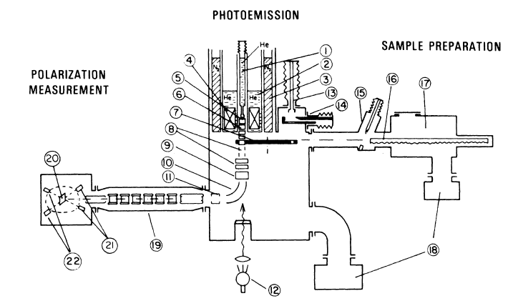
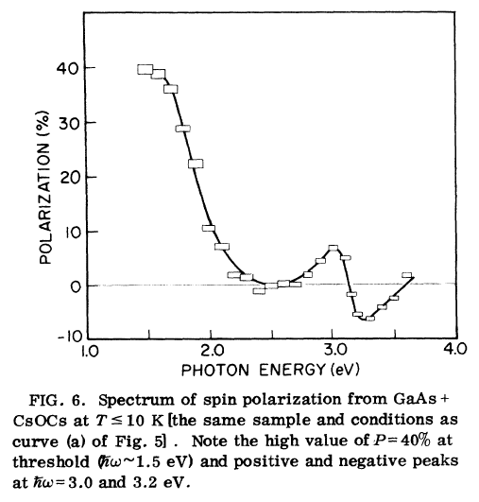
First Observation of Polarization from GaAs
9

Slide 10
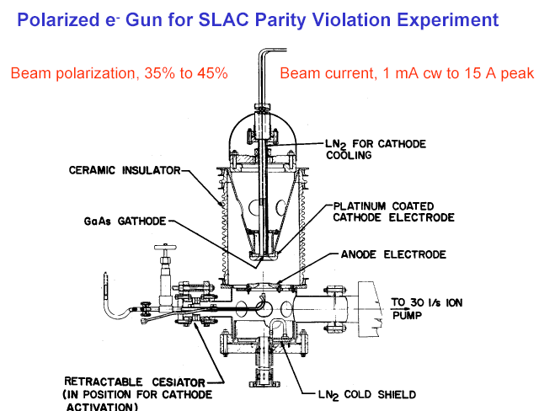
First HV GaAs photogun used on an accelerator
Built for SLAC parity-violation experiment E122
December 1977 - Polarized electrons accelerated at SLAC
June 1978 - E122 announces parity violation (Standard Model)
10

Slide 11
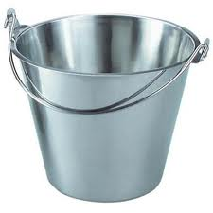
How is the spin polarization used?
Target
You measure
an experimental
asymmetry !
11

Slide 12
Parity Violation Experiments at Jefferson Lab
PV experiments have motivated polarized e-source R&D
12

Slide 13
What does “A_{PV} = 234 ppb” even mean?
A
ε = (A - B)/(A + B)
Target
1,000,000,000
A - B
= 0.000000234
1,000,000,000
B
A = 500,000,117
B = 499,999,883
13

Slide 14
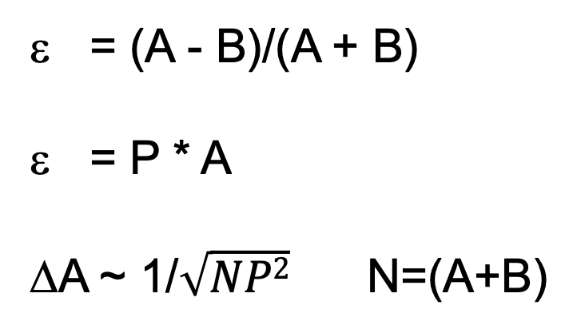
Polarized source figure of merit (FOM)
Measured asymmetry
Physics asymmetry
Error on analyzing power
= (A - B)/(A + B)
= P * A
ΔA ~ 1/$\sqrt{NP2}$ N=(A+B)
For example, increasing the beam polarization from 30% to 90% achieves the same uncertainty in events needs by (30/90)² ~ 1/9th the time.
Experiments could be done in one year,
not one decade.
14

Slide 15
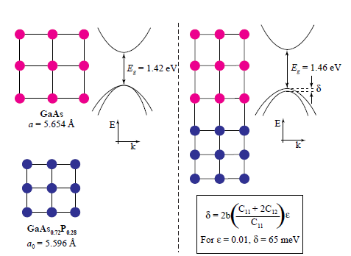
Breaking the P=50% barrier
Lattice mismatch provides stress
The band gap of the substrate layer must be larger than surface layer
Lattice constants must differ enough to introduce suitable strain
Adjust lattice constant of substrate by varying concentration of third element
Pablo Saez, PhD Thesis, SLAC Report 501, 1997
1% lattice mismatch provides equivalent force as hydraulic press!
15

Slide 16
Strained layer GaAs
S_{1/2}
m_{j} = -1/2
+1/2
0.1 μm
Strained GaAs
σ+
σ-
250 μm
GaAs_{1-x}P_{x} (x=0.29)
P_{3/2}
m_{j} = -3/2
+3/2
250 μm
GaAs_{1-x}P_{x} (0<x<0.29)
-1/2
+1/2
p-type GaAs
substrate
Polarization 75% >> 50% ☺
Strain relaxes in 0.1 μm layer
Not all electrons reach surface
QE 0.1% << 6% ☹
600 μm
MOCVD-grown epitaxial spin-polarizer wafer
16

Slide 17

Strained layer superlattice GaAs/GaAsP
GaAsP
30 A
Strained GaAs
30 A
1000 A
Active Region
GaAs_{0.64}P_{0.36}
Buffer
GaAsP
2.5μm
Strained GaAs
GaAs_{(1-x)}P_{x} Graded Layer
2.5μm
GaAsP
Strained GaAs
GaAs Substrate
D. Luh et al, SLAC, PESP2002
QE 1% and Polarization 85%
From Aaron Moy, SVT Assoc and SLAC, PESP2002
17

Slide 18
Polarization from GaAs (JLab: 1997 – 2019)
?
workhorse
18

Slide 19
Diffraction Bragg Reflector Strained Superlattice
Standard Photocathode : absorption < 5% in the GaAs/GaAsP superlattice
  Most light passes into the substrate leading to unwanted heating
DBR photocathode : absorption > 20% in the GaAs/GaAsP superlattice
  Less light required to make required beam, less light means less heat
QE 6% and Polarization 90%
19

Slide 20
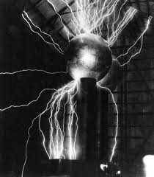
How to make the electrons “energetic” ?
Air ~ 6 MV/m
Sulfur hexafluoride ~15 MV/m
Ceramic ~ 30 MV/m
20

Slide 21
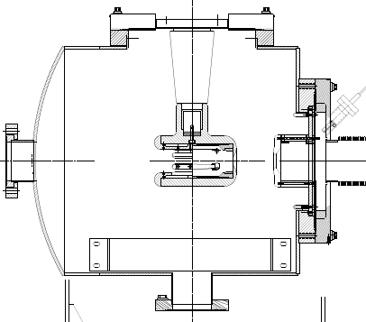
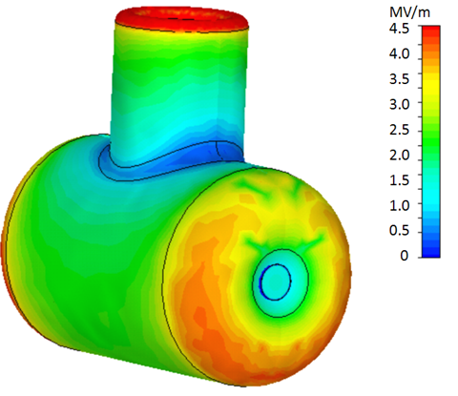
Applying high voltage to the photocathode
-130kV
light in
electrons out
photocathode
<Joe => put GaAs/puck fig here)>
21

Slide 22
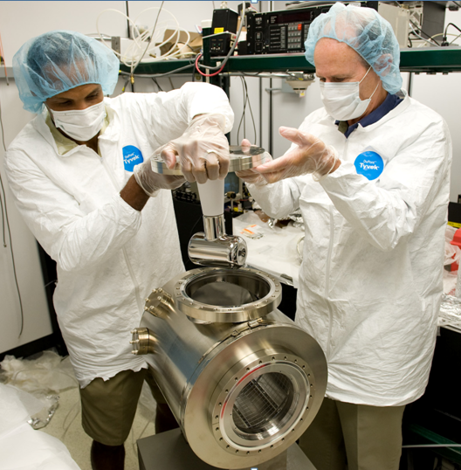
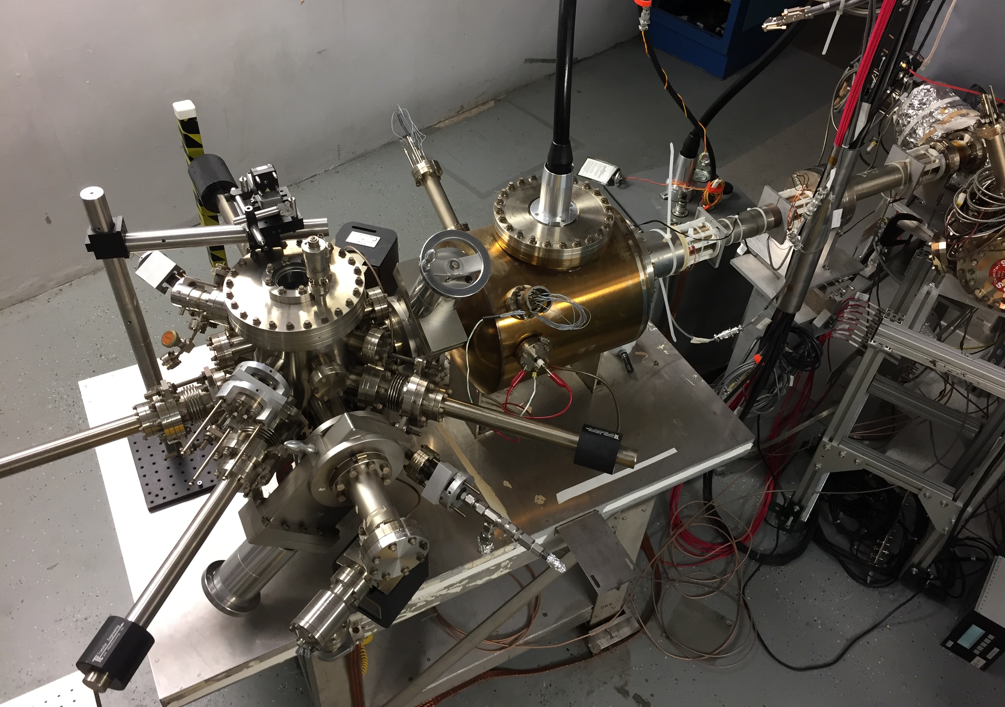
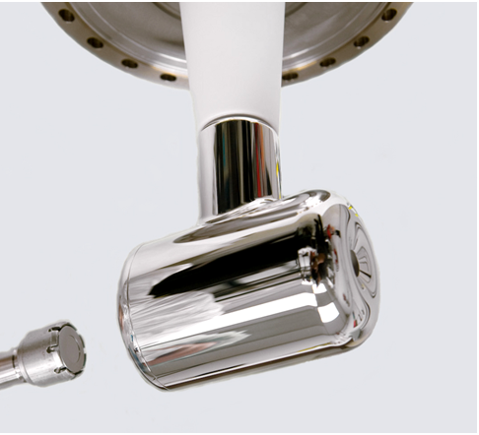
Polarized electron source
22

Slide 23
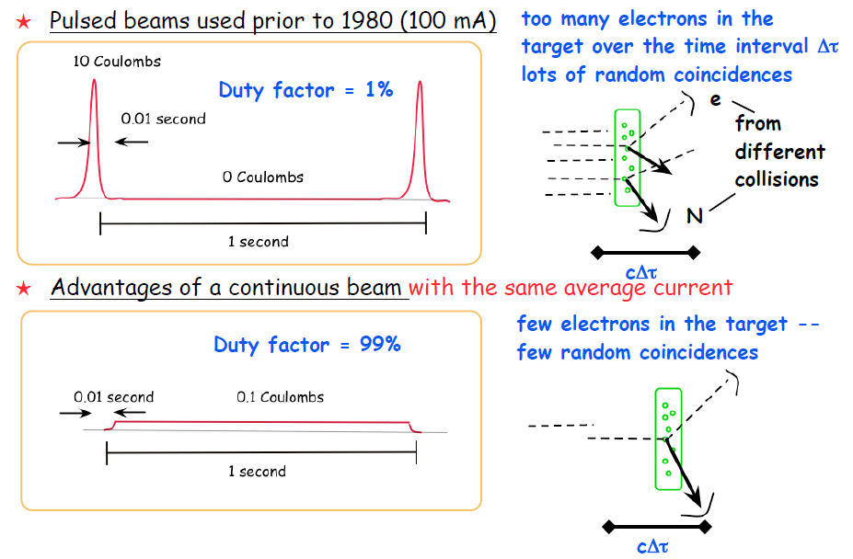
Continuous vs. Pulsed Beams
1 Coulomb
1 Coulomb
23

Slide 24
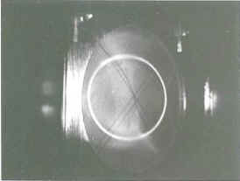
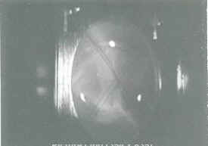
…but continuous does NOT mean DC
2 ns/revolution
Short e- bunch <50 psec
A B C
DC beam (on ALL the time)
Beam pulse (on each RF cycle)
24

Slide 25
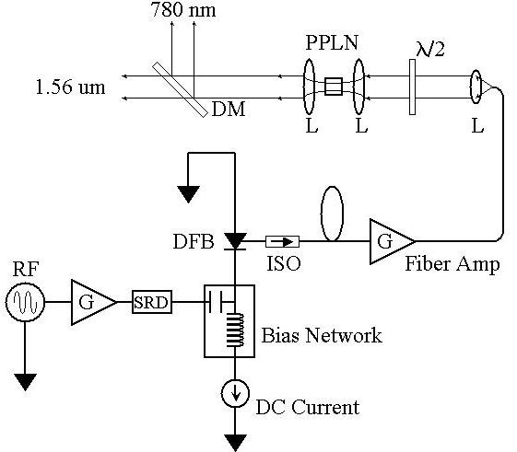
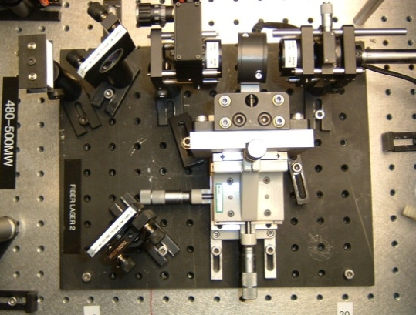
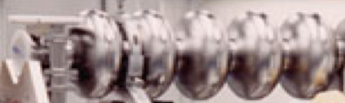
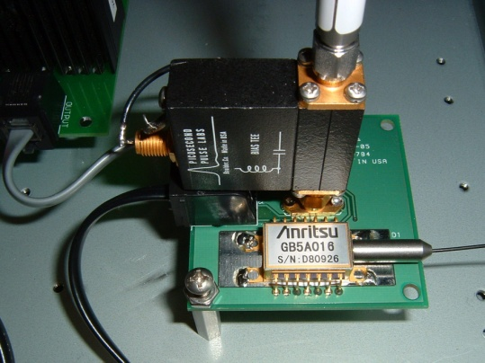
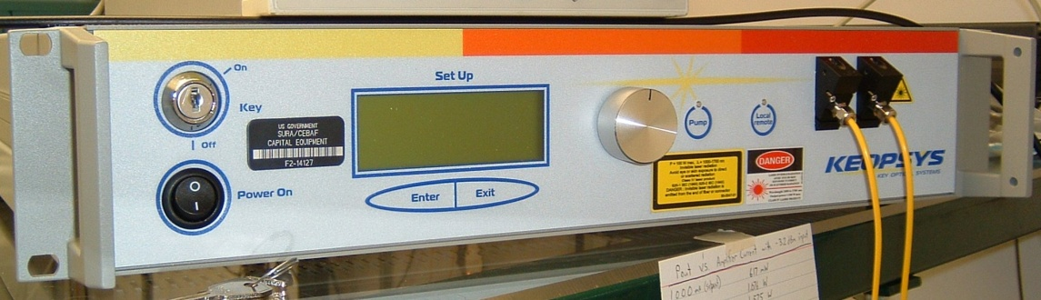
Polarized source laser
200 mW @ 780 nm
50 ps @ 499/249.5 MHz
=> 6 uA/mW/%
Frequency-doubler
1560 nm to 780 nm
30% Efficiency (2 W)
780 nm
1560 nm
Master Oscillator
499 MHz
Low-Power (1 mW)
1560 nm Fiber Diode
Follows RF sine wave
High Power (6 W) 1560 nm Fiber Amplifier
25

Slide 26
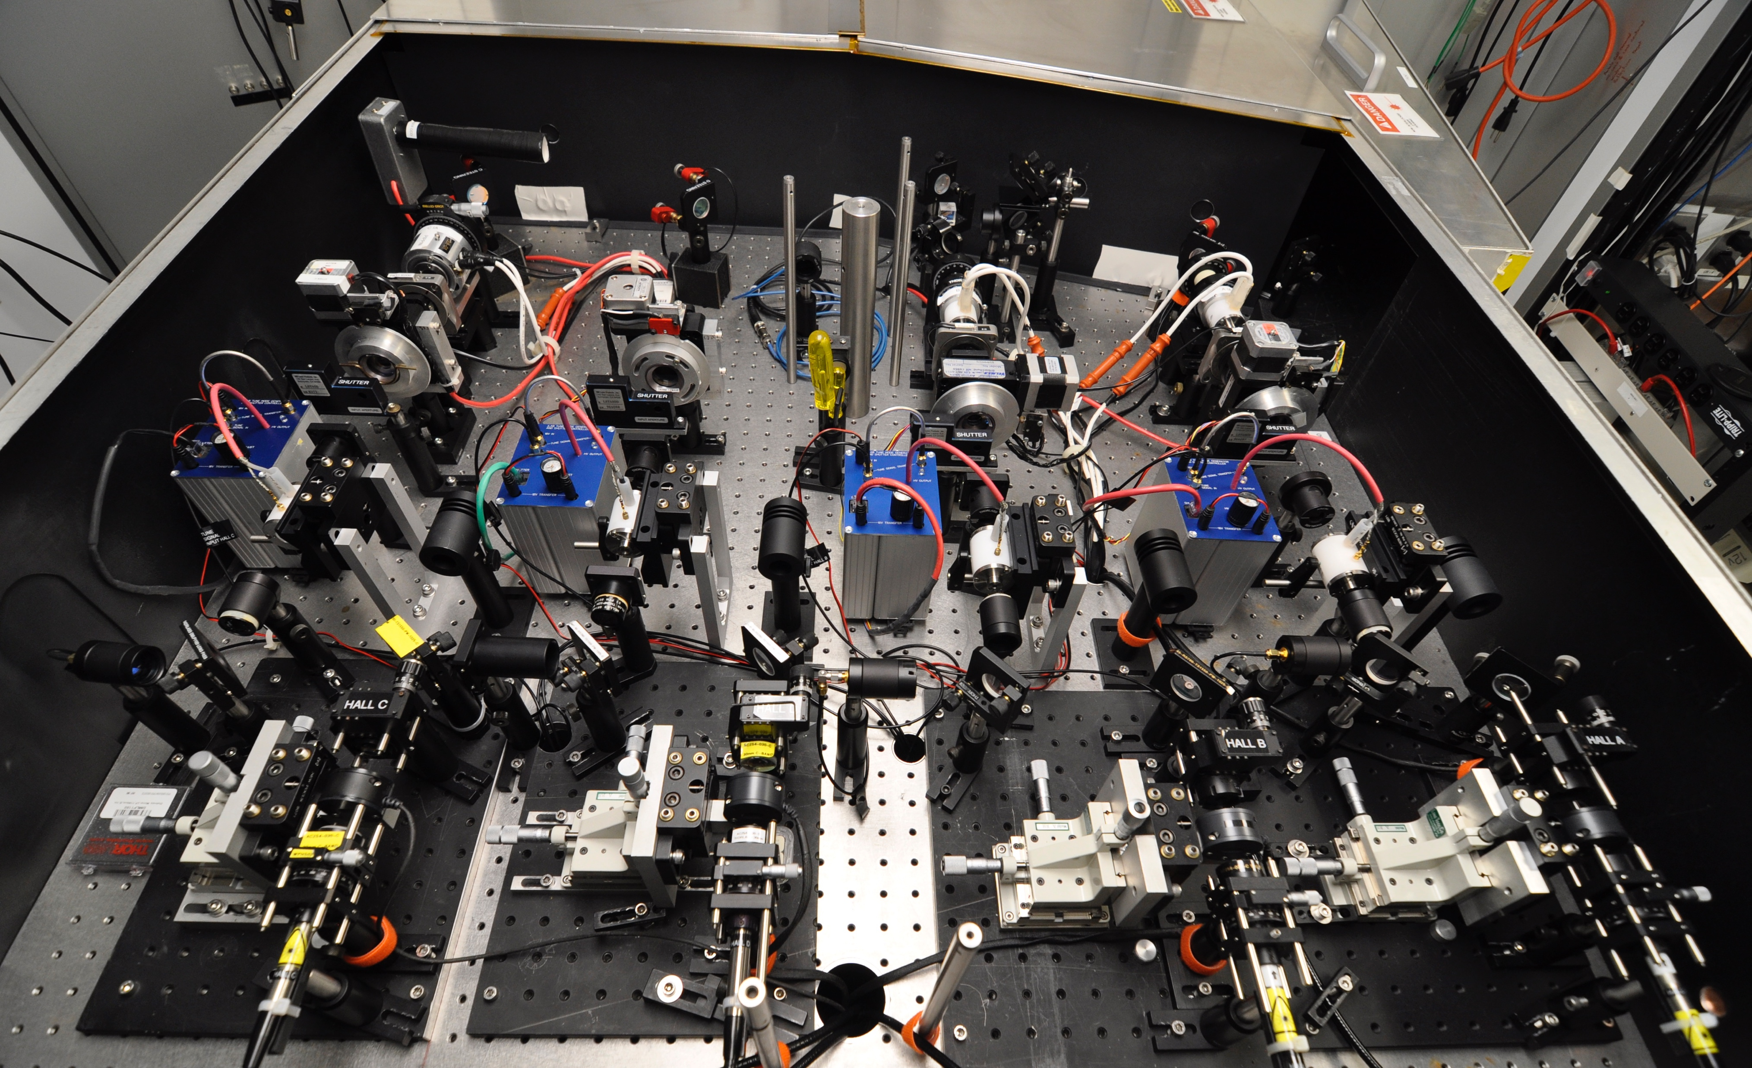
CEBAF 4-Beam Drive Laser
Controls intensity, polarization, rep rate
Synchronized with RF, diagnostics
Should be stable, reliable, pragmatic
26

Slide 27
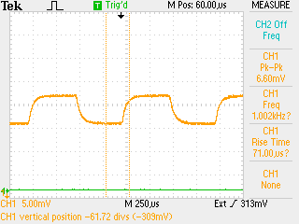
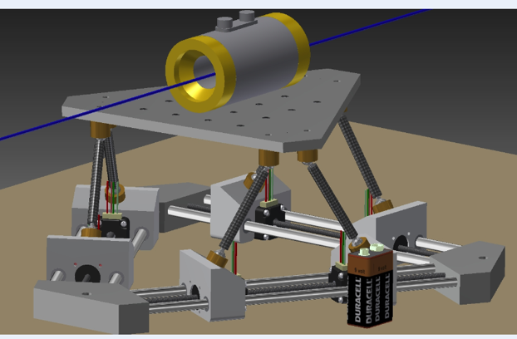
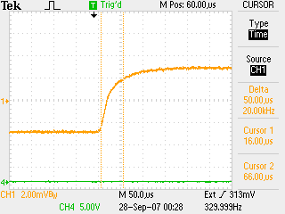
Fast helicity reversal
Electro-optic waveplate
Pockels cell λ/2 flipping at 1kHz.
Perfect symmetry and no voltage droop over time.
Pockels cell λ/2 transition optical result. ~70us with no ringing.

Slide 28
Part of the ”bigger picture”

Slide 29
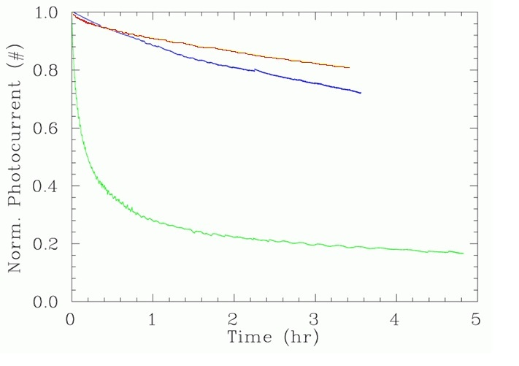
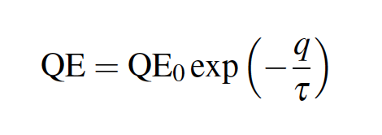
QE degradation (charge lifetime)
Does QE degrade with time? Yes, and no.

Slide 30

We understand Alice’s worry…
“The woods were dark and foreboding, and Alice sensed that sinister eyes were watching her every step. Worst of all, she knew that Nature abhorred a vacuum” – Gary Larson
Air ~ 10¹⁶ / Torr-cm³
  ^{(molecules ~2 nm apart)}
Gun ~ 10⁻¹² Torr
  ^{(molecules ~1 mm apart)}

Slide 31
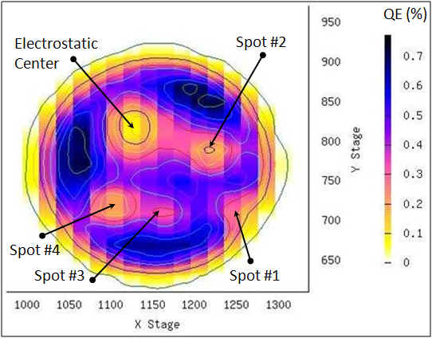
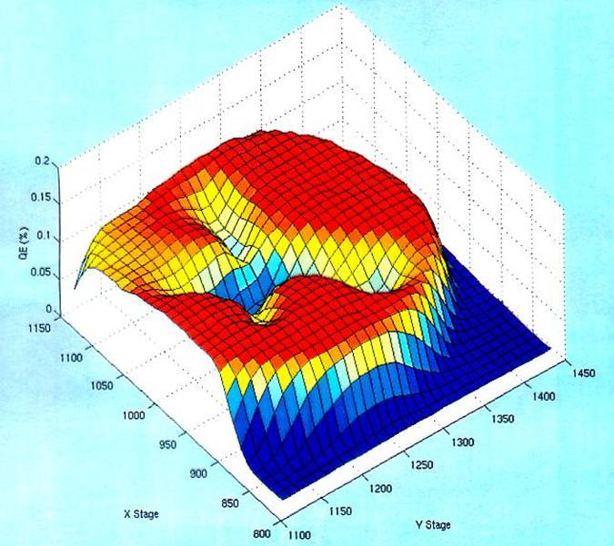
Ion back-bombardment leads to QE reduction
These ions may strike the photocathode, generate secondary electrons or x-rays, and desorb gas from surfaces; all leading to a reduction of the photocathode quantum efficiency (QE).

Slide 32
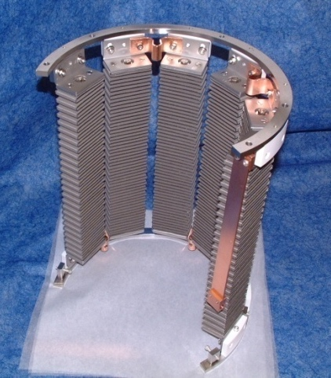
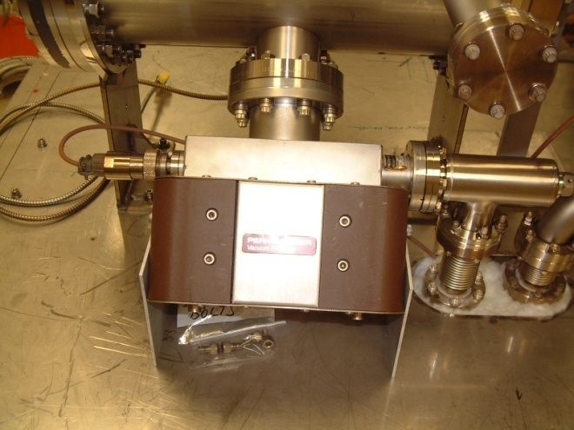
Achieving Extreme High Vacuum
Avoid contamination by oils due to roughing pumps, fingerprints, machining.
Baking used to get pressures below 10⁻¹⁰ Torr
  250°C for 30 hours removes water vapor bonded to surface that otherwise limits pressure
Getter Pumps
  Chemically active surface
    Titanium sublimed from hot filament
    Non-Evaporative Getters
  Molecules stick when they hit
    Does not work well for inert gasses such as Argon, Helium or for methane
Ion Pumps
  Electric field to ionize gasses
  Magnetic field to direct gasses into cathodes where they are trapped
    Has some pumping capability for noble gasses
NEG pump array
Ion Pump

Slide 33
Vacuum conditions in an accelerator
Application | Pressure Range | Location | Vacuum Regime
Beamline to dumps | 10⁻⁵ Torr | Target to dump line | Medium
Insulating vacuum for cryogens | 10⁻⁴ Torr to 10⁻⁷ Torr | Cryomodules, transfer lines | Medium to high
Targets, Scattering Chambers | 10⁻⁶ to 10⁻⁷ Torr | Experimental Halls | High to very high
RF waveguide warm to cold windows | 10⁻⁷ to 10⁻⁹ Torr | Between warm and cold RF windows | High to very high
Warm beamline | 10⁻⁷ to 10⁻⁸ Torr | Arcs, Hall beamline, BSY, some injector | High to very high
Warm region girders | 10⁻⁹ Torr or better | Girders adjacent to cryomodules | Very high to ultrahigh
Differential pumps | Below 10⁻¹⁰ Torr | Ends of linacs, isolate cryomodules | Ultrahigh vacuum
Baked beamline | 10⁻¹⁰ to 10⁻¹¹Torr | Y chamber, Wien filter, Pcup | Ultra high vacuum
Polarized guns | 10⁻¹¹ to 10⁻¹² Torr | Photoguns | Ultra to Extreme high vacuum
SRF cavity vacuum | < 10⁻¹² Torr | Inside SRF cavities with walls at 2K | Extreme high vacuum

Slide 34
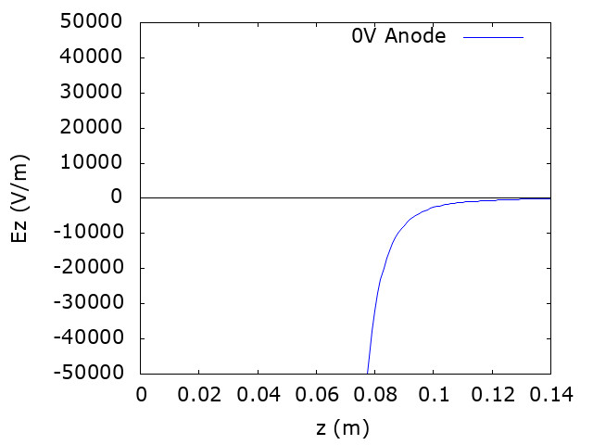

Mitigating ion back-bombardment
Work of J. Yoskowitz (Old Dominion University), Proc. of PSTP-2019

Slide 35
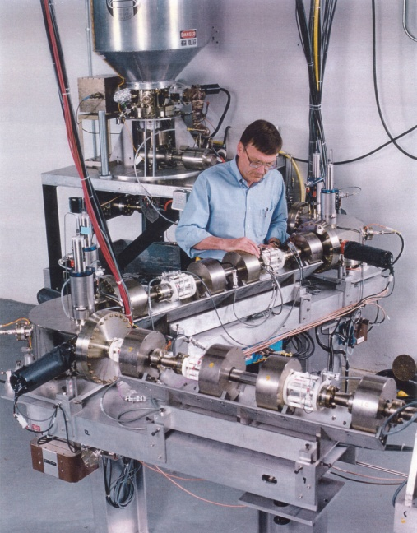
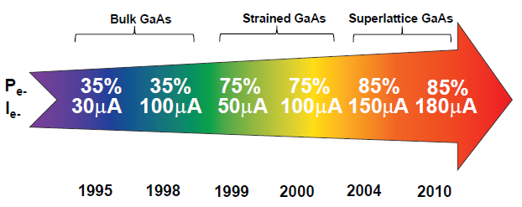
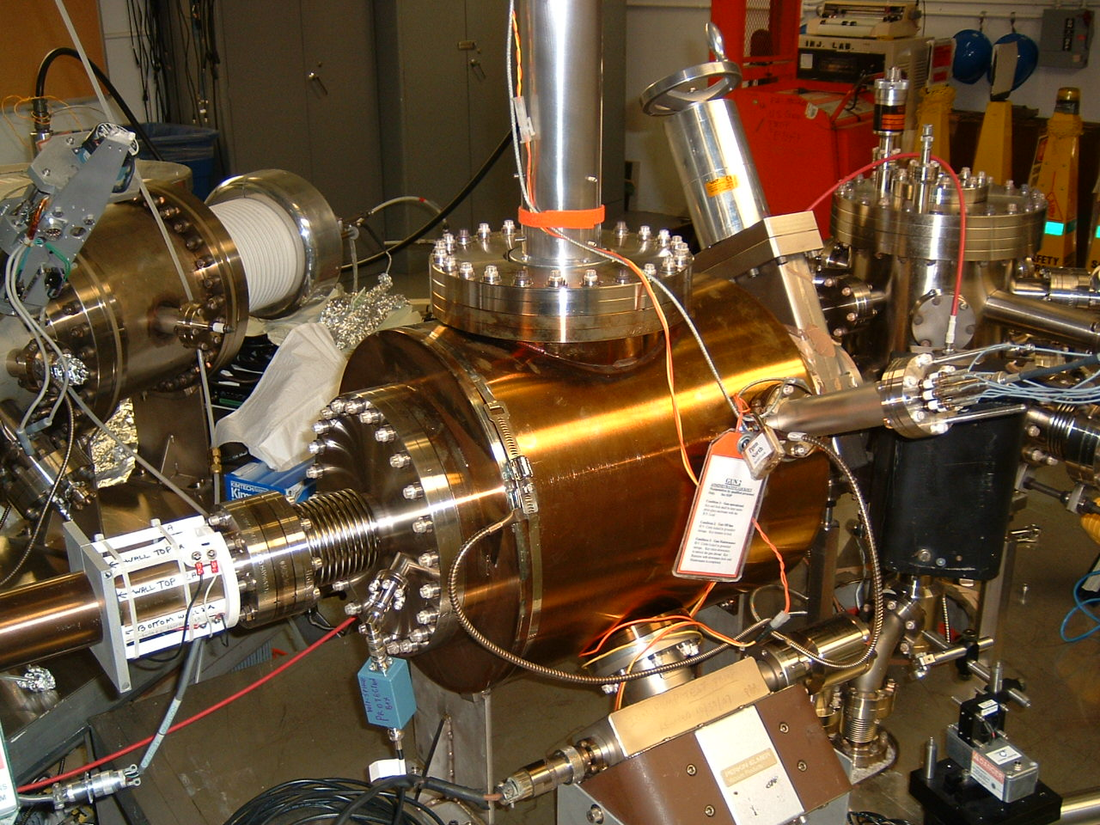
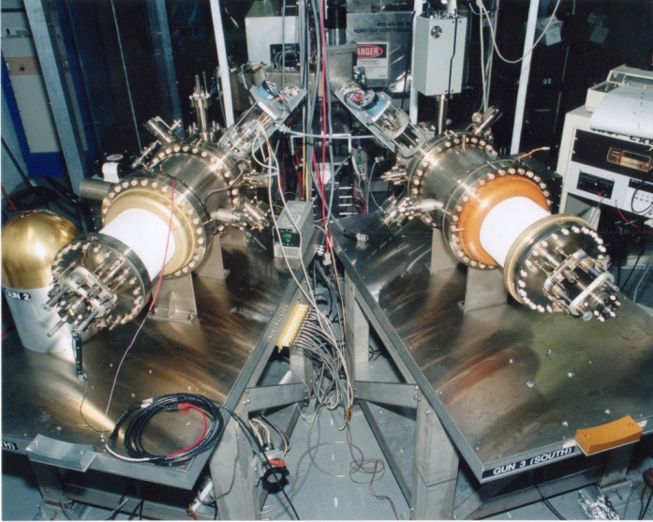
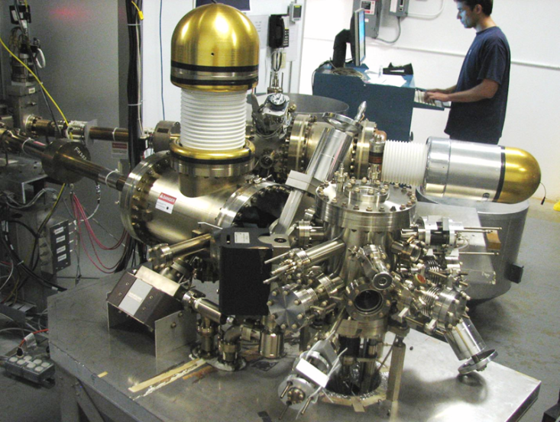
Always Tweaking the Design
1
5
The endless (?) quest for perfection
4
2
3

Slide 36
I did not cover…
Low energy spin rotations
Dipole
Solenoid
Wien filter
Spin flipping
Low energy polarimetry
Mott Scattering

