Slide 1
Booster Studies
Y. Wang
Feb 28, 2021

Slide 2
Incoming Beam Conditions
Gun HV: 200 KeV
Chopper: off
Buncher: on, negative slope zero crossing, gset = 40, pset = -65 degs.
Solenoids: beam centered
Apertures #3 and #4: beam centered

Slide 3
Gradient Calibration of 2-Cell Cavity
ITVM703
30 deg.
2-cell
7-cell
Q501
Q502
Q503
Q504
MDML601
ITVM601

Slide 4
Gradient Calibration of 2-Cell Cavity
Preparation for beam:
7-cell cavity: off and detuned
MQJM501, 502, 503 and 504: beam centered
MQJM701 and 703: cycled at zero field and turned off
Established good beam to ITVM601
Established good beam to ITVM703
At each gset: cavity on crest and beam centered; quads beam centered; beam path unchanged

Slide 5
Gradient Calibration of 2-Cell Cavity

Slide 6
Gradient Calibration of 2-Cell Cavity

Slide 7
Gradient Calibration of 2-Cell Cavity

Slide 8
Gradient Calibration of 2-Cell Cavity
The plots in the previous slides are not linear
My explanation is the beam is not fully relativistic yet
either at entrance or exit of the 2-cell cavity.
Energy gains from the 2-cell and the 7-cell
are not simple arithmetic

Slide 9
Gradient Calibration of 7-Cell Cavity
Preparation for beam:
2-cell cavity: gset at 3.3 MV/m, and on crest
MQJM501, 502, 503 and 504: beam centered
MQJM701 and 703: cycled at zero field and turned off
Established good beam to ITVM601
Established good beam to ITVM703
At each gset: cavity on crest and beam centered; quads beam centered; beam path unchanged

Slide 10
Gradient Calibration of 7-Cell Cavity

Slide 11
Gradient Calibration of 7-Cell Cavity

Slide 12
Recommended Settings
2-cell cavity gradient: 2.5 MV/m
  Kinetic energy gain: 334.5 KeV.
7-cell cavity gradient: 7.4 MeV/m
  Beam momentum downstream Booster: 6.3 MeV/c
Very stable beam
  No beam motion observed on spectrometer viewer ITVM703

Slide 13
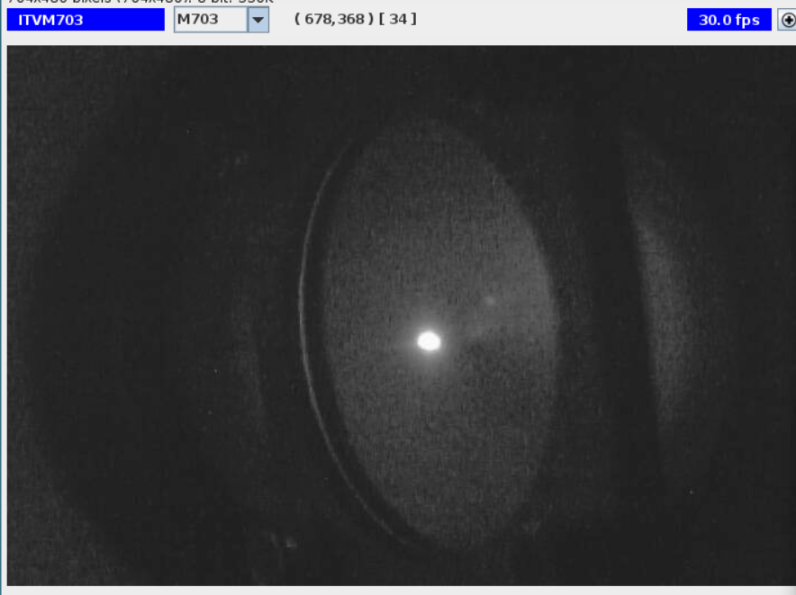
Stable 6.3 MeV/c Beam on Spectrometer Viewer

Slide 14
X/Y Coupling Baseline
Booster: off and detuned
MHB403H&V: steer beam horizontally and vertically using MHB403V
Measure beam positions on ITVM201
MHB403H&V
2-cell
7-cell
ITVM201

Slide 15

X/Y Coupling Baseline (Booster off)
5.1°
-2.7°
H
V

Slide 16
X/Y Coupling Caused By Booster
Beam Displacement Direction and Rotation | Baseline (Booster off) | 2-cell (gset = 2.5 MV/m) | 7-cell (gset = 7.4 MV/m) | Booster (6.3 MeV/c)
H, Rotation (deg) (cw = +) | -2.7486863 | 1.082646967 | 3.668817087 | 4.751464054
V, Rotation (deg) (cw = +) | 5.097034794 | 0.807545637 | -1.174272579 | -0.366726942

Slide 17
Kicks From Cavities
Measure beam positions on ITVM201 with cavities on/off
Calculate angular displacements
 | Distance to ITVM201 (mm)
2-cell center | 1946.86155
7-cell center | 1116.17185
θ
2-cell
7-cell
ITVM201

Slide 18
Kicks From 2-cell Cavity

Slide 19
Kicks From 7-cell Cavity relative to 2-cell

Slide 20
Kicks From Booster

Slide 21
Some Observations
2-cell and 7-cell are not perfectly aligned: need to adjust MHBK403H by 0.1 Gcm, and MHBK403V by 1.6 Gcm after beam centering 2-cell cavity.
When moving the incoming beam horizontally and vertically with the 2-cell cavity on only and on crest, the exit beam moved accordingly. When the cavity phase was adjusted by -16 degrees the exit beam movement started to change polarity. No polarity changes were observed when the phase was increased.
When moving the incoming beam horizontally and vertically with both cavities on and on crest, the exit beam moved in opposite direction. When the 7-cell cavity phase was adjusted by +10 degrees the exit beam movement started to change polarity. No polarity changes were observed when the phase was decreased. And -/+ 20 degrees adjustment of 2-cell phase did not affect it.
When the incoming beam moves horizontally and vertically with the 7-cell cavity on only and on crest, the exit beam move accordingly. When the 7-cell cavity phase was adjusted by -20 degrees, the exit beam movement started to change polarities. No polarity changes were observed when the phase was increased.

Slide 22
To Do list
Energy spread
Bunchlength
Adiabatic Damping
(emittances upstream and downstream of Booster)
6.3 MeV/c beam setup with Gun HV at 130 KV

Slide 23
Correctors and Viewer Used
MHBK403H&V: 20.5” upstream
ITVM201: 10.5” downstream
No other correctors or lenses between MHBK403 and ITVK201
20.5”
90”
10.5”
MHBK403H&V
Booster
ITVM201

Slide 24
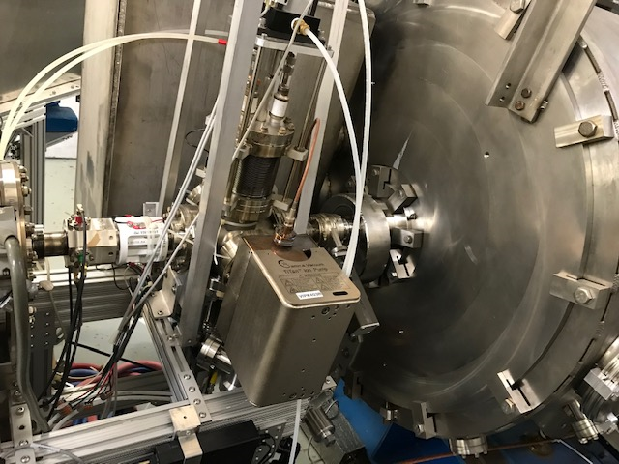
Booster and Upstream MHB403H&V
Fcup and Viewer
Booster
Ion Pump
MHBK403H&V

Slide 25
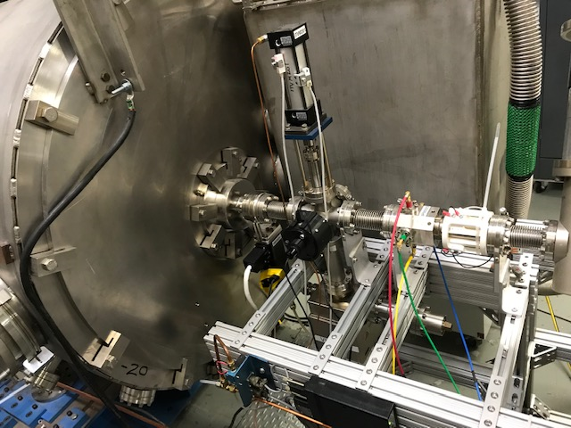
Booster and Downstream ITVM201
Booster
ITVM201
Ion pump

Slide 26
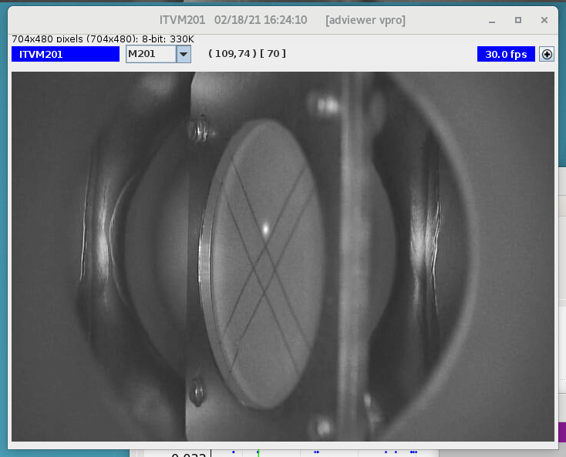
ITVM201 Calibration

Slide 27
ITVM201 Calibration
Assume 1 pixel in x plane is equal to1 pixel in y plane
Rotation angle (deg) | Conversion | factor (mm/px)
wrt y axis | x | y
26.03 | 0.15561602 | 0.07599734
θ
ITVM201

