Slide 3
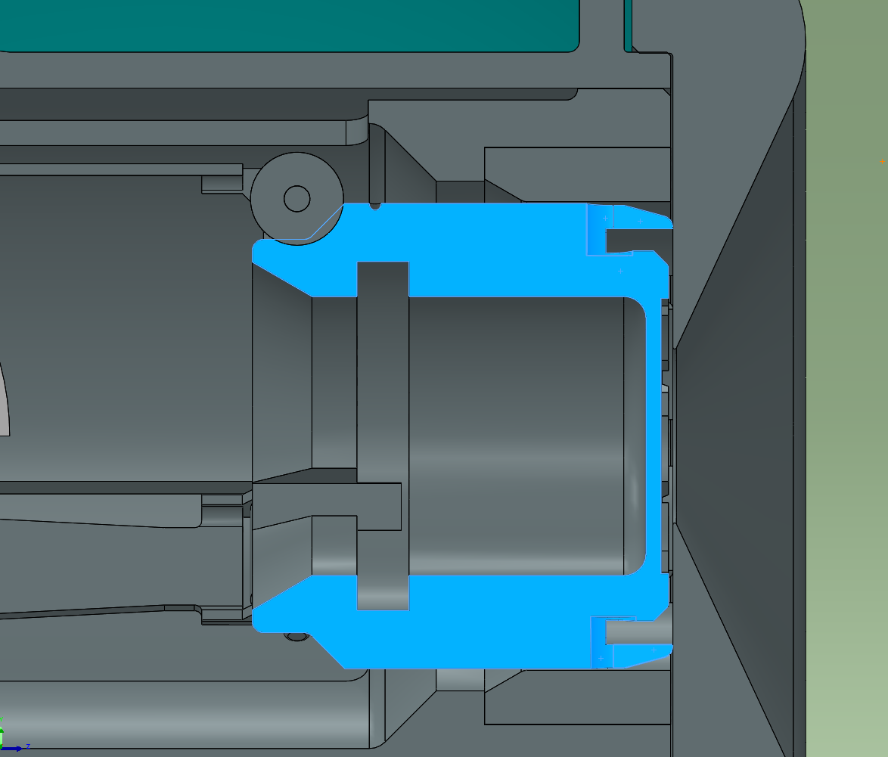

Slide 4
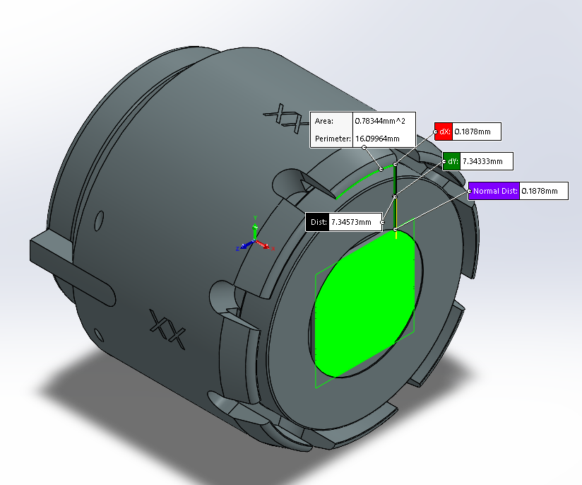
0.0330-(0.0010+0.0246) = 0.0074

Slide 5
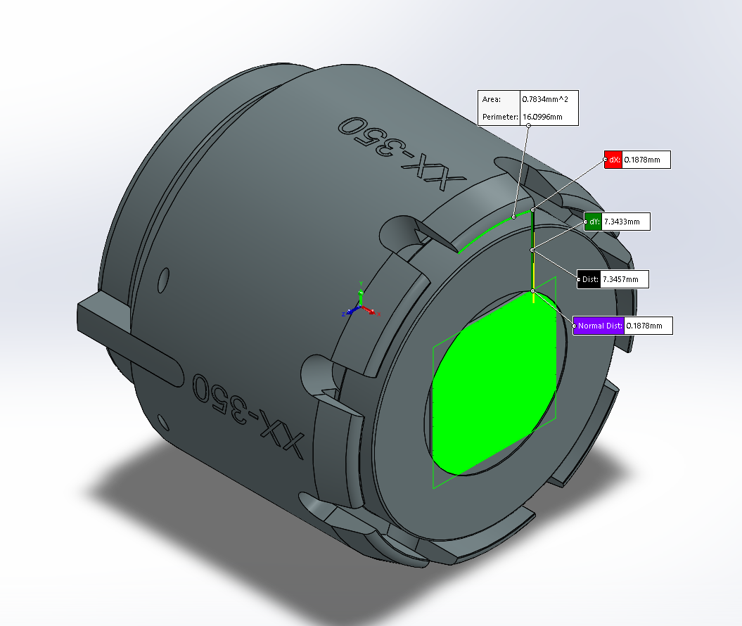
0.0222-(0.0010+0.0138) = 0.0074

Slide 6
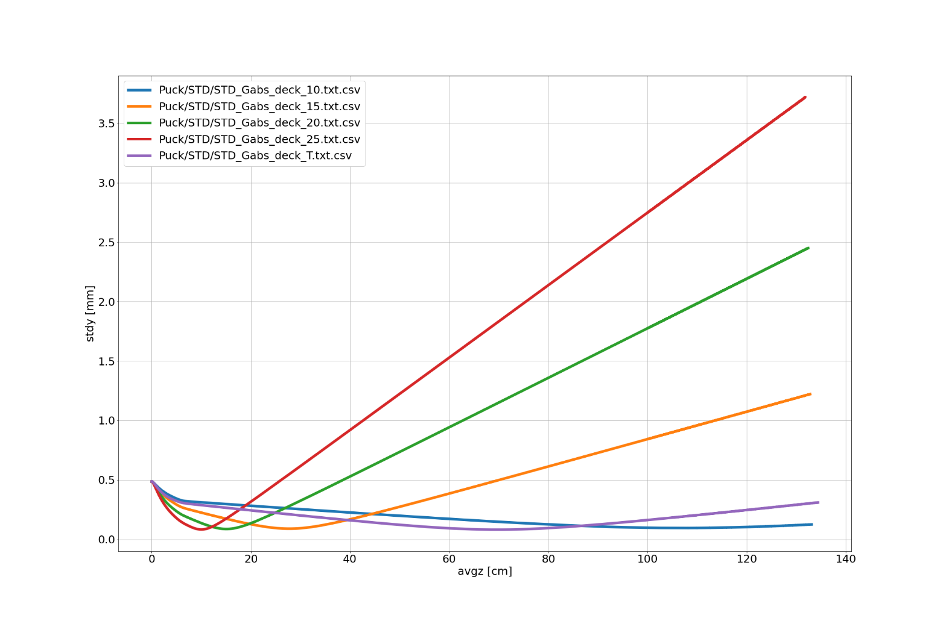

Slide 7
# Photocathode
nps = 10000 ; # Start 10000 particles
Qtot = -100e-15 ; # Total charge 100 fC
setparticles( "beam", nps, me, qe, Qtot ) ;
# These particles are to be started uniformly in a 25 ps time interval, having an initial radius of 0.5 mm.
tlen = 25e-12 ; # Laser pulse length: 25 ps
radius = 0.5e-3 ; # Bunch radius: 0.5 [mm]
Zstop = 2 ; # Z stop at 1 m
setrxydist( "beam", "g", 0, radius, 0, 3) ;
setphidist( "beam", "u", 0, 2*pi ) ;
Eo = 0.1 ; # Start with 0.1 eV
G = 1-q*Eo/(m*c*c) ; # Corresponding Gamma
GB = sqrt(G^2-1) ; # Corresponding Gamma*Beta
setGBzdist("beam", "g", 0, GB, 0, 3) ;
# Start in time
settdist("beam", "g", 0, tlen, 3, 3) ;
# Field maps

