Slide 1
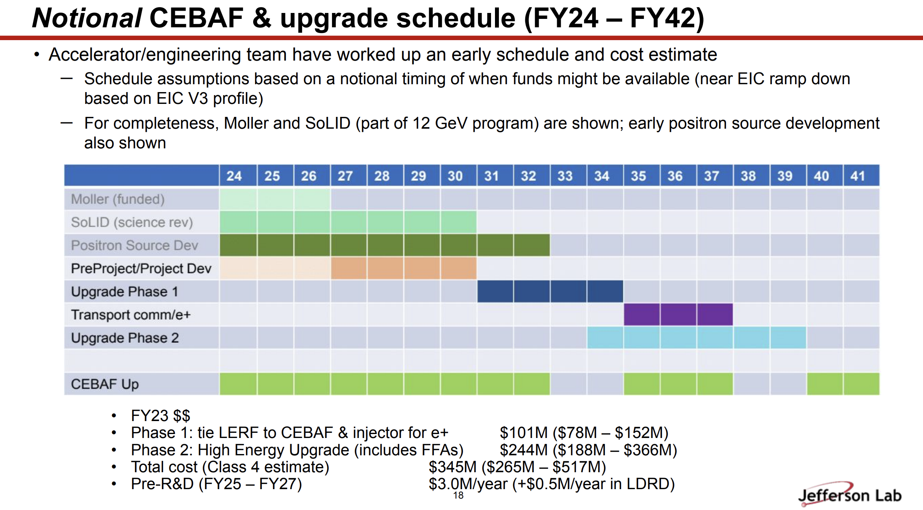
 | 24 | 25 | 26 | 27 | 28 | 29 | 30 | 31 | 32 | 33 | 34
Amy LDRD | X
Silviu Tgt/HEP | ? | ? | ?
Xelera PbBi | ? | ? | ?
LDRD PEPPo-II | ? | ?
Carlos Gun/HEP | ? | ? | ?
Mamun ECA | ? | ? | ? | ? | ?
Share w/ LCLS-II | X | X
Share w/ EIC |  | X | X | X | X | X | X

