Slide 1
Generation and Characterization of Magnetized Bunched Electron Beam from DC Photogun for
JLEIC Cooler
Laboratory Directed Research and Development (LDRD) Proposal
Riad Suleiman and Matt Poelker
June 28, 2017

Slide 2
JLEIC Magnetized Beam LDRD
Generate magnetized electron beam and measure its properties
Explore impact of cathode solenoid on photogun operation
Simulations and measurements will provide insights on ways to optimize JLEIC electron cooler and help design appropriate source
JLab will have direct experience magnetizing high current electron beam

Slide 3
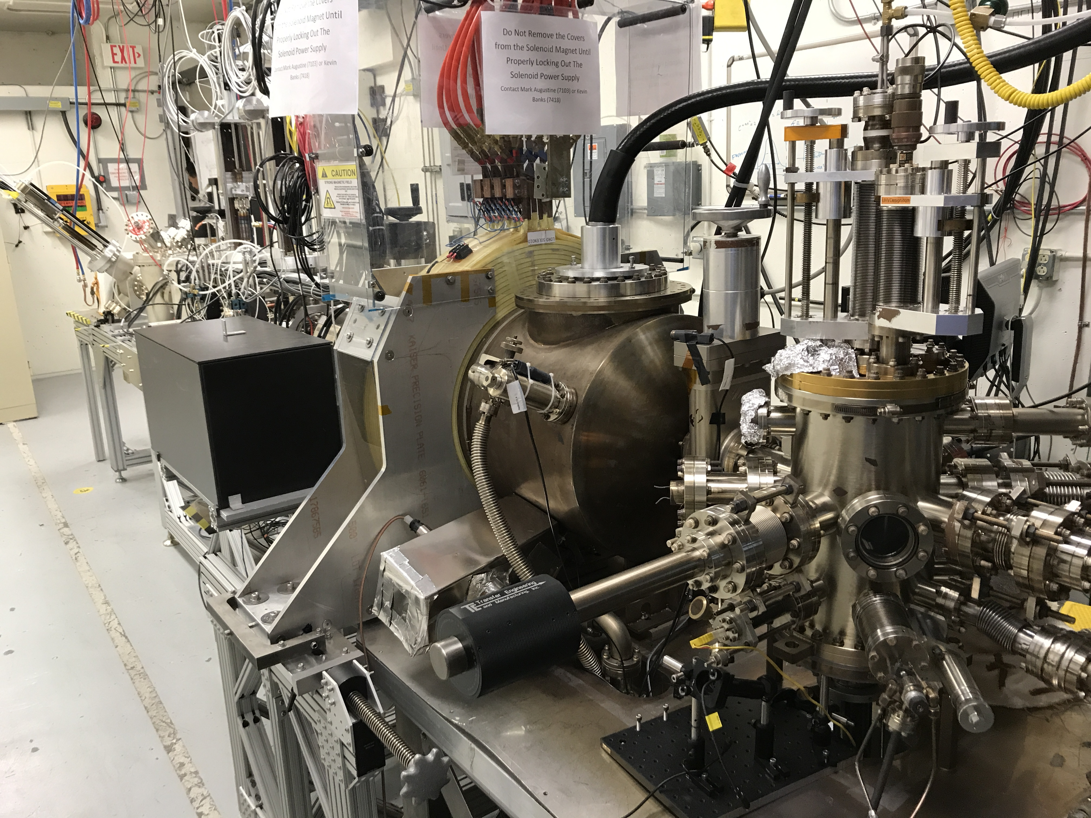
Magnetized Electron Source at GTS
K₂CsSb Photocathode Preparation Chamber, Gun, Solenoid and Beamline are all operational

Slide 4
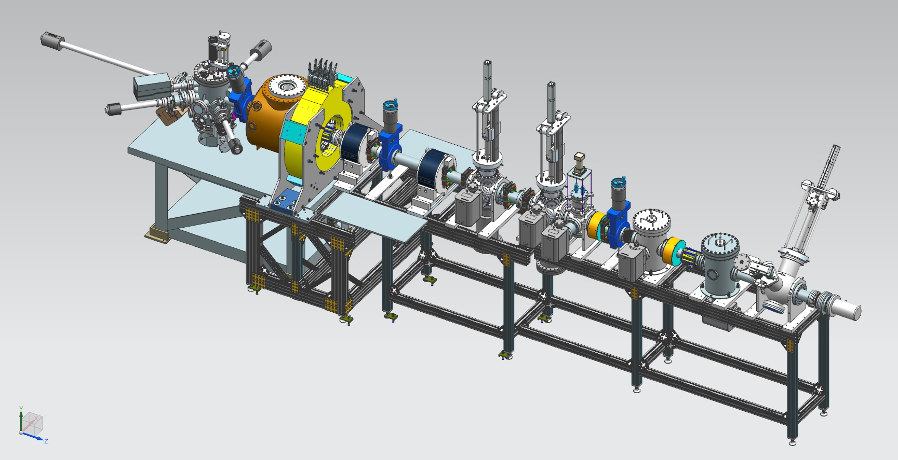
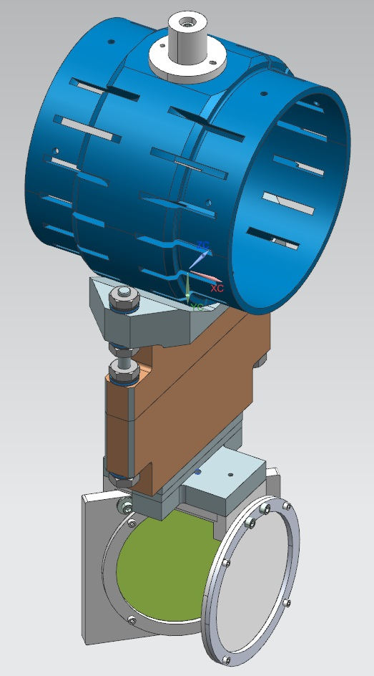
Gun HV Chamber
Photocathode
Preparation
Chamber
Beamline
Gun Solenoid
Shield Tube
Viewer 3 Screen
Beam Dump
Slit
Viewer Screen

Slide 5
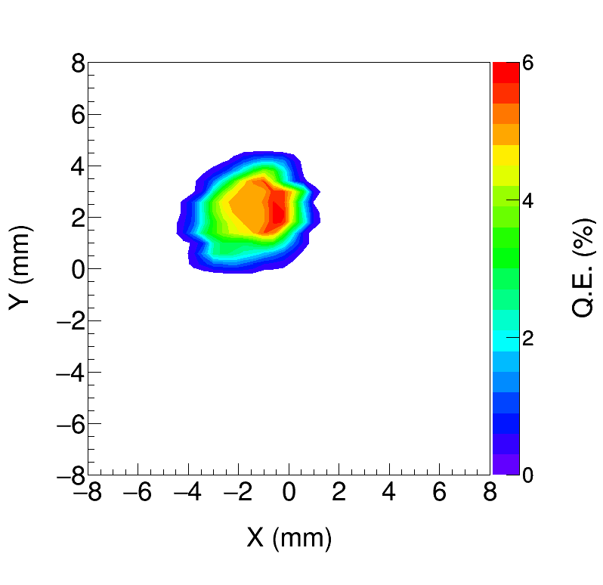
K₂CsSb Quantum Efficiency ~ 6%
K₂CsSb grown with a mask – limit photocathode active area (3 mm diameter) to reduce beam halo
Active area can be offset from electrostatic center
5 mm active area also available
Entire photocathode can be activated too
Work of M. Mamun and Y. Wang

Slide 6
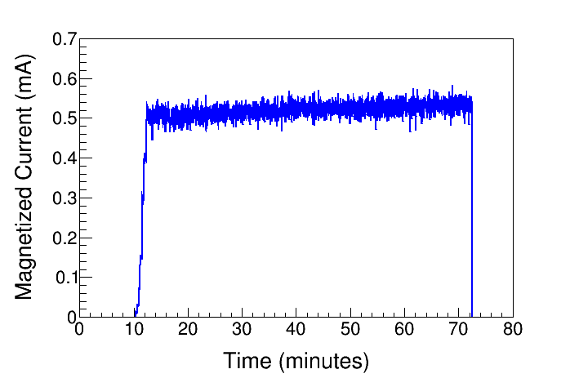
High Current Magnetized Beam
1450 G
Delivered 0.5 mA dc
Plan for 5 mA by end of summer

Slide 7
Measuring Beam Magnetization
Use slit and viewscreens to measure mechanical angular momentum:
$B_{z}$: solenoid field at photocathode
$a_{0}$: laser rms size
Φ: rotation (sheering) angle

Slide 8
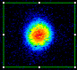
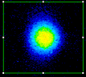
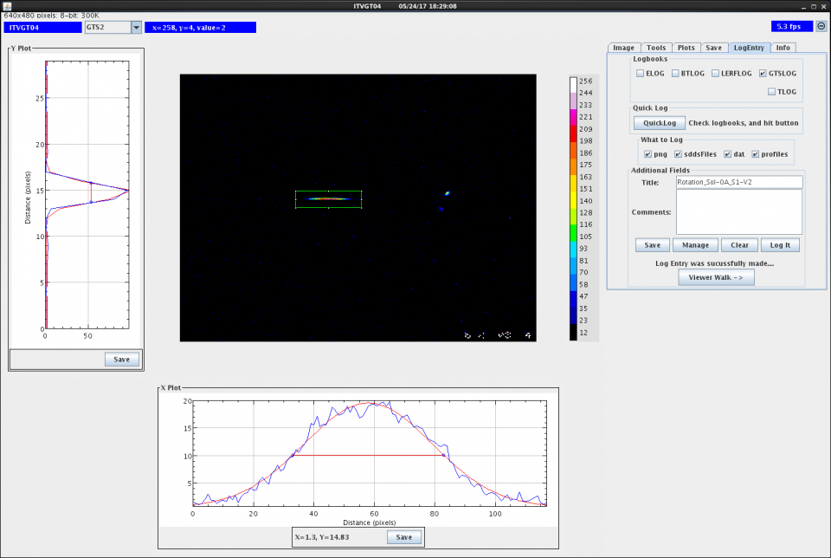
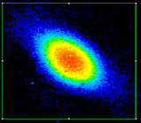
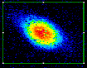
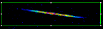
0 G
at photocathode
1088 G
at photocathode

Slide 9
Work of M. Mamun

Slide 10
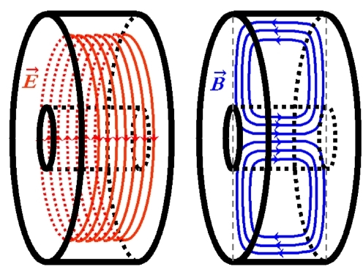
TE₀₁₁ Cavity: non-invasive technique
New non-invasive technique to measure beam magnetization
Filed inventor disclosure entitled “Non-invasive RF Cavity to Measure Beam Magnetization”

Slide 11
Summary and Outlook
K₂CsSb Photocathode Preparation Chamber, Gun, Solenoid and Beamline are all operational
Photogun operates reliably at 300 kV
Cathode solenoid can trigger field emission but we have learned how to prevent this
Have successfully magnetized electron beam and measured rotation angle
Continue to characterize magnetized beam and cross check measurements with simulation
Install RF pulsed laser
Demonstrate 32 mA
Build and install TE₀₁₁ cavity at GTS to measure beam magnetization in collaboration with Brock and SRF Institute
Next: Funded Phase-II SBIR with Xelera, to develop rf-pulsed dc high voltage thermionic gun to be installed at GTS in 2019

Slide 12
Budget
FY16 | $339,211
FY17 | $265,850
FY18 | $285,966
Total | $891,027
Materials and Supplies:
  TE₀₁₁ copper pillbox cavity
  Three skew quadrupoles
  Laser components
  Travel to conferences
Labor:
  Mechanical designer for TE₀₁₁ cavity
  ASTRA and GPT modeling (Fay Hannon)
  Postdoc
  Sajini Wijethunga, student from ODU started her Ph.D. thesis on magnetized beam (advisor: Jean Delayen, funded by 75% JLab + 25% ODU)
As of today, spent 65%

Slide 13
Questions to be addressed in your June 28th presentation
Could the authors please provide a reasonably detailed spreadsheet of 2018 purchases, categorized in terms of, for example, the main items to be purchased and their cost?
In accordance with the rules for LDRD funded projects, it is essential that the project be fully completed in 2018; review your plan and milestones to ensure this will be the case.
LDRD Goals and Purchases (this year remaining direct money – $10k parts and $54k labor):
  32 mA HV Power Supply: cables ordered – complete
  RF Laser: Diode laser ordered – complete
  High Bunch Laser: mirrors, synchronization electronics – $10k
  Round to Flat Beam Transformation: three skew quads – need to design and procure – $9k (use labor money)
  TE₀₁₁ Cavity: requested $20k in 2018

Slide 14
Milestones

Slide 15
Year 1 Milestones
Q1 (Oct, Nov, Dec):
    HV condition gun to 350 kV and build K₂CsSb preparation chamber ☑
    Design beamline, locate magnets and diagnostics at optimum positions ☑
    Design cathode solenoid magnet ☑
Q2 (Jan, Feb, Mar):
    Connect existing beamline to gun and instrument beamline ☑
    Procure cathode solenoid magnet ☑
    Design and procure slits ☑
Q3 (Apr, May, Jun):
    Commission exiting beamline with beam ☑
    Measure photocathode lifetime at 5 1 mA and 350 350 kV (non-magnetized) ☑
    Relocate new spare CEBAF dogleg power supply to GTS ☑
Q4 (Jul, Aug, Sep):
    Install cathode solenoid magnet ☑
    Assemble new beamline and commission with beam ☑

Slide 16
Year 2 Milestones
Q1 (Oct, Nov, Dec):
    Generate magnetized beam ☑
    Measure mechanical angular momentum vs magnetization and laser size on photocathode ☑
    Benchmark simulation against measurements ☑
Q2 (Jan, Feb, Mar):
    Measure mechanical angular momentum vs magnetization and laser size
    Benchmark simulation against measurements
Q3 (Apr, May, Jun):
    Measure photocathode lifetime vs magnetization at 5 mA and 300 kV
    Study beam halo and beam loss vs magnetization
    Design TE₀₁₁ cavity to measure beam magnetization
Q4 (Jul, Aug, Sep):
    Measure mechanical angular momentum vs bunch charge
    Generate very high currents magnetized beam and study beam transport vs electron bunch charge
    Design and procure three skew quads

Slide 17
Year 3 Milestones
Q1 (Oct, Nov, Dec):
    Commission TE₀₁₁ cavity with beam
    Install three skew quads
    Generate flat beam with skew quads – RTFB Transformer – and measure horizontal and vertical emittances using slit method
Q2 (Jan, Feb, Mar):
    Measure RTFB transformation versus electron bunch charge
    Use simulation to quantify how good or complete RTFB transform
Q3 (Apr, May, Jun):
    Change to HV Supply of 32 mA and 200 kV
Q4 (Jul, Aug, Sep):
    Measure photocathode lifetime vs magnetization at 32 mA and 200 kV
    Study beam halo and beam loss vs magnetization

