Slide 1
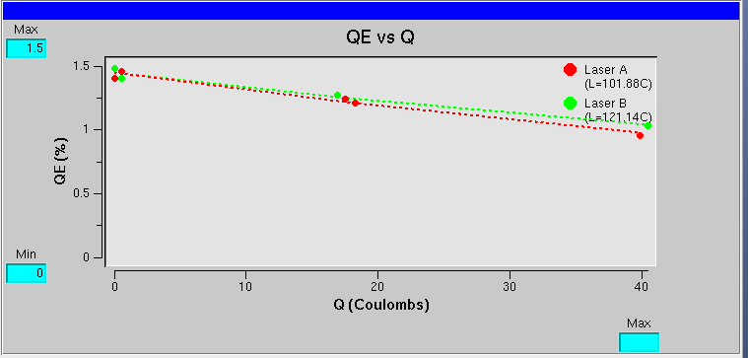
Gun2 - Spring 2015 Run
Duration | 2/19 - 5/18
Photocathode | Puck #3 5247-4 (1st 1/7/15)
Spot Location | 11500/11250
Charge Extracted | 40 C
Charge Lifetime | 100-120 C
Polarization | 87_{Mott} – 89_{Moller} %
Start of Run 2/19
End of Run 5/18
f_{A} = 249.5 MHz
f_{B} = 499.0 MHz

Slide 2
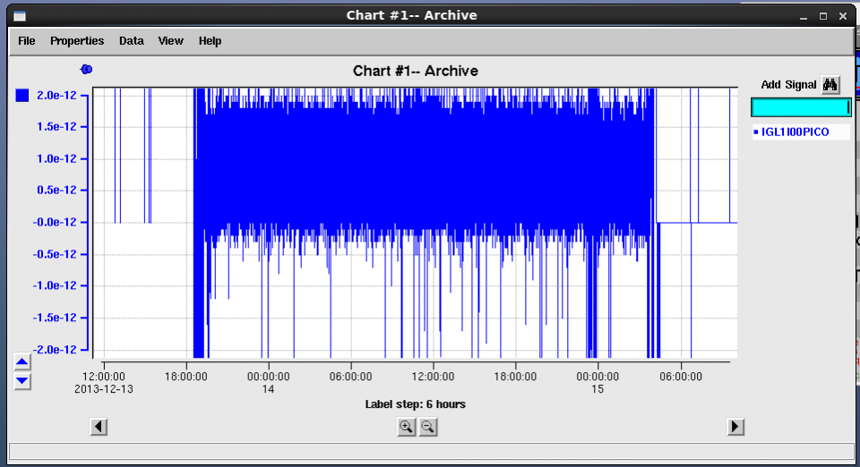
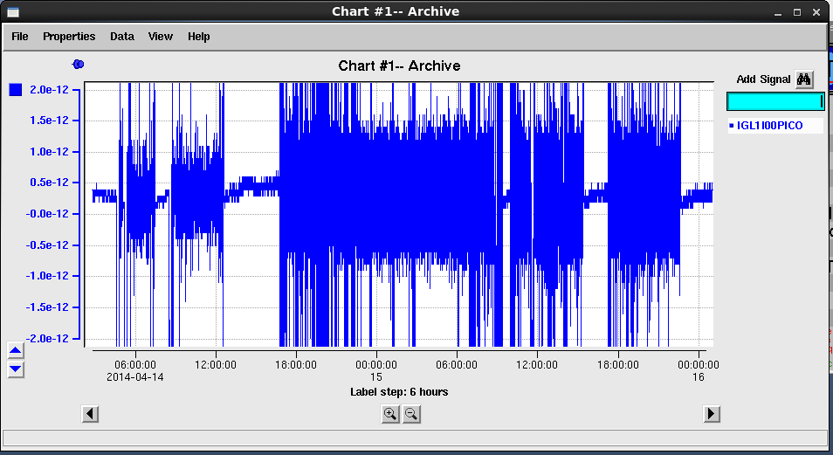
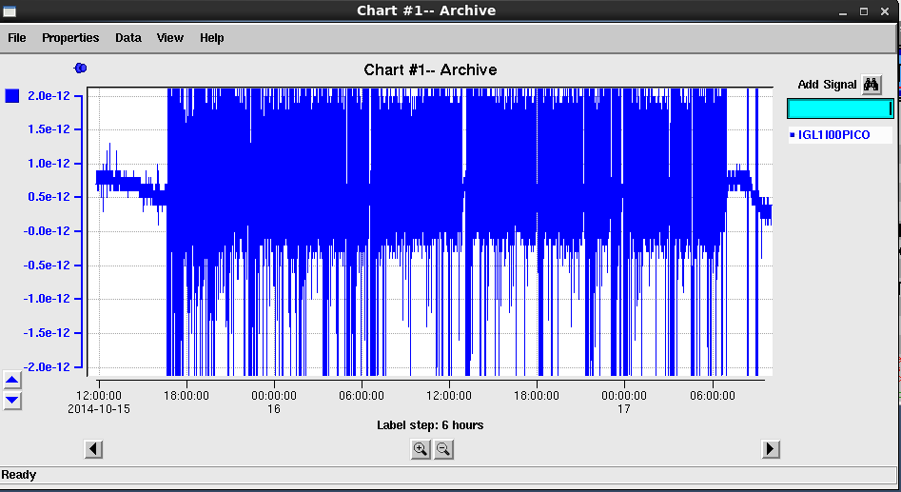
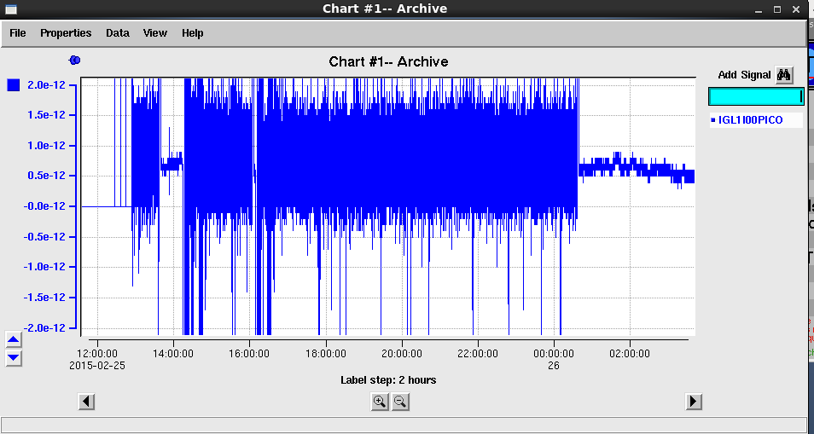
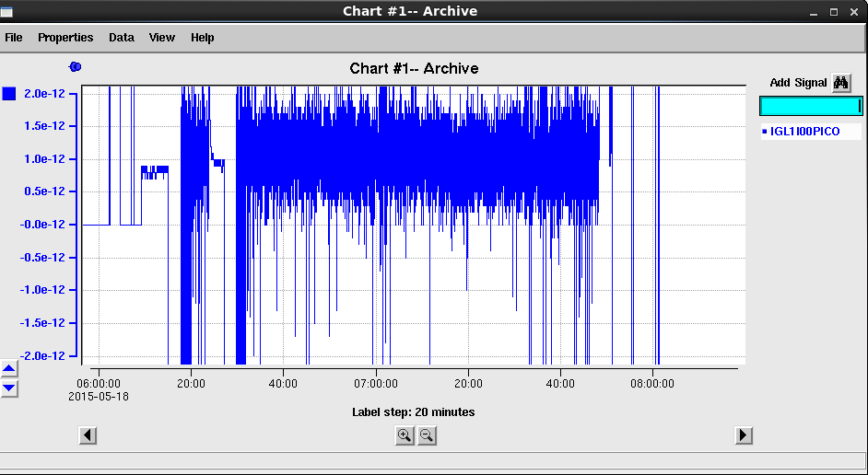
12/13/13
4/14/14
10/15/14
12/17/14
Anode Current (±2pA FS)
2/25/15
5/18/15

