Slide 1
How to Use UITF
JLEIC electron injection demo
J. Guo, J. Grames
December 12, 2018

Slide 2
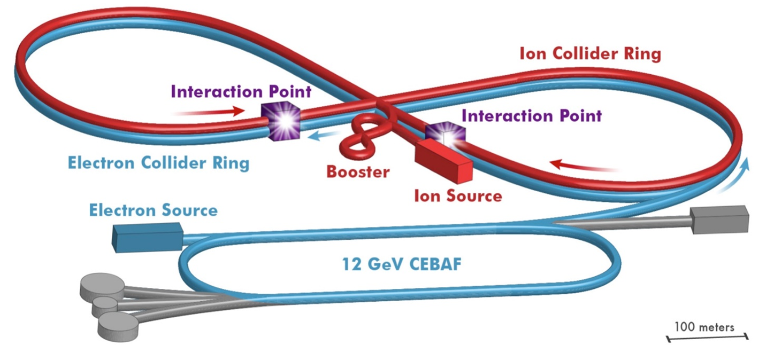
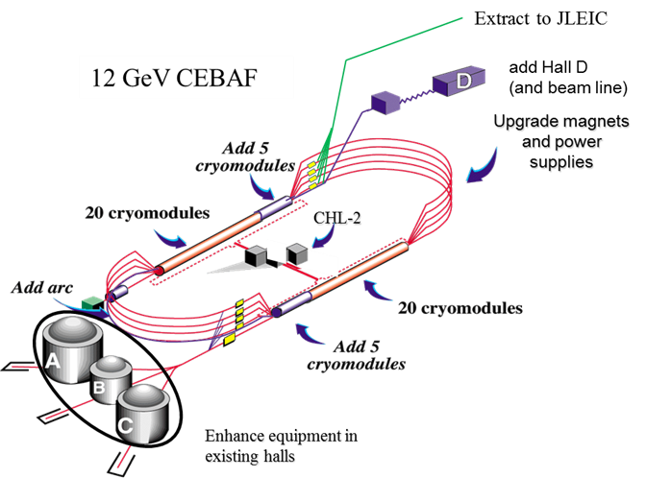
JLEIC e-ring injection beam requirement
JLEIC e-ring has the circumference of ~2256m, two 476MHz 1047m (3.49μs) long bunch trains of opposite polarization, with up to 3A average current (~7nC per bunch)
JLEIC electron injection requires pulsed bunch trains with low repetition rate, limited by both the kicker recovery time (up to 60Hz) and transverse damping time (6-400 ms).
Injected bunch repetition rate 17.01-68.05 MHz to match the 1497MHz CEBAF RF frequency.
Requires ~1047m bunch train with pulsed current ~2mA, charge per bunch up to 30-50pC to achieve the injection time goal.
More complicated time structure desired: double charge or reprate in a few bunches at the head/tail of the bunch train
Down polarized bunch train
Up polarized bunch train
gaps

Slide 3
What can be demonstrated at UITF
UITF provides more potential to test beam closer to JLEIC e-ring injection requirement, with better availability and less restriction.
Generating the up to 2mA 4-24μs bunch train
Only 0.4mA generated in CEBAF gun
Generate the 68MHz or 17MHz polarized beam with 25-50pC charge per bunch
CEBAF tests were limited to ~0.4pC with 2×499MHz reprate
Generating the double intensity head/tail section (70-130ns each) in the bunch train
Test the RF feed-forward algorism
Reprograming CEBAF RF control modules considered risky for CEBAF operation

