Slide 1
CEBAF Injector Drawing & Dimensions
Josh Yoskowitz

Slide 2
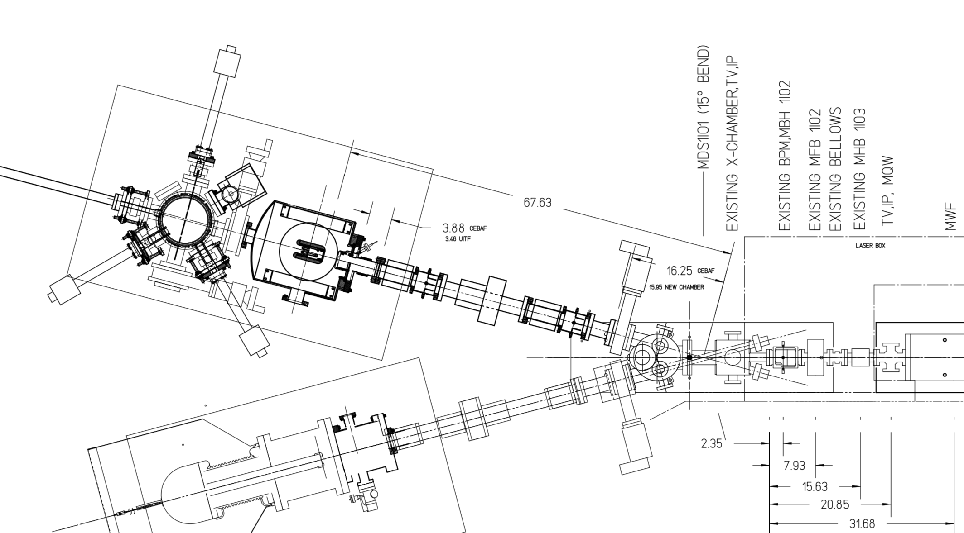
(units = inches)
Gun to Entrance of Wien filter
Cathode-Center Dipole
Two pair of H/V steering coils puts beam on axis
Other H/V coils can stay “off”

Slide 3
Drawing Pt 1: Gun Front Flange to Valve
Front Flange of Gun
Assume 0.25” uncertainty in measurement (unless otherwise stated)
Cathode
Anode
VBV2I02
MBI2I01 H&V
IPM2I01
MBH2I02 H&V
MFH2I01
MBH2I03 H&V
IPM2I02
(x,y)
7.75”
12.625”
21.5”
26”
34.25”
39”
47±1”

Slide 4
Drawing Pt 2: Valve to Vertical Wien Filter Entrance
Assume 0.25” uncertainty in measurement (unless otherwise stated)
MWF1I04 (entrance)
VBV2I02
ITV2I01
MFB1I02
MDS1I01
ITV1I02
MBH1I02 H&V
MHB1I03 H&V
ITV1I03
7”
10±1”
16”
5±1”
21”
29”
Front Face of Dipole Magnet
34”
37.5”

Slide 5
Table of Element Names and Lengths (maybe good to stay to same units: m, Tesla, ?)
Name | Type | Physical Length (inches) | Physical Radius (dia.) | Field Map Length (in) | Field Map Radius Extent | Field Map Name
MBH2I01 H&V | Steering Coil | 4.25 | 2.375” | 19.7 |  | BH_Steering_Coil_FieldMap.txt
IPM2I01 | Beam Position Monitor | 0 | 2.375”
MBH2I02 H&V | Steering Coil | 4.25 | 2.375” | 19.7 |  | BH_Steering_Coil_FieldMap.txt
MFH2I01 | Solenoid | 3 | 2.375” | 19.7 |  | Solenoid_FieldMap.txt
MBH2I03 H&V | Steering Coil | 4.25 | 2.375” | 19.7 |  | BH_Steering_Coil_FieldMap.txt
IPM2I02 | Beam Position Monitor | 0 | 2.375”
VBV2I02 | Valve | 0 | 2.375”
ITV2I01 | Viewer | 0 | 2.375”
MDS1I01 | Dipole | 4.25 | 2.375” |  |  | Still need to add
ITV1I02 | Viewer | 0 | 1.375”
MBH1I03 H&V | Steering Coil | 4.25 | 1.375” | 19.7 |  | BH_Steering_Coil_FieldMap.txt
MFB1I02 | Solenoid | 3 | 1.375” | 19.7 |  | Solenoid_FieldMap.txt
MHB1I03 H&V (not MBH1I03) | Steering Coil | 2.94 | 1.375” | 19.7 |  | HB_Steering_Coil_FieldMap.txt
ITV1I03 | Viewer | 0 | 1.375”
MWF1I04 | Entrance to Vertical Wien Filter | 0 | 15mm

