Slide 1
UITF: Booster and HDIce testing (3/17/2020)
Deliverables/Milestones
Commission the QCM before installation at CEBAF 2021 (for Moller)
Provide beam to HDIce for target tests (three or four run periods requested)
Staffing for FY2020
FTEs: “Run0” (booster commissioning): Injector Group, Engineering HCO and support as needed, including Cryo to reconfigure CTF
FTEs: “Runs1-3” (HDIce tests), request (3) fulltime Operators
Skills :
Facility Manager and Operators
Cryo
I&C
DC power
RF group
Survey and Alignment
Safety System Group
Software, High Level Apps, Computer support
Installation to remove/replace roof tiles
When needed: now
Issues/Concerns that are/could affect on time delivery
Approved UITF Operators (Kazimi and company) are busy at CEBAF
Gun Group will be rebuilding CEBAF injector during SAD, not available to operate UITF for HDIce tests
24/7 operations required
DOE accelerator requirements are very formal, very strict
Must close out (2) CATS items to obtain permission to Operate UITF (i.e., for HDIce runs)
Covid-19
Recommended Mitigation:
Take advantage of window of opportunity, a break in LCLS-2 CM testing at CMTF
Operators available during SAD
Poelker to close the 2 remaining CATS items by end April, ready to ask for permission to Operate and hope Site Office grants permission in timely manner

Slide 2
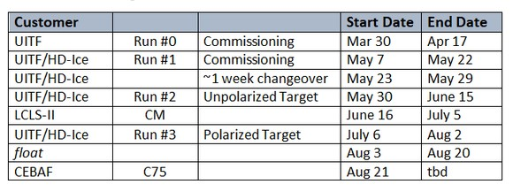
UITF schedule, following productive meeting with Allison, Patrizia, Andy, Tony, Camille, Bob May, Steve Smith on 3/5/2020
(3/17/2020)
There’s a gap in LCLS-2 and CEBAF CM testing at CMTF, a perfect opportunity to perform Runs 0 - 3

Slide 3
Noteworthy developments
(3/5/2020)
Buncher tests look good, we have numbers for phase and gradient, longitudinal waist at 2-cell cavity inside booster
Yao cavity tests have started, seems like a useful tool to set phases
Closed one CATS item - document procedures
Nearly finished closing out another CATS item: SAF162 UITF Operator is now a formal training, first training session scheduled for March 26
In good shape for Run0

Slide 4
Preparing for Runs1, 2 and 3 (3/17/2020)
Still quite a lot of work to do
Elevated beamline vacuum work, need vacuum from gun to HDIce dump
HDIce computer interfaces
Machine protection nodes related to HDIce
ERR response must be filed
Install 2nd Rowgowski coil for testing during Run0
There is confusion about priority of UITF and HDIce tests as it relates to Medcon5

Slide 5
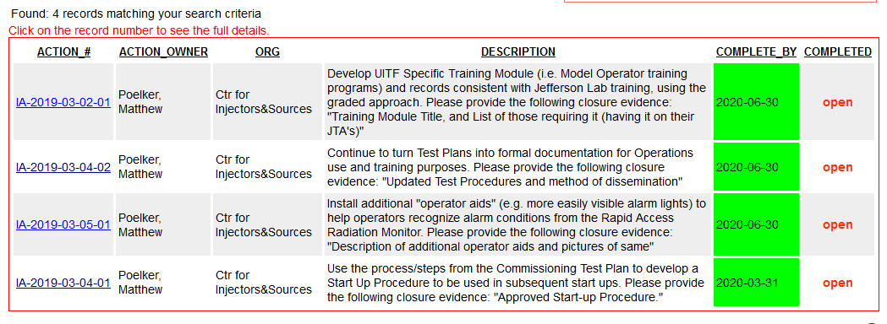
UITF – Comments (3/17/2020)
ARR “post-start” findings
almost
This one does not need to be closed
Will work on this one now and immediately after Run0, with plan to distribute start up procedure ~ 1 week after commissioning run, ~ April 23. Then work with Bob to draft letter requesting permission to Operate, permission granted by May 7, that’s the plan

