Slide 1
Booster Commissioning at UITF
Yan
February 18, 2022

Slide 2
Contents
Gradient calibration of Booster cavities
Beam deflection caused by Booster
Beam x/y coupling generated from Booster
Beam energy spread downstream of Booster
Beam emittances upstream and downstream of Booster
Beam instability
Future work

Slide 3
Booster
Booster, a SRF cryomodule, installed and commissioned at UITF
Composed of a 2-cell cavity and a 7-cell cavity,
Designed to accelerate 200 keV beam to energies up to 10 MeV
Installed at CEBAF in 2023
Two successful runs
9.6 MeV run for HDice experiment in 2020 & 2021
8.0 MeV run for Water Irradiation experiment in 2021.
Beam based evaluation of Booster

Slide 4
Partial UITF Beamline
ITVM703
Chopper Buncher
MDML601
ITVM201/401
30°
Gun
25°
z
ITVM601
MDS201
Solenoids
Booster
Quads
ITVM803

Slide 5
Beam Conditions
Gun HV: 130/180/200 KV
Chopper: on/off
Buncher: on & at negative zero crossing
Booster: on crest & beam centered
Beam momentum: 6.3 MeV/c
All solenoids: beam centered & cycled
All quads: beam centered, zero field & cycled

Slide 6
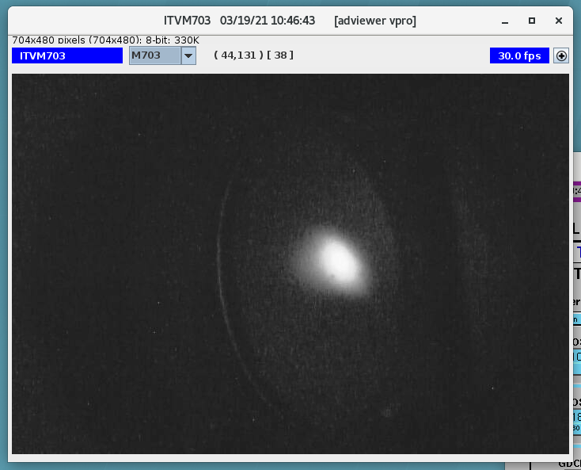
Beam Images with Gun HV at 130 KV
2-cell on (gset at 2.5 MV/m), 7-cell off
7-cell on (gset at 7.5 MV/m), 2-cell off

Slide 7
Stable 6.3 MeV/c Beam with Gun HV at 130 KV (2-cell Gset at 2.5 MV/m, 7-cell Gset at 7.5 MV/m)

Slide 8
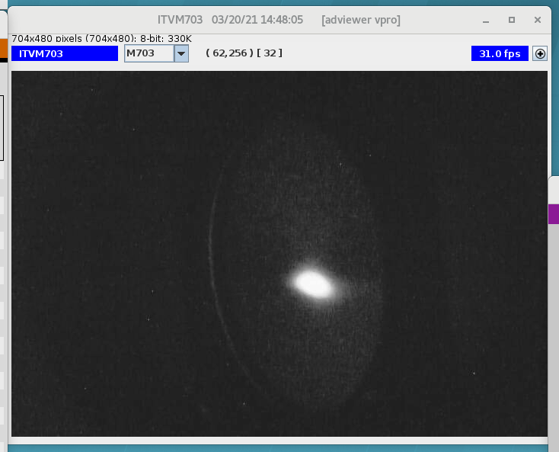
Beam Images with Gun HV at 200 KV
2-cell on (gset at 2.5 MV/m), 7-cell off
7-cell on (gset at 7.5 MV/m), 2-cell off

Slide 9
Stable 6.3 MeV/c Beam With Gun HV at 200 KV (2-cell Gset at 2.5 MV/m, 7=cell Gset at 7.46 MV/m)

Slide 10
Beam Momentum vs. 2-Cell Cavity Gset

Slide 11
Kinetic Energy Gain from 2-Cell Cavity

Slide 12
Beam Momentum vs. 7-Cell Cavity Gradient

Slide 13
Emittance Measurement
UITF
KeV region: MQZK203 & ITVK203
MeV region: MQJM501 & ITVM603
CEBAF
KeV region: MFX2I01 & ITV2I01
MeV region: MQJ0L02, MQJ0L02A & IHA0L03

Slide 14
Emittance Measurement
Gun HV (kV) | UITF | ɛ_{x} (m-rad) (E-7) | ɛ_{y} (m-rad) (E-7) | ɛ_{nx} (m-rad) (E-7) | ɛ_{ny} (m-rad) (E-7)
130 | KeV | 7.02 +/- 0.23 | 6.84 +/- 0.02 | 5.32 +/- 0.18 | 5.18 +/- 0.18
130 | 6.3 MeV/c | 0.44 +/- 0.01 | 0.39 +/- 0.02 | 5.42 +/- 0.02 | 4.76 +/- 0.02
180 | KeV | 4.35 +/- 0.03 | 4.37 +/- 0.07 | 3.87+/- 0.03 | 3.89 +/- 0.06
180 | 6.3 MeV/c | 0.38 +/- 0.02 | 0.57 +/- 0.04 | 4.64 +/- 0.02 | 6.98 +/- 0.05
Gun HV (kV) | CEBAF | ɛ_{x} (m-rad) (E-7) | ɛ_{y} (m-rad) (E-7) | ɛ_{nx} (m-rad) (E-7) | ɛ_{ny} (m-rad) (E-7)
130 | KeV | 10.40+/- 2.76 | 8.63 +/- 1.67 | 7.88 +/- 2.09 | 6.54 +/- 1.27
130 | 6.3 MeV/c | 0.35 +/- 0.01 | 0.36 +/- 0.01 | 4.60 +/- 0.03 | 4.70 +/- 0.01

Slide 15
Normalized Emittance, courtesy of A. Hofler

Slide 16
Beam Deflection by Booster
Booster
ITVM201
θ
d
Deflection angle θ = ATAN(d/L)
L

Slide 17
Beam Deflection by Booster
Measure beam positions on ITVM201 with cavities on/off
Calculate angular displacements
1946.86
1116.17
 | Distance to ITVM201 (mm)
2-cell center | 1946.9
7-cell center | 1116.2
θ
2-cell
7-cell
ITVM201

Slide 18
Correctors & Viewer Used (for x/y coupling and deflection studies)
MHBK403H&V: 20.5” upstream
ITVM201: 10.5” downstream
No other magnets between MHBK403 and ITVK201
20.5”
90”
10.5”
z
MHBK403H&V
Booster
ITVM201

Slide 19
Booster and Upstream MHB403H&V
Fcup and Viewer
Booster
Ion Pump
MHBK403H&V

Slide 20
Booster and Downstream ITVM201
Booster
ITVM201
Ion pump

Slide 21
Beam on ITVM201

Slide 22
Beam Deflection
UITF Gun HV (KV) | 130 | 130 | 180 | 180
Beam deflection | x (deg) | y (deg) | x (deg) | y (deg)
2-cell Cavity on | 0.11 +/- 0.01 | 0.18 +/- 0.01 | 0.13 +/- 0.01 | 0.19 +/- 0.01
Both Cavities on | 0.34 +/- 0.01 | 0.22 +/- 0.01 | 0.27 +/- 0.01 | 0.17 +/- 0.01

Slide 23
x/y Coupling Caused by Booster
Move beam on a viewer horizontally
or vertically
Measure the beam position
changes in both planes
Calculate beam rotation angle
θ

Slide 24
x/y Coupling caused by Booster
UITF Gun HV (KV) | 130 | 130 | 180 | 180
x/y Coupling (Baseline) | x (deg) | y (deg) | x (deg) | y (deg)
2-cell Cavity off | 1.65 +/- 0.16 | -0.09 +/- 0.03 | 2.83 +/- 0.40 | 0.01 +/- 0.20
Both Cavities off | 1.65 +/- 0.16 | -0.09 +/- 0.03 | 2.83 +/- 0.40 | 0.01 +/- 0.20
UITF Gun HV (KV) | 130 | 130 | 180 | 180
x/y Coupling (measured) | x (deg) | y (deg) | x (deg) | y (deg)
2-cell Cavity on | 5.18 +/- 0.29 | -0.38 +/- 0.03 | 4.57 +/- 0.17 | 0.63 +/- 0.09
Both Cavities on | 2.61 +/- 0.14 | 0.38 +/- 0.03 | 3.26 +/- 0.10 | 1.07 +/- 0.06
UITF Gun HV (KV) | 130 | 130 | 180 | 180
x/y Coupling (net) | x (deg) | y (deg) | x (deg) | y (deg)
2-cell Cavity on | 3.53 +/- 0.33 | -0.29 +/- 0.04 | 1.74 +/- 0.43 | 0.62 +/- 0.22
Both Cavities on | 0.96 +/- 0.21 | 0.47 +/- 0.04 | 0.43 +/- 0.41 | 1.06 +/- 0.21

Slide 25
Energy Spread Measurement
ITVM703/803
σ₁
σ₂
Booster
ITVM401
MDLM504/601
VP
ITVM601
Spectrometer Dipole MDLM504/601

Slide 26
Energy Spread Measurement
θ2
θ1
MDLM601
MDLM504
Weak de-focusing in bending plane
No focusing/de-focusing in bending plane

Slide 27
Energy Spread Measurement
All quads are beam centered, zero field, and cycled
Measure beam sizes σ₁ at ITVM703/803
Measure beam sizes at ITVM401/601
Calculate beam sizes σ₂ at Virtual Point using that at ITVM401/601
Beam size change $d\text{σ}$= $\sqrt{\text{σ}12 −\text{σ}22}$
Deflection angle change $dθ=\frac{d\text{σ}}{L}$, where 𝐿 is the spectrometer length
$BDL=kθp=k\left(θ+dθ\right)\left(p−dp\right)=kθp+k(dθp−θdp−dθdp)$
$\frac{dp}{p}=dθ/θ$ $= \frac{dσ}{θL}$

Slide 28
Energy Spread Measurement
Chopper / Slit Position | Buncher Aplitude change (KeV) | Buncher Phase change (deg) | 7-cell Phase change (deg) | dp/p at ITVM803 gun hv = 130 KV | dp/p at ITVM803 gun hv = 180 KV | dp/p at ITVM703 gun hv = 180 KV
Off / Out |  |  | 0 | 1.21E-004 | 4.36 +/- 0.26 E-4 | 4.94 +/- 0.28 E-4
Off / Out |  |  | -5 | 1.16E-003 | 8.35 +/- 0.72 E-4 | 7.99 +/- 0.19 E-4
Off / Out |  |  | -10 | 5.32E-003 | 1.32 +/- 0.01 E-3 | 1.29 +/- 0.02 E-3
Off / Out |  |  | 5 | 4.12E-004 | 4.93 +/- 0.33 E-4 | 6.46 +/- 0.40 E-4
Off / Out |  |  | 10 | 7.02E-004 | 6.28 +/- 0.19 E-4 | 8.70 +/- 0.28 E-4
Off / Out |  | -5 |  | 1.13E-003 | 5.83 +/- 0.27 E-4 | 7.13 +/- 0.08 E-4
Off / Out |  | -10 |  | N/A | 8.60 +/- 0.43 E-4 | 1.09 +/- 0.03 E-3
Off / Out |  | 5 |  | 5.42E-003 | 1.24 +/- 0.03 E-3 | 1.24 +/- 0.03 E-3
Off / Out |  | 10 |  | N/A | 2.53 +/- 0.02 E-3 | 2.51 +/- 0.01 E-3
Off / Out | -5 |  |  | 4.42E-004 | 7.91 +/- 0.22 E-4 | 4.89 +/- 0.19 E-4
Off / Out | -10 |  |  | 1.47E-003 | 1.83 +/- 0.01 E-3 | 1.48 +/- 0.02 E-3
Off / Out | 5 |  |  | 1.28E-003 | 5.48 +/- 0.06 E-4 | 4.08 +/- 0.13 E-4
Off / Out | 10 |  |  | N/A | 9.44 +/- 0.42 E-4 | 3.16 +/- 0.05 E-4
On / 285 (hole) |  |  |  | N/A | 2.09E-004 | N/A
On / 430 |  |  |  | N/A | 2.93E-004 | N/A
On / 530 |  |  |  | N/A | 2.92E-004 | N/A
On / 630 |  |  |  | N/A | 4.30E-004 | N/A
On / 730 |  |  |  | N/A | 5.72E-004 | N/A

Slide 29
Kinetic Energy, Energy Spread, courtesy of A. Hofler

Slide 30
Beam Instability
A few-Hz horizontal beam jitter observed downstream of Booster
On the straight-line viewers ITVM401, 504, 601 and 603
On the spectrometer-line viewer ITVM703
On the chicane viewer ITV803
Would last a minute or two when it comes
Not energy related. Root cause not identified yet
Beam instability studies by Max Bruker and company
Microphonic studies by SRF group
Inconsistent Booster trips. Unstable cryo?

Slide 31
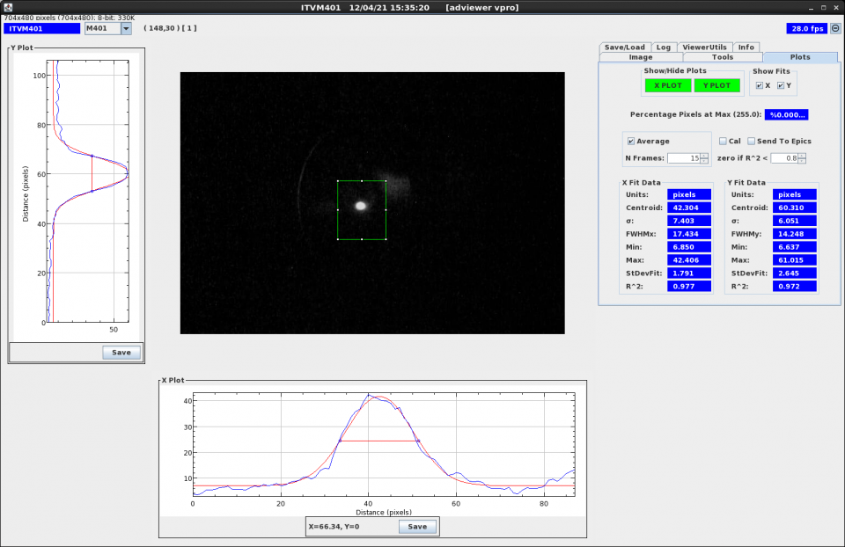
Beam Jitter on ITVM401

Slide 32
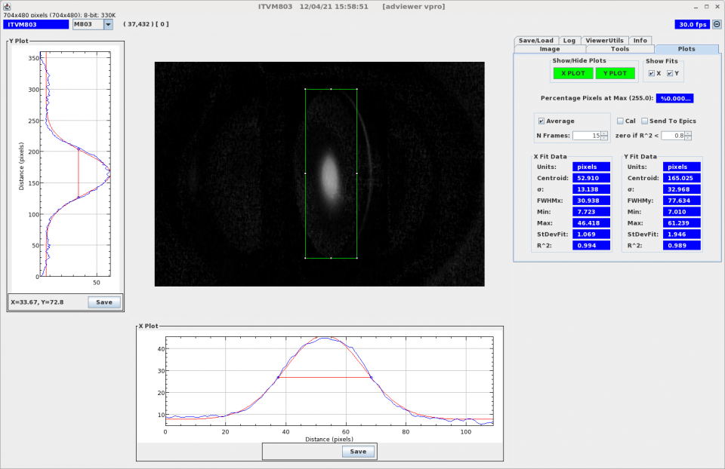
Beam Jitter on ITVM803

Slide 33
Future Work
High current run
Radiation shielding needed for high current run (150 – 200 uA)
Bunch length measurement
Hardware and software not ready yet downstream of Booster
Anything else?

