Slide 1
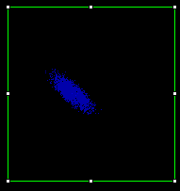


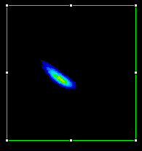







MFGGT02 current and expected rotation angle for emittance measurements laser spot x=0, y=+3 mm.
2.175 A
41.20˚
2.135 A
40.44˚
2.095 A
39.68˚
2.055 A
38.92˚
2.015 A
38.17˚
1.975 A
37.41˚
1.775 A
33.62˚
1.815 A
34.38˚
1.855 A
35.14˚
1.895 A
35.89˚
1.935 A
36.65˚

Slide 2
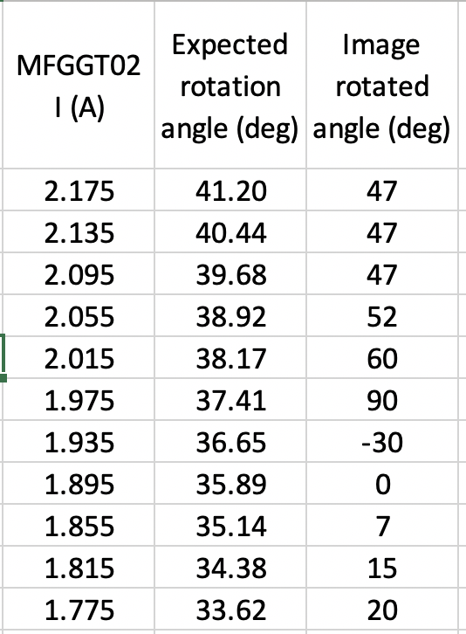
2.175 A, 41.20˚
Image rotated
by 47 ˚
2.175 A
41.20˚
Image rotation
Clockwise
1.935 A., 36.65˚
Image rotated
by 30 ˚
1.935 A
36.65˚
Image rotation
Counterclockwise

Slide 3
2.175 A, 41.20˚
Image rotated
by 47 ˚
2.135 A, 40.44˚
Image rotated
by 47 ˚
2.095 A, 39.68˚
Image rotated
by 47 ˚
2.055 A, 38.92˚
Image rotated
by 52 ˚
2.015 A, 38.17˚
Image rotated
by 60 ˚
1.975 A, 37.41˚
Image rotated
by 60 ˚
2.175 A, 41.20˚
Image rotated
by 20 ˚
1.815 A, 34.38˚
Image rotated
by 15 ˚
1.855 A, 35.14˚
Image rotated
by 7 ˚
1.895 A, 35.89˚
Image rotated
by 0 ˚
1.975 A, 37.41˚
Image rotated
by -30 ˚

