Slide 1
GPT -s
Overview of Benchmark Simulations
Simulation Results (from newest GPT –s version)
Next Steps
Mark Stefani

Slide 2
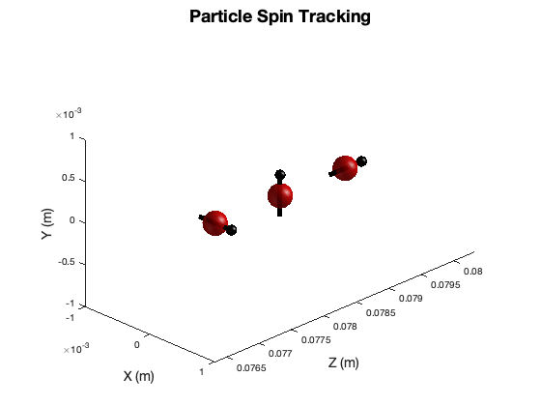
Benchmark Simulations
Main Simulations:
Solenoid, Dipole, and Wien Filter (Or, a combination of these elements)
Each Simulation contains 3 particles with orthogonal initial spin.
Each simulation has been performed with varying energies, and theoretical precession values
Simulation Conditions (being presented):
$γ$ = 4.914
$β$ = 0.9791
KE $≅$2 MeV
$S_{10}$ = (1,0,0), $S_{20}$ = (0,1,0), $S_{30}$ = (0,0,1)

Slide 3
Benchmark Simulations
Solenoid, Dipole, and Wien Filter Precession:
Total spin processions in lab frame; not relative to momentum.
Theoretical values make approximations of field integration and time of flight.
Solenoid: $θ=\frac{180}{π} \frac{e}{m} T [\frac{1}{γ}\left(a+1\right)\vec{B_{∥}}]$
Dipole: $θ=\frac{180}{π} \frac{e}{m} T [\left(a+\frac{1}{γ}\right)\vec{B_{⊥}}]$ $T≅\frac{L}{βc}$
Wein filter: $θ=\frac{180}{π} \frac{e}{m} T[a\frac{E}{βc}+\left(\frac{1}{γ^{2}−1}−a\right)\frac{βE}{c}]$

Slide 4
Simulation Results
Solenoid: $γ$ = 4.914, $β$= 0.9791
$T≅\frac{L}{βc}$ $θ=\frac{180}{π} \frac{e}{m} T [\frac{1}{γ}\left(a+1\right)\vec{B_{∥}}]$ = 90 deg
Initial: $S_{10}$=(1,0,0) $S_{20}$=(0,1,0) $S_{30}$=(0,0,1)
Calculated: $S_{1}$=(0,1,0) $S_{2}$=(-1,0,0) $S_{3}$=(0,0,1)
Simulation: $S_{1}$=(-6e-4,1,0) $S_{2}$=(-1,-6e-4,0) $S_{3}$=(0,0,1)

Slide 5
Simulation Results
Dipole: $γ$ = 4.914, $β$= 0.9791
$T≅\frac{L}{βc}$ $θ=\frac{180}{π} \frac{e}{m} T [\left(a+\frac{1}{γ}\right)\vec{B_{⊥}}]$ = 45 deg
Initial: $S_{10}$=(1,0,0) $S_{20}$=(0,1,0) $S_{30}$=(0,0,1)
Calculated: $S_{1}$=(0.707,0,-0.707) $S_{2}$=(0,1,0) $S_{3}$=(0.707,0,0.707)
Simulation: $S_{1}$=(0.707,0,-0.707) $S_{2}$=(0,1,0) $S_{3}$=(0.707,0,0.707)

Slide 6
Simulation Results
Wien Filter: $γ$ = 4.914, $β$= 0.9791 ( $B=\frac{E}{βc}$ )
$T≅\frac{L}{βc}$ $θ=\frac{180}{π} \frac{e}{m} T\left[a\frac{E}{βc}+\left(\frac{1}{γ^{2}−1}−a\right)\frac{βE}{c}\right]=$ 90 deg
Initial: $S_{01}$=(1,0,0) $S_{01}$=(0,1,0) $S_{01}$=(0,0,1)
Calculated: $S_{01}$=(1,0,0) $S_{01}$=(0,0,-1) $S_{01}$=(0,1,0)
Simulation: $S_{01}$=(1,0,0) $S_{01}$=(0,-3e-4,-1) $S_{01}$=(0,1,-3e-4)

Slide 7
Simulation Results
Wien Filter, Solenoid, Dipole/Dipole:
Check repeated manipulation and accumulation of spin numerical drift on single particle.
Theory: $S_{0}$=(0,0,1) -> $S$ =(0,1,0) -> $S$ =(-1,0,0) -> $S$=(-0.707,0,0.707) -> $S$=(-1,0,0)
Simulation:
Wein filter $S_{0}$=(0,0,1) -> $S$ =(0,1,-3e-4)
Solenoid $S$ =(0,1,-3e-4) -> $S$ =(-1,-6.7e-4,-3e4)
Dipole $S$ =(-1,-6e-4,-3e4) -> $S$=(-0.707, -6e-4, 0.706)
Dipole $S$=(-0.707, -6e-4, 0.706) -> $S$=(-1, -6e-4,-3e-4)

Slide 8
Simulation Results
Theory: $S_{0}$=(0,0,1) -> $S$ =(0,1,0) -> $S$ =(-1,0,0) -> $S$=(-0.707,0,0.707) -> $S$=(-1,0,0)

Slide 9
Comments
Dipoles have lowest accumulation of error. Increasing the significant figures of the output show that typical error is on the order of ~1e-6.
The deviation from theory has a few contribution factors
Approximations in theoretical values (dipole vs solenoid)
Numerical drift
Lack of unitary enforcement
Accumulated effects

Slide 10
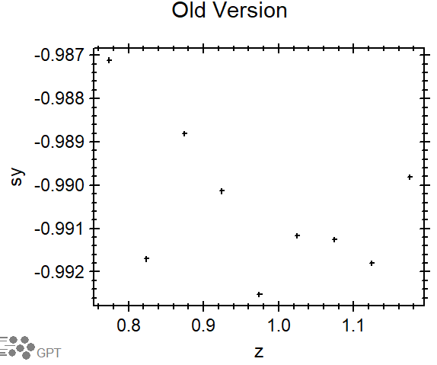
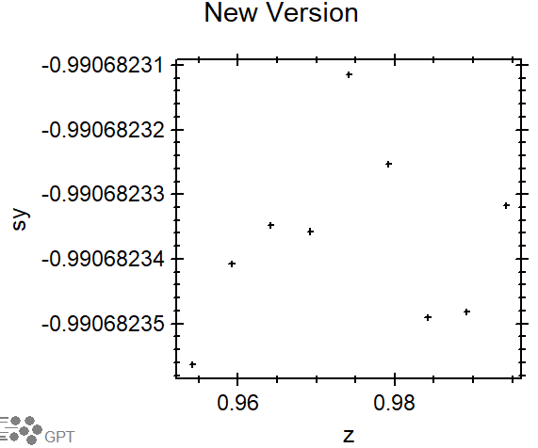
Multiple Particles & Spin Variation (Numerical)
Accuracy Issue Resolved with 9+ particles.
‘accuracy (10)’ ‘accuracy (5,6,7)’

Slide 11
Multiple Particles & Spin Variation (Numerical)
Accuracy Issue Resolved with 9+ particles.
‘accuracy (10)’ ‘accuracy (5,6,7)’

Slide 12
Future Version: Open Discussion
High confidence in GPT –s… So, what’s next?
Enforce unitary spin?
CCS?
GDFA Programs: avgSx, avgSy, avgSz, stdS…?
Particle distribution functions:
Particle characteristic: charge, mass, ect…?

Slide 13
Mark Stefani
Questions
mstefani@jlab.org
Topics Discussed:
Benchmark Simulations
Simulation Results
Future Version

