Slide 2
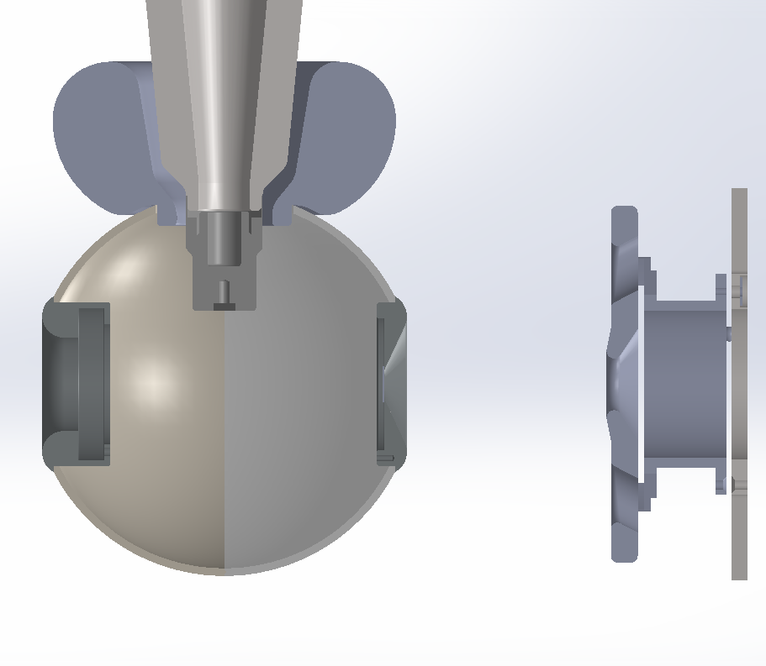
John’s design of Yan’s optimized shed for R30 inverted insulator

Slide 3
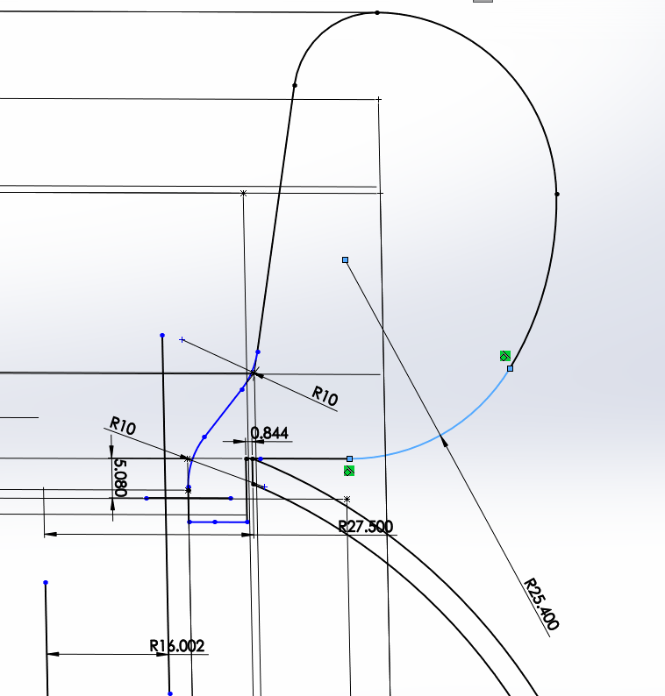
John: In your original document you would draw a circle of 1" radius at position X=4.02cm and Y= 9.642cm. This is the fillet that tapers your "C" curve inward to the mount. You can see that at 180 degree position it transitions to a flat that extends to the ball hole. It is also worth noting that the ball hole has been enlarged to a 2.75 cm opening, so the top of the hole is along this flat.I need you (Yan) to confirm that this does not change your fields.

Slide 4
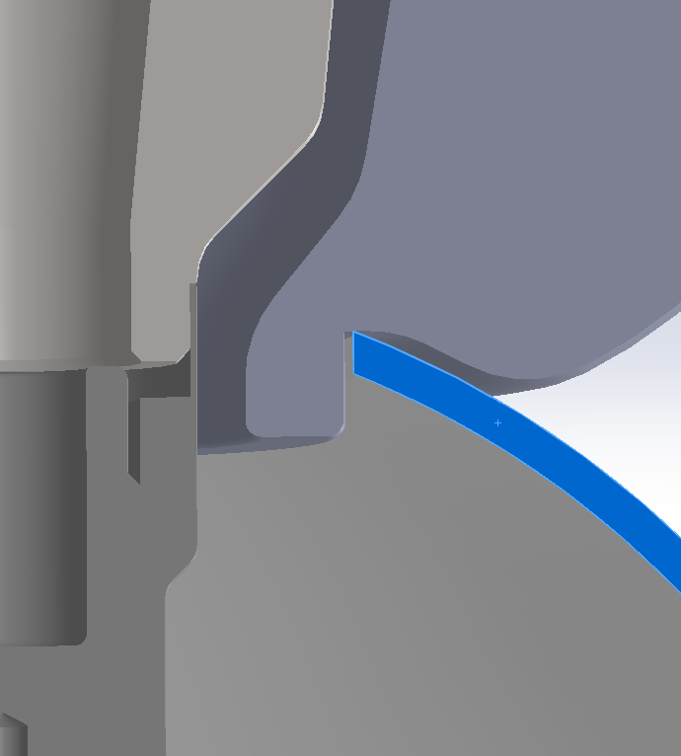
The opening of the ball cathode has to be widened to 2.16” diameter

Slide 5
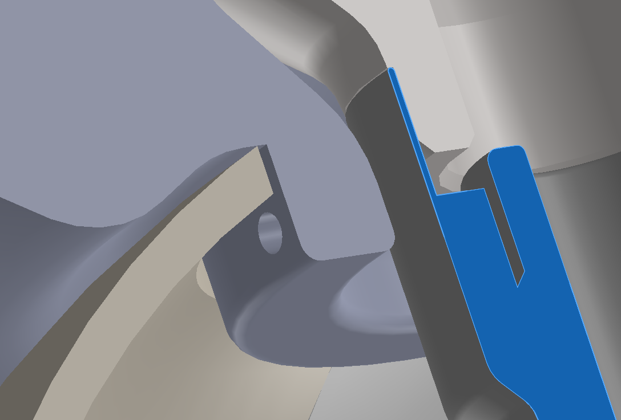
Three holes at 120 deg to hold it

Slide 6
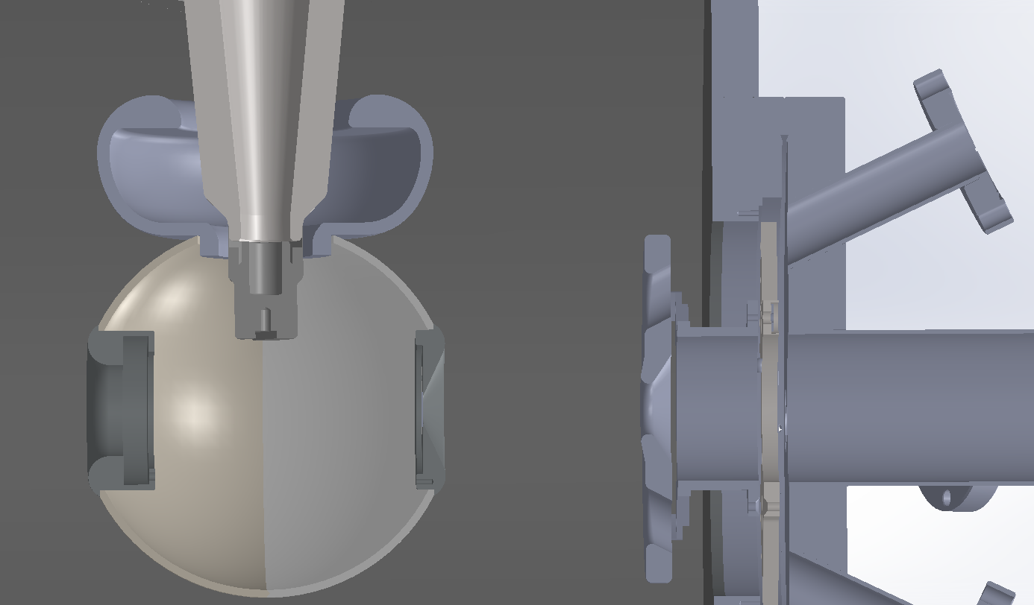
Hog out option to reduce weight, Yan’s preliminary simulations show no major changes in field, but Yan will make graphs of potential along ceramic

