Slide 1
UITF (1/21/2020)
Deliverables/Milestones
Commission the QCM before installation at CEBAF 2021 (for Moller)
Provide beam to HDIce for target tests (three or four run periods requested)
Staffing for FY2020
FTEs: 1 FTE requested for operations and 0.5 FTE for Engineering support; RSRUIT
FTEs: 2 FTEs requested to continue “building” UITF; ITFPTB
Skills :
Facility Manager and Operators
I&C
DC power
RF group
Survey and Alignment
Safety System Group
Software, High Level Apps, Computer support
Installation to remove/replace roof tiles
When needed: now
Issues/Concerns that are/could affect on time delivery
UITF gets worked on “best effort” basis
Approved UITF Operators are busy at CEBAF (LERF gun and laser)
CTF can’t cool CMTF and UITF at same time, CMTF scheduled for LCLS testing through May, June. After LCLS2, CMTF will be needed for CEBAF cryomodule tests
Key HDIce staff will retire soon, Postdoc leaving
24/7 operations required
DOE accelerator requirements are very formal, very strict
Recommended Mitigation:
Prioritize HDIce over LCLS2 and CEBAF
Hire dedicated Facility Manager and two Operators
Upgrade the CTF refrigerator to provide more LHe capacity

Slide 2
UITF “schedule”
(1/21/2020)
HDIce run schedule
done
After LCLS2 testing finished at CMTF, May/June 2020
Buncher commissioning January
Booster commissioning when opportunity presents itself
HDIce tests cannot be performed contiguously: weeks-long breaks are required between runs

Slide 3
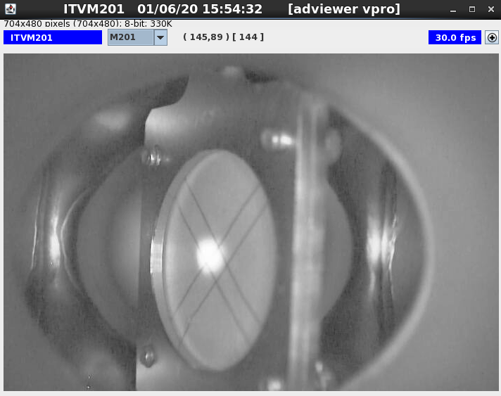
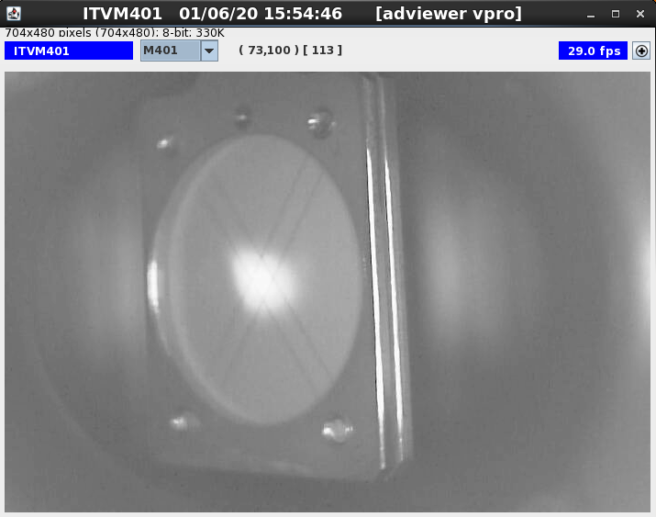
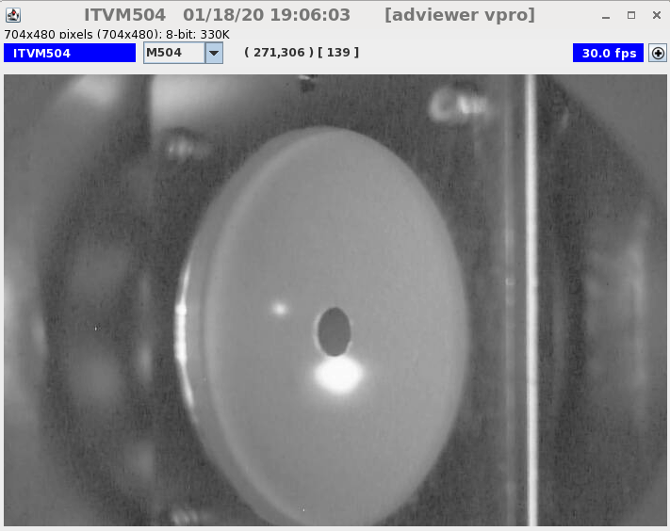
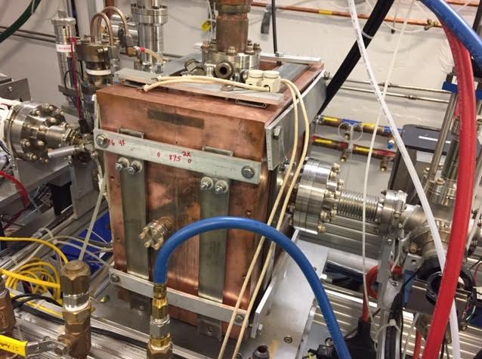
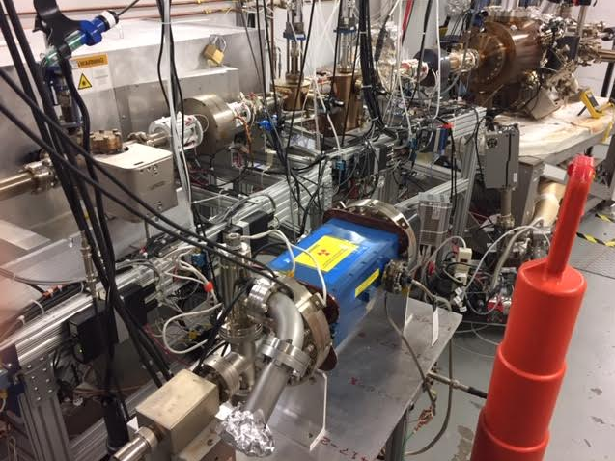
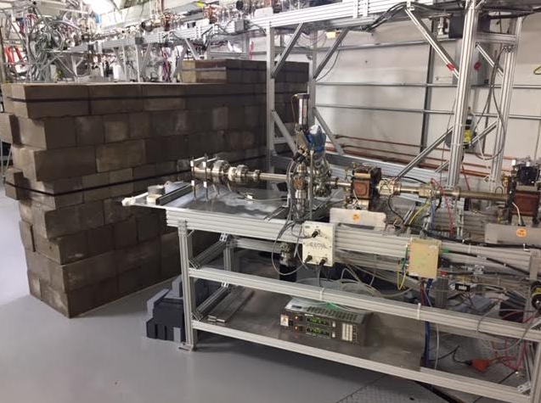
UITF today
(1/21/2020)
Commissioning Plan: 200 keV, 500 keV, 1 MeV, and 10 MeV beam delivered to two dumps
Floating 200 keV beam through booster
Heating the buncher to hit resonance
Testing Wien Filter for 200 keV beam
Building walls

Slide 4
UITF – Comments (1/21/2020)
We postponed installation of booster until 2021
Fairly short to-do list (https://wiki.jlab.org/ciswiki/index.php/UITF_Meeting_-_January_3,_2020)
Buncher on resonance!
Trying to lock up at least three times per week to make beam
Week of Jan 27, dedicated week of operations to commission the buncher and the Yao cavity time-of-flight system, and all the other devices on the waist height beamline
Will install a second Ragowski coil near booster, so HDIce can test nA BPM before run 1
Prepare for possible 2 week gap in April when there is no LCLS II cryomodule inside CMTF – this could be run 0, booster commissioning
Suspect there will be lots of documentation required to begin run 1 (aka “operate” the UITF accelerator, beam to HDIce via elevated beamline)

Slide 5
UITF – Comments (1/21/2020)
ARR “post-start” findings

