Slide 1
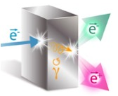
Polarized Beams – A Tale of Two Leptons
The production of Highly Spin Polarized Positrons
using MeV Energy Spin Polarized Electrons
Joe Grames
Center for Injectors & Sources
Jefferson Laboratory
Notes:
INJECTOR SCIENTIST AT JEFFERSON LAB
WOULD LIKE TO TELL YOU ABOUT A SMALL EXPERIMENT WE PERFORMED TO PRODUCE POLARIZED POSITRONS AT LOW ENERGY
WILL GET TO THIS COMMENT AT THE END

Slide 2

Thomas Jefferson National Accelerator Facility is a U.S. Department of Energy Office of Science national laboratory located in Newport News, VA
• Deliver discovery-caliber research of the atomic nucleus, its constituents, and their interactions
• Apply advanced particle accelerator to develop new basic research capabilities
• Over 1500 Users from 230 Institutions and 30 Countries; over 1/3rd of U.S. Ph.D’s in Nucl. Phy.

Slide 3
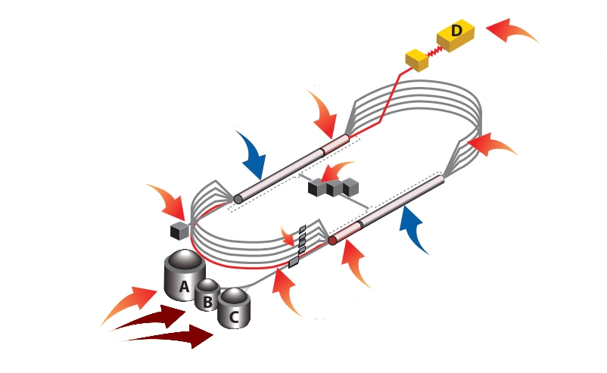
CEBAF Accelerator
CW electron beams to 4 Halls
Electron Polarization 85-90%
Max Energy: 11 GeV(ABC) / 12GeV(D)
Max Current: 85 mA
Still working on this graphic !!!

Slide 4
Outline
  Positron physics motivation at Jefferson Lab
  CEBAF Injector PEPPo Experiment
  Polarized Positron R&D Opportunities
  Outlook

Slide 5
Why Polarized Positrons at JLab?
Polarized Electrons have supported some of the highest impact results from the JLab program:
  The strangeness distribution in the nucleon (HAPPEX and G0)
  Precision Tests of the Standard Model (Q_{Weak})
  Measurement of the neutron skin in ²⁰⁸Pb
  Polarization transfer measurement of G_{E}/G_{M} for the proton
Unpolarized positron beams provide a key tool for further pushing the precision of electron scattering experiments
  Comparison of e⁻ with e⁺ tests our understanding of two photon effects
Polarized positrons beams provide essential tool
  Unraveling nucleon structure through the measurement of charge-sensitive General Parton Distributions
  Expand the nature of these tests (e.g. for G_{E}/G_{M} via polarization transfer)
Beam Quality | Electron Beam (Delivered) | Positron Beam (Desired)
Average Intensity | > 200 μA | > 100 nA (5 x 10¹¹ e+/s)
Duty Factor | 100% (cw) | 100% (cw)
Bunch Frequency | 499 MHz (or sub-harmonic) | 499 MHz (or sub-harmonic)
Polarization (orientation) | > 89% (4π control) | > 50% (4π control)
Helicity Control | Rapid reversal (> 2 kHz) | Rapid reversal (> 30 Hz)

Slide 6
JLab’s e⁻ Beams Provide the Basis for e⁺ Beams
Strained GaAs:
GaAs on GaAsP
Strained Superlattice GaAs:
Layers of GaAs on GaAsP
Bulk GaAs
100 nm
100 nm
625 μm
2 μm
14 Layers
350 μm
QE ~ 5%, 30 mA/W
Pol ~ 35% @ 780 nm
QE ~ 0.2%, 1 mA/W
Pol ~ 75% @ 850 nm
QE ~ 1%, 6 mA/W
Pol ~ 89% @ 780 nm
P_{e-} 35% 35% 75% 75% 85% 89%
I_{e-} 30μA 100μA 50μA 100μA 150μA 200μA
1995 1998 1999 2000 2004 2012 2018
Figure-of-Merit (P²I) has improved by a factor of 43
over the span of the CEBAF “6 GeV era”

Slide 7



Polarized Electrons for Polarized Positrons
E.G. Bessonov, A.A. Mikhailichenko, EPAC (1996) A.P. Potylitsin, NIM A398 (1997) 395
Polarized Bremsstrahlung
Polarized Pair Creation
P_{circ}(γ) / P_{z} (e⁻)
P_{z} (e⁺) / P_{circ} (γ)
E_{γ} / T_{e-}
T_{e+} / (E_{γ} – 2m_{e+})
E.A. Kuraev, Y.M. Bystritskiy, M. Shatnev, E.Tomasi-Gustafsson, PRC 81 (2010) 055208
Notes:
THE PEPPO METHOD IS PRETTY STRAIGHT-FORWARD
FIRST STAGE IS POLARIZED BREMMSTRHALUNG
SECOND STAGE IS POLARIZED PAIR CREATION
THIS COULD BE DONE IN SEPARATE TARGETS, BUT CONVENIENTLY ALSO IN ONE SINGLE TARGET
WE LEARNED EARLY ON THE CALCULATIONS OF OLSON/MAXIMON WERE NOT CORRECT AT LOW ENERGY, ESPECIALLY PAIR CREATION
NEW CALCULATIONS WERE DONE, THAT AGREE W/ OM AT HIGHER ENERGIES
WE WERE NOT FIRST TO PROPOSE THIS IDEA, SO WHY NOT BEFORE…

Slide 8

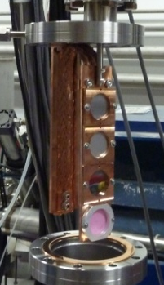
PEPPo Demonstrated Efficient e⁺ Production
The purpose of the PEPPo (Polarized Electrons for Polarized Positrons) experiment at the CEBAF Injector was to demonstrate the feasibility of using bremsstrahlung radiation of MeV energy Polarized Electrons for the efficient production of Polarized Positrons.
J. Grames, E. Voutier et al., JLab Experiment E12-11-105 (2011)

Slide 9
PEPPo: Principle of Operation
Polarized Electrons
(< 10 MeV/c) strike production target
Polarized Electrons
(< 10 MeV/c) strike production target
Positron Transverse and Longitudinal Phase Space Selection
S₁
e⁺
D
e⁻
e⁻
e⁻
T₁
T₁
1. BREMSSTRAHLUNG
Longitudinal e⁻ (P_{e-}) produce elliptical γ whose circular (P_{γ}) component is proportional to P_{e-}
2. PAIR PRODUCTION
In the same target, γ produce e⁺e⁻ pairs and transfer Pγ into longitudinal (P_{e+}) and transverse polarization averages to zero
S₂
P_{T}
D
Calorimeter
e⁺
T₂
3. Phase Space Definition
The emittance of the positron beam is defined by slits and magnetic fields
Compton Transmission Polarimeter
4. COMPTON TRANSMISSION POLARIMETER
Polarized e⁺ convert into polarized γ (P_{γ}) whose transmission through a polarized iron target (P_{T}) depends on P_{γ}.P_{T}

Slide 10
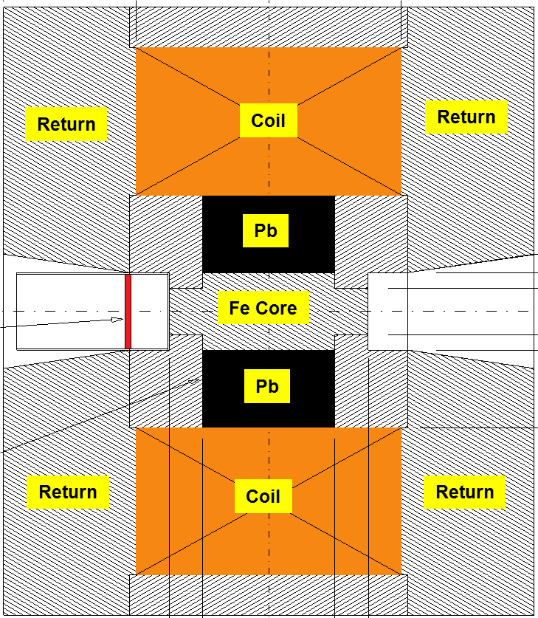
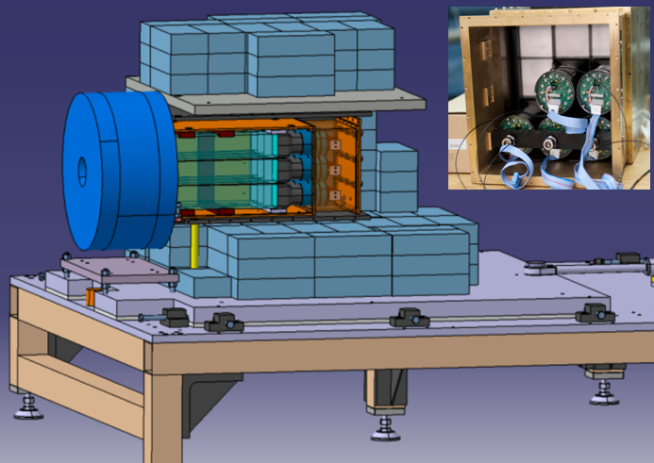
Compton Transmission Polarimetry
Polarized positrons incident on a target also produce polarized bremsstrahlung.
Positron polarization is related to the transmission of the bremsstrahlung through magnetic material by the spin dependent Compton cross-section.
P_{e+}
γ
e⁺
Fe Core
Polarimeter Target (Densimet D17K) 90.5% W, 7%, 2.5% Cu
P_{T} = 7.06% ± 0.05% _{(sys1)} ± 0.07% _{(sys2)}
μ1 - Compton absorption coefficient
L - target length
P₃ - photon polarization (long.)
P_{e} - electron/positron polarization
P_{T} - target polarization
A_{e} - analyzing power

Slide 11
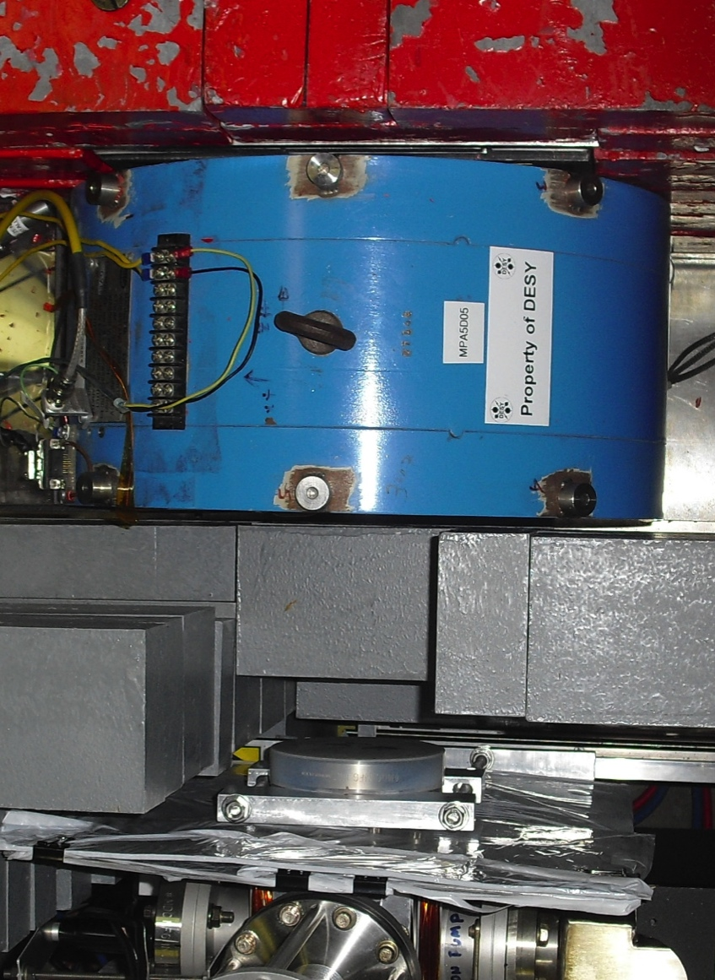
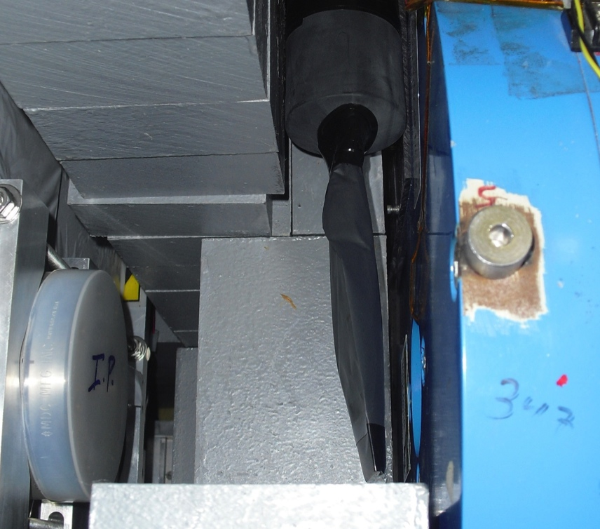
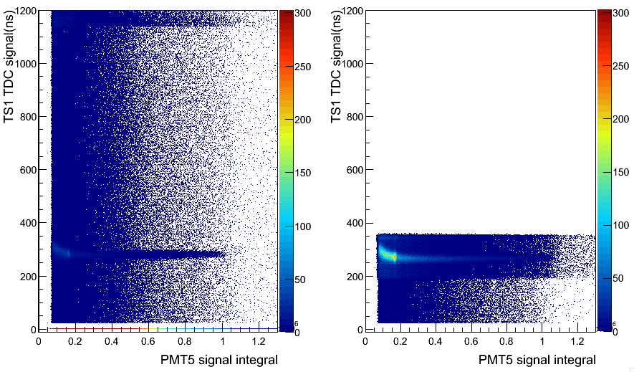
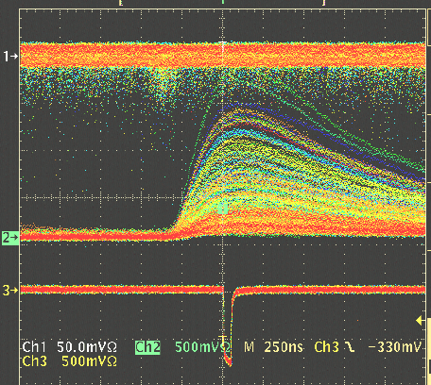
Compton Transmission Polarimeter
Positrons are detected in coincidence between a thin trigger scintillator placed prior to the reconversion target and the central crystal and tagged by e- helicity.
C
A
L
O
R
I
M
E
T
E
R
Background
g
WITHOUT
Coincidence
e+
Reconversion
Target
10mil Al window
Trigger Scintillator
Trigger Scintillator
Calorimeter
WITH
Coincidence
Coincidence

Slide 12

PEPPo Experiment Result
(PEPPo Collaboration) D. Abbott et al. , Phys. Rev. Lett. 116 (2016) 214801
PEPPo demonstrated efficient polarization transfer of 8.2 MeV/c polarized electrons to positrons, expanding polarized positron production using MeV electron beam energies.
electron beam polarization
85.2 ± 0.6 ± 0.7 %
Whenever producing e⁺ from e⁻, polarization is coming for free, if initial electrons are polarized.

Slide 13
The PEPPo Collaboration
P. Adderley¹, A. Adeyemi⁴, P. Aguilera¹, M. Ali¹, H. Areti¹, M. Baylac², J. Benesch¹, G. Bosson²,
B. Cade¹, A. Camsonne¹, L. Cardman¹, J. Clark¹, P. Cole⁵, S. Covert¹, C. Cuevas¹, O. Dadoun³,
D. Dale⁵, J. Dumas^{1,2}, E. Fanchini², T. Forest⁵, E. Forman¹, A. Freyberger¹, E. Froidefond²,
S. Golge⁶, J. Grames¹, P. Guèye⁴, J. Hansknecht¹, P. Harrell¹, J. Hoskins⁸, C. Hyde⁷, R. Kazimi¹,
Y. Kim^{1,5}, D. Machie¹, K. Mahoney¹, R. Mammei¹, M. Marton², J. McCarter⁹, M. McCaughan¹,
M. McHugh¹⁰, D. McNulty⁵, T. Michaelides¹, R. Michaels¹, C. Muñoz Camacho¹¹, J.-F. Muraz²,
K. Myers¹², A. Opper¹⁰, M. Poelker¹, J.-S. Réal², L. Richardson¹, S. Setiniyazi⁵, M. Stutzman¹,
R. Suleiman¹, C. Tennant¹, C.-Y. Tsai¹³, D. Turner¹, A. Variola³, E. Voutier^{2,11}, Y. Wang¹, Y. Zhang¹²
¹Jefferson Lab, Newport News, VA, US, ² LPSC, Grenoble, France, ³LAL, Orsay, France
⁴ Hampton University, Hampton, VA, USA ⁵ Idaho State University & IAC, Pocatello, ID, USA
⁶ North Carolina University, Durham, NC, USA ⁷ Old Dominion University, Norfolk, VA, US
⁸ The College of William & Mary, Williamsburg, VA, USA ⁹ University of Virginia, Charlottesville, VA, USA ¹⁰ George Washington University, Washington, DC, USA ¹¹ IPN, Orsay, France
¹² Rutgers University, Piscataway, NJ, USA ¹³ Virginia Tech, Blacksburg, VA, USA
Many thanks for support from SLAC E166, DESY, Princeton, Cornell, International Linear Collider Project and Jefferson Science Associates

Slide 14
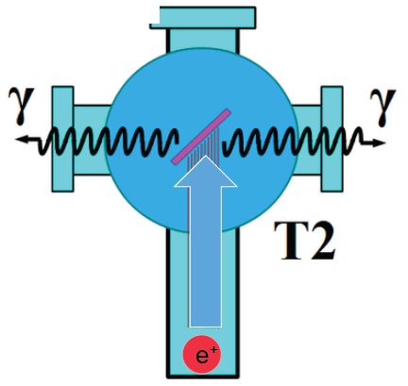
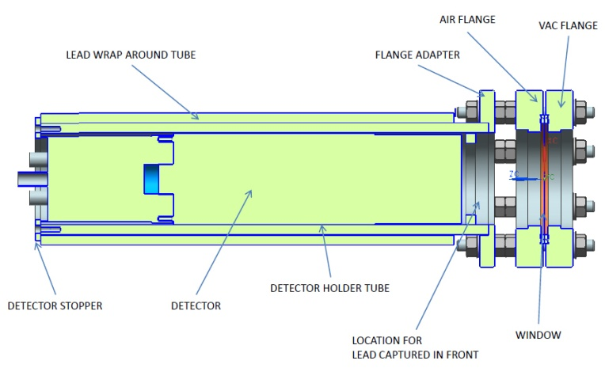
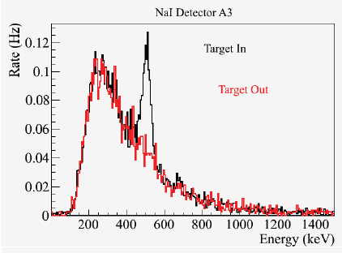
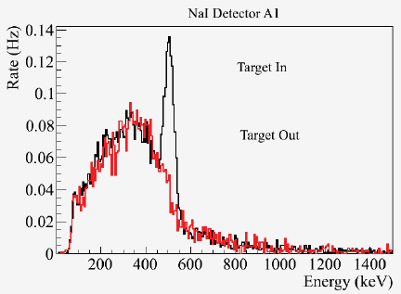
Positron Yield at MeV Energies
S₁
Two NaI detectors measured coincidence of back-to-back photons emitted by annihilation of positrons in a viewscreen.
e⁻
e⁺
D
T₁
p_{e-}= 8.2 MeV/c
A3
D
e⁺
S₂
T₂
A1
For these data we had a yield of ~10⁻⁵ e⁺/e⁻
A3
A1

Slide 15



15
Figure of Merit (E_{e-} = 60 MeV)
R. Dollan, K. Laihem, A. Schälicke, NIM A 559 (2006) 185,
J. Dumas, J. Grames, E. Voutier, JPos09, AIP 1160 (2009) 120
J. Dumas, Doctorate Thesis (2011)
The polarization distribution of generated positrons is dominated by low-energy events.
The positron energy at the optimum FoM (P²I) is about half of the electron beam energy.
Producing highly polarized positron beams with intensities > 100 nA with typical injector energies (10-100 MeV) requires polarized electron beam intensities of >1-10 milliAmps
Optimum
FoM
Optimum energy

Slide 16


Lifetime of GaAs/GaAsP at mA current
  Recent measurements demonstrate improved conditions to extend useful operational lifetime at mA beam intensity
  Charge lifetimes 300-450 C are now achieved beam intensity >1.0 mA

Slide 17
  Superlattice Performance >1 mA Encouraging
SLAC: First GaAs photogun
JLAB: Low-P Bulk GaAs
JLAB: High-P GaAs/GaAsP
?
Intensity (mA)
Year

Slide 18

Polarized Positrons at an Electron Ion Collider
A polarized positron injector suitable for the Jefferson Lab Electron Ion Collider (JLEIC) has been considered.
L ≥10³³cm⁻²s⁻¹ P_{e+}≥40%
I_{ave} > 10 nA
e⁺
Challenge is accumulating high electron bunch charge prior to conversion.

Slide 19
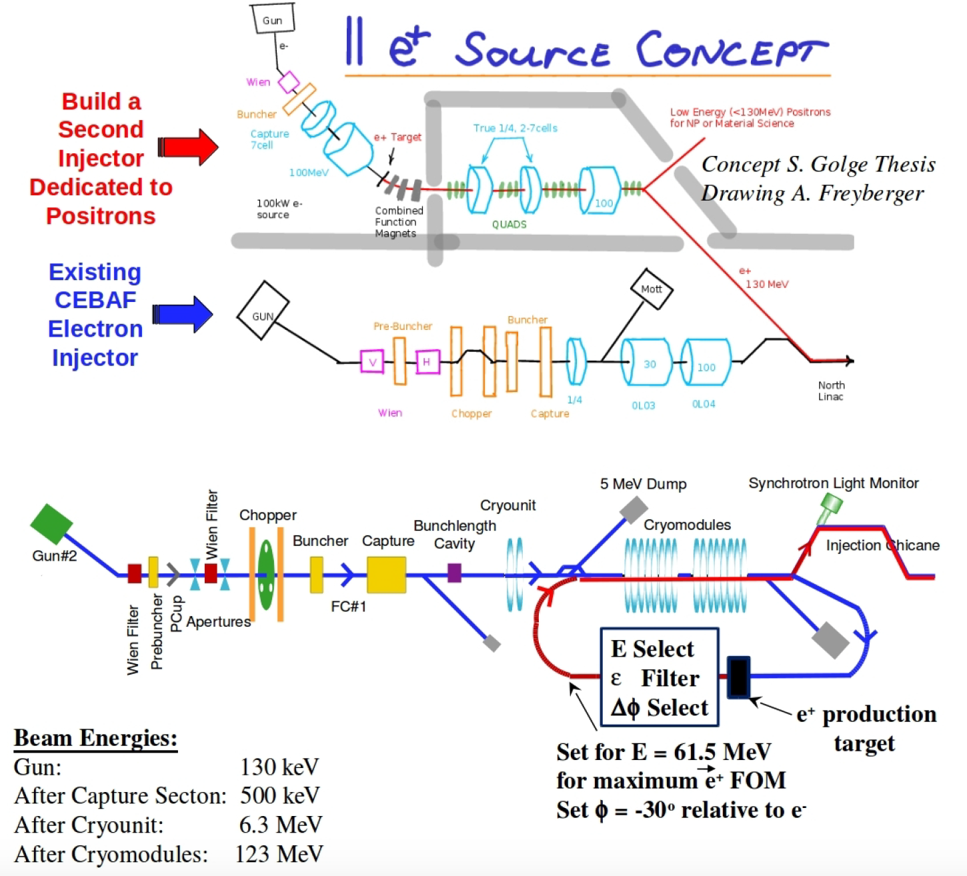
Polarized Positron Injector Concepts Abound
We’ve explored a number of concepts to varying degrees (PhD theses, proposals, intuitions, napkins).
The common denominator at JLab is making use of our skill sets: Polarized Beams, SRF, Photoinjectors, High energy beams, etc).
A polarized e+ injector is novel:
  mA polarized e- source
  fast helicity reversal
  cw operation
  high power target
  srf acceleration

Slide 20
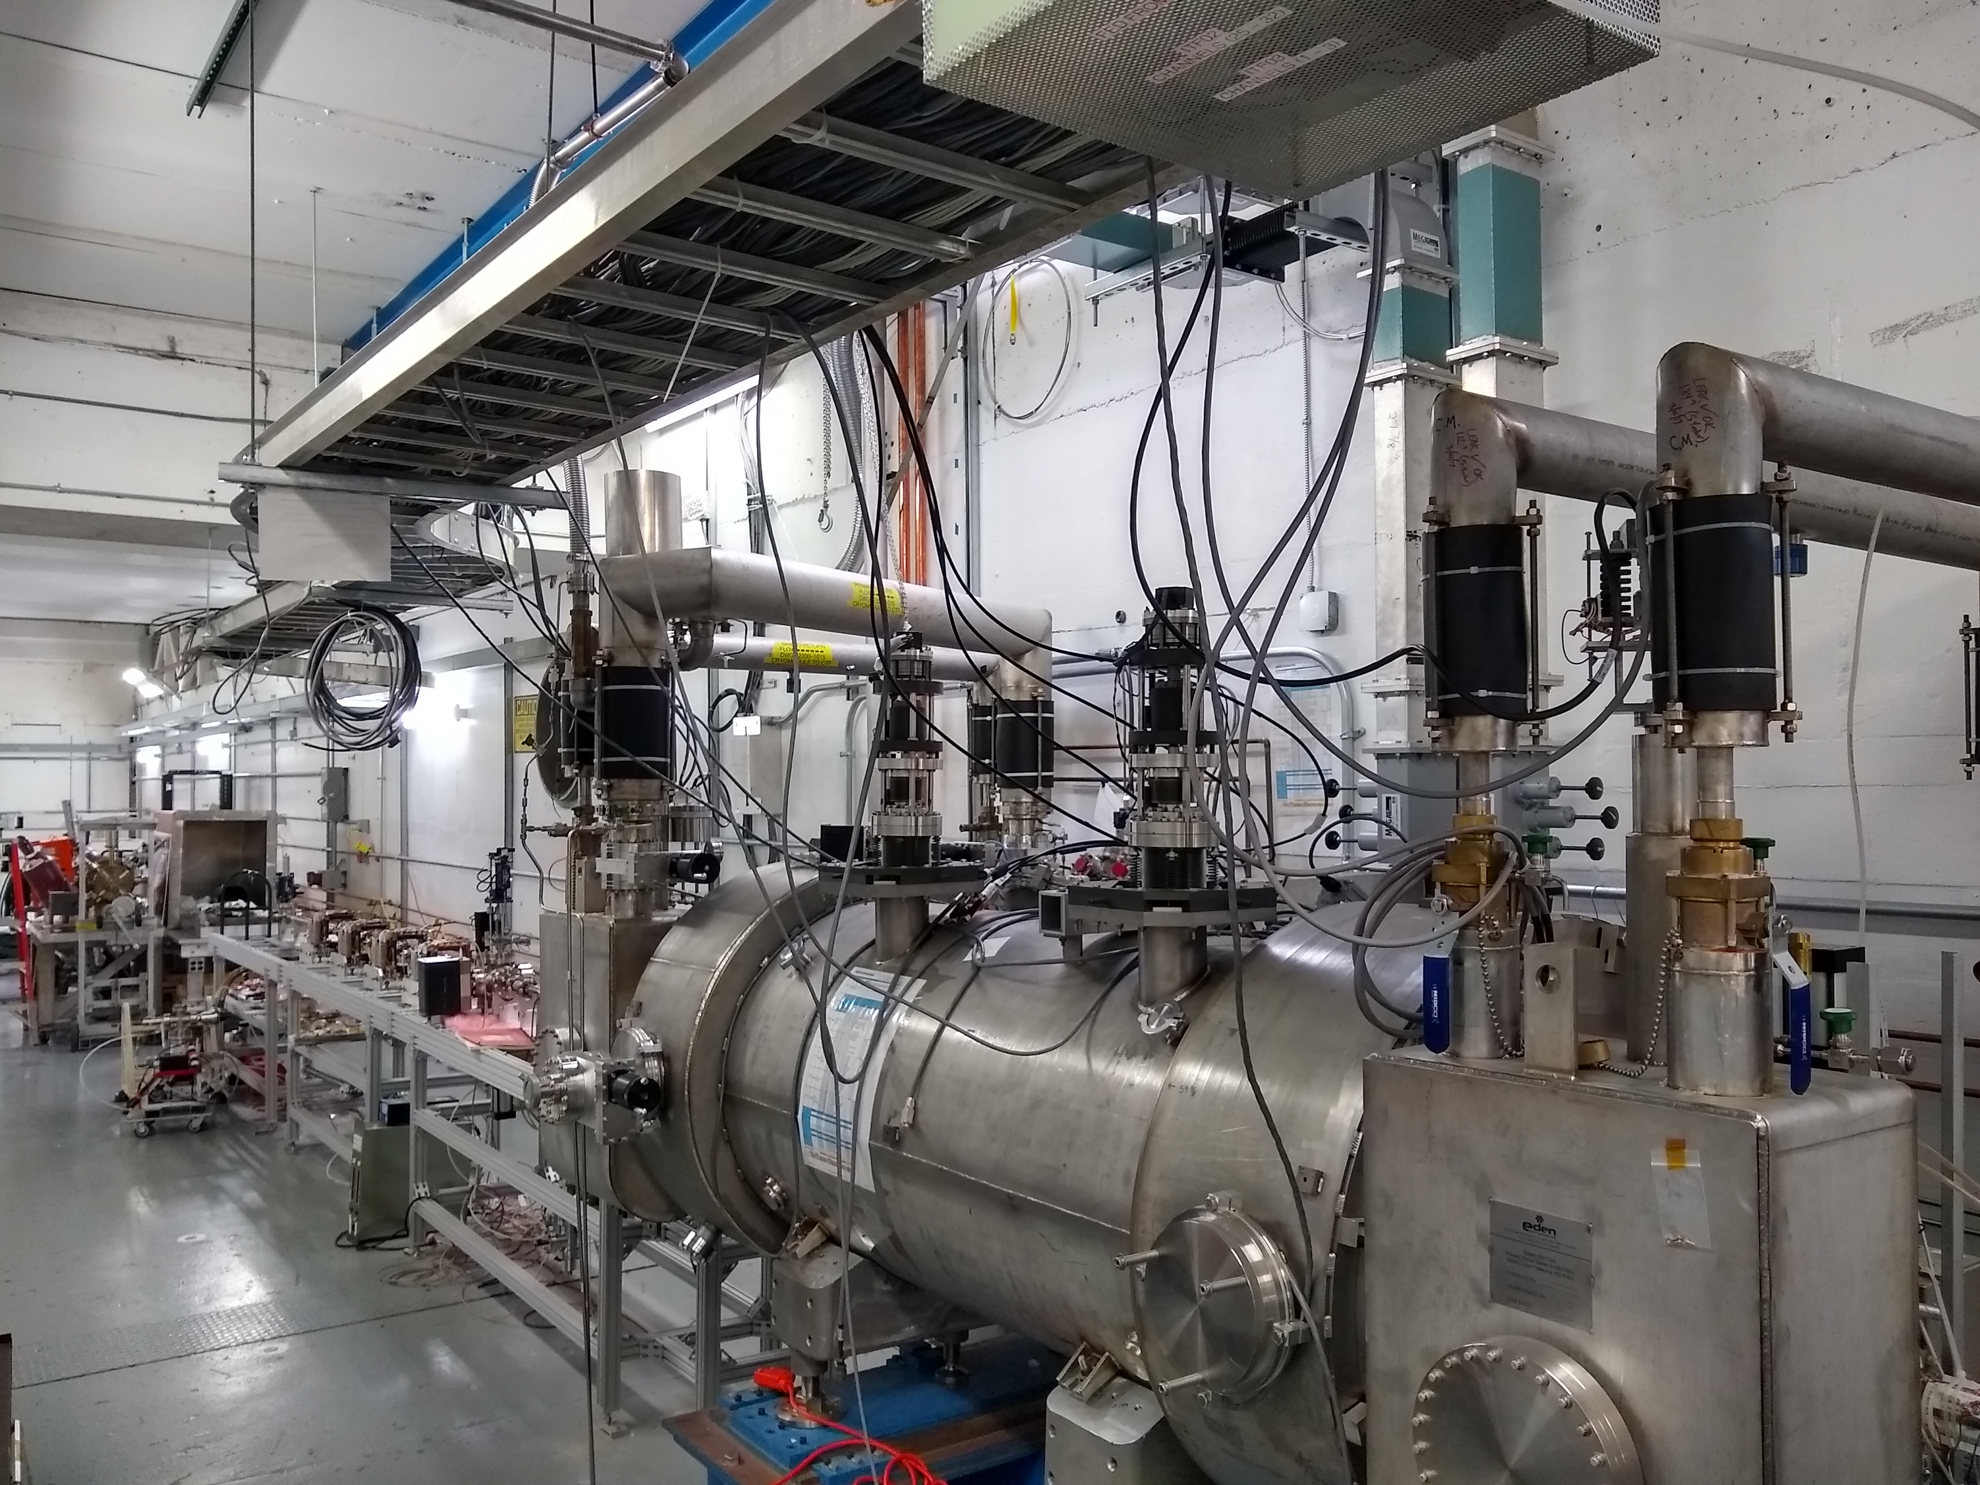
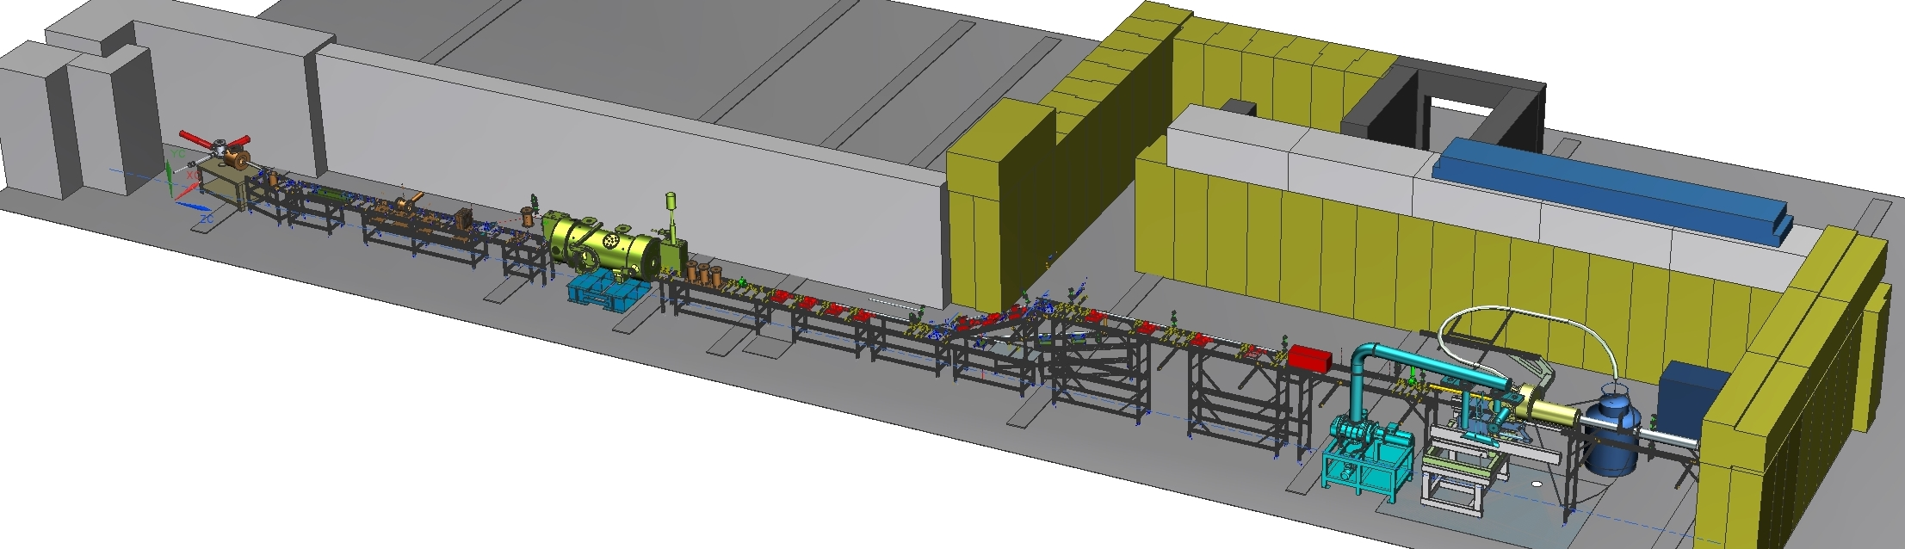
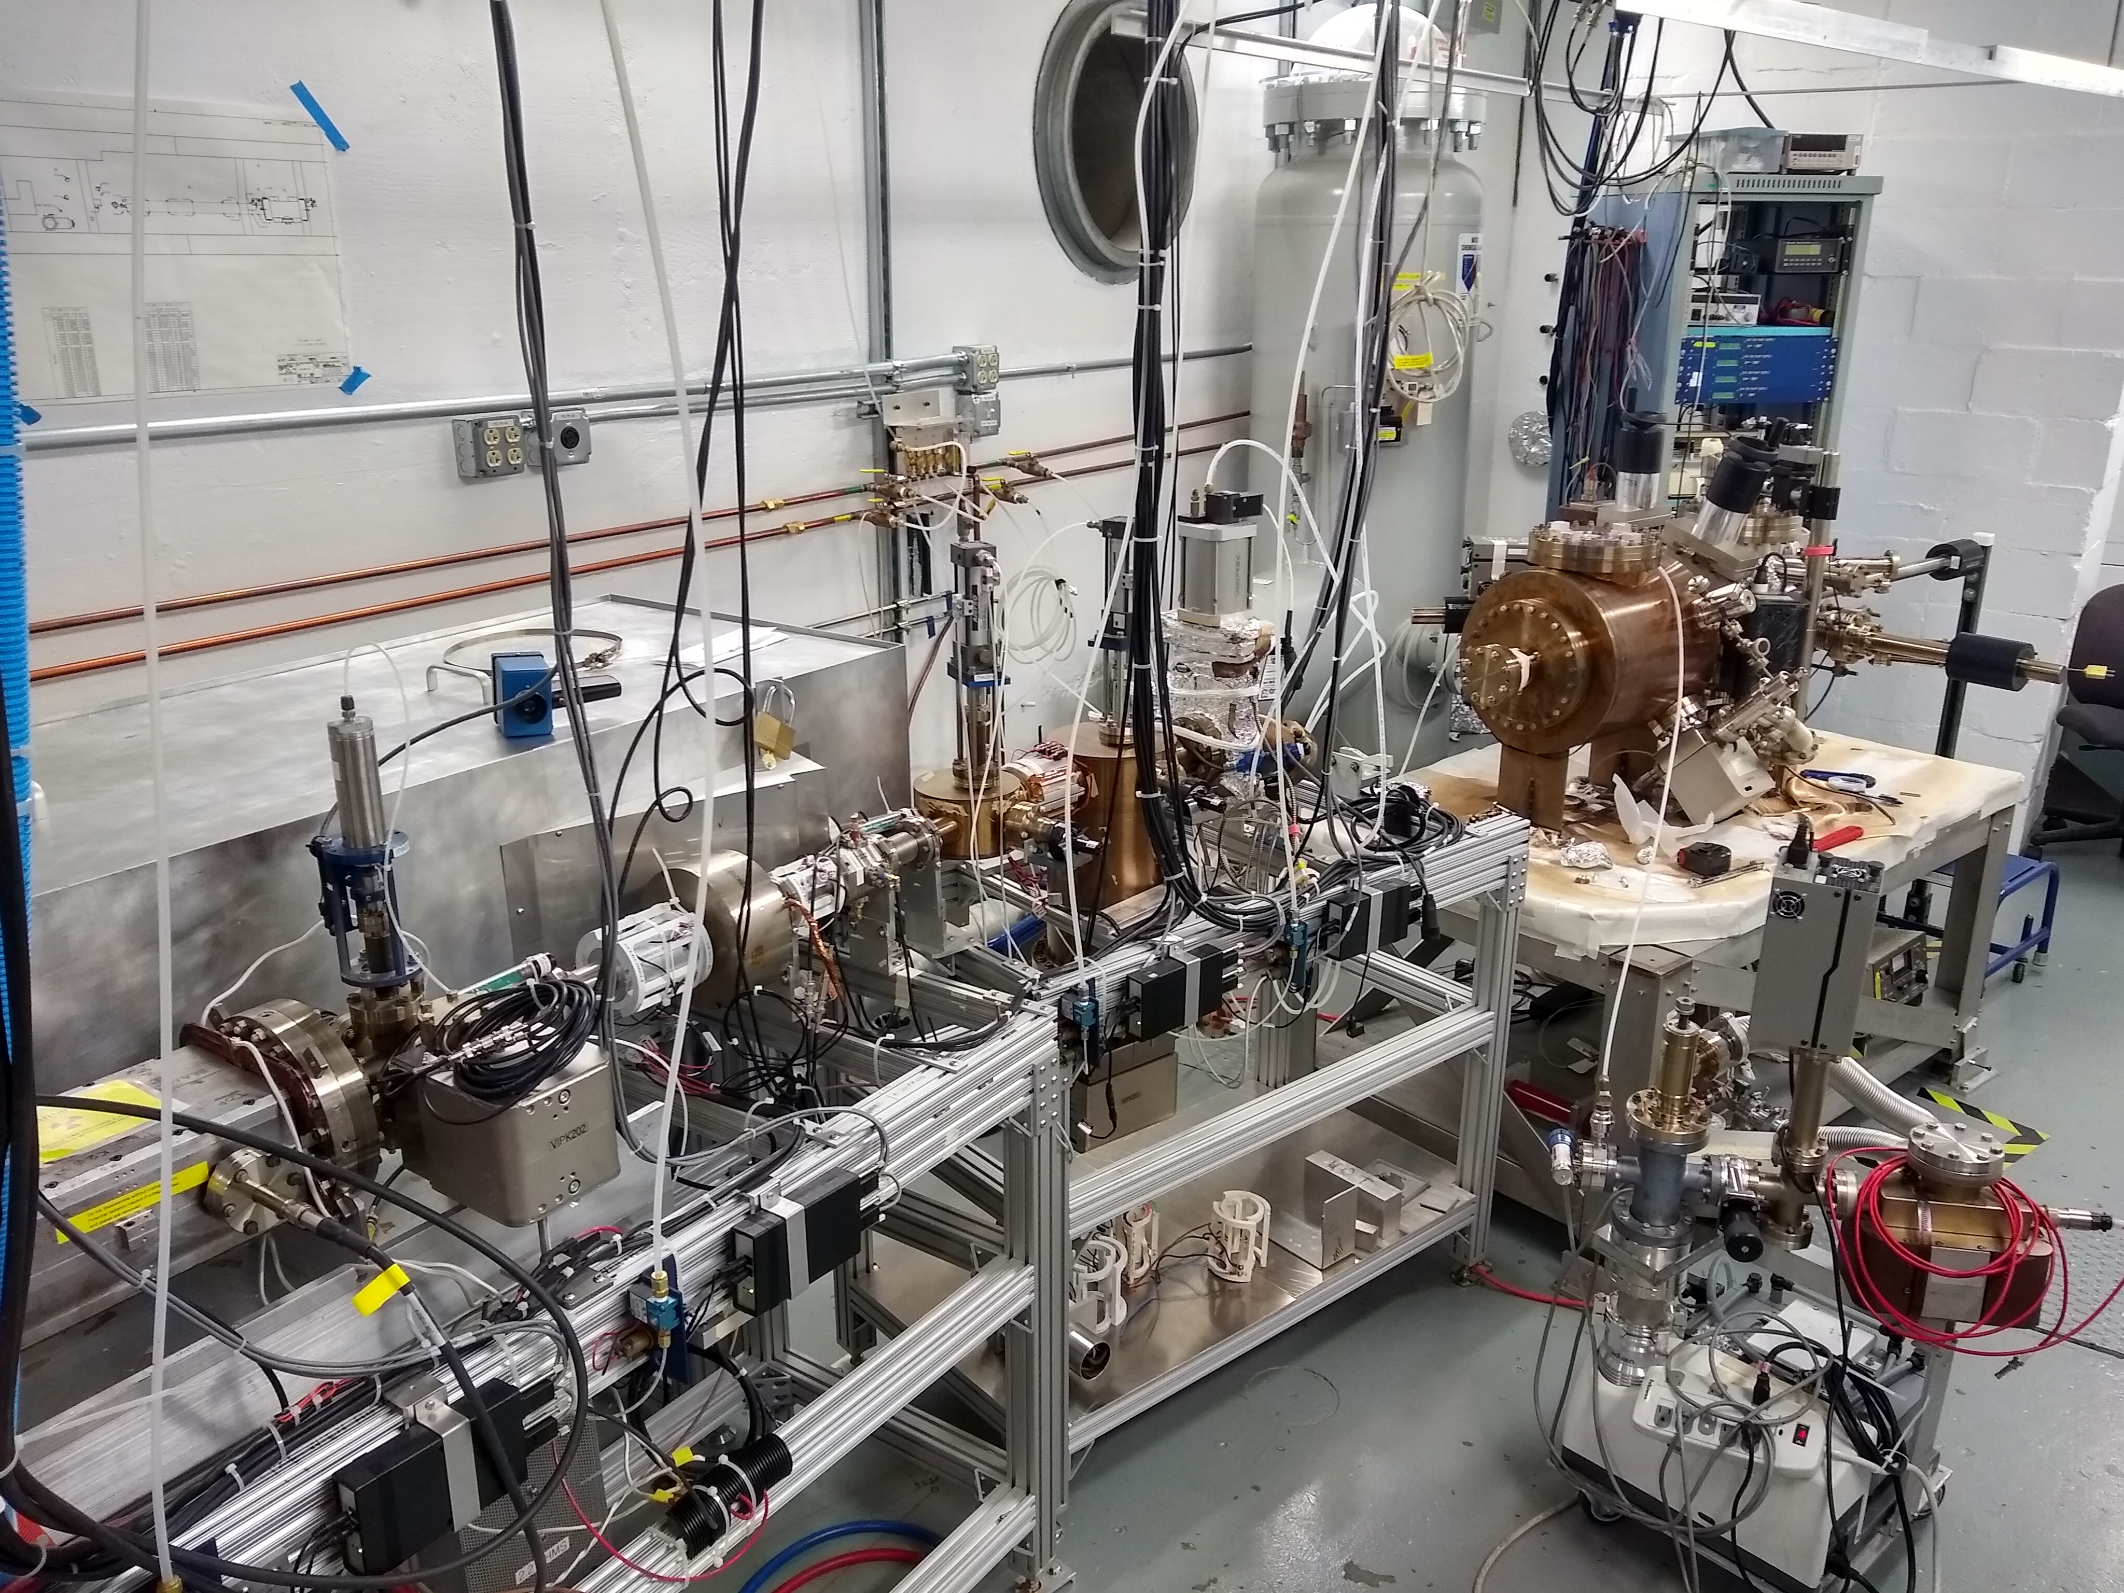
Upgraded Injector Test Facility
A new injector facility for research and design is coming on-line soon
Polarized electron beams
Beam energy up to 10 MeV
Beam intensity up to 100 μA (100 nA initial)
THIS AREA could be used to test key apparatus for a polarized positron source (target and collection).

Slide 21
Summary and Outlook
Jefferson Lab Users are making a case to JLab Management to use polarized positron beams at CEBAF for high impact experiments.
With a relatively small footprint (cost, energy, radioactivity) the PEPPo experiment demonstrated highly spin-polarized positrons from moderate energy polarized electrons.
The progress of mA-sources and MeV-energy electron injectors is promising for the development of polarized positron beams with intensity >100 nA (5 x 10¹¹ e+/sec).
Future work at JLab would focus on building and testing a collection system that defines the transverse, longitudinal and energy acceptance.
Synergistic collaboration can be fruitful, but a comprehensive plan supported by JLab Management that can be successfully executed is essential.

Slide 22
Backup

Slide 23
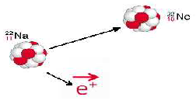




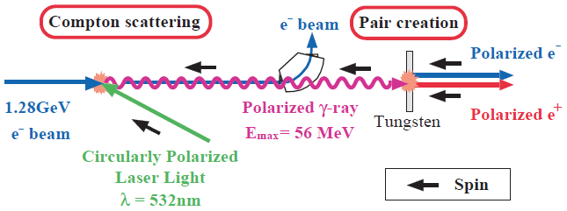
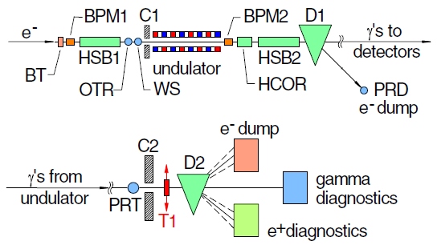
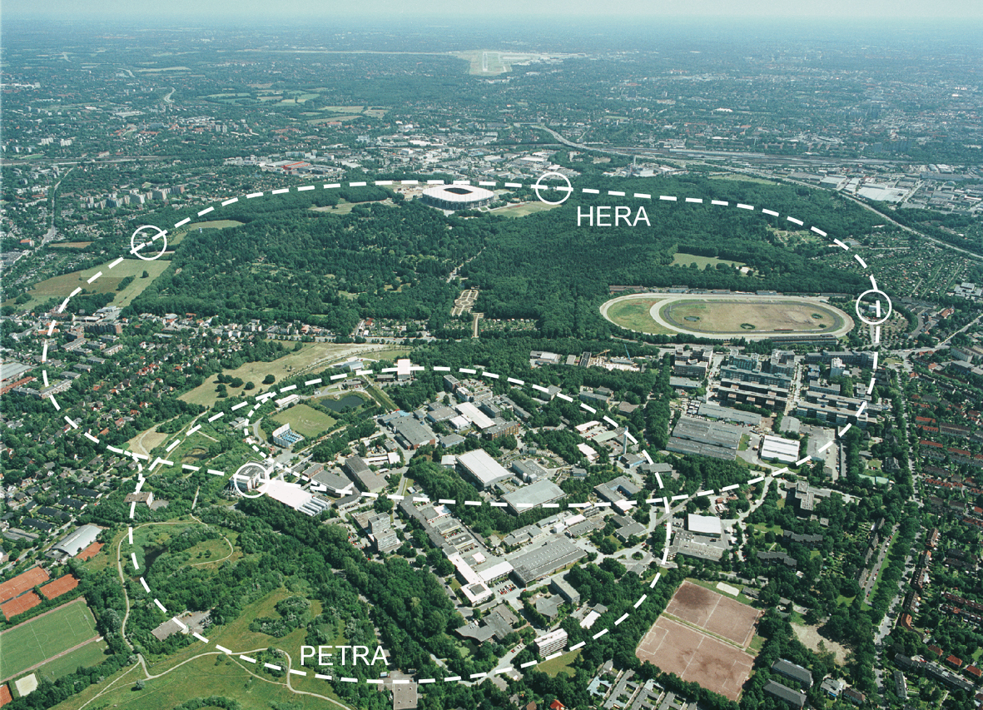
Methods for Generating Polarized Positrons
Polarized β⁺ Decay
L.A. Page & M. Heinberg. Phys. Rev.
106(6):1220-1224 (1957)
Sokolov-Ternov Effect
D. Barber , AIP Conf. Proc. 588, 338 (2001)
HERA 27.5 GeV e+/e-
Polarized due to parity non-conservation in the weak interaction
P(e⁺) ~ 40 %
P(e⁺) ~ 70 %
Compton Backscattering (KEK)
T. Omori et al, PRL 96 (2006) 114801
Helical Undulator (SLAC E166)
G. Alexander et al, PRL 100 (2008) 210801
47.7GeV
P(e⁺) = 73 ± 15_{(stat)} ± 19_{(syst)} %
P(e⁺) = 80 ± 7_{(stat)} ± 9_{(syst)} %
Notes:
TO PROVIDE SOME CONTEXT, POLARIZED POSITRONS CAN BE COLLECTED IN A NUMBER OF WAYS
BETA DECAY – WEAK INTERACTION (NOT EFFICIENT FOR RF ACCEL)
ST – QUANTUM EMISSION OF SYNC. RAD. (NOT COMPATIBLE W/ CW BEAM)
PAIR PRODUCTION BY POLARIZED GAMMAS (PLAUSIBLE, BUT HIGH TECHNICAL CHALLENGE – INTENSE LASERS, HIGH ENERGY BEAMS)
WE WONDERED IF WE COULD SIMPLY USE OUR POLARIZED ELECTRON BEAM

Slide 24
Energy Integrated Asymmetry
511 keV from e+ annihilation at rest
Bremsstrahlung
end-point
Energy (FADC units)
Accidentals
Time (TDC units)

Slide 25
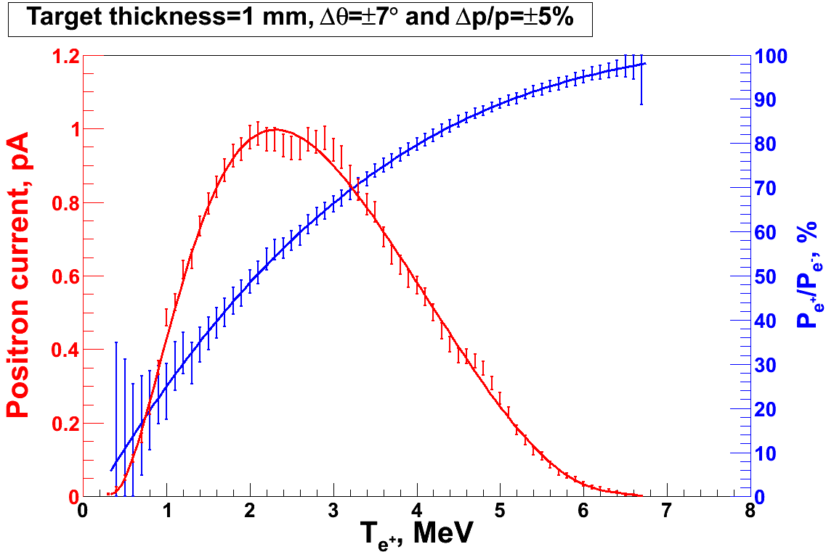
PEPPo Principle of Operation
Polarized Electrons
(< 10 MeV/c) strike production target
Geant4
Positron Transverse and Longitudinal Phase Space Selection
J. Dumas, PhD Thesis (2011)
E_{e} = 6.3 MeV
I_{e} = 1 µA
T₁ = 1 mm W
S₁
e⁺
D
e⁻
e⁻
PEPPo
T₁
S₂
P_{T}
D
Calorimeter
e⁺
T₂
Compton Transmission Polarimeter
PEPPo measured the longitudinal polarization transfer from 8.25 MeV/c e⁻ to e⁺ in the 3.07-6.25 MeV/c momentum range.

