Slide 1
Growth and study of Cs-Sb-O on GaAs at UITF
9/23/2021

Slide 2
Plan of experiments during Jai’s visit
Cs and NF3 activation of GaAs as benchmark
Activation of GaAs photocathode with Cs-Sb-O
Study spectral response
Study QE lifetime

Slide 3
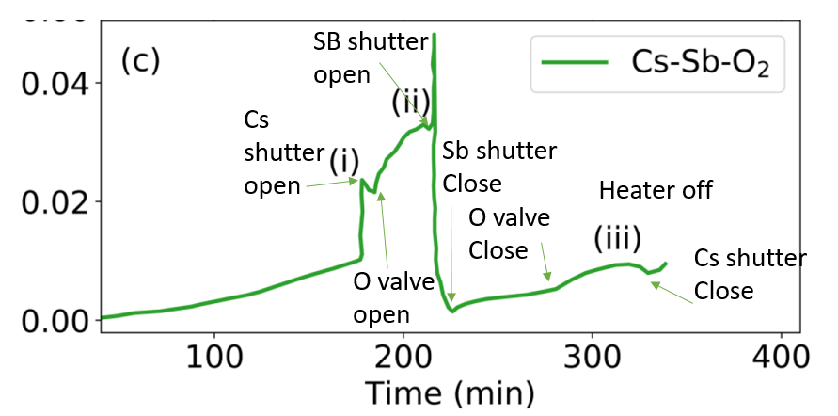
Steps of Cs-Sb-O growth on GaAs (applicable to UITF version)
QE @ 780 nm over time (GA12)
Activation of GaAs photocathode with Cs-Sb-O:
- Heat clean GaAs substrate for 12 hours and ramp down to 80 °C
- Supply current to Sb power supply to warm up Cs (63 °C) and Sb (~ 400 °C) sources
- Use the 780 laser and monitor the initial photocurrent and its rise during the activation
Bring Cs source above the substrate and wait until QE reaches to 1.2% and then start decreasing slowly when bleed O₂ in the chamber
The targeted base pressure should increase from 2e-9 Torr to 9.9e-9 Torr with Oxygen
Keep bleeding O₂ until QE peaks off (~1.65% ) before slowing down with max pressure within 1.0e-8 Torr when retract the Cs source (keep it warm) and insert the Sb source
Keep depositing Sb until photocurrent decreases close to initial photocurrent
At this point retract the Sb source and insert Cs source again to get the photocurrent arise steadily again until QE reaches to ~ 0.25% discontinue substrate heating for faster QE rise until it saturates at ~ 0.44% when close the O₂ leak valve
The photocurrent increases and reaches its maximum at 0.47%. And by this time the substrate temperature would drop to 43 °C
At about 40 °C , discontinue Cs deposition by retracting the Cs source and switching off power supply.
After discontinuing QE is expected to show initial decrease followed by increase again up to ~ 0.5%

Slide 4
Back up slides

Slide 5
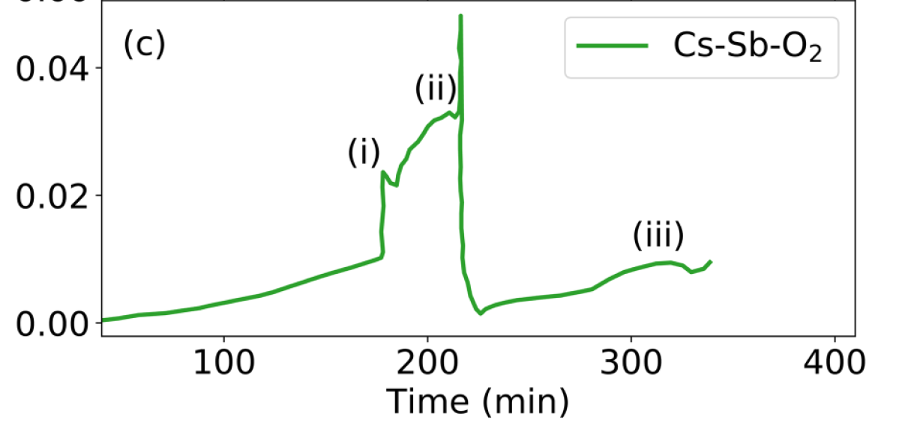
QE @ 780 nm over time (GA12)
SB shutter open
Cs
shutter open
Sb shutter Close
Heater off
O valve Close
Cs shutter Close
O valve open

Slide 6
Steps followed at Cornell
QE @ 780 nm over time (GA12)
GaAs (10x10 mm ) was cleaved from (100) wafer
Rinsed in IPA, demineralized water, HF 1% (30 sec), demineralized water
double bagged in nitrogen and then installed onto a puck
loaded into the growth chamber and heated to 10 Amps for about 12 hours
heater then was set to 4.5 Amps and the sample is cooling down
When the jaw temperature reading was 80 C ramped up the temperatures of Cs and Sb at 63 (set poin 70) and 400 C respectively
Connected the 780 laser (about 40 uW) and measured the initial photocurrent
photocurrent increases steadily with Cs shutter closed up to 0.5%
At T=13500 opened the Cs shutter
QE went almost immediately up to 1.2% and then slowly decreased
The pressure is 9.9e-9 Torr (with O2) with a base pressure of about 2e-9 Torr.
The QE increases, and it reaches 1.65% before slowing down. Saturates at 1.67%.
If I open Oxygen further (1.4e-8 Torr), the photocurrent starts decreasing. Optimal P seems to be 1e-8
QE status constant at 1.62%. I keep the leak valve open, and I start the Sb layer deposition.
I open the Sb shutter at t=16910s
The Sb flux (measured as a difference from Cs flux) is 2e12 atoms/cm2/s
The photocurrent decreases during th deposition of the Sb layer and at the end (1000 s) reaches 8e-4 (QMB measures about 0.7 nm of Sb)
Closing the Sb shutter, the photocurrent starts increasing again
At T=22000 photocurrent is steadily increasing with an estimate QE of about 0.25% we decided to switch off the heater to see if we can increase QE faster
With cooling, the photocurrent and differential photocurrent grow
The photocurrent saturates at QE=0.44%. at T=24950s we close O2.
The photocurrent increases and reaches its maximum at 0.47%. The jaw temperature is 43 C.
at about T(jaw)=40C I close the Cs shutter. After an initial decrease, photocurrent starts increasing again. The final QE is a little below 0.5%

