Slide 1
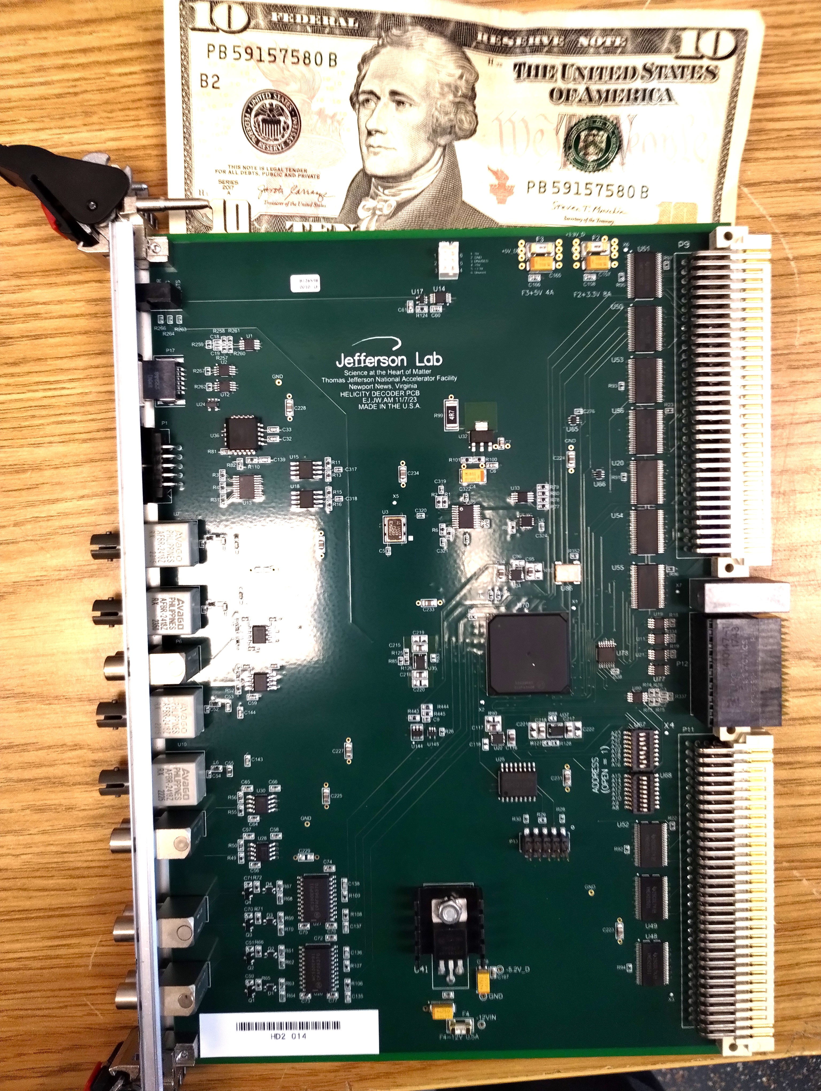
Helicity Decoder Board
Thanks to:
Chris Cuevas, Ed Jastrzembski, Bryan Moffit, and Paul King
Riad Suleiman

Slide 2
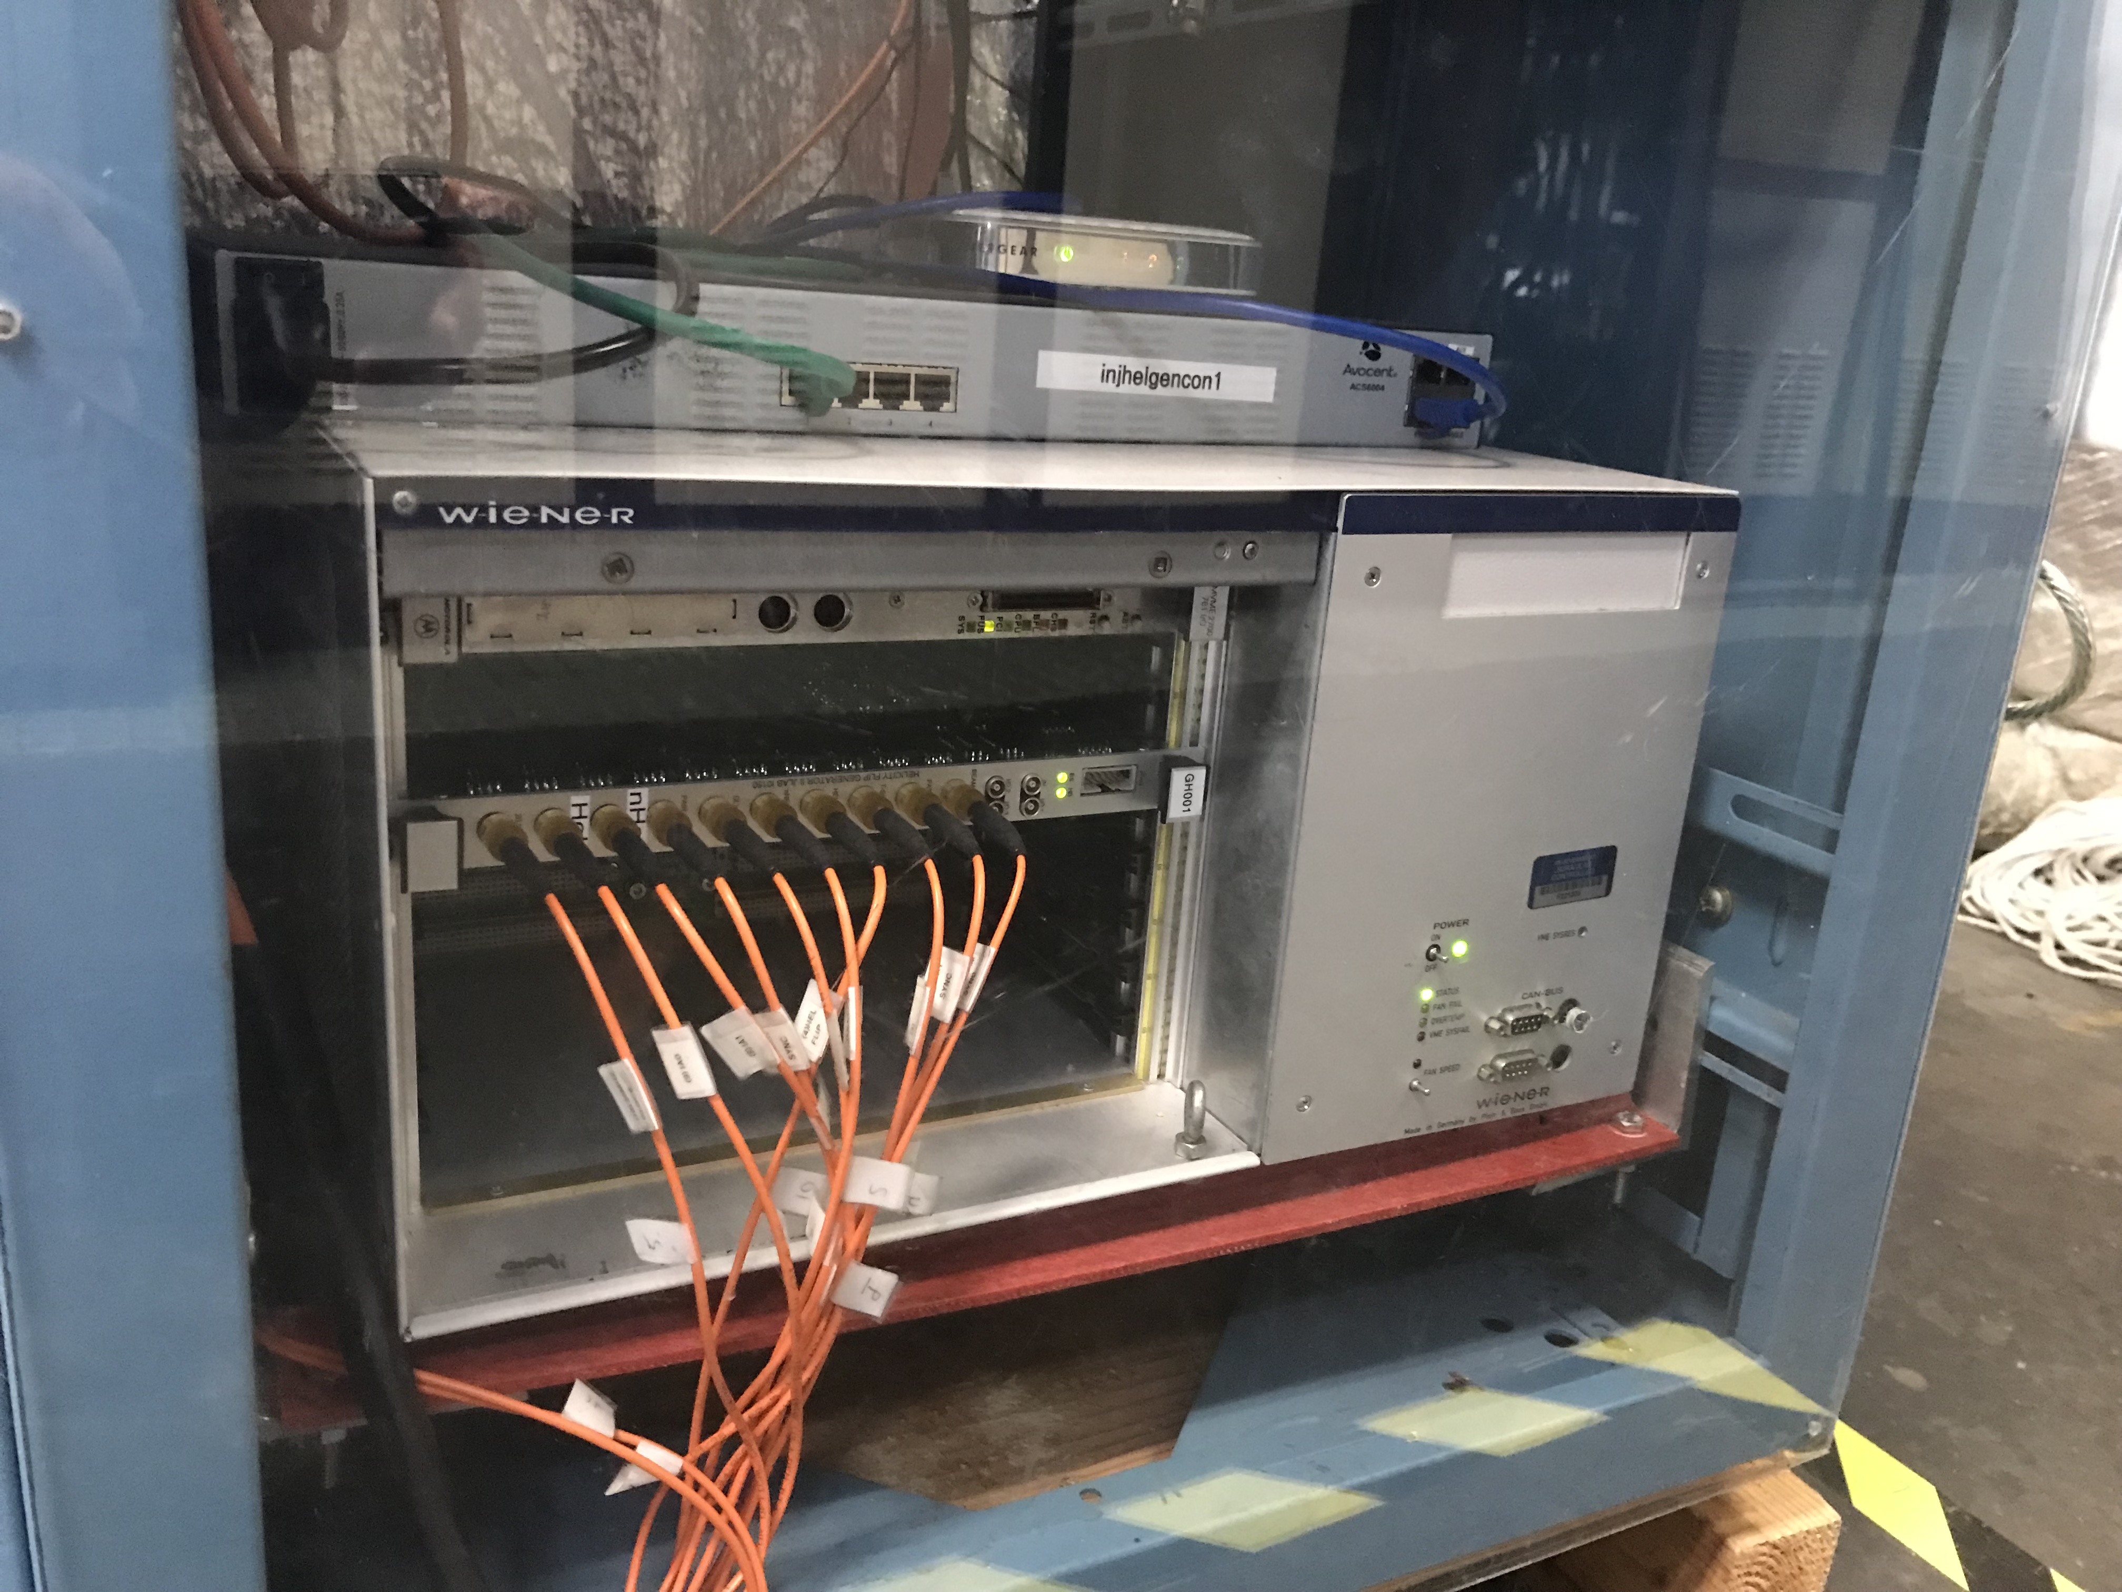
Helicity Generator Board
Now:
Free Clock Mode at 30 Hz Default, 500 µs T_Settle, 33330 µs T_Stable
Quartet pattern, and 8-window delay.
New Helicity settings for MOLLER:
Free Clock Mode at 1920 Hz, 10 µs T_Settle, 510.85 µs T_Stable
64-window patterns: Thue-Morse-64, 16-Quad, 32-Pair
Board is supported by Jefferson Lab Fast Electronics Group

Slide 3
Helicity Generator Settings
Pseudo-random Bit out
30-Bit Shift Register
Shift Left
30
29
28
27
…
7
…
1
OR
XOR
XOR
Pseudo-random Bit
(0 or 1)
1
XOR
Switch
Open: Pseudo-random Patterns
Closed: Toggle Pattern

Slide 4
Helicity Decoder Board
MOLLER fast helicity reversal with delay reporting could cause mis-identification of real helicity of some of events in counting mode (these are random events), diluting measured asymmetry
Board developed by: MOLLER Collaboration (Ohio University), Jefferson Lab Fast Electronics Group and Accelerator Division
Will be used by all data acquisition systems using helicity signals (parity and non-parity)
Board will not reconstruct real helicity or real 30-Bit Shift Register
Board has four input signals: T_Settle, Delayed Helicity, Helicity Pattern, and Pair Sync
For each counting event:
Now: Delayed Helicity and Pattern are recorded in Rings of helicity-gated SIS3801 Scaler. Offline analysis then attempts to construct real helicity, a complicated process due to delay and randomness of events.
New Board: board will keep records of helicities spanning last 30 patterns – to be able to construct 30-bit shift register seed of pseudo-random helicity generator – and position within pattern. And for each event, these records are read along with event. Offline analysis (anytime>n-patterns) will calculate real helicity using helicity predictor. Will be able to correctly identify helicity of every event.

Slide 5
Electron Beam Travel Time
With 10 µs T_Settle time, travel time from photocathode (Pockels Cell) to Hall target becomes relevant. Also, time it takes for helicity board signals to propagate to Laser Hut and to Halls.
It takes electron beam about 4.3 µs per pass to reach Hall
Total distance at 5 passes is about 6.5 km
Fiber length from Injector Service Building (ISB) IN01B05 to Counting House was measured to be 1705 ft. With n=1.45, it takes 2.5 µs for helicity signals to travel in fibers to Hall DAQ
All these travel times will be accounted for in this new Helicity Decoder Board such that recorded events have correct helicity at Physics Interaction Time
Without Helicity Decoder: Experiment deadtime is (4.3 per pass + 10.0)/510.85 instead of 10.0/510.85
Built 20 Production Boards, tested and ready for distribution:
Five in use: 2 MOLLER, 1 Hall B, 1 Hall D, 1 Injector Mott Polarimeter
Contact Chris Cuevas to get your board

Slide 6
Decoder Board I/O and Features
Input:
T_Settle
Delayed Helicity
Helicity Pattern
Pair Sync
External 250 MHz FADC Clock (ECL) – Board has 250 MHz internal clock
Trigger and Sync Signals
Output:
Four NIM helicity outputs: T_Settle, Delayed, Pattern and Pair Sync
Data words for each trigger event
Add programable common delay (0-32 µs) for input helicity signals:
To fix time delays due to beam travel time and helicity signal distribution to Hall
Will be measured for each board in a specific DAQ
Will sync helicity of beam at Physics Interaction Time in Hall
NIM or Fiber, programmable

Slide 7
Board Programmable Common Delay
How to set input common time delay:
Helicity Board: 60 Hz Beam Sync (354 µs)
Electron Beam: VL, 60 Hz Beam Sync, 50 ns pulses
First, check relative timing of electron VL Generator and Helicity signal on laser table
Adjust board common delay to match relative timing at laser table
60 Hz Beam Sync
Check relative timing
ISB
Helicity Decoder Board
Check relative timing
Delayed
Helicity
Fiber
Helicity Generator
VL
Generator
Real
Helicity
Fiber
DAQ
Trigger
HV Supply
RTP
Cell
Board Common Input Delay (0-32 µs)
Hall
CEBAF
Target

