Slide 1





Design of a 10 MeV Beamline at the Upgraded Injector Test Facility for e-beam Irradiation
12th International Particle Accelerator Conference - IPAC’21, May 24 – 28, 2021.
Xi Li¹ (xli009@odu.edu), Fay Hannon², Helmut Baumgart^{1,3},
Gianluigi Ciovati², Shaoheng Wang².
1 Department of Electrical and Computer Engineering, Old Dominion University, Norfolk, VA 23529.
2 Thomas Jefferson National Accelerator Facility, Newport News, VA 23606
3 The Applied Research Center at Thomas Jefferson National Accelerator Facility, Newport News, VA 23606

Slide 2
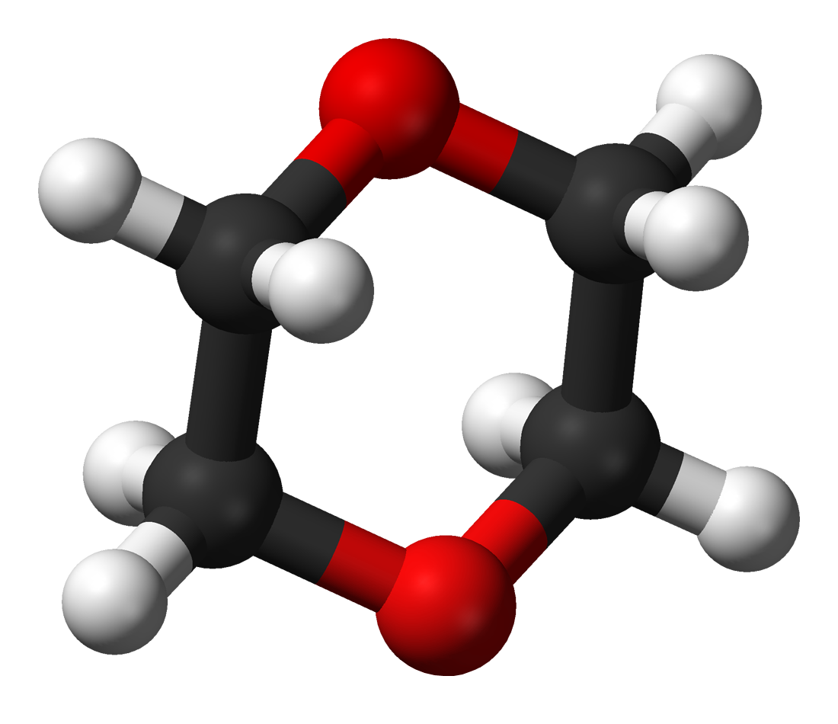
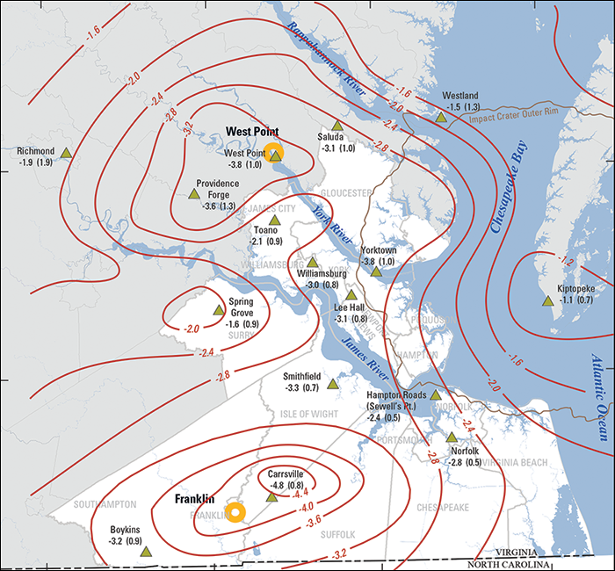
EB irradiation for wastewater treatment
Restoration of the Chesapeake Bay Land subsidence program
Treat the wastewater to the drinking water level and send it to the water aquifer to slow down and stop the sand sinking.
by HRSD (Hampton roads sanitation district).
Pollutants in wastewater
Micro-organisms, bacterial, viral, phatogen.
Metal, toxic chemicals.
Manufactured organic compounds..
  1,4 dioxane
  PFAS (Perfluoroalkyl and Polyfluoroalkyl Substances).
Miscible in water and difficult to be removed by the conventional treatment methods.
EB (electron beam) irradiation is proven to be the most suitable method to remove them.
Versatile, non-selective for kinds of pollutants
Effective and efficient, large-scale treatment with less time.
Risk-free, absence of extra chemicals or radioactive risks.
https://www.chesapeakequarterly.net/sealevel/main2/
Charles N. Kurucz, et al. Full-scale electron beam treatment of hazardous wastes – effectiveness and costs, in High energy electron beam irradiation of water, wastewater and sludge. Advances in Nuclear Science and Technology. Vol. 22. p1-43.
Notes:
1,4 dioxane: cosmetics products, cleaning products. Stable. (https://www.eurofinsus.com/environment-testing/testing-services/specialty-services/1-4-dioxane-analysis/)

Slide 3
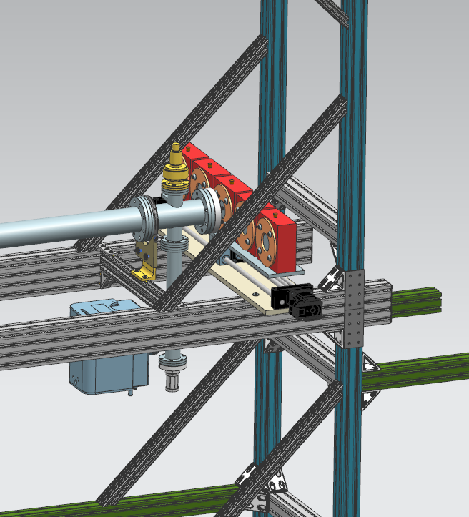
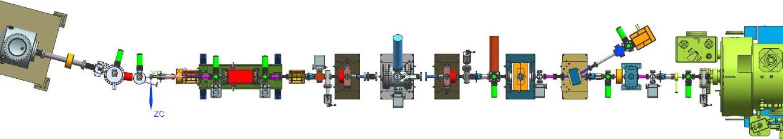
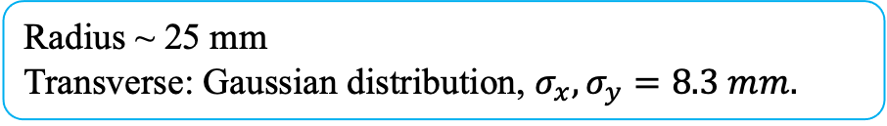
UITF wastewater beamline at Jlab
Facility: UITF at Jefferson lab. Energy: 8 MeV (Max: 10 MeV)
Current: 100 nA (CW)
Depth: 4 cm,
volume: 75 mL.
-> radius: ~2.43 cm
Radius ~ 25 mm
Transverse: Gaussian distribution, $σ_{x}, σ_{y}=8.3 mm.$
x
Electron Gun
y
UITF (Upgraded injector test facility) in Jefferson lab. keV beamline.
Joe Grames, UITF optics overview, March 2016. Jefferson lab report.
Notes:
The energetic electrons interact with water molecules to produce oxidants and reducers, among which the hydroxyl radical is the main factor to oxide the 1,4 dioxane

Slide 4
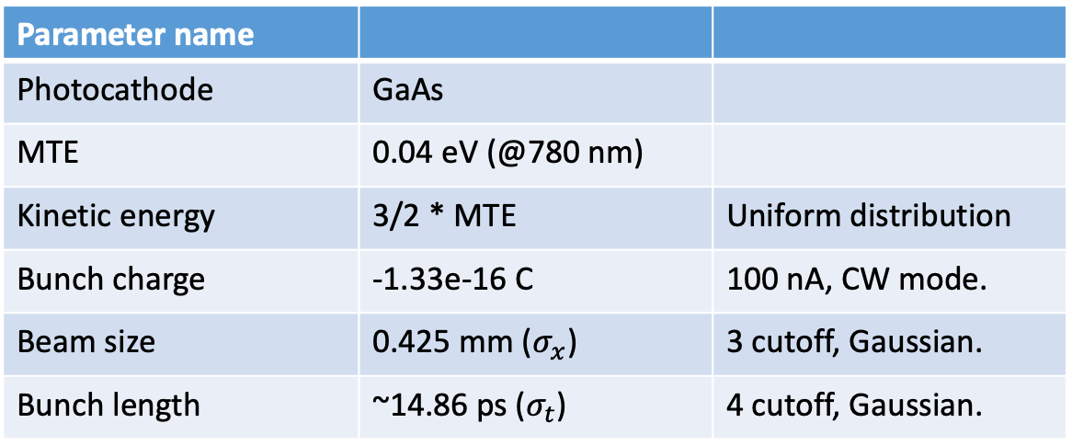
Electron beam initial parameters
Transverse spatial distribution.
GPT simulation: 5000 macro particles.
Parameter name
Photocathode | GaAs
MTE | 0.04 eV (@780 nm)
Kinetic energy | 3/2 * MTE | Uniform distribution
Bunch charge | -1.33e-16 C | 100 nA, CW mode.
Beam size | 0.425 mm ($σ_{x}$) | 3 cutoff, Gaussian.
Bunch length | ~14.86 ps ($σ_{t}$) | 4 cutoff, Gaussian.
The electrons are assumed to be emitted uniformly from the photocathode.
Notes:
In the reality, the treated water is flowing.

Slide 5
SRF acceleration
2-cell cavity: 0.333 MeV energy gain, 169 degree phase shift.
7-cell cavity: ~7.5 MeV energy gain, 234 degree phase shift.
The electron beam is accelerated to 8 MeV after the 2 cavities with the crest energy phases. The energy spread $σ_{E}$ is around 75 keV when the acceleration is not at the crest energy.

Slide 6
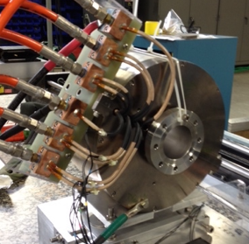
Defocusing solenoid
Quads and solenoid magnets
The optimum position of the solenoid is between 20 to 20.5 m, which is simulated by a fixed peak magnetic strength on axis. The quadrupoles are adjusted to let the beam radius of 𝜎 ~ 1.1 - 1.2 mm at the entrance of the solenoid.

Slide 7
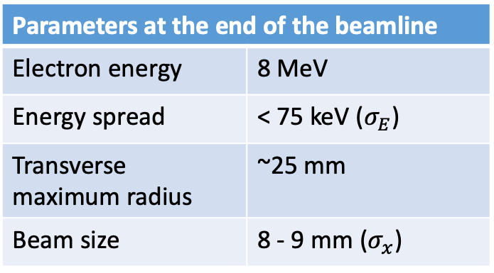
Beam envelope
Space charge effect with higher beam current.
Parameters at the end of the beamline
Electron energy | 8 MeV
Energy spread | < 75 keV ($σ_{E}$)
Transverse maximum radius | ~25 mm
Beam size | 8 - 9 mm ($σ_{x}$)
With space charge effect considered, the beam size at the end of the beamline is increasing with the beam current or bunch charge increasing, while it does not affect the beam envelop under 100 nA current.

Slide 8
Conclusions and outlook
With the ability to remediate kinds of organic compounds, bacteria, virials and other pollutants in the wastewater, EB irradiation is versatile and prospective for the wastewater treatment.
Based on the UITF at Jefferson lab, the EB wastewater treatment beamline is designed and achieved successfully with 8 MeV electron energy and 0.8 cm to 0.9 cm statistic transverse radius.
The principle for a big beam size is utilizing a high magnetic strength solenoid to to over focus the electron beam and blow it up. Despite that there is no necessity to worry about the space charge effect under the 100 nA beam current, knowledge about the influences from it will help understand the beamline operation.
For further study, the beamline will be installed, commissioned and run for the wastewater sample irradiation.

Slide 9
Thank you!
12th International Particle Accelerator Conference - IPAC’21, May 24 – 28, 2021.
Design of a 10 MeV Beamline at the Upgraded Injector Test Facility
for e-beam Irradiation
Xi Li (xli009@odu.edu), Fay Hannon,
Helmut Baumgart, Gianluigi Ciovati, Shaoheng Wang.

