Slide 1

Polarized Positrons
Polarized Electrons for Polarized Positrons (PEPPo)
Positrons at Jefferson Lab
  CEBAF
  JLEIC
Why not PEPPo for the ILC, CLIC, LHeC ?
R&D Topics
Joseph Grames, Carlos Hernandez-Garcia, Matt Poelker
Center for Injectors and Sources
US-Japan Collaboration Meeting
February 25, 2019

Slide 2

CEBAF @ 12 GeV
Users: 1500 (230 Institutions/30 Countries)
Multiplicity: 4 Halls (simultaneously)
Beam Polarization: >85% (90%)
Beam Energy: 11 GeV (ABC) / 12 GeV (D)
Beam Power: 1 MW (85 μA @ 11 GeV)
Cryogenics: Two 4.5 kW plants @ 2.1 K

Slide 3
High Impact Physics
Polarized electron beams have supported some of the highest impact results from the JLab program:
  The strangeness distribution in the nucleon (HAPPEX and G0)
  Precision Tests of the Standard Model (Q_{Weak})
  Measurement of the neutron skin in ²⁰⁸Pb
  G_{E}/G_{M} of the proton

Slide 4
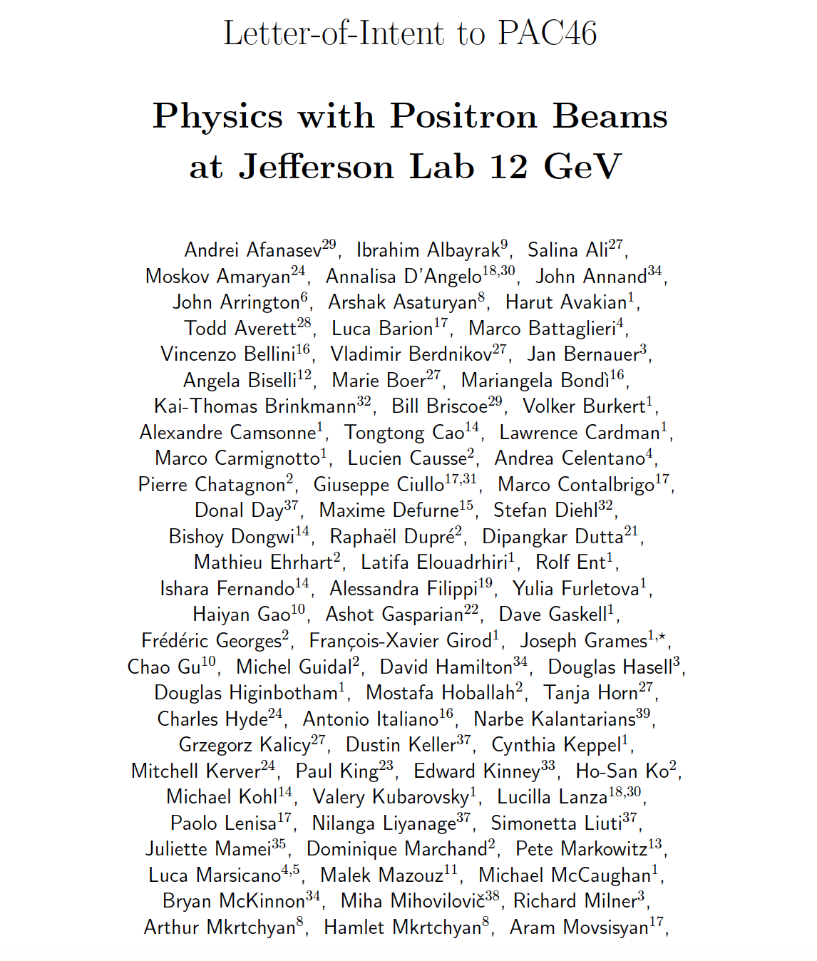
Polarized Positron Beams at Jefferson Lab ?
Unpolarized positron beams offer greater precision
  Comparison of e⁻ with e⁺ tests our understanding of two photon effects
Polarized positron beams provide a key tool
  Unraveling nucleon structure through the measurement of charge-sensitive General Parton Distributions
  Expand the nature of these tests (e.g. for G_{E}/G_{M} via polarization transfer)
Jefferson Lab Positron Working Group (formed 2016)
  120 members (>90% are Users), and growing…
  39 institutions
“Physics Program with Positron Beams at CEBAF 12 GeV “ (July 2018)
PAC Response: “These measurements all have significant physics interest. The proposers should carefully evaluate feasibility and present the best case possible in a future proposal.”

Slide 5




PEPPo : Exploit Spin Transfer of Electromagnetic Shower
Polarized Bremsstrahlung
Polarized Pair Creation
P_{circ}(γ) / P_{z} (e⁻)
P_{z} (e⁺) / P_{circ} (γ)
Longitudinal spin polarization passes from incident electron beam to bremsstrahlung to outgoing pair-produced positrons in the electromagnetic shower.
E_{γ} / T_{e-}
T_{e+} / (E_{γ} – 2m_{e+})
E.A. Kuraev, Y.M. Bystritskiy, M. Shatnev, E.Tomasi-Gustafsson, PRC 81 (2010) 055208

Slide 6
PEPPo : Principle of Operation
Polarized Electrons
(< 10 MeV/c) strike production target
Polarized Electrons
(< 10 MeV/c) strike production target
Positron Transverse and Longitudinal Phase Space Selection
S₁
e⁺
D
e⁻
e⁻
e⁻
T₁
T₁
1. BREMSSTRAHLUNG
Longitudinal e⁻ (P_{e-}) produce elliptical γ whose circular (P_{γ}) component is proportional to P_{e-}
2. PAIR PRODUCTION
In the same target, γ produce e⁺e⁻ pairs and transfer Pγ into longitudinal (P_{e+}) and transverse polarization averages to zero
S₂
P_{T}
D
Calorimeter
e⁺
T₂
3. Phase Space Definition
The emittance of the positron beam is defined by slits and magnetic fields
Compton Transmission Polarimeter
4. COMPTON TRANSMISSION POLARIMETER
Polarized e⁺ convert into polarized γ (P_{γ}) whose transmission through a polarized iron target (P_{T}) depends on P_{γ}.P_{T}
6

Slide 7

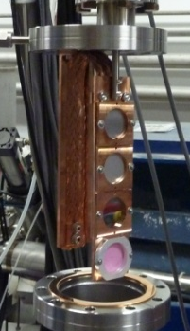
PEPPo : Demo Experiment @ CEBAF Injector
Demonstrate feasibility to produce highly spin polarized positrons from GaAs/GaAsP spin polarized electron source at low beam energy and with low power target.
J. Grames, E. Voutier et al., JLab Experiment E12-11-105 (2011)
8 MeV, 1μA, 85% polarization
W (1mm)
PEPPo possible due to support from SLAC E166, DESY, Princeton, Cornell, International Linear Collider Project and the Jefferson Science Associates.

Slide 8

PEPPo : Production of Highly Spin Polarized Positrons
Phys. Rev. Lett. 116 (2016) 214801
electron beam polarization
85.2 ± 0.6 ± 0.7 %
Whenever producing e⁺ from e⁻, polarization is coming for free, if initial electrons are polarized.

Slide 9



Figure of Merit for Electron Energy 60 MeV (Injector Energy of 6 GeV CEBAF)
R. Dollan, K. Laihem, A. Schälicke, NIM A 559 (2006) 185,
J. Dumas, J. Grames, E. Voutier, JPos09, AIP 1160 (2009) 120
J. Dumas, Doctorate Thesis (2011)
The polarization distribution of generated positrons is dominated by low-energy events.
The positron energy at the optimum FoM (P²I) is about half of the electron beam energy.
Optimum
FoM
Optimum energy

Slide 10
12 GeV CEBAF: Low Energy (123 MeV) with High Current + Modest Bunch Charge
Positrons would be created at the CEBAF injector, using the 123 MeV electron beam.
Selecting 60 MeV positrons maximizes the FoM (60%, 100 nA).
Selecting 6 MeV positrons maximizes the flux (> 1 μA).
Sz
Positron source should have tunability
to optimize for Intensity or Polarization

Slide 11
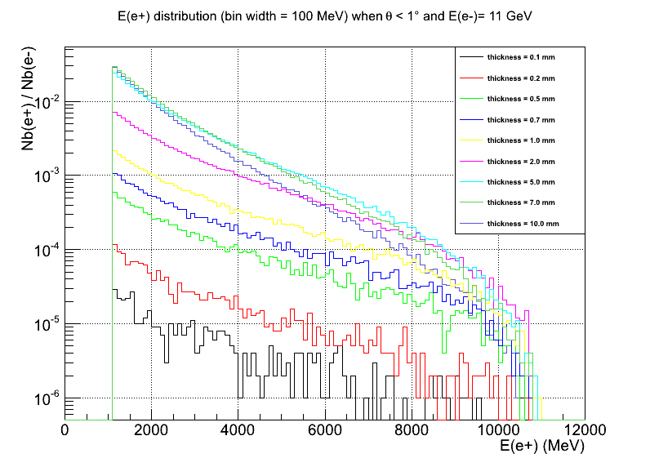
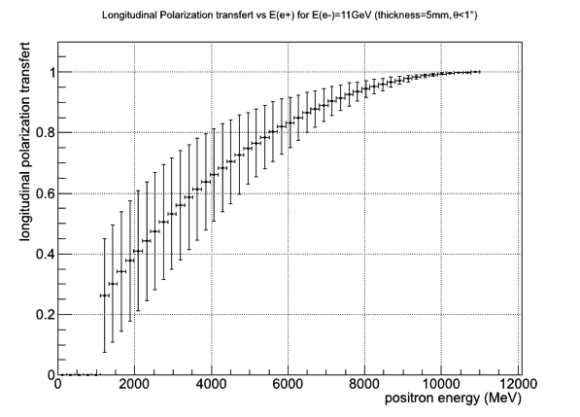
CEBAF: High Energy (11 GeV) with Low Current + Low Bunch Charge
11

Slide 12

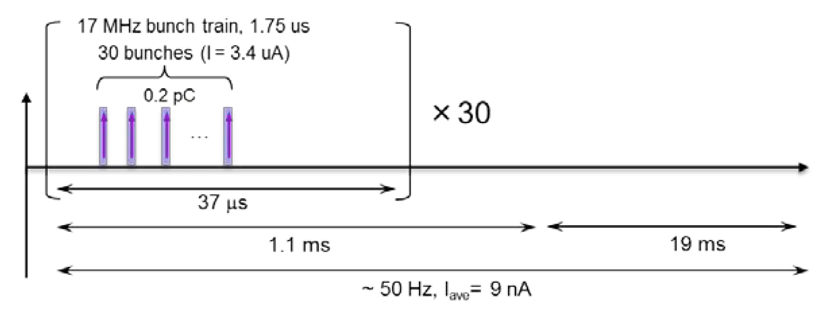
Polarized Positrons at the Jefferson Lab Electron Ion Collider
A polarized positron injector suitable for the Jefferson Lab Electron Ion Collider (JLEIC) has also been considered.
L ≥10³³cm⁻²s⁻¹ P_{e+}≥40%
I_{ave} > 10 nA (~10¹⁰ e+/s)
I_{peak} > 4 μA (~10¹³ e+/s)
e⁺
Challenge is accumulating positron bunch charge with JLEIC bunch pattern.

Slide 13
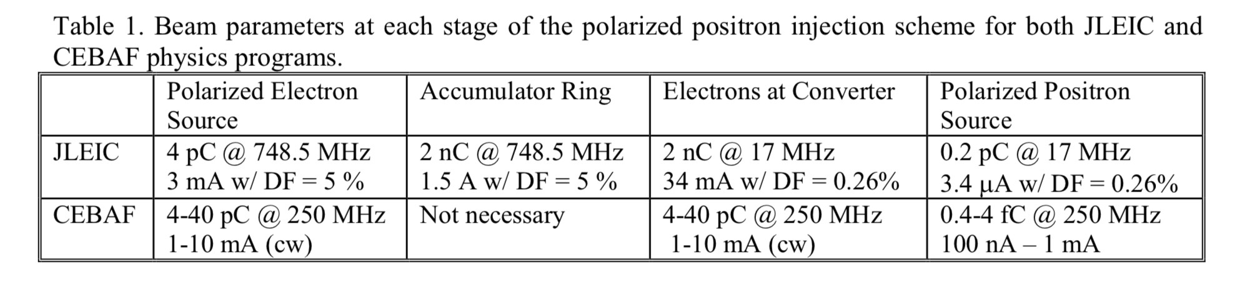
JLEIC: Low Energy (50 MeV) with Low Current + High Bunch Charge
Positron Conversion/Collection Efficiency ~ 5 x 10⁻⁴
60% in polarization
Accumulator Ring (36m)
500-turn
phase-space painting
Power on target
3.4 MW peak power
0.6 kW average
Bunch
Management
Polarized Electron
50 MeV Injector
Harmonic kicker
Extraction
to CEBAF
200 keV polarized e⁻
8 pC @ 748.5 MHz
(DF=100%)
50 MeV polarized e⁻
4 nC bunches @ 748.5 MHz
350 keV polarized e⁻
2 nC @ 17 MHz
(DF=0.26%)
50 MeV polarized e⁻
4 nC @ 17 MHz
25 MeV Polarized e⁺
0.2 pC @ 17 MHz
(DF=0.26%)
Polarized Electron Source

Slide 14
GaAs Polarized Electron Source Parameters
Parameter \ Machine => | CEBAF | SLC | JLab/FEL | Cornell ERL | LHeC | eRHIC | CLIC | ILC | JLEIC(e+) | CEBAF (e+)
Polarization | Yes | Yes | No | No | Yes | Yes | Yes | Yes | Yes | Yes
Number electrons/microbunch | 2.5 x 10⁶ | 1 x 10¹¹ | 8.3 x 10⁸ | 4.8 x 10⁸ | 1 x 10⁹ | 2.2 x 10¹⁰ | 6 x 10⁹ | 3 x 10¹⁰ | 1.2 x 10¹⁰ | 2.5 x 10⁸
Number of microbunches | CW | 2 | CW | CW | CW | CW | 312 | 3000 | 900 | CW
Width of microbunch | 50 ps | 2 ns | 35 ps | 2 ps | 100 ps | ~ 100 ps | ~ 100 ps | ~ 1 ns | 100 ps | 50 ps
Time between microbunches | 2 ns | 61.6 ns | 13 ns | 0.77 ns | 25 ns | 71.4 ns | 0.5002 ns | 337 ns | 1.33 ns | 4 ns
Microbunch rep rate | 499 MHz | 16 MHz | 75 MHz | 1300 MHz | 40MHz | 14MHz | 1999 MHz | 3 MHz | 750 MHz | 250 MHz
Width of macropulse | - | 64 ns | - | - | - | - | 156 ns | 1 ms | 1.1 ms | -
Macropulse repetition rate | - | 120 Hz | - | - | - | - | 50 Hz | 5 Hz | 50 Hz | -
Charge per micropulse | 0.4 pC | 16 nC | 133 pC | 77 pC | 500 pC | 3.6 nC | 0.96 nC | 4.8 nC | 2 nC | 40 pC
Charge per macropulse | - | 32 nC | - | - | - | - | 300 nC | 14420 nC | 1800 nC | -
Average current from gun | 200 uA | 2 uA | 10 mA | 100 mA | 20 mA | 50 mA | 15 uA | 72 uA | 88 uA | 10 mA
Average current in macropulse | - | 0.064 A | - | - | - | - | 1.9 A | 0.0144 A | 0.034 A | -
Duty Factor | 2.5 x 10⁻² | 2.8 x 10⁻⁷ | 2.6 x 10⁻³ | 2.6 x 10⁻³ | 4 x 10⁻³ | 1.4 x 10⁻³ | 0.2 | 3x10⁻³ | 2.6 x 10⁻³ | 1.2 x 10⁻²
Peak current of micropulse | 8 mA | 8 A | 3.8 A | 38.5 A | 5 A | 35.7 A | 9.6 A | 4.8 A | 20 A | 0.8 A
Current density* | 4 A/cm² | 10 A/cm² | 19 A/cm² | 500 A/cm² | 100 A/cm² | 182 A/cm² | 12 A/cm² | 6 A/cm² | 20 A/cm² | 16 A/cm²
Laser Spot Size* | 0.05 cm | 1 cm | 0.5 cm | 0.3 cm | 0.5 cm | 0.5 cm | 1 cm | 1 cm | 1 cm | 0.10 cm
* Loose estimates
Demonstrated
Proposed (excuse outdated values)
My Speculations

Slide 15
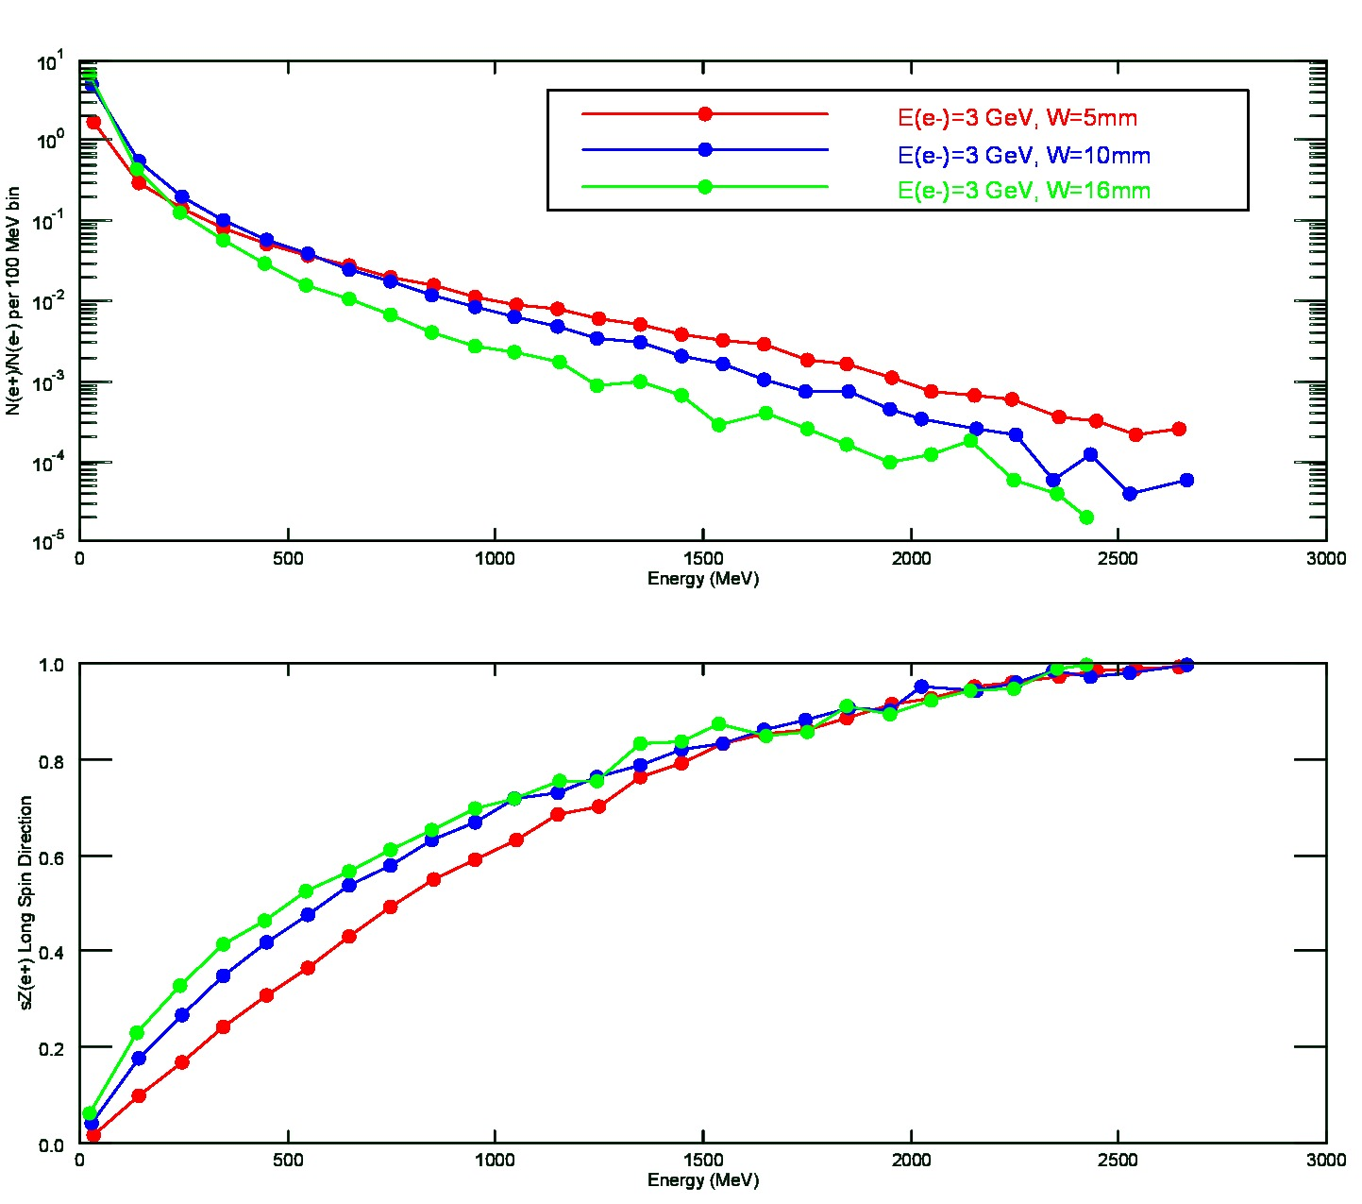
ILC : Spin Polarized Electron Driven Source ?
What is expected (w/o any cuts) for a 3 GeV spin polarized electron beam over range of target thickness (5mm – 16 mm)
Thicker targets improve yield of lowest energy positrons, and provide a degree of spin filtering.
Thinner targets conversely improve yield of highest energy positrons, and with less impact by spin filtering.
E(e+) | N(e+)/N(e-) | <Sz> | P (%)
150 MeV | 0.436 | 0.23 | 21
350 MeV | 0.056 | 0.41 | 37
E(e-)=3 GeV
W=16mm

Slide 16
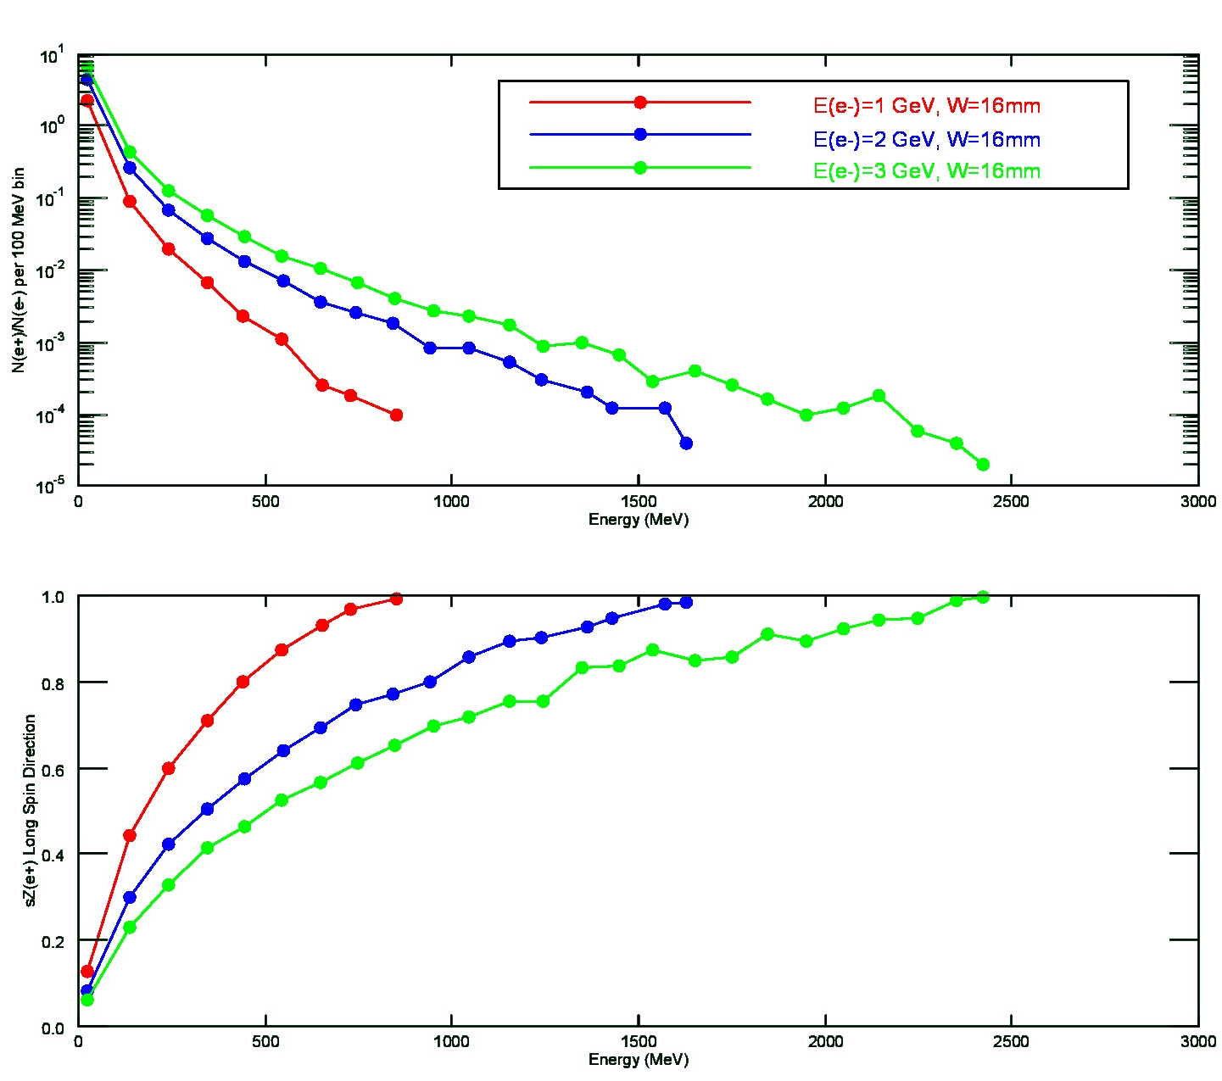
ILC : Spin Polarized Electron Driven Source ?
What is expected (w/o any cuts) if the electron beam energy were lowered, for the same target thickness (16mm).
Lower electron beam energy results in lower yield, expectedly, preferentially at low positron energy.
Lower electron beam energy results in high spin polarization at same positron energy
E (e-) | N(e+)/N(e-) | <Sz> | P (%)
3 GeV | 0.436 | 0.23 | 21
1 GeV | 0.091 | 0.44 | 40
E(e+)=150 MeV
W=16mm
E (e-) | N(e+)/N(e-) | <Sz> | P (%)
3 GeV | 0.056 | 0.41 | 37
1 GeV | 0.007 | 0.71 | 64
E(e+)=350 MeV
W=16mm

Slide 17
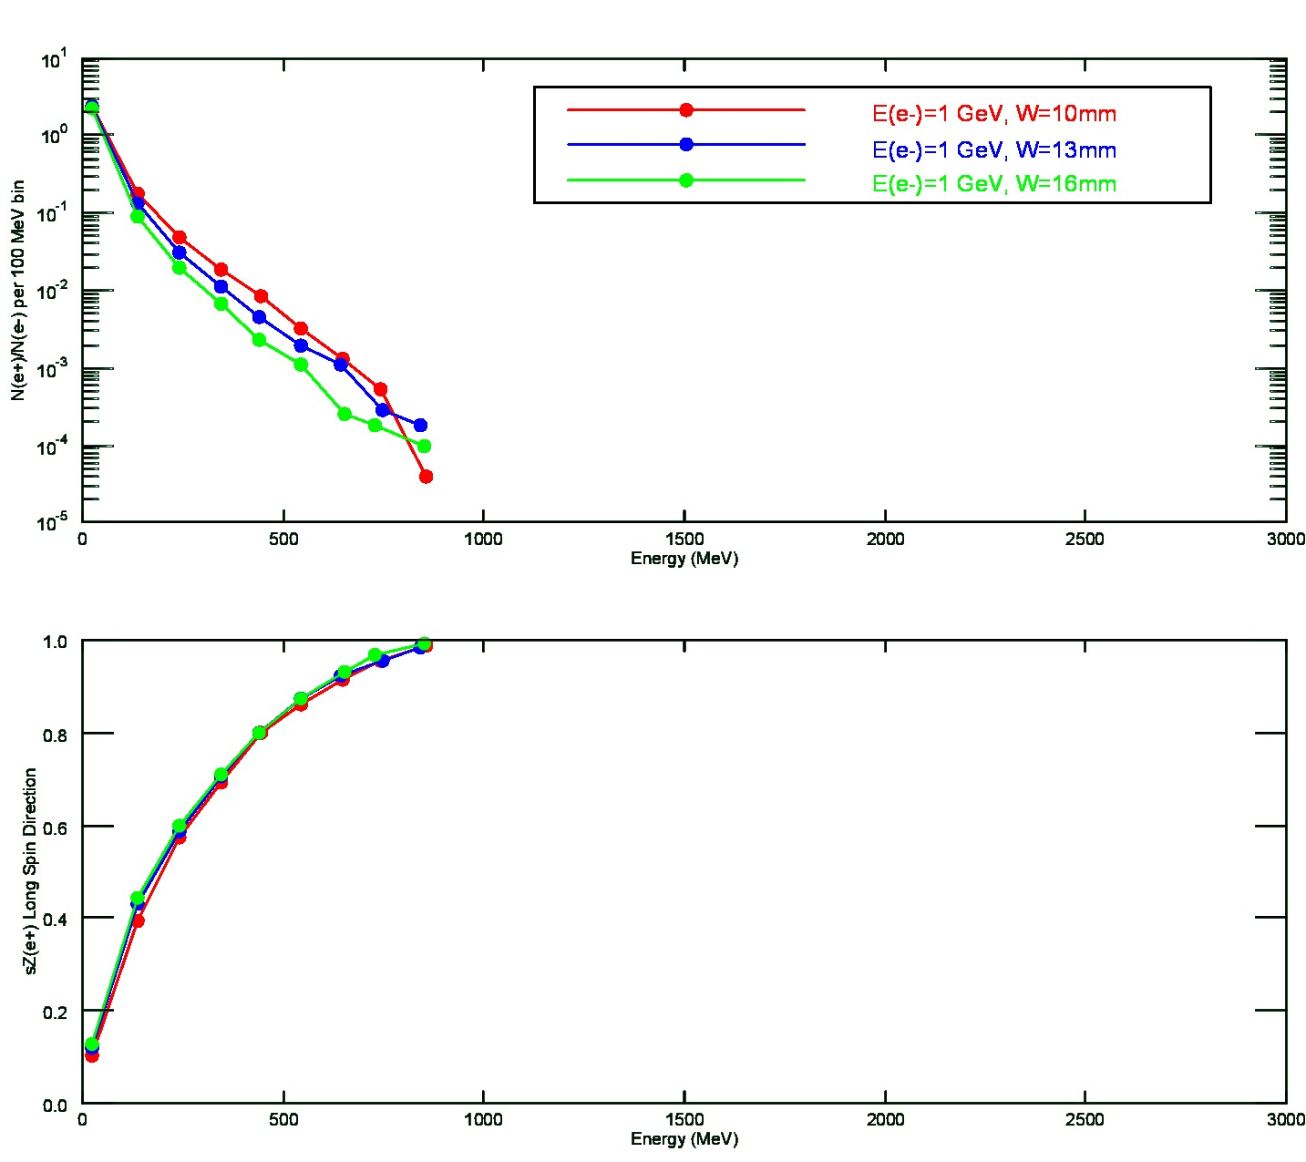
ILC : Spin Polarized Electron Driven Source ?
What is expected (w/o any cuts) if the electron beam energy were 1 GeV, and target thickness reduced.
Small reduction in target thickness has the effect of increasing yield (at this lower electron beam energy).
Target thickness has less impact when positron energy large fraction of electron energy.
E (e-) | Target | N(e+)/N(e-) | <Sz> | P (%)
3 GeV | 16 mm | 0.436 | 0.23 | 21
1 GeV | 10 mm | 0.178 | 0.39 | 35
E(e+)=150 MeV
E (e-) | Target | N(e+)/N(e-) | <Sz> | P (%)
3 GeV | 16 mm | 0.056 | 0.41 | 37
1 GeV | 10 mm | 0.018 | 0.69 | 62
E(e+)=350 MeV

Slide 18
R&D Topics
PEPPo Option for High Energy Physics Colliders
  Collaborating with KEK to evaluate the PEPPo concept as applied to ILC design parameters.
High Voltage Polarized Electron Source (>400kV)
  Extending the capability for reliably applying very high voltage w/o field emission or breakdown to a GaAs polarized source for high bunch charge (nC) operation (R&D activity of Carlos Hernandez-Garcia, CIS)
High Current Polarized Electron Source (>10 mA)
  Mitigating the QE degradation of GaAs in high voltage photogun to achieve >1000C charge lifetime at mA current (PhD thesis work of Josh Yoskowitz, Old Dominion University)
  Evaluating DBR/GaAs photocathodes that exhibit very high quantum efficiency (>5%)
Polarized Positron Collection Experiment (PEPPo II)
  Designing, building and testing a positron beam collection system to optimized to achieve a new metric of spin polarized source luminosity.
  Collaborating with P3 (IN2P3, CERN, Orsay, Mainz) to develop low energy high power polarized production system.
  Developing proposal for new PhD student on this topic.
18

Slide 19
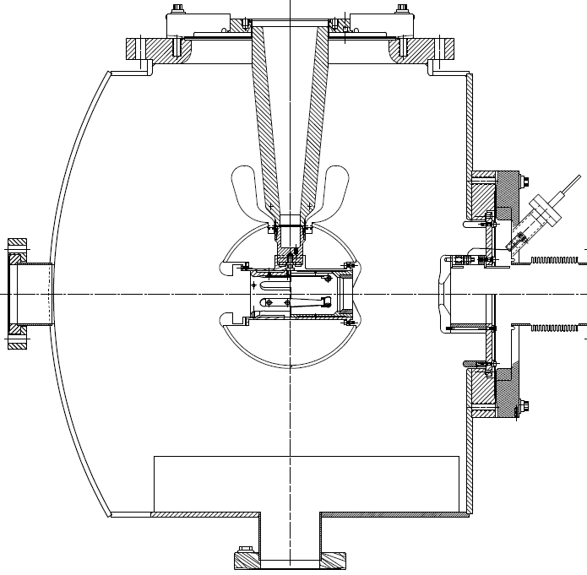

Jefferson Lab: Inverted Insulator Photogun
with optimized triple point shields and mildly conductive insulators
CEBAF 200 kV Gun
350 kV gun for GTS and UITF
Both designs, maximum field strength < 10 MV/m

Slide 20
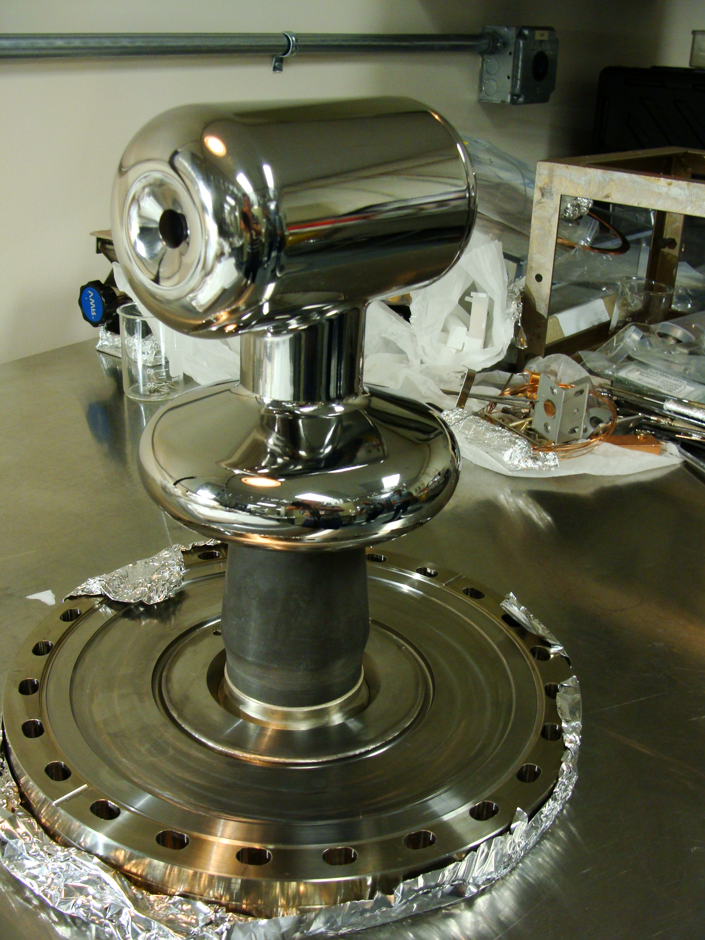
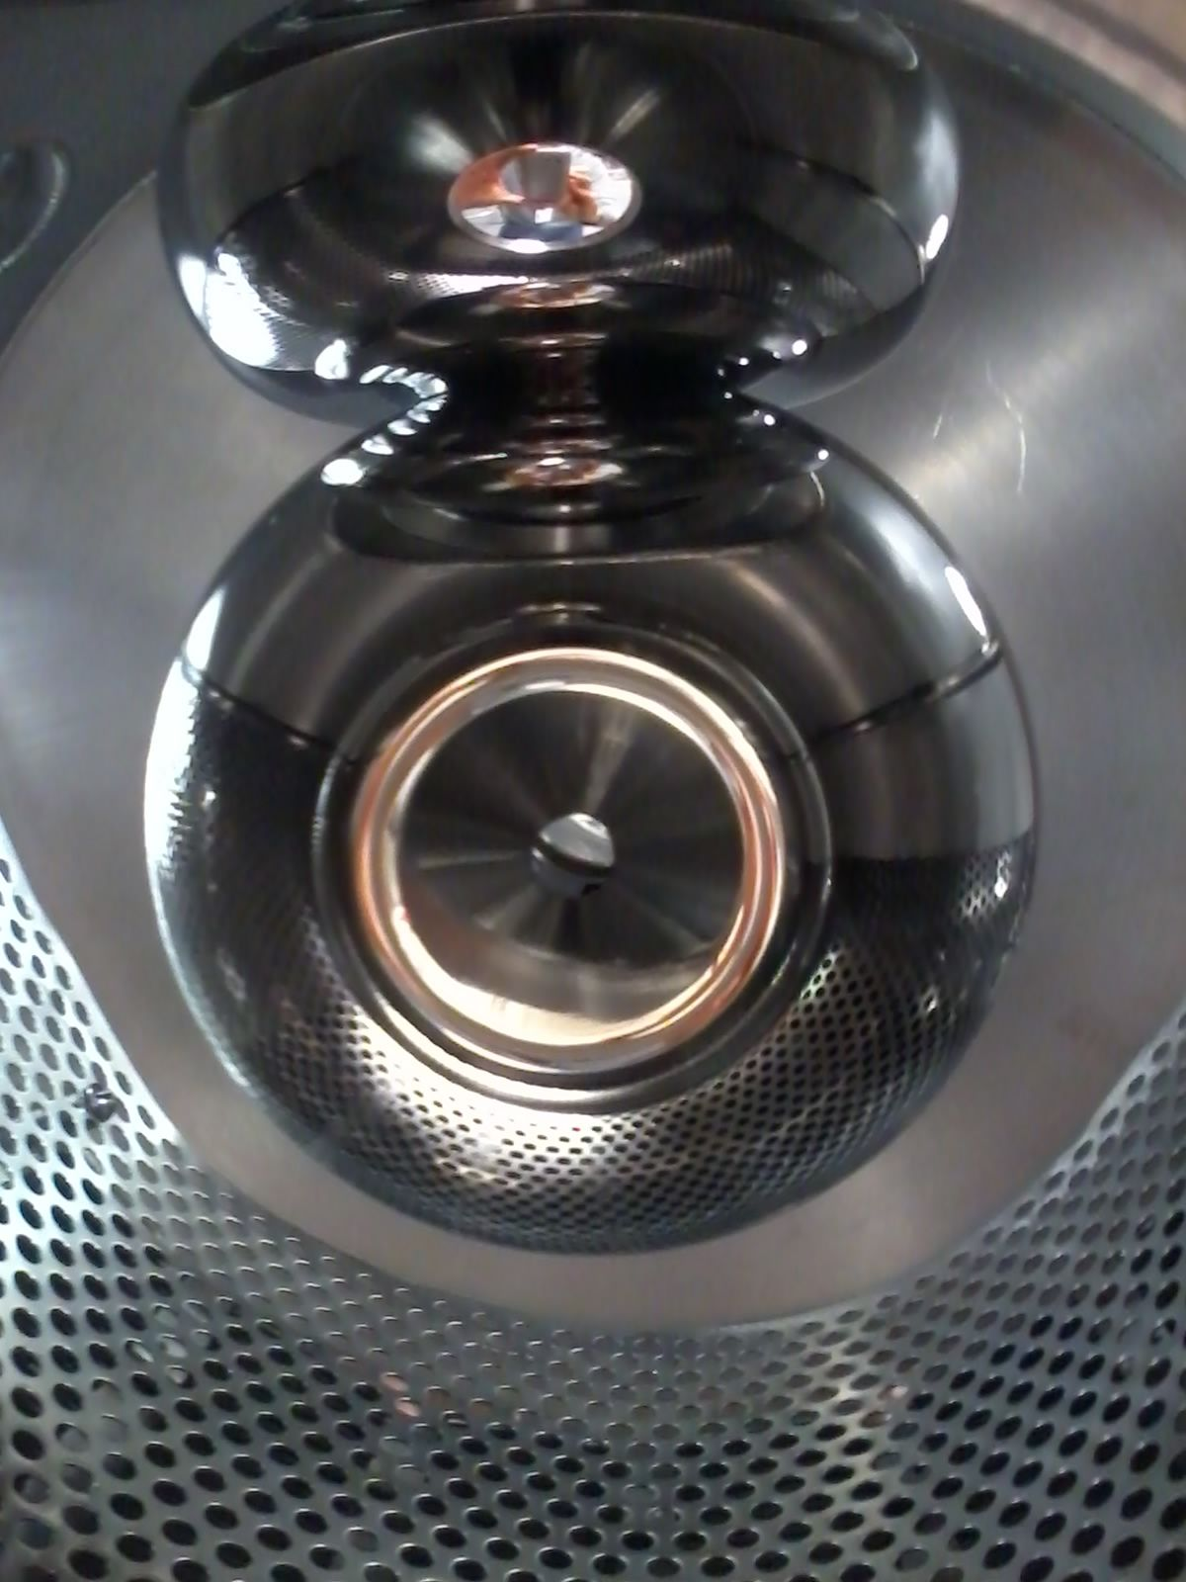
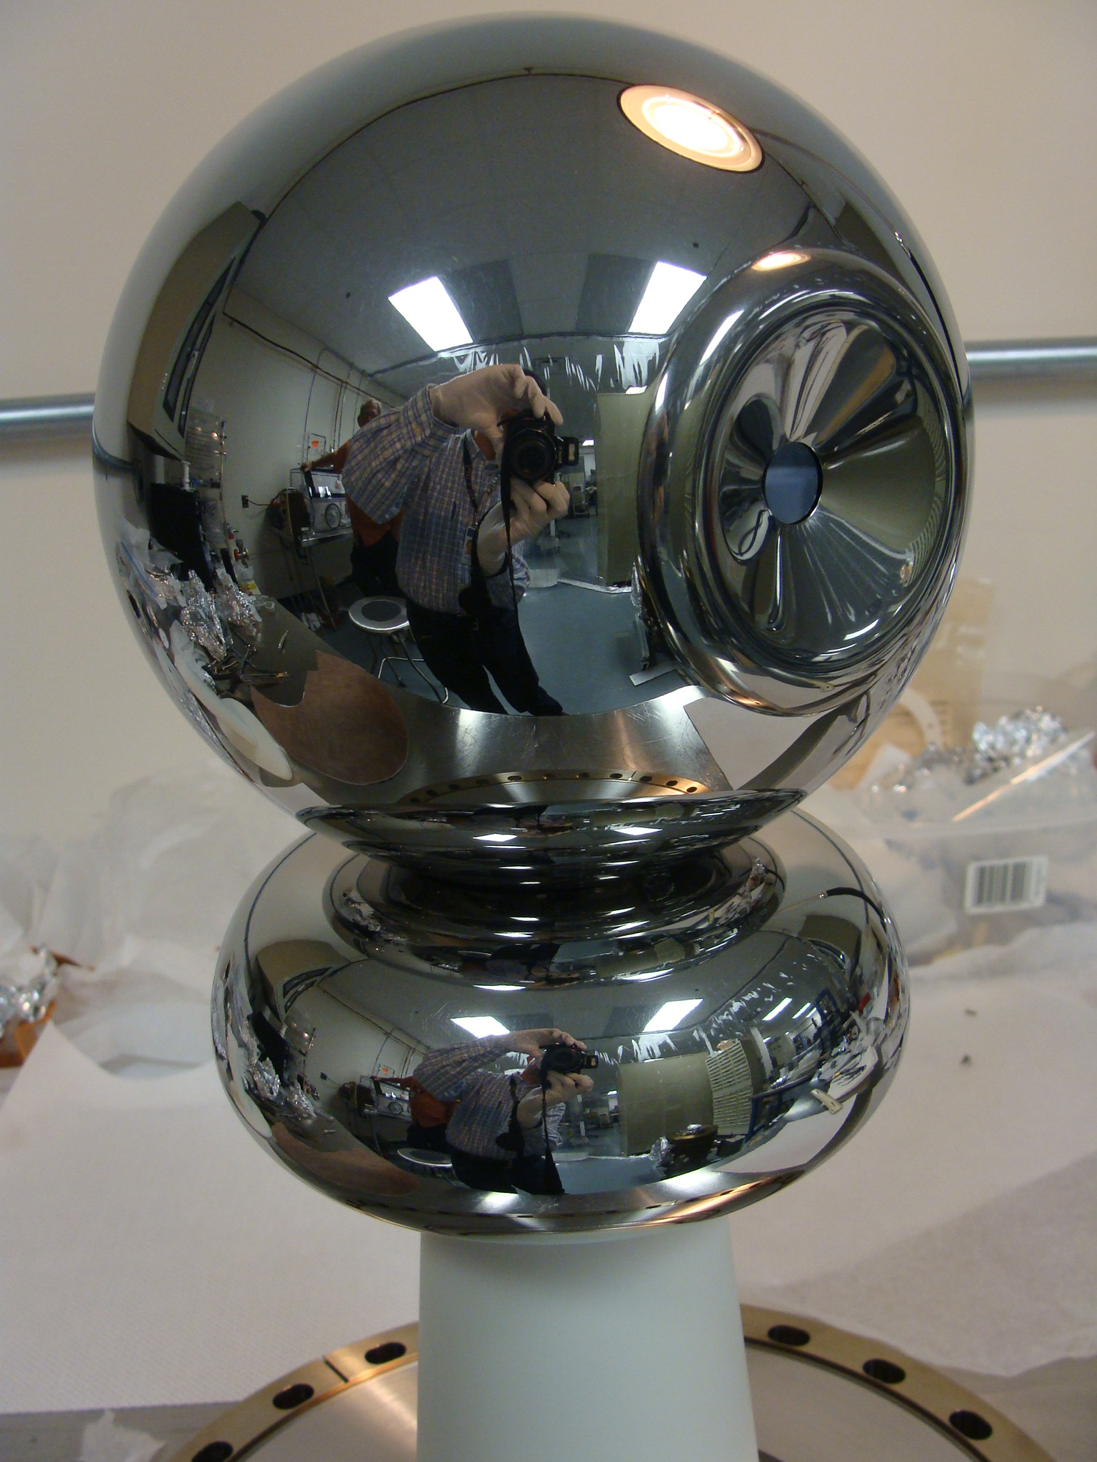
Jefferson Lab: High Voltage (200-350 kV) Inverted Insulator Photo-guns
CEBAF 200 kV
Installed June 2018
(operates at 130kV until an upgrade in 2020)
GTS 350 kV
In operation since Nov 2016 with CsK₂Sb photocathode
UITF 350 kV
Polarized Gun
Under assembly

Slide 21
Metric of Success: High Voltage without Field Emission
Reached
360 kV in 70 hours
10 MV/m at 350 kV
Vacuum and radiation levels indistinguishable from background at 350kV

Slide 22
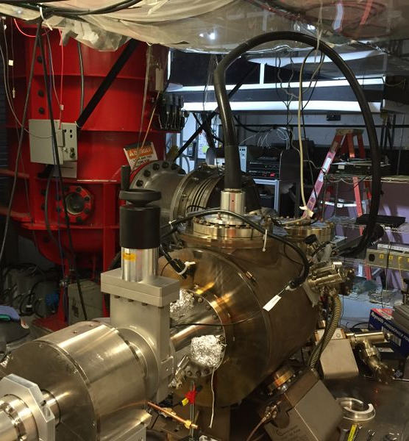
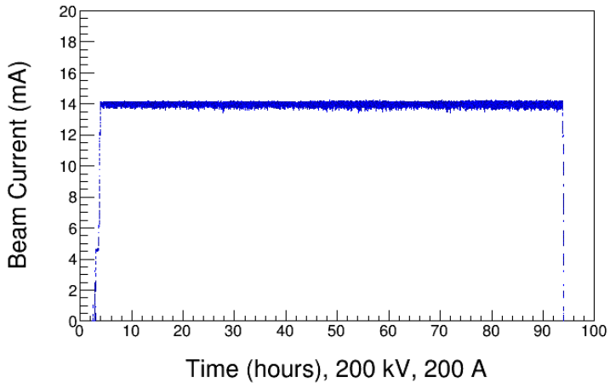
Magnetized Beam Photogun at the Gun Test Stand (GTS)
Magnetized Beam LDRD, PI's: R. Suleiman and M. Poelker
Load-lock inverted insulator photo-gun (multiple photocathodes), like CEBAF geometry.
Cable connection from HVPS to gun.
Over 1000 hours operating >300kV; HV conditioning about 1 week.
Operating with CsKSb photocathodes at >10 mA average current, and 0.7nC bunch charge.

Slide 23
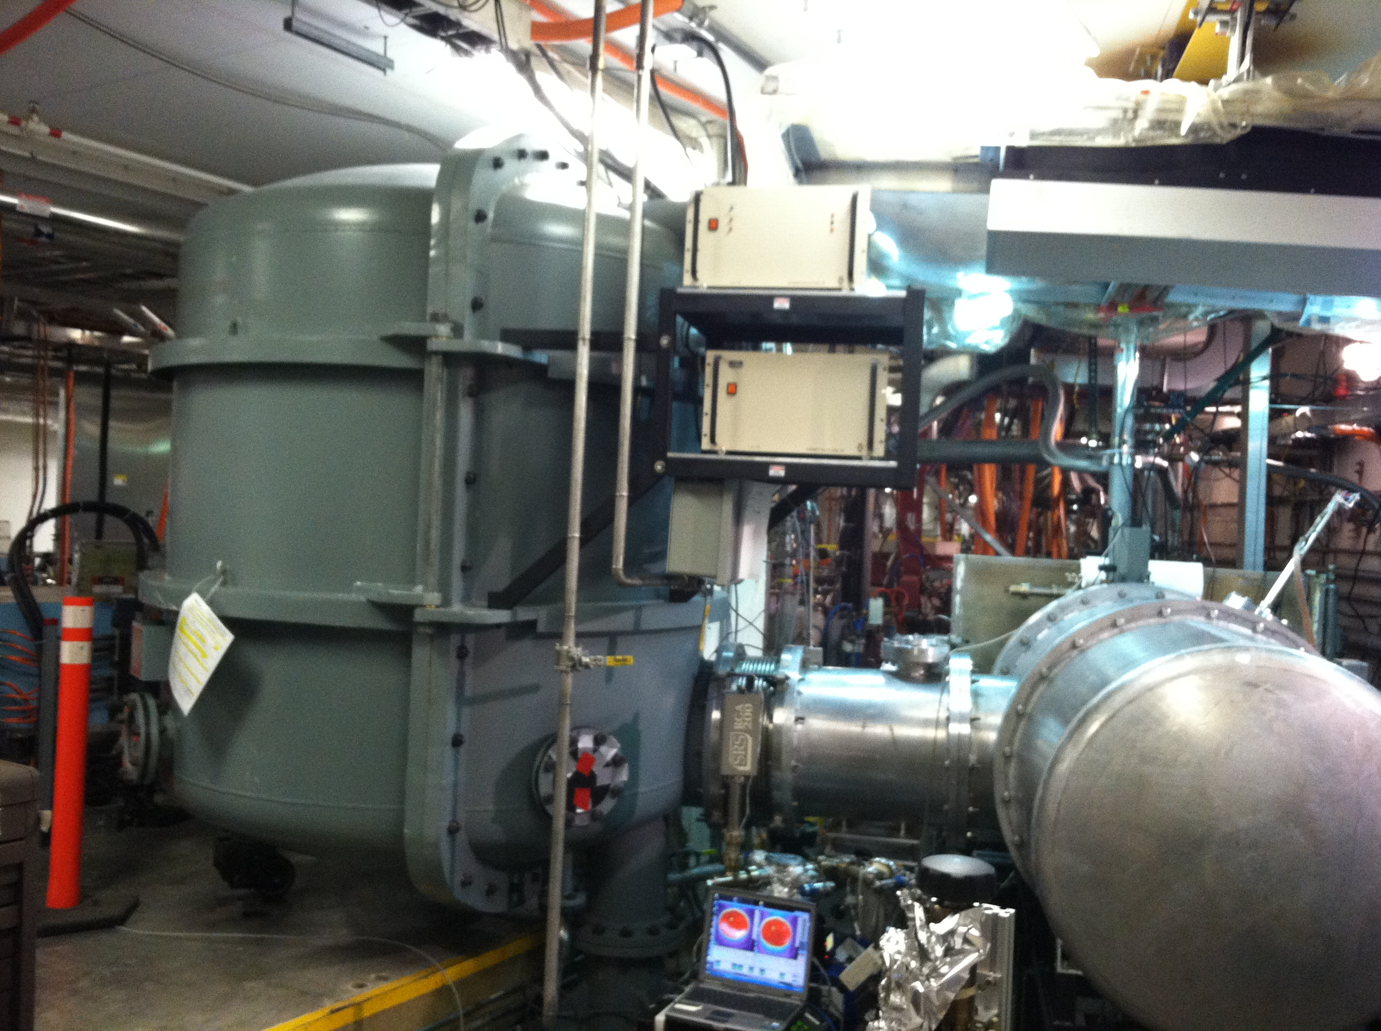
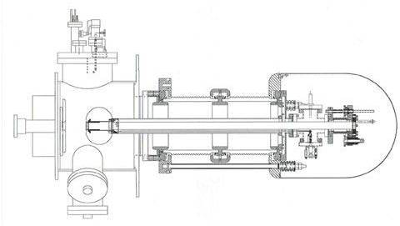
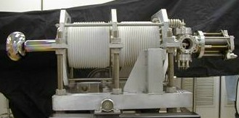
Higher voltages present a challenge
The 350 kV FEL vent-bake gun is based on large cylindrical insulators
Demonstrated 10 mA with with ~500 Coulombs 1/e lifetime
Takes about 4 weeks to replace a photocahode (no load-lock)
Requires large SF6 filled tank to connect with high voltage power supply
RGA, extractor gauge
and leak valve
Electrodes
Corona shield
Vacuum chamber
Ceramic stand-offs
End flange
Photocathode retractor mechanism
Anode
Photocathode
End flange
(3) 1000 l/s NEG pumps
High voltage feed
23
80 cm

Slide 24
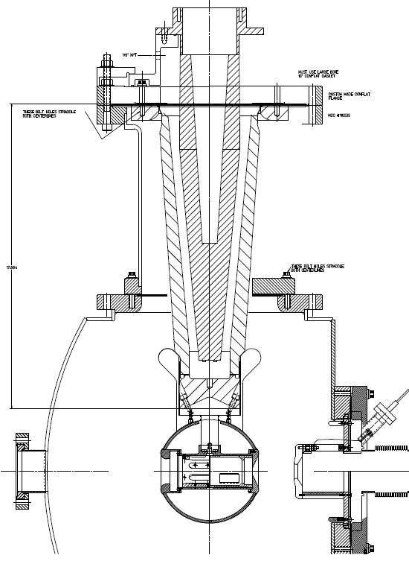
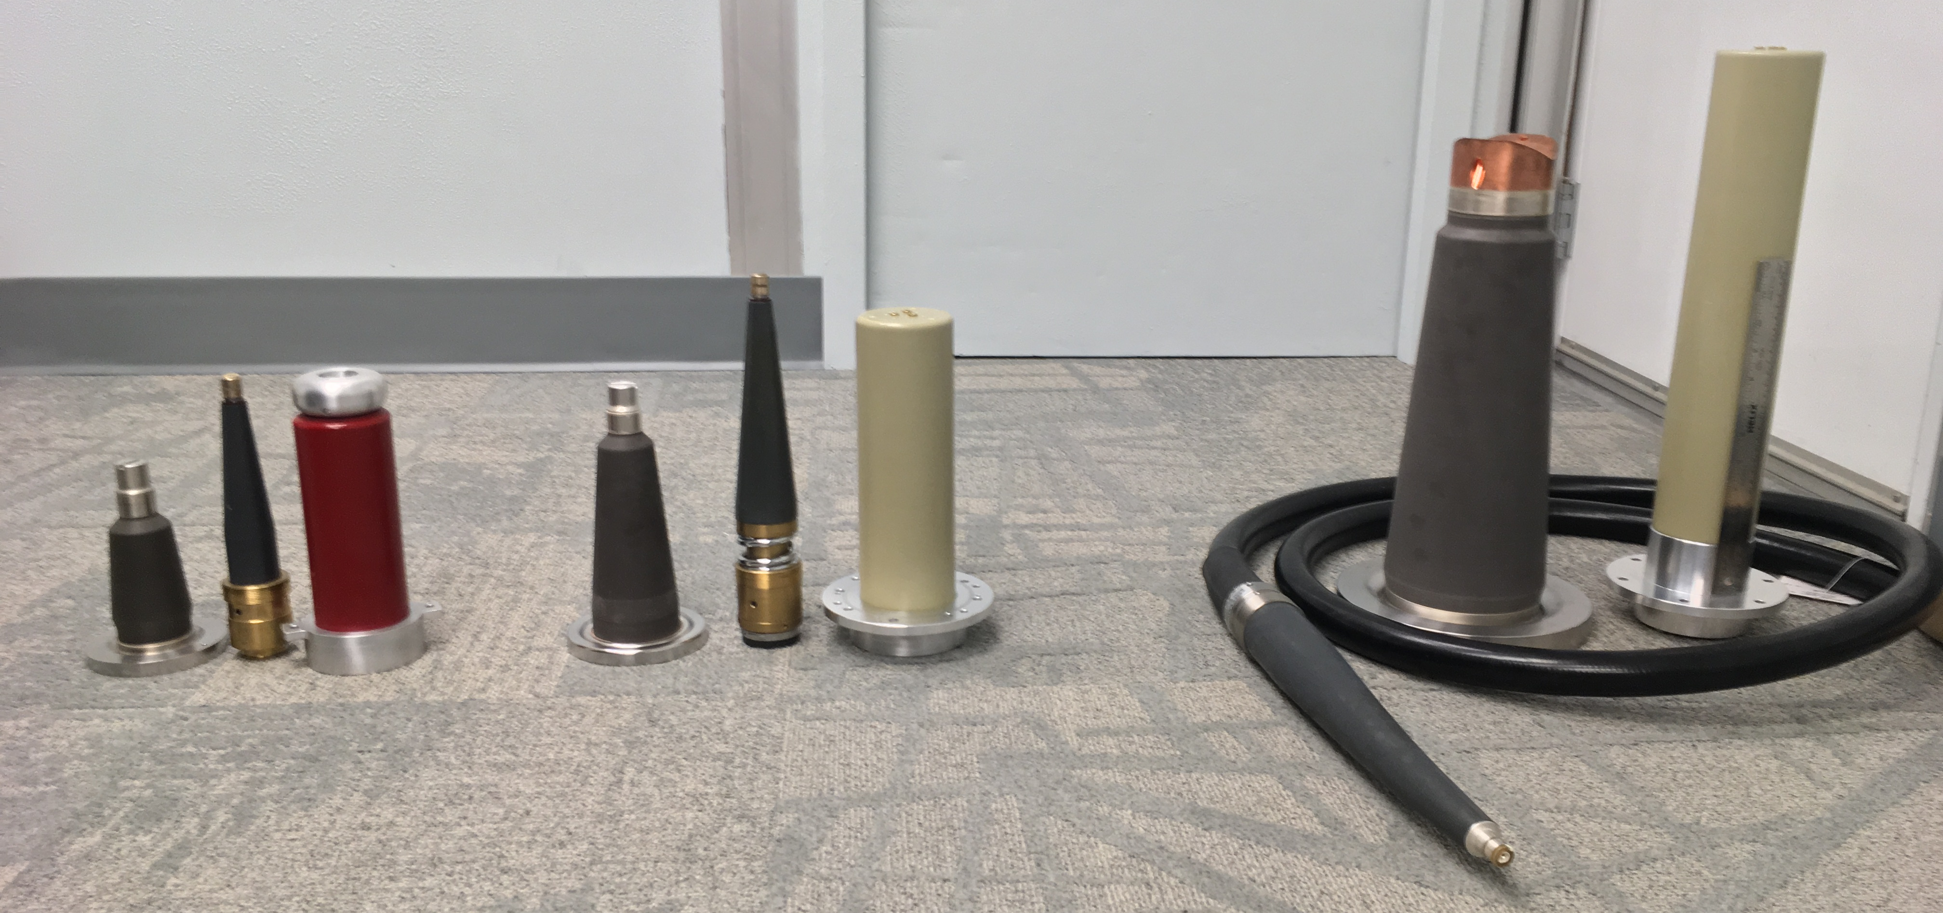
Our quest for higher voltage inverted insulator guns using cables
350 kV GTS Gun
The next step:
400 kV
R&D !
CEBAF 200 kV Gun
CONCEPT !
12"
R28 200kV
R30 300kV
R350, 400kV ?

Slide 25
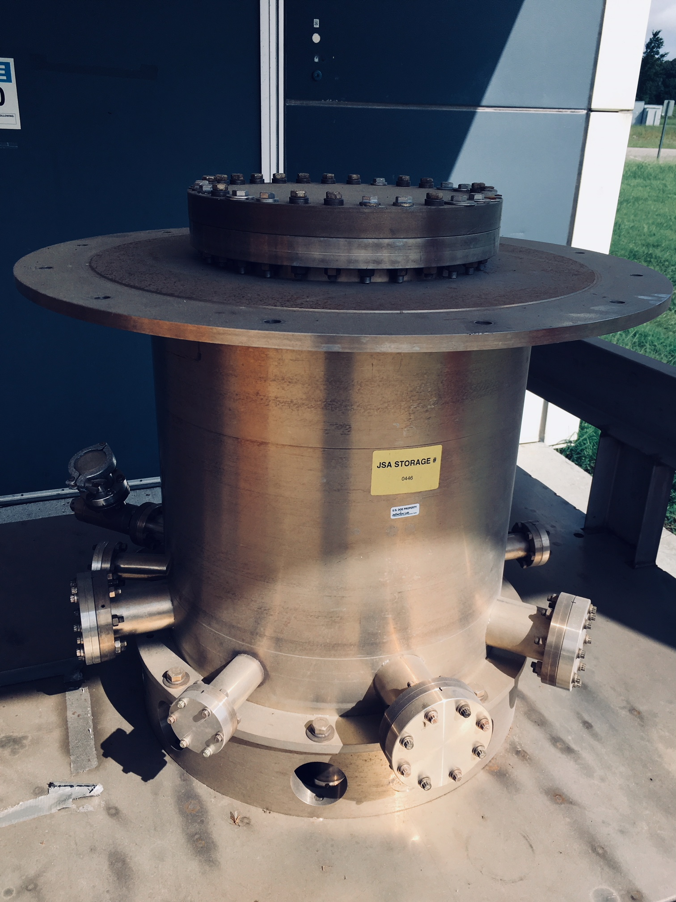
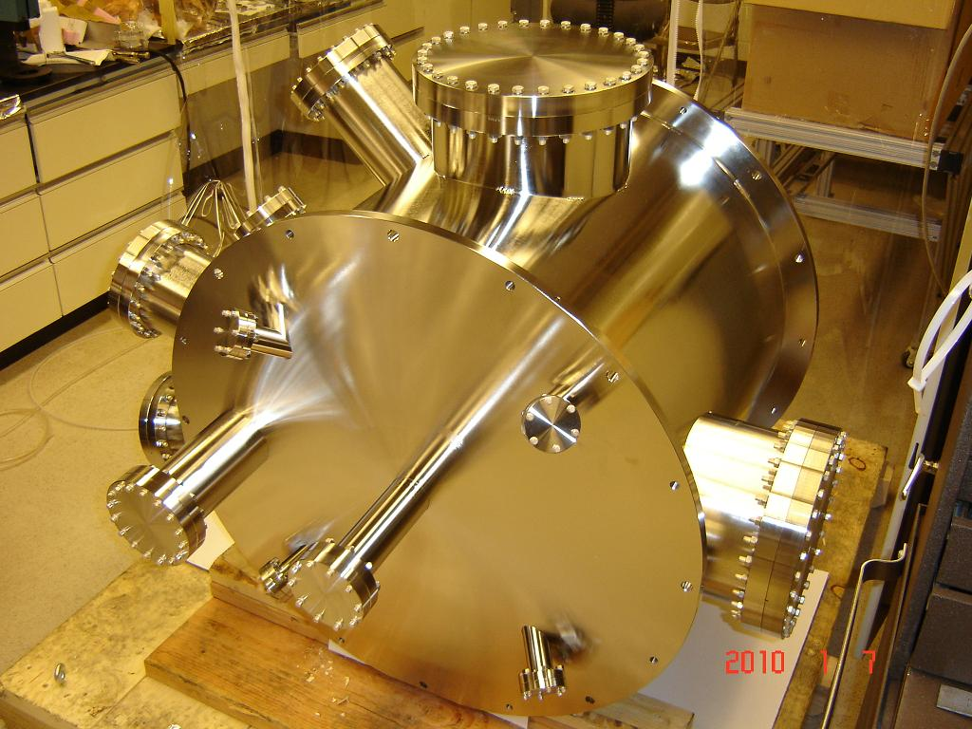
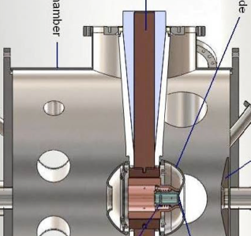
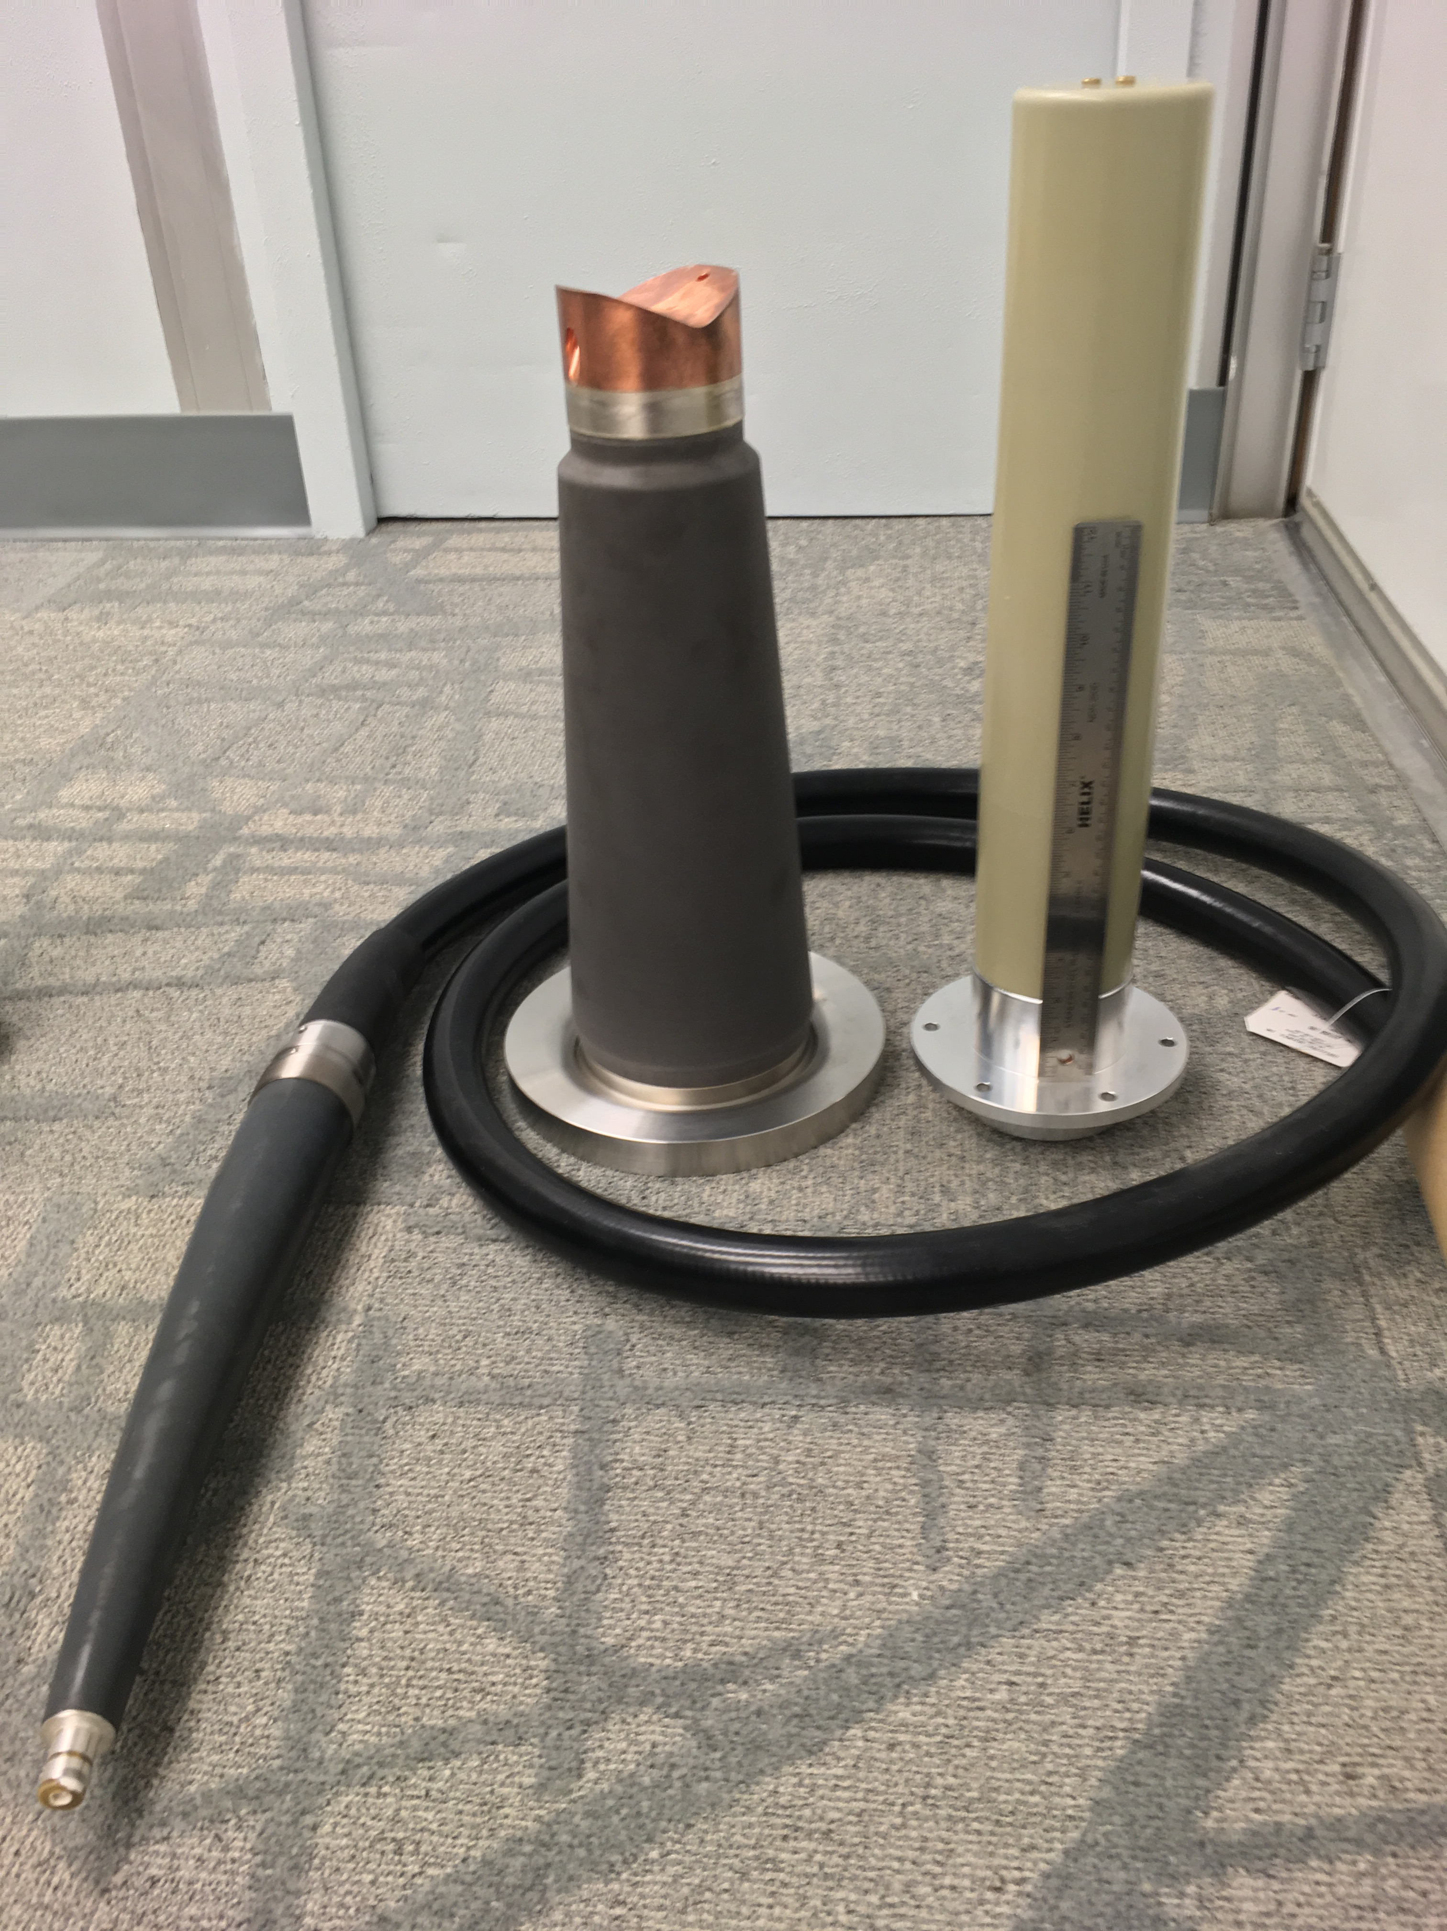
The next step: our 400kV R&D plan
Can the commercial plugs and receptacles be operated at 400kV sustained for days?
What is the highest voltage limit before breakdown?
Design coupling between large insulator and R350 cable plug
  (spinoff: partner with industry to design new conical insulator to mate with commercial R350 cable plug as done now for 200kV and 300kV)
Test all of this in SF6-filled chamber
Success? Then:
Design electrode and triple junction shields
Build and test in vacuum, likely will need larger chamber to keep gradient < 10 MV/m at 450kV
Our HV chamber
25

Slide 26
Summary
Jefferson Lab Users are making the physics case for both high energy polarized and unpolarized positron beams at CEBAF 12 GeV.
PEPPo demonstrated high positron polarization from polarized electrons at low energy w/ small footprint (cost, energy, radioactivity), extensible to high energy.
We are exploring concepts to produce positron beams for both CEBAF (CW, pC, mA) and JLEIC (pulsed, nC, μA) with tunability on intensity and polarization.
Recent progress is promising to develop a 400 kV polarized source based on the inverted insulator geometry necessary for >nC bunch charge.
Can the PEPPo concept applied to the ILC electron driven positron source turn a “no polarization” scheme into a “polarization scheme”, even for a later upgrade?

Slide 27
Backup Slides

Slide 28
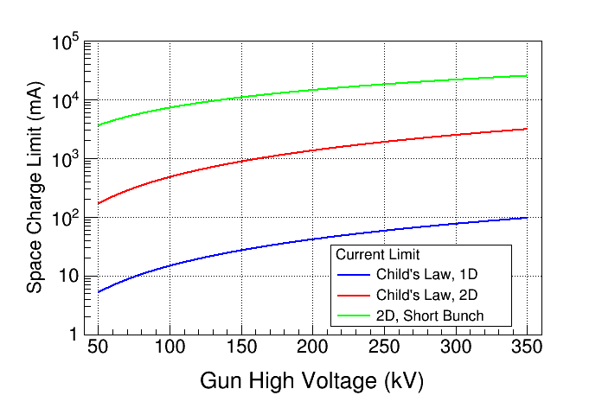
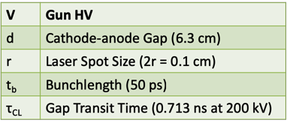
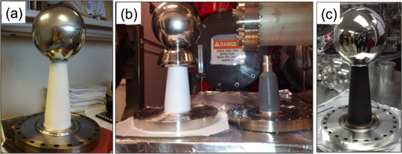
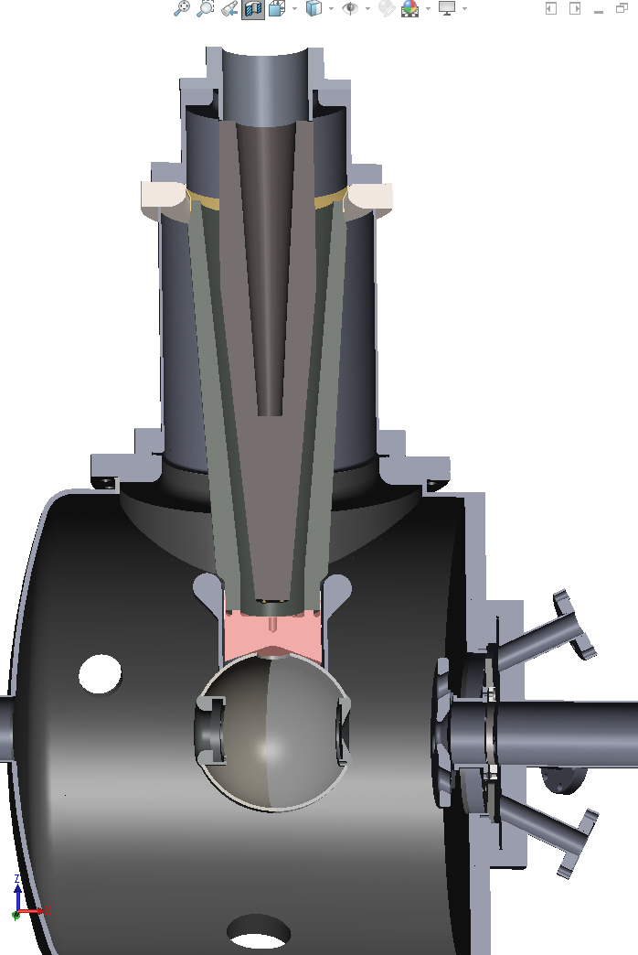
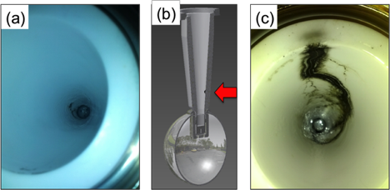
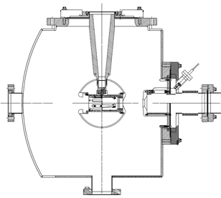

Areas of Interest
Guns – high bunch charge means managing gradients inside/outside the vacuum chamber
Managing gradient on vacuum side (triple point, shed, beam effects)
Managing gradient on the air side (linearity, breakdown, charging)
Managing gradient on electrodes (FE, gas desorption, x-rays)
1A
“150kV Gun”
“300 kV Gun”

Slide 29
Areas of Interest
Polarized Photocathodes – generation of high peak current and limitations
Surface Charge Limit (Surface Photovoltage Effect), reduces NEA of GaAs: Photoelectrons trapped near GaAs surface produce opposing field that reduces NEA resulting in QE reduction at high laser power (LP).
Higher Gun HV suppresses SCL!

Slide 30
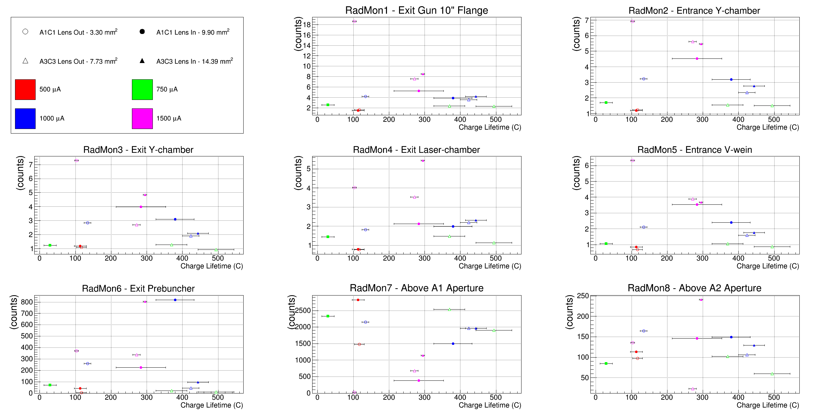
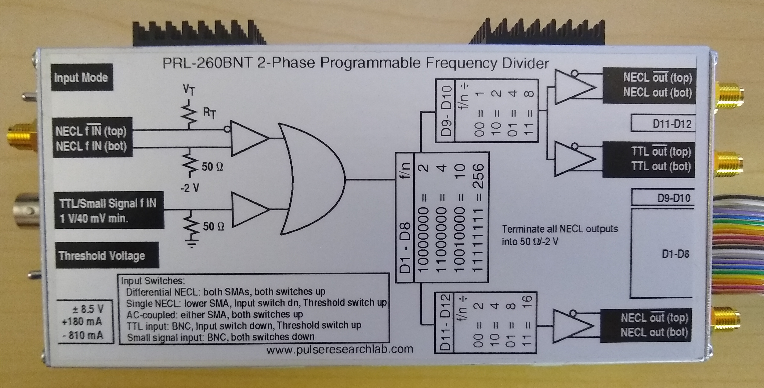
Areas of Interest
Beam – managing every electron counts for photocathode lifetime
Accounting for loss at the ppm level is significant, and becomes increasingly challenging with bunch charge
Lasers – high peak power short pulse rf-synchronized lasers
Digital gain switching provided CEBAF with 250 MHz and 32 MHz rep rate beam; the lower rep rate can be exploited for UITF and phase locking can be investigated to have option at CEBAF for many rep rates

