Slide 1
UITF beamline installation
Cleaning components

Slide 2
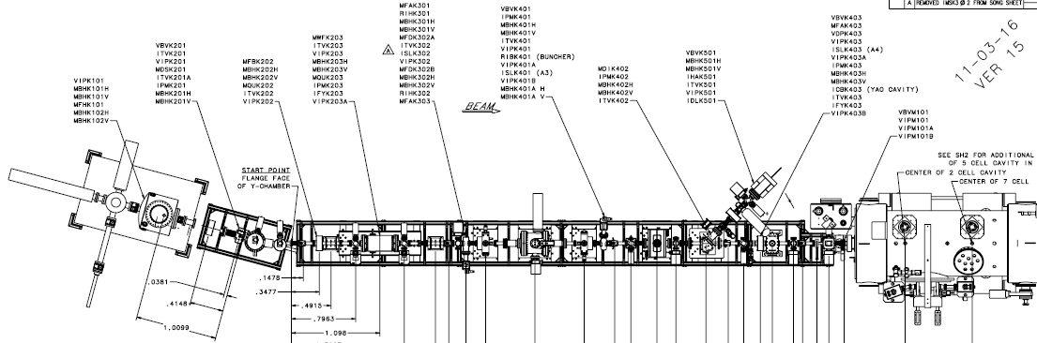
Beamline
Assembled, baked
Assembled
SRF clean/assemble?

Slide 3
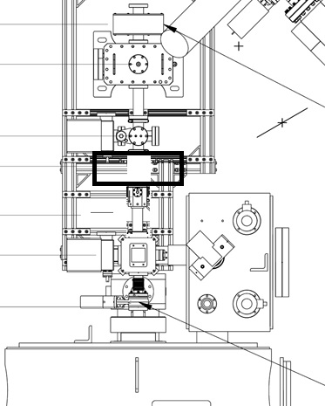
Components
element | name | position (m)
VDPK403 | diff pump | 5.86545
 | nipple/corrector | 6.01785
ISLK403 | A4 | 6.14485
 | Brock cavity | 6.27185
 | adapter Brock/BPM | 6.34805
IPMK403 | BPM/corrector | 6.39885
IFYK403 | faraday cup/viewer | 6.58935
 | bellows | 6.76715
VBVM101 | SRF valve | 6.85605

Slide 4
How do we clean & assemble?
element | name
VDPK403 | diff pump | Assembled, small aperture
 | spool
ISLK403 | A4 (ion pump) | These must be aligned together: can they be cleaned after assembly, bench testing and alignment?
 | Brock cavity
 | adapter spool
IPMK403 | BPM | Leak checked and assembled. Clean as is?
IFYK403 | faraday cup/viewer/ion pump | Two manipulators: top and bottom? How are these cleaned and installed CEBAF
 | bellows
VBVM101 | SRF valve

Slide 5
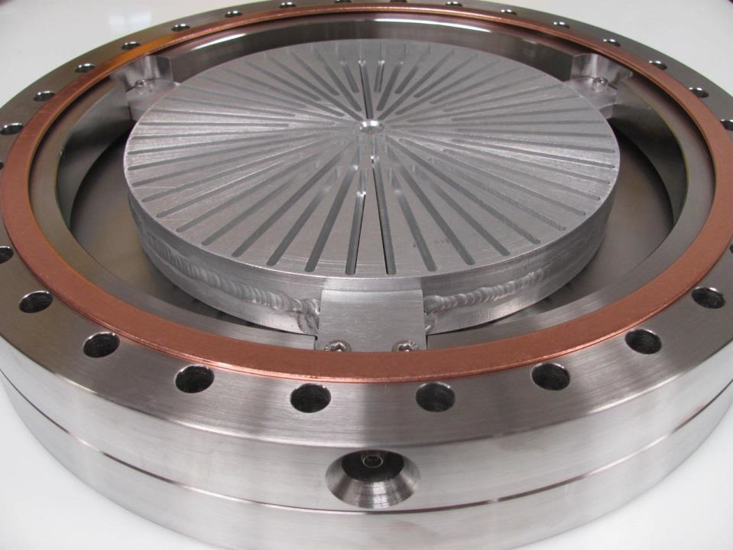
Brock Cavity: bunchlength monitor
Aperture must be aligned to A4
Finely tuned structures inside
Can this be cleaned after assembly to cross with aperture in position?
Attached to 6 way 2.75” cross:
Top: manipulator set to correct distance for faraday cup
bottom or side: ion pump (can be installed later)

Slide 6
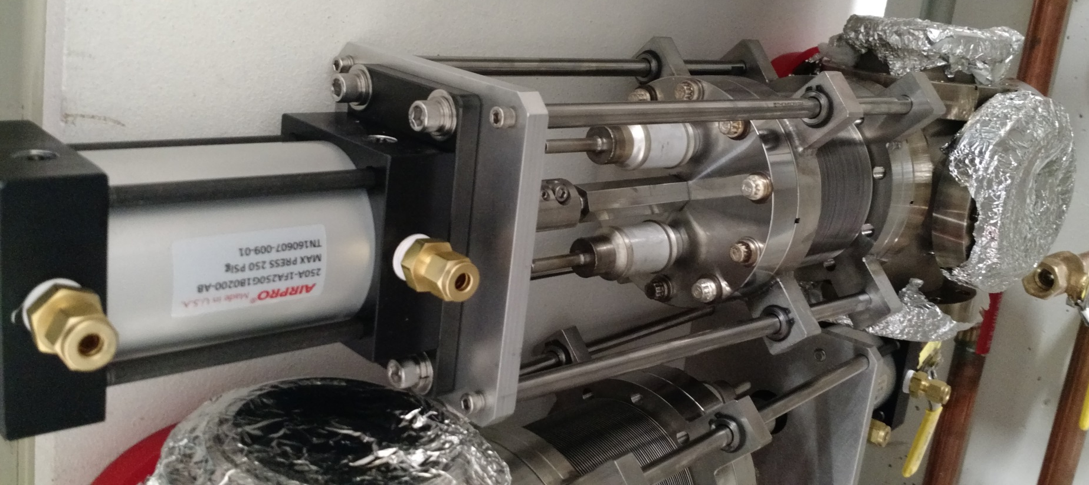
Faraday cup / viewer cross
How to clean? Faraday cup, ion pump, viewer on 4 5/8” cross. Faraday cup already aligned.

