Slide 1

Ce⁺BAF
Machine concept and status
Topics we’ll address at this meeting
  Joe, polarized e- source
  Andriy, high power e+ target
  Sami, formation of e+ beam
  Dennis, transport of e+ beam to halls
Joe Grames

Slide 2




Ce⁺BAF Working Group
J. Benesch, A. Bogacz, L. Cardman, J. Conway, S. Covrig, J. Grames, J. Gubeli, C. Gulliford, S. Habet, C. Hernandez-Garcia, A. Hofler,
R. Kazimi, V. Kolstrum, F. Lin, V. Lizarraga-Rubio, M. Poelker, Y. Roblin, A. Seryi, K. Smolenski, M. Spata, R. Suleiman, A. Sy, D. Turner, A. Ushakov, C. Valerio, E. Voutier, S. Zhang, Y. Zhang

Slide 3

12 GeV Ce⁺BAF : Polarized Electron or Polarized Positron Beams
2020 JLAAC Recommendations
  “R6: Augment the scientific case with a plan to translate the R&D into a realistic facility.”
  “R7: Include radiation protection considerations into the evaluation of the electron beam energy choice.”
2021 JLAAC Recommendations
  “R4: Elaborate on the possibility for fielding a rapid operational switching mode between e- and e+ operation in FFA arcs.”
  “Q5: …required photocathodes to enable polarized e+ production should continue to be developed.”
  “R20: Work out how efficient magnet polarity switching (~8 hours) could be implemented between e- and e+ operation.”
Machine Parameter | Electrons | Positrons
Hall Multiplicity | 4 | 1 or 2
Energy (ABC/D) | 11/12 GeV | 11/12 GeV
Beam Repetition | 249.5/499 MHz | 249.5/499 MHz
Duty Factor | 100% cw | 100% cw
Unpolarized Intensity | 170 μA | > 1 μA
Polarized Intensity | 170 μA | > 50 nA
Beam Polarization | > 85% | > 60%
Fast/Slow Helicity Reversal | 1920 Hz/Yes | 1920 Hz/Yes

Slide 4
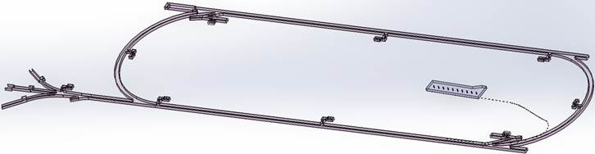
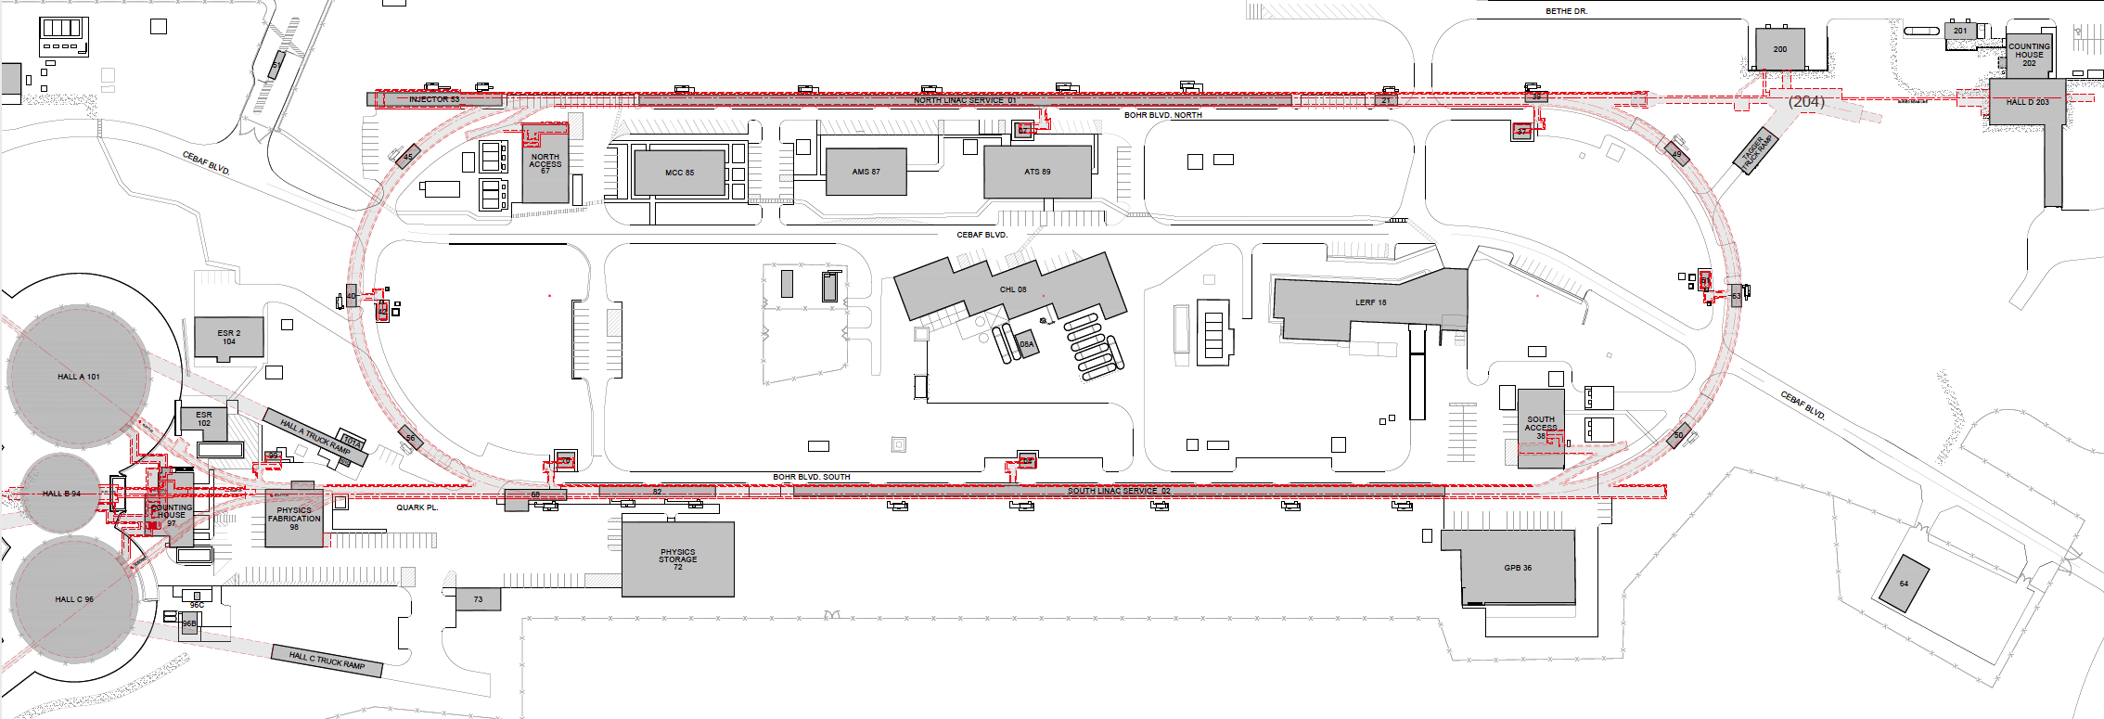

Turning the LERF into a positron injector facility
123 MeV
One year ago we were exploring e+ production at 10, 100, 1000 MeV…
Today we are focused on producing 123 MeV e⁺ utilizing the Low Energy Research Facility
Inject e⁺ into North Linac to usual 12 GeV (w/ magnets reversed)
Build e⁺ injector at the LERF
Build new LERF to CEBAF tunnel
123 MeV
Build new transport line along South Linac and West Arc

Slide 5
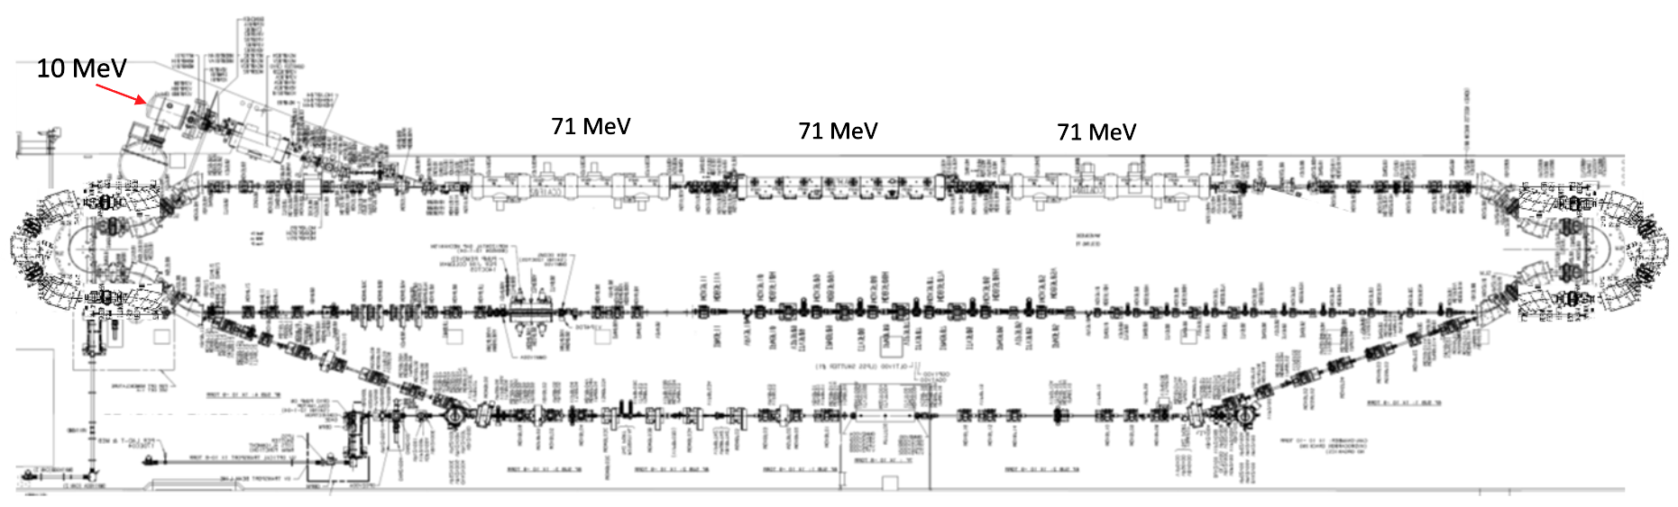
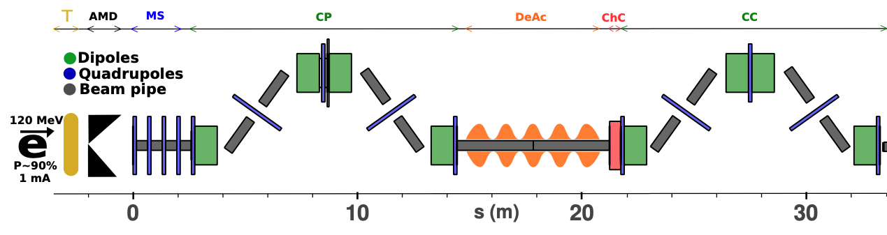
LERF Polarized Positron Injector Concept
Focus is developing a S2E technical report based on a polarized e⁺ injector at LERF
  High current polarized electron injector (10 MeV/10 mA)
  High current 1-3 mA LINAC (two C75 CM)
  Positron conversion target (~100 kW)
  Positron bunch collection and momentum selection
  Positron bunch compression and acceleration to 123 MeV
#1 – Compact 10 mA P-Gun, Wien filter, 10 MeV e- injector
#6 – SRF accelerate e+ to 123 MeV
#2 - SRF accelerate to 120 MeV
#5 – Transport e+
#3 – Extract e- to target
#4 - Produce and collect e+ 20 to 60 MeV
#7 – Evaluating 123 MeV spin rotator concept
#8 – Transport e+ at 123 MeV to CEBAF
5

Slide 6
CEBAF : spin polarization from GaAs photocathodes
GaAs photocathodes with both high QE and POL is the enabling technology.
Reliable
expectation
J. Dumas, J. Grames, E. Voutier, “A Polarized Positron Source for CEBAF”, arXiv:0907.5348 (2009)
….…
Reliable
expectation

Slide 7


Exploit electron spin polarization to produce polarized positrons
When a longitudinally polarized e⁻ beam strikes matter, e⁺ produced in the shower carrying >50% of the e⁻ beam energy are significantly longitudinally spin polarized…
Polarized Bremsstrahlung
Polarized Pair Creation
P_{circ}(γ) / P_{z} (e⁻)
P_{z} (e⁺) / P_{circ} (γ)
…so why not take advantage of this?
E_{γ} / T_{e-}
T_{e+} / (E_{γ} – 2m_{e+})
E.A. Kuraev, Y.M. Bystritskiy, M. Shatnev, E.Tomasi-Gustafsson, PRC 81 (2010) 055208

Slide 8

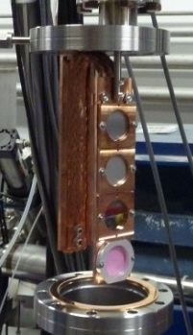
PEPPo : Polarized Electrons for Polarized Positrons
The spin transfer from e⁻ to e⁺ was tested in a feasibility experiment at CEBAF in 2012 (remember, the energy argument is scalable…)
J. Grames, E. Voutier et al.,JLab Experiment E12-11-105 (2011)
8 MeV, 1μA, 85% polarization
Record for linac positron polarization.
P(e+) = 82.2 %
Tungsten (1mm)
Efficiency >95%
PEPPo possible due to support from SLAC E166, DESY, Princeton, Cornell, International Linear Collider Project and the Jefferson Science Associates
D. Abbott et al., Phys. Rev. Lett. 116 (2016) 214801

Slide 9
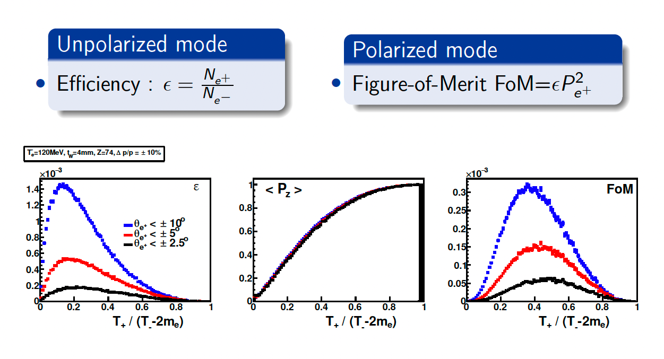
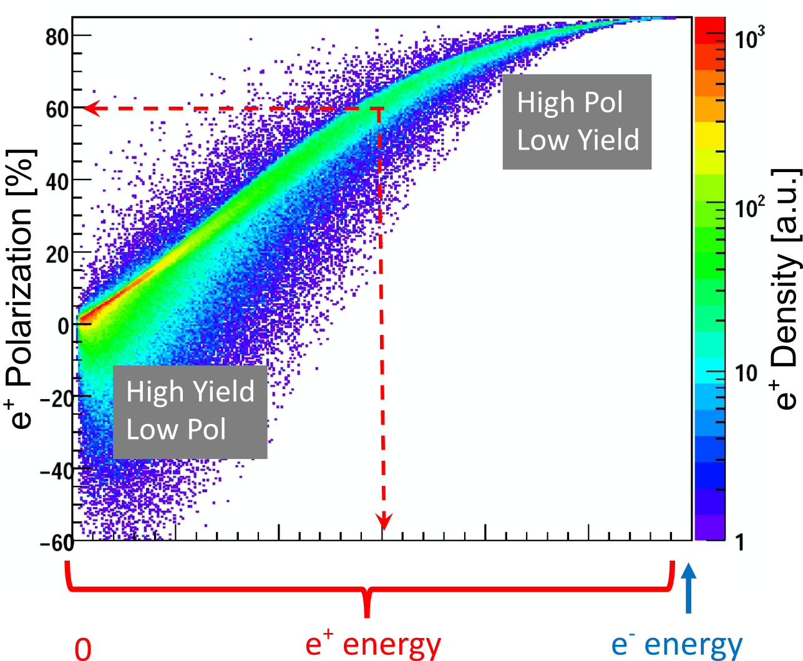
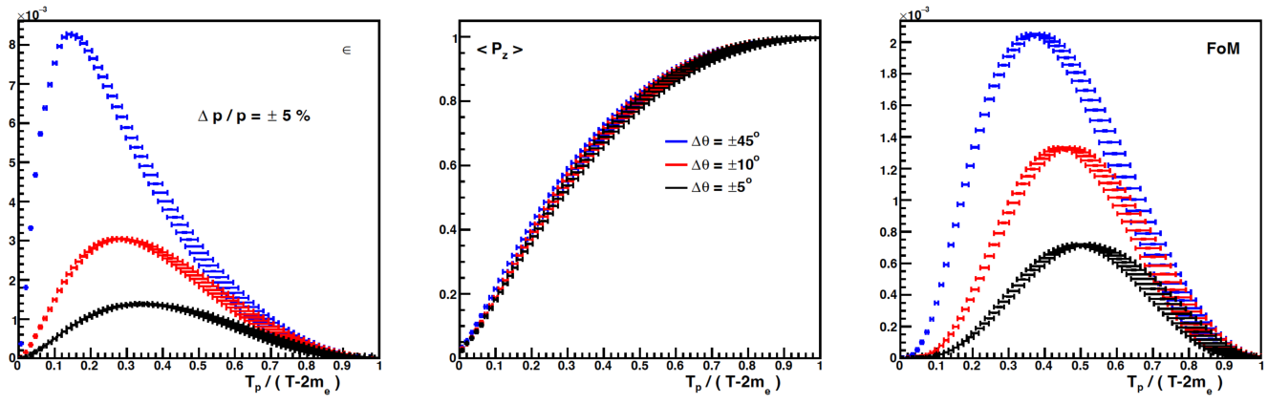
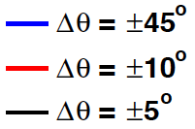
Yield and Polarization at Target vs Energy. Polarized and Unpolarized Modes
e⁺ Polarization vs Energy
4 mm Tungsten Target
120 MeV e‒
Efficiency
FoM
e⁺
e‒
e⁺
e‒
Positron beamline has to be designed
for efficient capture and transport of e⁺ with different energies

Slide 10
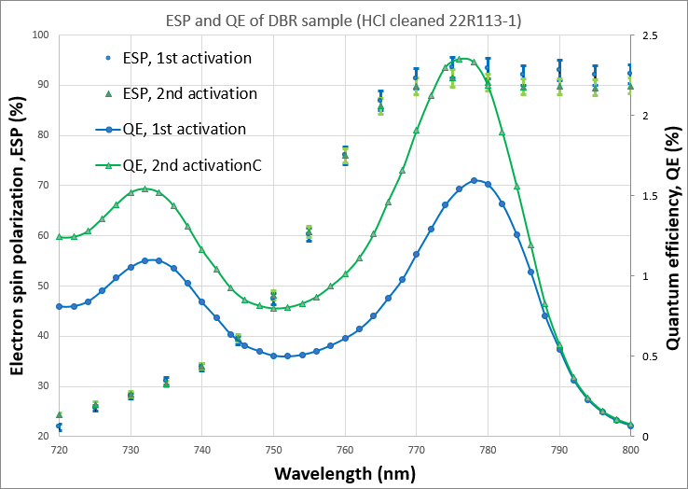
Diffracted Bragg Reflector (DBR) superlattice
W. Liu, S. Zhang, M. Stutzman, M. Poelker, Y. Chen, W. Lu, and A. Moy, Appl. Phys. Lett. 109, 252104 (2016)
July 2022 (unpublished) results of collaboration between Old Dominion University, Brookhaven National Lab and Jefferson Lab
MOCVD growth of DBR-SLSP by industrial partner
  QE > 2%
  Polarization > 90%
> 10 mA/W

Slide 11
Charge lifetime...
Show calculation of what is needed….
Will CEBAF source do it? No.
Strategy to get there.

Slide 12
Can the CEBAF photo-gun support an e⁺ program?
Positively biasing the photo-gun anode has had a tremendous impact on JLab gun lifetime.
PhD work of J. Yoskowitz in preparation for PR-AB
With a >400 C lifetime we could operate at 1 mA for almost 1 week

Slide 13
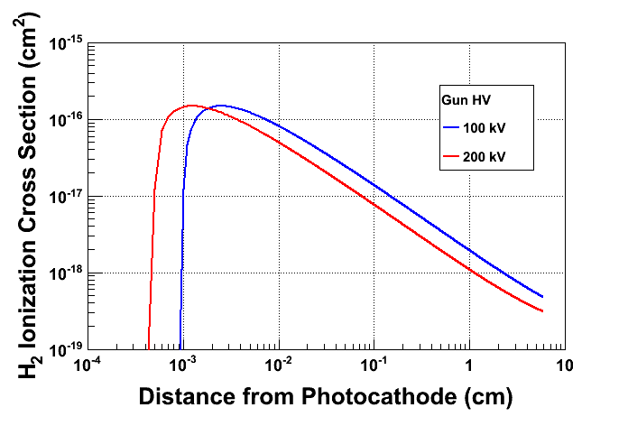
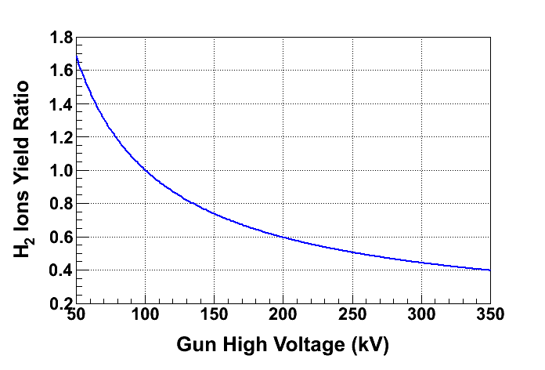
Optimizing the gun voltage for charge lifetime
What about the cathode potential, i.e. is there is “best” potential for increasing charge lifetime?
Ion generation largest here
Fewer ions created as gun voltage increases

Slide 14
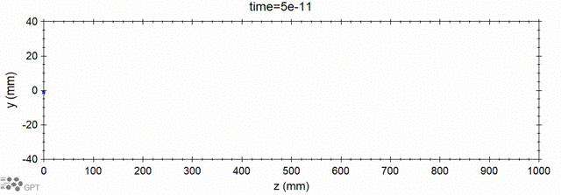
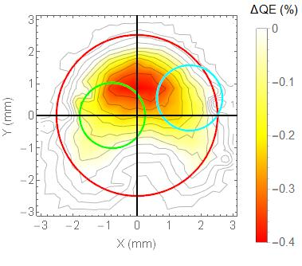
Modeling ion generation and bombardment
GPT custom element IONATOR simulates electron-impact ionization of residual beam line gasses and tracks outgoing particles.
Simulations of ion back-bombardment predict ions created within the cathode-anode gap, depositing their energy at the photocathode, closely resembles the measured damage pattern.
e- beam
ions
ejected e-
scattered e-
Simulated
Simulated
Simulation of biased anode
PhD work of Josh Yoskowitz
Measured
QE Loss

Slide 15



PES: reducing ion surface density to increase lifetime
Increasing laser beam size at photocathode has increased charge lifetime…
J. Grames, et al., Phys. Rev. ST Accel. Beams 14 043501 (2011)
Bulk 532nm
GaAs/GaAsP 780nm

Slide 16
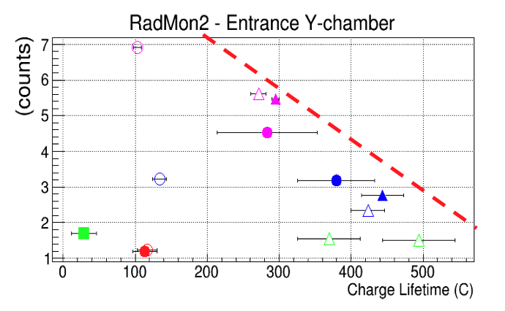
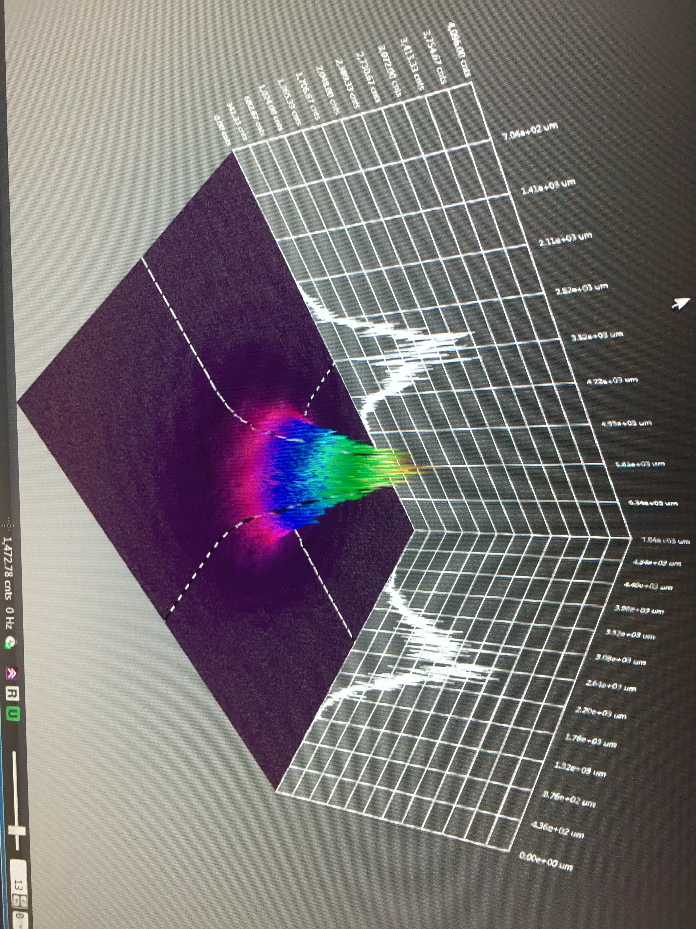

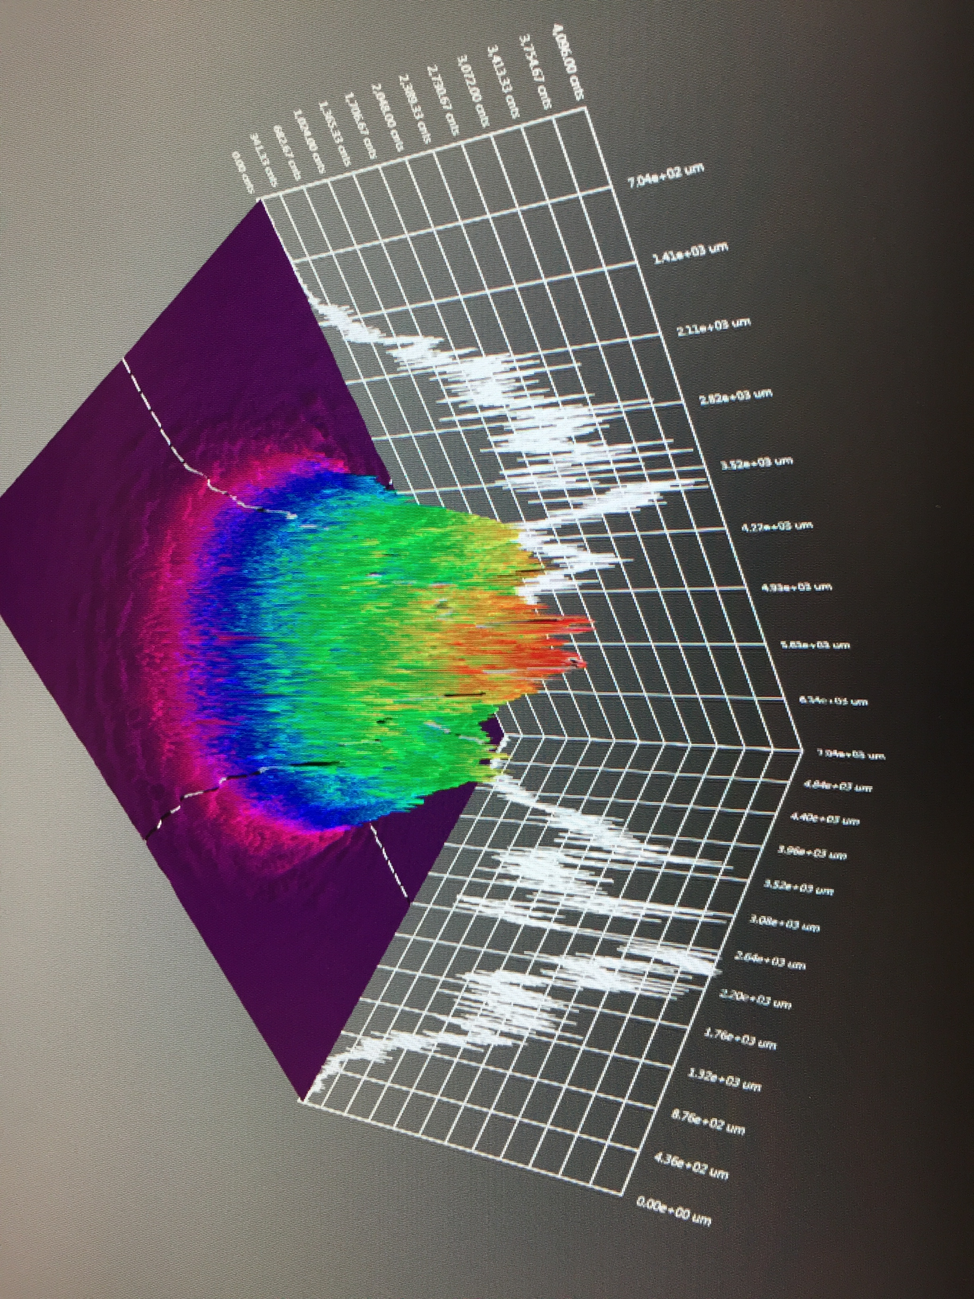
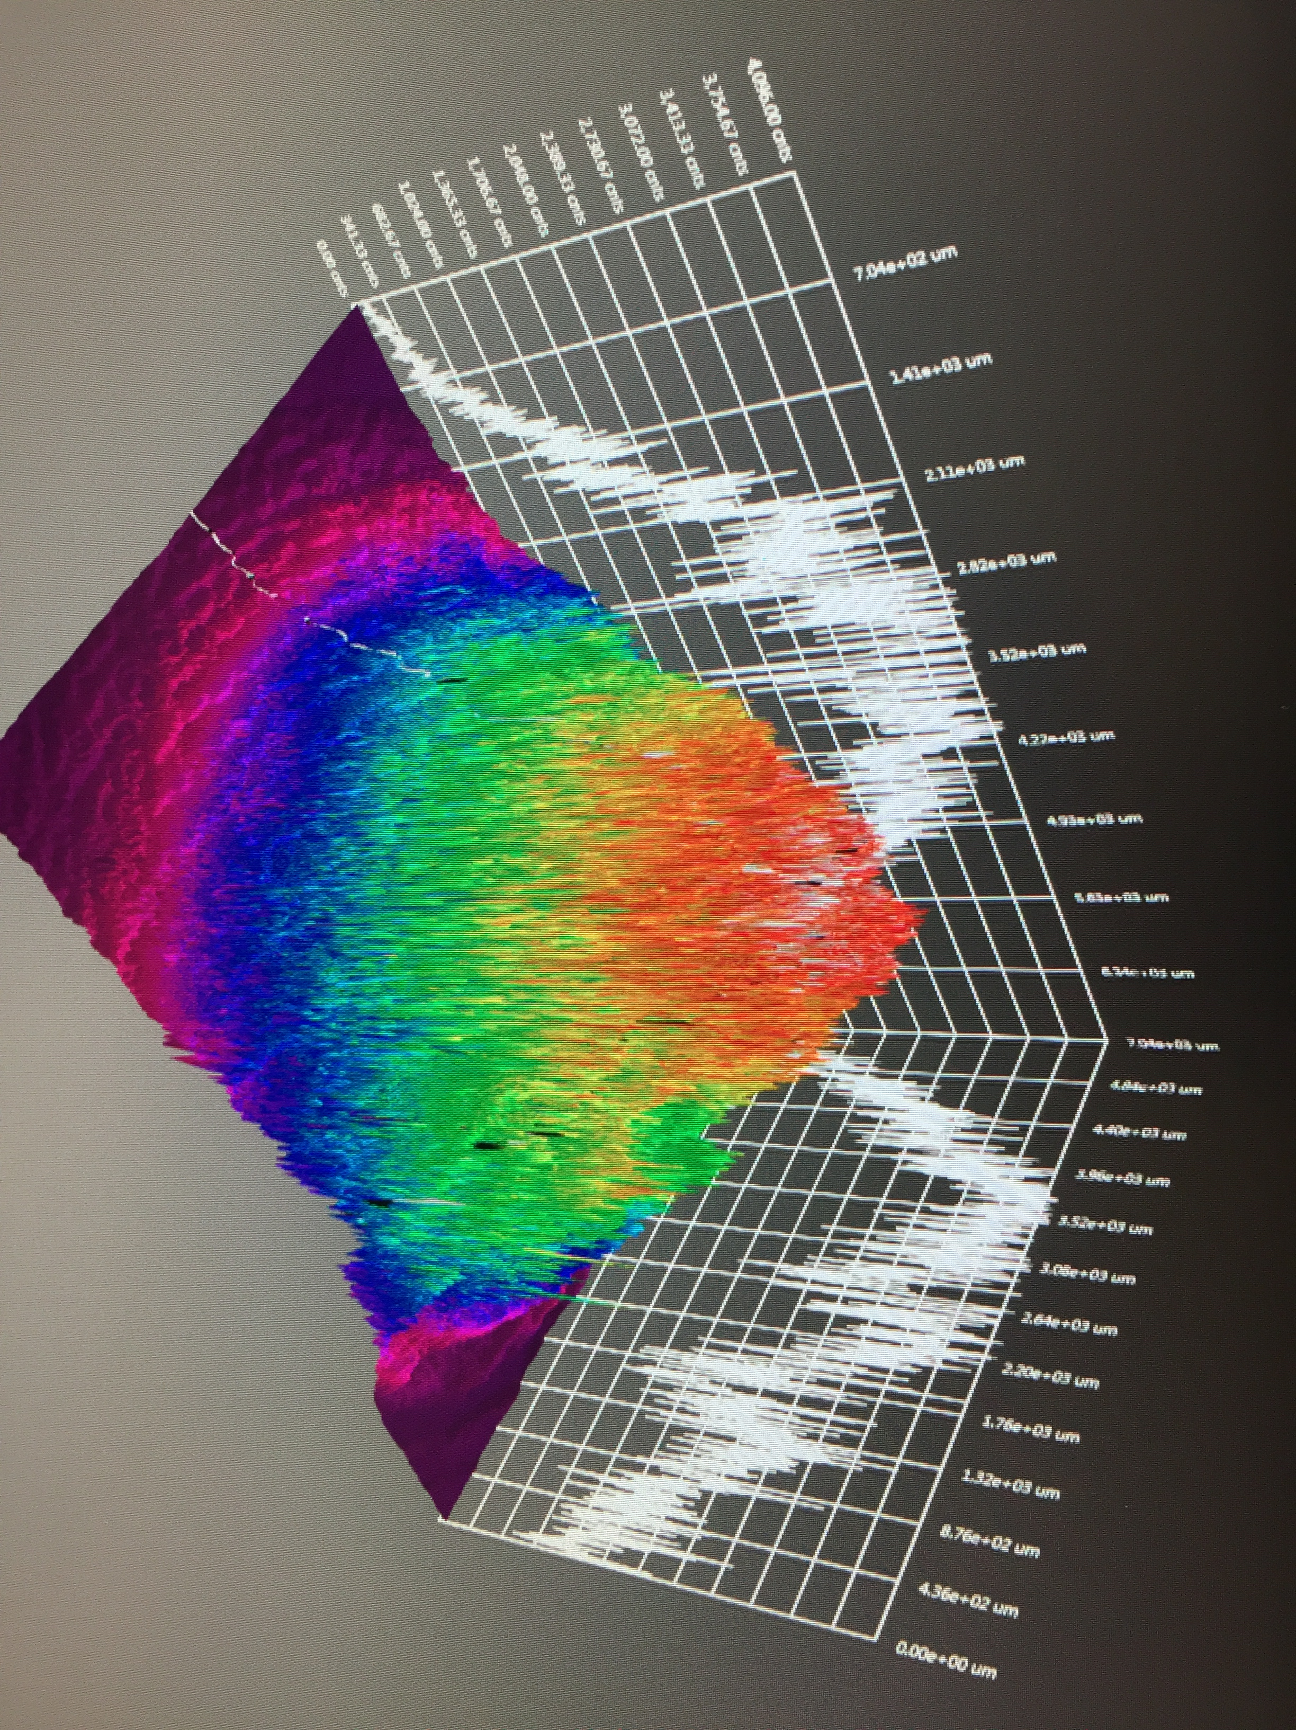
GaAs/GaAsP charge lifetime at milliamp current
Results from PSTP’17 suggests increasing laser spot size is viable to exceed >500 C lifetime; however we need to build another gun to test this assertion.
J. Grames, P. Adderley, J. Hansknecht, R. Kazimi, M. Poelker, D. Moser, M. Stutzman, S. Zhang, “Milliampere beam studies using high polarization photocathodes at the CEBAF Photoinjector” Polarized Sources, Targets and Polarimeters Workshop, Dajeon South Korea (2017)
Measurements were performed without anode biasing
Days
Trend we want to realize

Slide 17
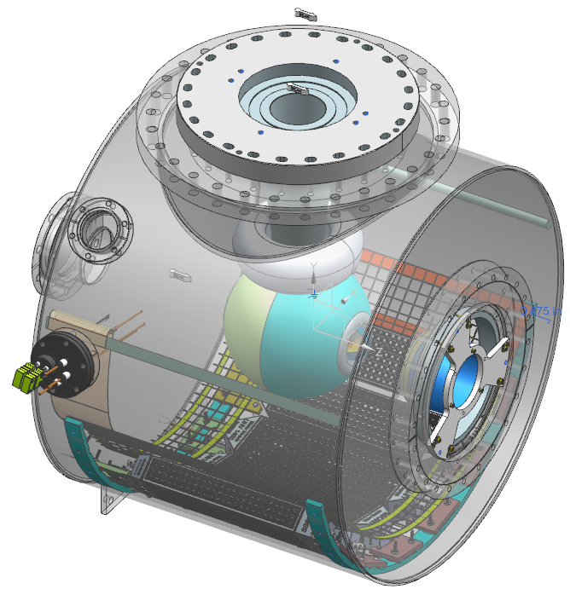
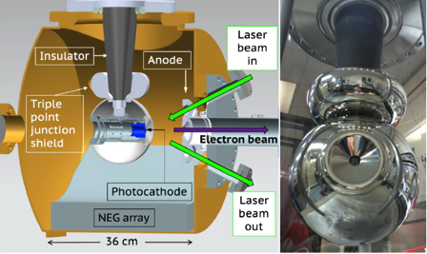
Build a mA polarized gun for e⁺
  Next, we want to combine our lessons learned and experience with the Magnetized 4mA/300 kV gun and new Polarized CEBAF 200 kV gun to build a new third gun optimized for positron generation…
300 kV Magnetized Beam Electron Source (CsKSb)
CEBAF 200 KV Polarized Gun (GaAs/GaAsP)
C. Hernandez-Garcia et al., Phys. Rev. Accel. Beams 22, 113401 (2019)
R30 inverted geometry ceramic insulator
Conditioned to 350 kV
Demonstrated 4.5 mA CW 300 keV
Operate at >200 kV without field emission
HV conditioning >350 kV (uses R30 inverted ceramic insulator)
Dynamic pressure (during beam delivery) ~ 1x10⁻¹² Torr

Slide 18
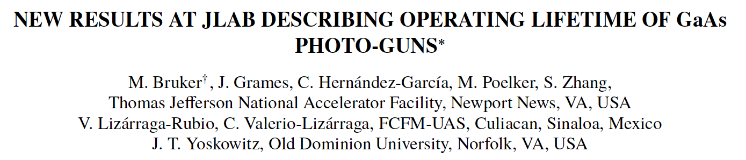
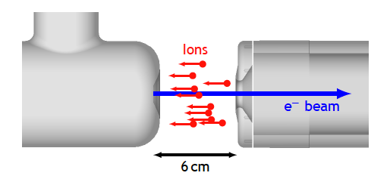
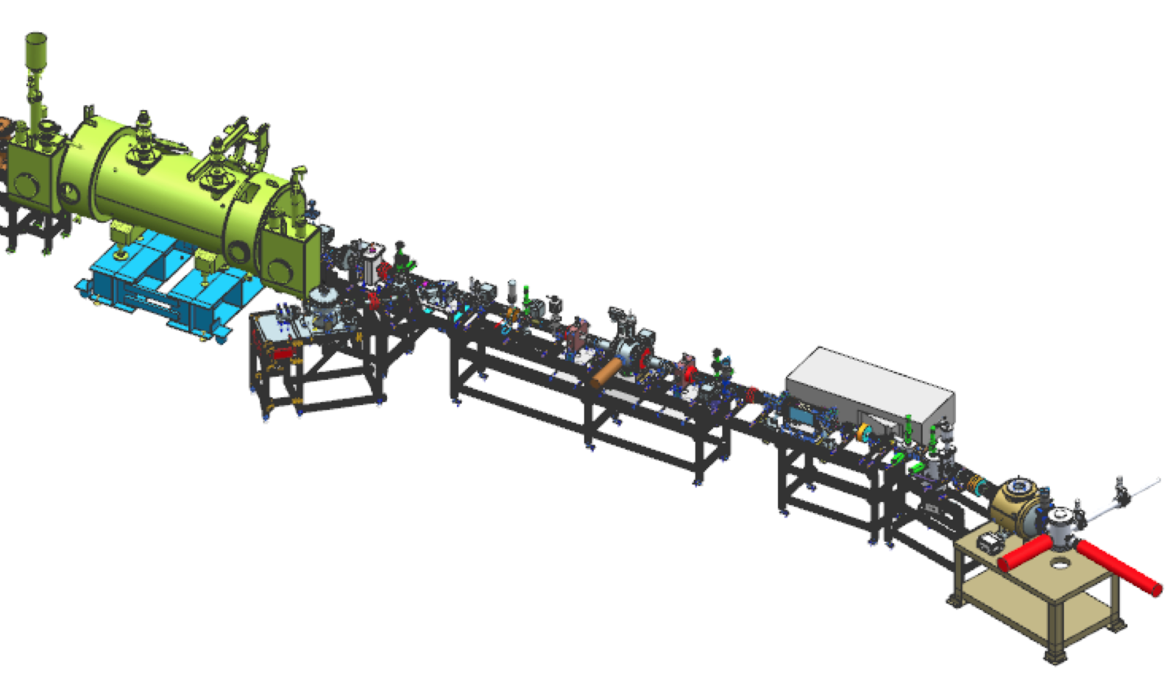
Measuring charge lifetime dependence on cathode potential
Exploratory measurement to map out conditions for an experiment at the UITF.
Biased
100 vs. 180 kV
NA-PAC 2022 (WEPA13)

Slide 19
Present Workforce
Beginning in FY22 positron research was supported at the division level
  ~2 FTE spread across CIS, CASA, OPS departments
  Includes one full-time scientist and one PhD grad student
In FY23 the Ce⁺BAF working group has grown and with broader collaboration
  JLab Physics division supporting target and magnet R&D
  JLab Eng. division supporting evaluation of electrical requirements (magnets reversal, diagnostics)
  SRF discussions for NC capture linac R&D and SRF integration starting
  ORNL contributing to conceptual design of a 123 MeV e⁺ spin rotator
  IJCLab (France) remains an important collaborator, contributing to target development
  Xelera Inc. awarded SBIR Phase 1 to evaluate a liquid metal target option
  HEP proposal submitted in support of e⁺ collaboration (SLAC/KEK/JLAB)
Looking forward to FY24
  S2E technical report (Jun, Sep, Dec)

Slide 20
Summary and Outlook
Jefferson Lab’s framework of a 22 GeV/e+ upgrade has helped define the goals of the Ce+BAF working group
We are on track to deliver in 2023 a technical report describing a start-to-end concept of positron beams for CEBAF 12 GeV
The concept is based on repurposing the LERF as a high power electron and positron injector (of course there is much to do after this, working towards technical design of critical injector components (target, solenoid, NC linac).
Spin polarized e⁻ sources operating at milliamp intensities, with high spin polarization >90% and large charge lifetime >1 kC are essential.
In N years we could make >100 nA positron beams, this means with good beam quality, suitable for acceleration.

