Slide 1
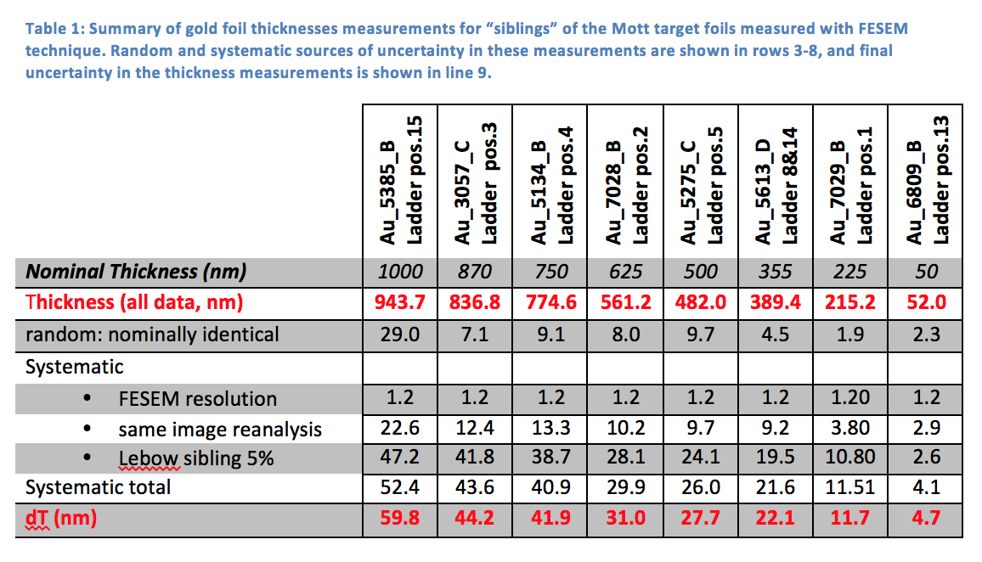
Thickness
Mott Target Ladder Gold Foil Thickness Measurements
M. L. Stutzman, Md. A. Mamun
JLab-TN-16-049

Slide 2
Good Events
For each detector (L/R/U/D) in an individual run…
Determine the mean μ_{t} and sigma σ_{t} of a Gaussian fit to the timing region around the events from the coil.
Apply timing cuts at μ_{t} ± 2σ_{t}.
For remaining events determine the mean μ_{E} and sigma σ_{E} of a Gaussian fit to energy channels [8000:9000].
Apply energy cut from μ_{E}– 0.5σ_{E} to μ_{E} + 2σ_{E} .
Sum remaining events.

Slide 3
Asymmetries
For each run form respective (L/R) and (U/D) super-ratio:
Physics asymmetry
Detector asymmetry
Beam asymmetry
We statistically average the asymmetries for a set of runs for a given foil.
Note that a different pair of detectors were used for each run:
Run I polarization was horizontal so we use the U/D physics asymmetry
Run II polarization was vertical so we use the L/R physics asymmetry

Slide 4
Rates
For each run we first compute an un-normalized rate (Hz) and then correct for:
Electronics dead time, typically 0.1%
DAQ dead time, typically 5-20%
For each run we average the un-normalized L/R/U/D and normalize to BCM calibrated average current to form normalized average rate detector rate (Hz/uA).
For each run we use the average of the (Run I/II) 1um Au foil runs to correct the corresponding rates of the extrapolation foil measurements:
Run I – correction was 1.0 (no correction)
Run II – correction of 1.0372 +/- 0.0008 applied to foil#15 (1um), foil#2(0.625um) and two of six runs for foil#13(0.050um)
We statistically combine the the normalized (Hz/uA) L/R/U/D average corrected rate for a set of runs for a given foil.
For each foil we combine three uncertainties to the final rate:
Statistical – per recipe above
Systematic – average of BCM uncertainties (dI/I) of runs per foil, typically 1%
Systematic – drift uncertainty of 1.32% (Run I) and 1.47% (Run II)

Slide 5
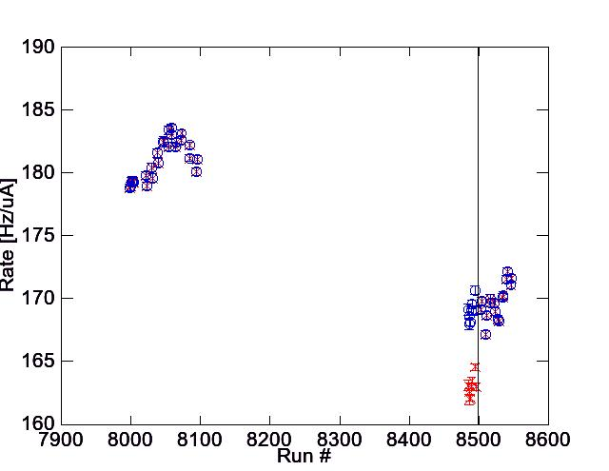
Rate Corrections and Drift Uncertainties
DRIFT UNCERTAINTY = (MAX-MIN)/(MAX+MIN) = 1.32%
DRIFT UNCERTAINTY = (MAX-MIN)/(MAX+MIN) = 1.47%

